Slide 1
Treasure Hunt
Presentation
Let's start

Slide 2
Here’s what you’ll find in this Slidesgo template:
A slide structure based on a multi-purpose presentation, which you can easily adapt to your needs. For more info on how to edit the template, please visit Slidesgo School or read our FAQs.
An assortment of graphic resources that are suitable for use in the presentation can be found in the alternative resources slides.
A thanks slide, which you must keep so that proper credits for our design are given.
Two resources slide, where you’ll find links to all the elements used in the template.
Instructions for use.
Final slides with:
The fonts and colors used in the template.
A selection of illustrations. You can also customize and animate them as you wish with the online editor. Visit Storyset to find more.
More infographic resources, whose size and color can be edited.
Sets of customizable icons of the following themes: general, business, avatar, creative process, education, help & support, medical, nature, performing arts, SEO & marketing, and teamwork.
You can delete this slide when you’re done editing the presentation.

Slide 3
Our games
01. Mazes
03. Puzzles
02. Riddles
04. Open chests

Slide 4
Our games
01
02
03
04
05
06
b
Mazes
Riddles
Puzzles
Open chests
Tracks
Team

Slide 5
—SOMEONE FAMOUS
b
“This is a quote, words full of wisdom that someone important said and can make the reader get inspired.”

Slide 6
—SOMEONE FAMOUS
b
“This is a quote, words full of wisdom that someone important said and can make the reader get inspired.”

Slide 7
b
Do you know what helps you make your point clear? Lists like this one:
They’re simple
You can organize your ideas clearly
You’ll never forget to buy milk!
And the most important thing: the audience won’t miss the point of your presentation

Slide 8
b
Do you know what helps you make your point clear? Lists like this one:
They’re simple
You can organize your ideas clearly
You’ll never forget to buy milk!
And the most important thing: the audience won’t miss the point of your presentation

Slide 9
01
Mazes
b
You can enter a subtitle here if you need it

Slide 10
01
Mazes
b
You can enter a subtitle here if you need it

Slide 11
Maze # 1
Find the right way and get the chest!
Option A
Option B

Slide 12
Yes, it’s a big chest!

Slide 13
Oops, it’s a big chestnut!

Slide 14
Maze # 1
b
Choose a way and discover what’s in the chest
Mercury
It’s the closest planet to the Sun
Neptune
It’s the farthest planet from the Sun

Slide 15
Yes, it's full of gold!
Mercury
Mercury is the closest planet to the Sun and the smallest one

Slide 16
Oops, it's a big chestnut!
Venus
Venus has a beautiful name and is the second planet from the Sun

Slide 17
Maze # 2
b
Find the right way and get the gold!
Option B
Option A

Slide 18
Yes, the gold is yours!

Slide 19
Oh no, it's just sand!

Slide 20
Maze # 2
b
Mercury
It’s the closest planet to the Sun
Venus
Venus is the second planet from the Sun

Slide 21
Yes, the gold is yours!
Venus
Venus is the second planet from the Sun

Slide 22
Oh no, it's just sand!
Mercury
It’s the smallest planet in the Solar System

Slide 23
AHOOOYYY

Slide 24
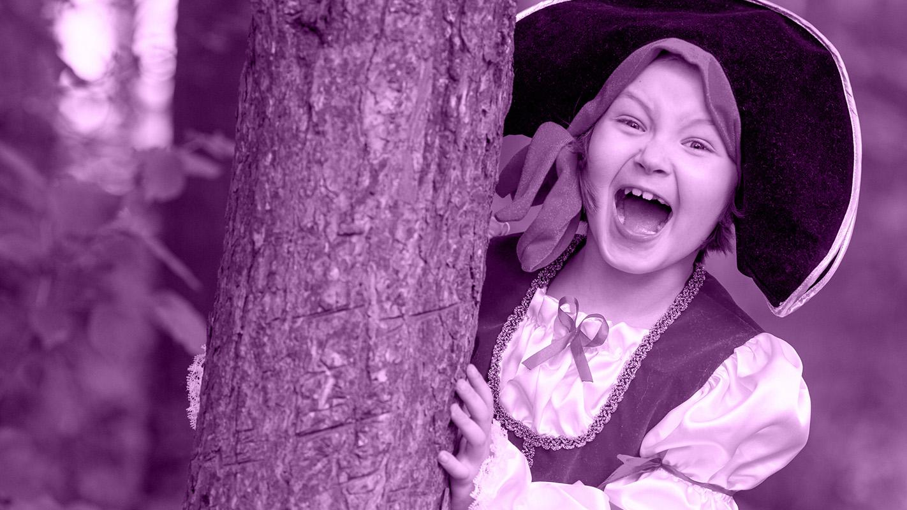
Pirates
arrre
cool!

Slide 25
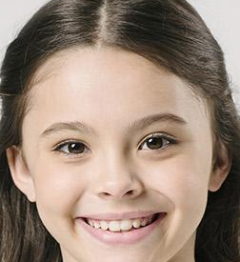
Pirate diploma
Insert your name
For having successfully completed all the games!

Slide 26
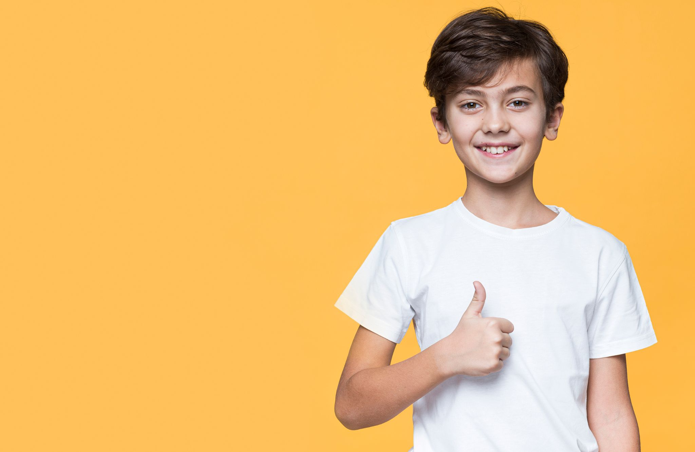
Pirate diploma
Insert your name
For having successfully completed all the games!

Slide 27
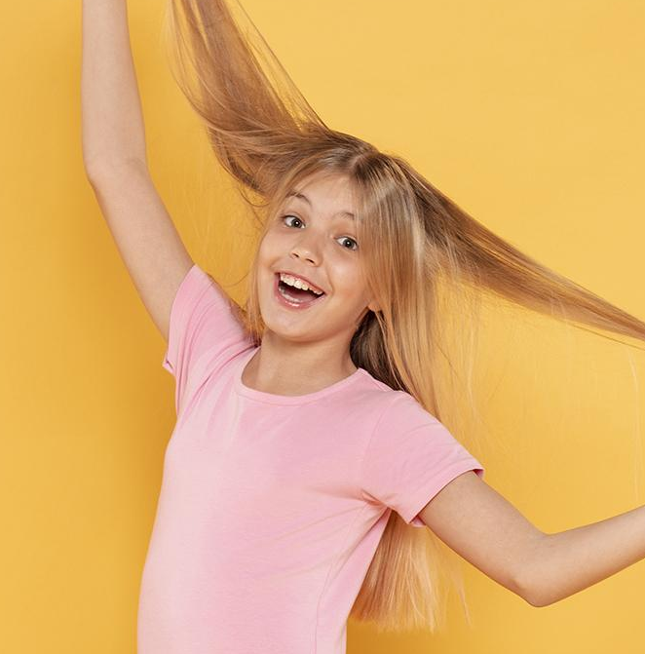
Our team
James Black
Zoey Smith
You can talk a bit about this person
You can talk a bit about this person

