Slide 1
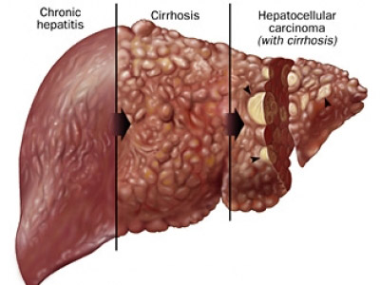
Viral Hepatitis
Dr. Hesham Alshowaikh

Slide 2
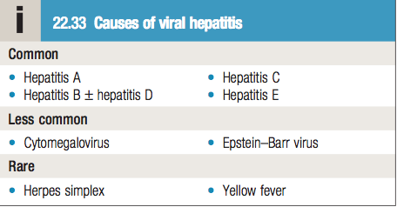
Etiology
Viral hepatitis should be considered in anyone presenting with hepatitic liver blood tests ( high transaminases)
All these viruses cause illnesses that have the same clinical and pathological features
Difference- Tendency to cause acute and chronic infection

Slide 3
Acute Hepatitis
Clinical features
Prodromal illness- Headache, myalgia, arthralgia, nausea and anorexia
Dark urine and pale stools
Jaundice ( 2 weeks after prodromal illness)
Vomiting, diarrhea, Abdominal discomfort
Tender liver which is only minimally enlarged
Mild splenomegaly and cervical lymphadenopathy
These symptoms are more frequent in children or with Epstein-Barr virus infection
Symptoms last 3-6 weeks. Rarely longer

Slide 4
Investigations
Liver function tests – show a hepatitic pattern
Serum transaminases – 200-2000 U/L in acute infection ( lower and fluctuating in chronic infection
Plasma Bilirubin – Reflects the degree of liver damage
Prolongation of PT – indicates severity of hepatitis
Alanine phosphatase – Rarely exceeds twice the upper limit
WBC – Normal with relative lymphocytosis
To confirm the cause of diagnosis – Serological tests

Slide 5
Management
Most individuals do not need hospital care
Drugs metabolized in the liver should be avoided eg: sedatives, Narcotics
Alcohol should be avoided
Elective surgery should be avoided – risk of postoperative liver failure
Liver transplantation- Rarely indicated in acute hepatitis complicated by liver failure
Commonly performed for complications of cirrhosis resulting from chronic hepatitis B and C infection

Slide 6
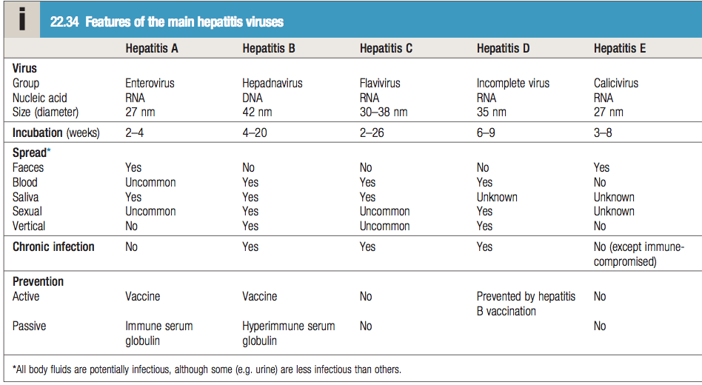
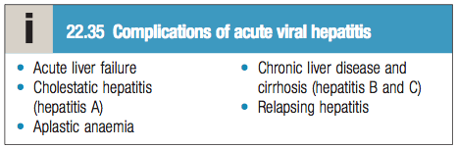

Slide 7
Hepatitis A
Features
Belongs to the Picornavirus group of enteroviruses
Spread – Feco-Oral Route, Water and shellfish
Excretion in faeces – 2-3 weeks before the onset of symptoms until about 2 weeks after symptoms occur
Infection is more common in areas of overcrowding and poor sanitation
Common in children but asymptomatic- 30% of adults have serological evidence of past infection but no history of jaundice
A chronic carrier state cannot occur

Slide 8
Investigations
Only one HAV antigen is present
Antibodies to this antigen ( Anti-HAV) are important in the diagnosis of Hepatitis A infection
Excretion of HAV in stools only occurs for 7-14 days after onset and the virus cannot be grown readily
Anti-HAV IgG – of no diagnostic value, Presence indicates immunity to HAV.
Diagnosis of HAV infection – Anti-HAV-IgM
Indicates a primary immune response. Already present in blood at the onset of clinical illness.

Slide 9
Management
Prevention-
Improving social conditions – overcrowding and poor sanitation
Active immunization – inactivated virus vaccine
Vaccination should be considered in individuals with chronic hepatitis B or C infections and people travelling to endemic areas
Immediate protection –
Immune serum globulin (Anti-HAV)- given soon after exposure to the virus
Should be considered in those with close contact to HAV infected patients, the elderly, pregnant women, outbreaks.

Slide 10
Complications
Cholestatic phase – elevated ALP levels
Acute liver failure is very rare (0.1%)
Chronic infection does not occur
Infection in patients who already have chronic liver disease- life threatening
There is no role of Antiviral drugs in the therapy of HAV infection

Slide 11
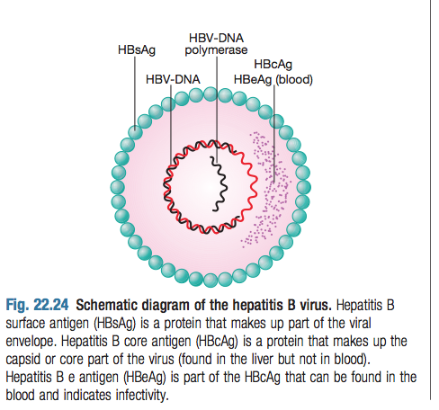
Hepatitis B
Features
Core- Contains DNA and DNA polymerase
Surface protein- Surrounds the core
The virus (Dane particle) + Hepatitis B surface antigen (HBsAg) circulate in blood.
Hepatitis B – one of the most common causes of chronic liver disease and hepatocellular carcinoma worldwide
May cause Acute viral hepatitis- asymptomatic
Risk of progression to chronic liver disease- depends on source and timing of infection
Vertical transmission – most common cause of infection worldwide

Slide 12
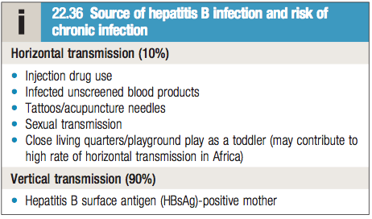
Features
Chronic hepatitis – can lead to cirrhosis or hepatocellular carcinoma (usually after decades of infection)
Chronic hepatitis is also most often asymptomatic
The virus is not directly cytotoxic to cells – the immune response to viral antigens displayed on infected hepatocytes initiates liver injury

Slide 13
Investigations
Antigens in HBV (Serology) –
Hepatitis B surface antigen
Hepatitis B core antigen
Hepatitis B e antigen
Viral load – measurement of HBV-DNA in blood by PCR.
It gives a measure of the number of viral particles in the blood stream

Slide 14
Hepatitis B surface antigen
Indicator of active infection
Appears in blood – late in incubation period but before prodromal phase.
Lasts for – 3-4 weeks – can persist for up to 5 months
Persistence of HBsAg for more than 6 months – chronic infection
Anti-HBs appears after 3-6 months and persists for many years and perhaps permanently
Presence of Anti-HBs could either mean a previous infection or previous vaccination

Slide 15
Hepatitis B core antigen
It is not found in blood
Anti-HBc appears early in the illness
Initially – IgM HBc
Presence in blood Indicates acute hepatitis B infection
Can sometimes reveal an acute HBV infection when HBsAg has already disappeared and before anti-HBs has appeared
IgG HBc antibody appears later and is an indicator of Chronic hepatitis B infection

Slide 16
Hepatitis B e antigen
It is an indicator of ongoing viral replication in the liver
In Acute hepatitis B- It appears only transiently and disappears
Anti-HBe production follows its appearance
Its presence indicates active hepatitis
Absence of HBeAg indicates low viral replication
HBeAg- negative chronic hepatitis B – High levels of viral replication, serum HBV-DNA and hepatic necroinflammation is seen, despite negative HBeAg
Also known as pre-core mutant infection
Notes:
Individuals with HBeAg negative chronic hepatitis B – there Is a mutation in the pre core protein which means that the virus no longer secretes the e antigen into serum. Therefore, even when there is an active infection with high viral replication of this mutant virus, HBeAg cannot be detected in blood.

Slide 17
Viral load and Genotype
Measurement of HBV-DNA in blood
Presence of active viral replication –
>10⁵ copies/ml
presence of e antigen in blood
Low viral replication but HBsAg and Anti-Hbe positive- less than 10⁵ copies/ ml
Pre core mutant infection –
HBeAg is absent in blood
Anti-HBe positive
High viral load and evidence of hepatocellular damage

Slide 18
Viral load and Genotype
Individuals with pre core mutant (e- antigen negative) chronic hepatitis respond differently to antiviral drugs from those with e antigen positive chronic hepatitis
Measurement of viral load is important in
Monitoring antiviral therapy
Identifying patients with pre core mutant infection

Slide 19
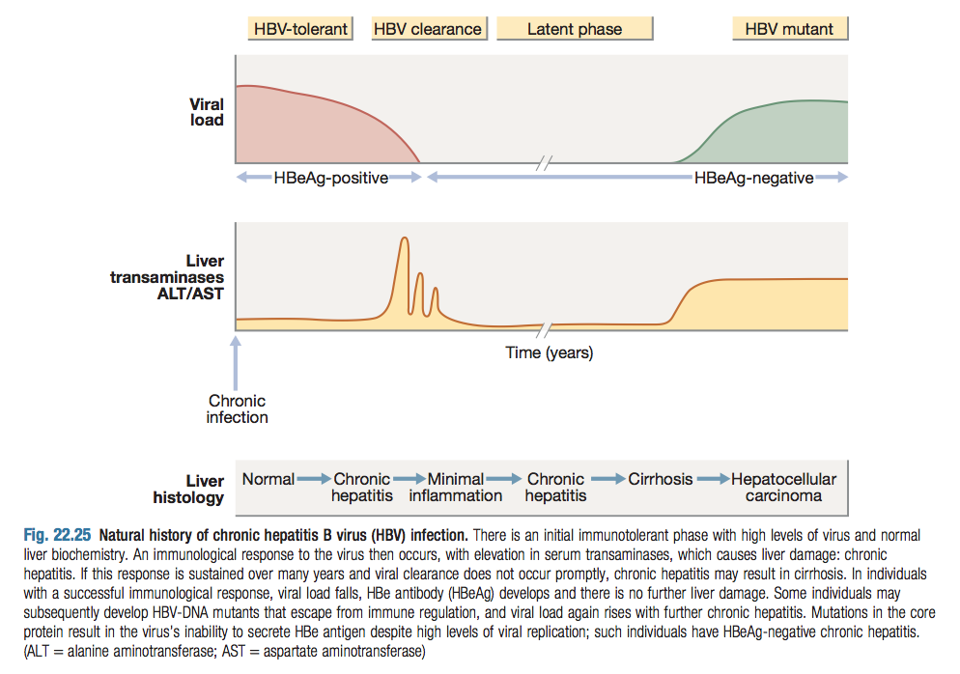
Chronic Hepatitis B

Slide 20
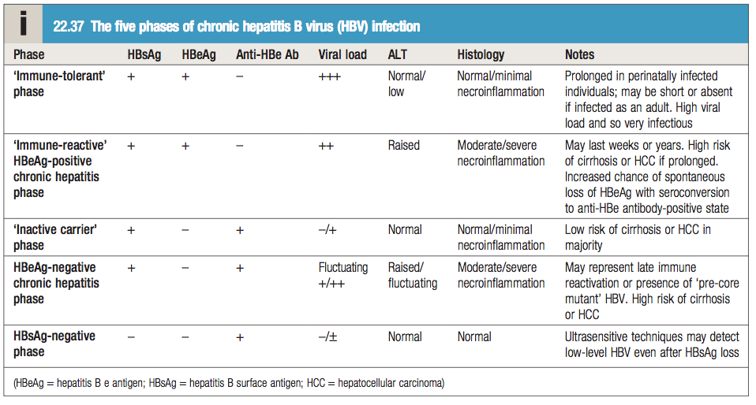

Slide 21
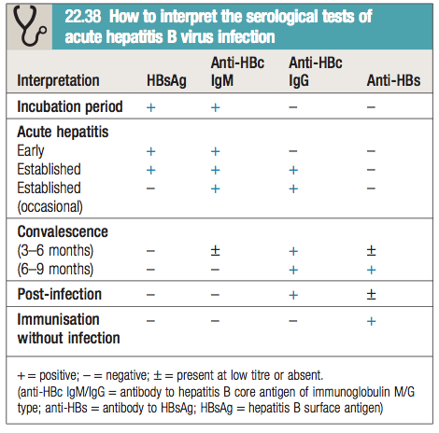
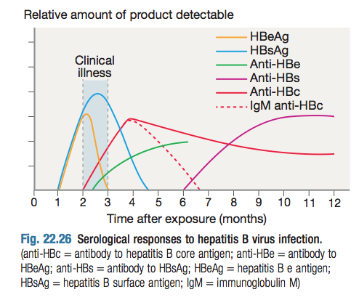

Slide 22
Management – Acute Hepatitis B
Supportive treatment with monitoring for acute liver failure
No evidence that antiviral therapy reduces the duration or severity of acute hepatitis B
90-95% Full recovery
5-10% Chronic hepatitis B that continues for life
Individuals at High risk of developing chronic infection:
Infection from mother to child at birth- 90% , recovery is rare
Immuno-deficient individuals – HIV or Down syndrome

Slide 23
Management- Chronic Hepatitis B
Drugs
Direct acting nucleoside/nucleotide antiviral agents
Interferon alpha
2. Liver transplantation
No drug is consistently able to eradicate Hepatitis B infection completely
Goals of treatment –
HBeAg seroconversion
Reduction in HBV-DNA
Normalization of LFT

Slide 24
Management- Chronic Hepatitis B
Indications of treatment –
High viral load in presence of active hepatitis
Histological evidence of inflammation and fibrosis
Oral antiviral agents – more effective in patients with “e antigen negative chronic hepatitis”
Cirrhosis develops in 15-20% of patients with chronic HBV over 5-20 years
This proportion is higher in “e antigen positive chronic hepatitis”

Slide 25
Direct acting Nucleoside/Nucleotide antiviral agents
MOA- Inhibition of reverse transcription of pregenomic RNA to HBV-DNA by DNA polymerase. No direct effect on Circular DNA (cccDNA) template for viral replication. Therefore relapse is common once treatment is withdrawn
Drug | Features | Contraindications/complications | Used now
Lamivudine | Effective but now seldom used in the treatment of HBV | Long term therapy is complicated by development of DNA polymerase mutants – viral resistance | To prevent reactivation of HBV in previously infected HBsAg negative patients
Entecavir and Tenofovir | More effective than lamivudine for both HBeAg negative and positive chronic hepatitis Antiviral resistance only 1-2% after 3 years of exposure | Monotherapy contraindicated in HIV positive patients – Their additional anti- HIV action may lead to HIV antiviral drug resistance | Monotherapy for both HBeAg positive and negative chronic hepatitis

Slide 26
Interferon Alpha
MOA – It acts by augmenting a native immune response
Most effective in patients with: Low viral load with serum transaminases twice the upper limit of normal.
Response rates are lower in “HBeAg negative chronic hepatitis”
Contraindicated – In presence of cirrhosis as it causes a rise in serum transaminases and precipitates liver failure.
Side effects : Fatigue, depression, irritability, bone marrow suppression, triggering of autoimmune thyroid disease

Slide 27
Liver Transplantation
Historically contraindicated in hepatitis B – due to occurrence of infection in the graft
The use of post liver transplant prophylaxis with direct acting antiviral agents and Hepatitis B immunoglobulins proved to reduce reinfection rate.
This makes transplantation an acceptable treatment option

Slide 28
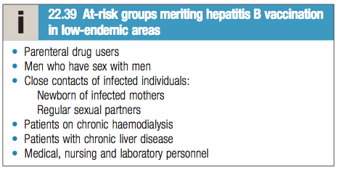
Prevention
HBV-DNA is found in – saliva, urine, semen, vaginal secretions
The virus is 10 times more infective than hepatitis C which is 10 times more infective than HIV.
Recombinant hepatitis B vaccine (Engerix)
Contains HBsAg
Produces active immunization in 95% normal individuals
Hepatitis B immunoglobulin – Given within 48 hours- 1week
Vaccine can be given together with immunoglobulin (active passive immunization)
Neonates born to hepatitis B infected mothers – should be immunized at birth and given immunoglobulin – serology should be checked at 12 months of age

Slide 29
Co-infection with HIV
Co-infection increases morbidity and mortality:
Greater levels of HBV viremia
Faster progression to chronic infection
Greater risk of cirrhosis and hepatocellular carcinoma
Higher risk of perinatal transmission of HBV in co-infected mothers
Immunosupression caused by HIV – leads to loss of anti-HBs, reactivation of infection, poor response to HBV vaccination
Diminished response to interferons and increased resistance to lamivudine
Pregnant women should receive antiviral therapy – using drugs with dual activity such as tenofovir with emtricitabine or lamivudine

Slide 30
Hepatitis D
Features
RNA defective virus: Depends on HBV for replication
Same sources and modes of spread as HBV
Simultaneous infection with HBV – causes severe acute hepatitis but is limited by recovery from HBV infection
Superinfection in HBV chronic carriers –
Causes acute hepatitis with spontaneous recovery
Occasionally – simultaneous cessation of Chronic HBV infection
Chronic hepatitis with HBV and HDV is possible – frequently causes rapid progressive chronic hepatitis and cirrhosis

Slide 31
Investigations
HDV contains only one antigen to which infected individuals make an antibody – Anti-HDV
Diagnosis – detection of Anti-HDV in blood
Simultaneous infection with HBV and HDV
Low titers of Anti-HDV (IgM) within few days of onset
Usually Anti-HDV disappears within 2 months of illness
Super-infection in patients with chronic HBV
High titers of HDV ( initially IgM and later IgG)
Plateau of Anti-HDV at high levels when chronic infection with both viruses occurs

Slide 32
Management
Effective management of hepatitis B prevents Hepatitis D

Slide 33
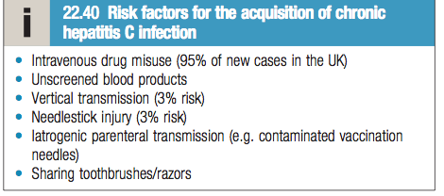
Hepatitis C
Features
Acute infection- Asymptomatic
Individuals identified by screening (if risk factors present) or when they develop chronic infection
80% of individuals exposed to the virus will develop chronic liver disease
There is no active or passive protection against hepatitis C virus
Most people remain asymptomatic until cirrhosis occurs- However, fatigue can complicate chronic infection and is unrelated to the degree of liver damage.
Hepatitis C is the most common cause of “ non A non B hepatitis”

Slide 34
Progression
If left untreated, progression from chronic hepatitis to cirrhosis occurs over 20-40 years
Risk factors for progression to cirrhosis -
Male gender
Immunosuppression (HIV, prothrombotic states)
Heavy alcohol misuse
20% individuals will develop cirrhosis within 20 years
Cirrhosis may then progress to hepatocellular carcinoma

Slide 35
Investigations
Serology and virology
It takes 3-6 weeks for antibodies to appear in blood following acute infection
Hepatitis C RNA can be identified in blood as early as 2-4 weeks after infection.
Active infection – confirmed by presence of HCV-RNA in blood in anyone who is antibody positive
Anti-HCV persists in serum even after viral clearance
Molecular analysis
There are six common viral genotypes – distribution varies worldwide
Genotype has no effect on progression of liver disease but does affect response to treatment (selection of drugs)

Slide 36
Liver function tests
Investigations
LFT may be normal or may show fluctuating serum transaminases (50-200 U/L)
Jaundice is rare – only appears in end stage cirrhosis
Liver Histology
Serum transaminases are a poor indicator of liver fibrosis in hepatitis C
Liver biopsy – to stage extent of liver damage
Metavir system- histological grading of liver fibrosis
Grading 1 to 4 – 4 = cirrhosis

Slide 37
Management
Aim of treatment- to eradicate the infection
Sustained virological response (SVR) – Viral clearance (aviremia) achieved 6 months after finishing treatment
With new direct acting antivirals – the infection is cured in 99% individuals who achieve SVR
Until 2011- treatment of choice – dual therapy of {pegylated interferon alpha + oral ribavirin}
Drawbacks –
long treatment (12 months )
Side effects –
Ribavirin- induces hemolytic anemia , Teratogenic
Interferon- influenza like symptoms, irritability and depression

Slide 38
Management
Since 2011- New classes of Direct acting antivirals (DAA) have been developed
They allow for “interferon-free” regimens which maximizes efficacy without exposing the patient to side effects of interferon-alfa therapy
DAAs are – orally administered, efficacious and well tolerated
Liver transplantation- considered when complications of cirrhosis occur –eg: diuretic resistant ascites
If the virus is not cleared, hepatitis will infect the transplanted liver and patient will develop liver cirrhosis within 5 years of transplant

Slide 39
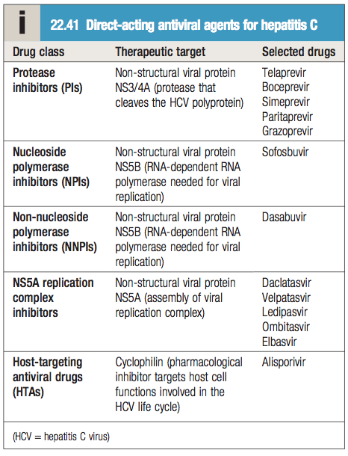
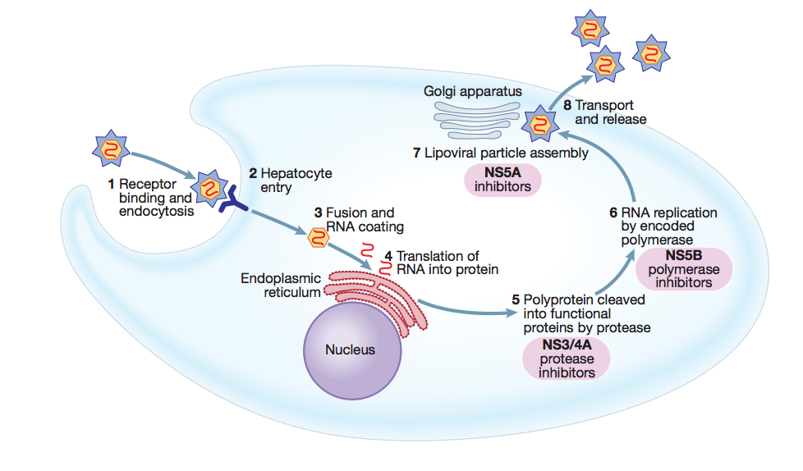
12 weeks of treatment with oral sofosbuvir + ledipasvir + ribavirin can achieve 99% SVR in treatment-naiive genotype 1 patients

Slide 40
Hepatitis E
Endemic in India and the middle east
Clinical presentation and management is similar to hepatitis A
Spread- feco-oral route , through contaminated food
Presents as – self limiting acute hepatitis
Does not usually develop chronic infection in normal people
Chronic infection – seen in Immunocompromised, especially organ transplant recipients
Treatment of chronic infection – Ribavirin
Hepatitis E differs from Hepatitis A in that – Hepatitis E infection during pregnancy is associated with liver failure - high mortality
Diagnosis of acute infection – Anti-HEV (IgM) positive

Slide 41
CASE- 1
Muneer, a 48 year old patient has history of being HBsAg positive with elevated ALT and AST 6 months ago. Today he presents to your clinic for a follow up. You run some tests and find out that he has fully recovered and showed no signs of Chronic liver disease. Which of the following was seen in Muneer’s tests?
Hepatitis B surface antigen
Antibody for Hepatitis B surface antigen
Raised bilirubin
Hepatitis B e antigen
Raised ALT

Slide 42
CASE 2
Ahmed, a 22 year old male develops histological features of liver cirrhosis. When asked, he reports that he has been suffering from Hepatitis infection since birth. His mother also suffered of Hepatitis since birth.
Which type of hepatitis infection does ahmed most probably have?
Which drug is contraindicated in ahmed’s case?
What is the most effective treatment in ahmed’s case?

Slide 43
CASE 3
Sophie, a 55 year old female comes for a follow up in the medical clinic and you run some tests. The results of her tests is as follows :
HBsAg - positive HBeAg- negative Viral load- High
Anti-HBe – positive LFT- ALT is raised
Which of the following Phases is Sophie currently in:
Immune tolerant phase
Immune reactive HBeAg positive chronic hepatitis
HbeAg negative chronic hepatitis
Inactive carrier phase
Acute hepatitis B infection

