Slide 1
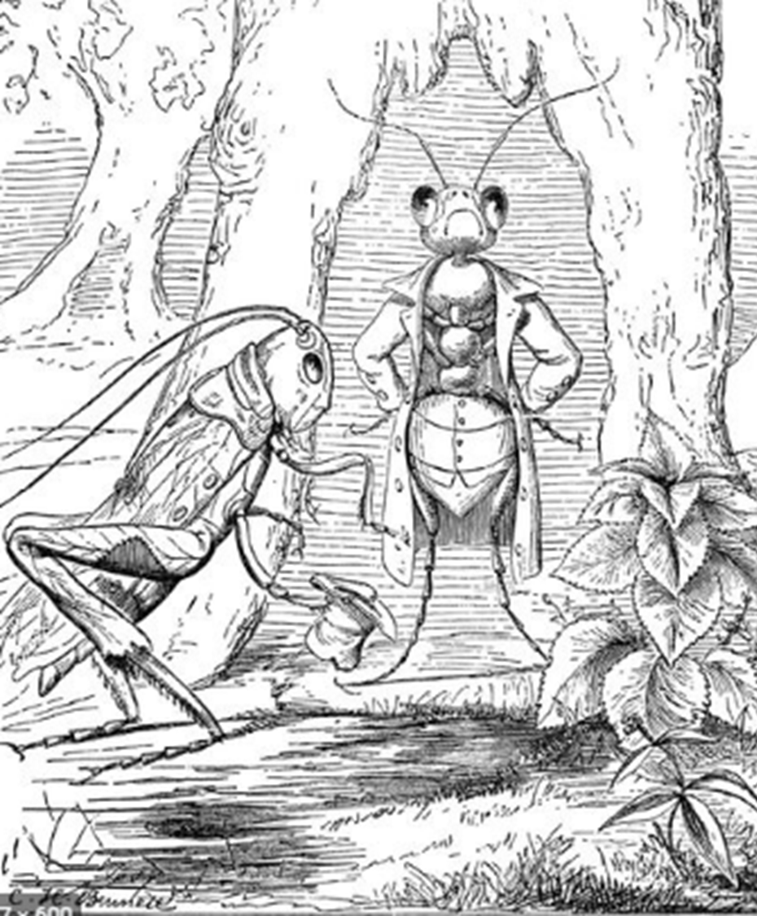

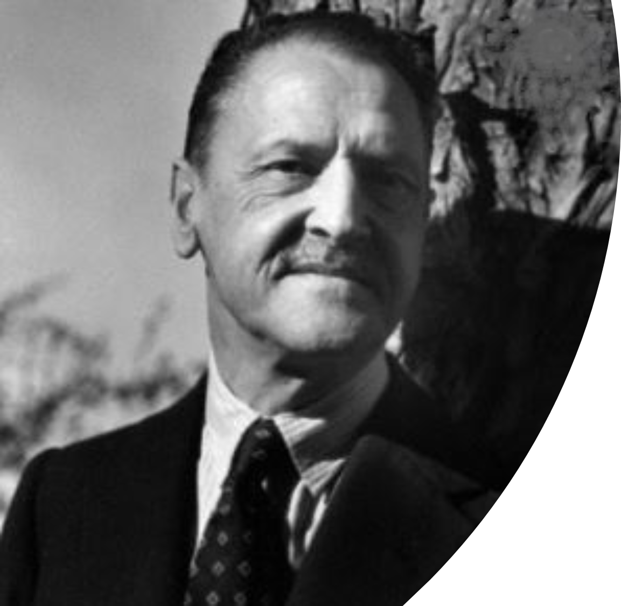
Advanced level English writing course : through studying masterpieces of modern literature
The Ant and the Grasshopper
W.S. Maugham
Instructor: Andrew Ness

Slide 2
When I was a very small boy I was made to learn by heart certain of the fables of La Fontaine
When I was a very small boy I was made to learn by heart certain of the fables of La Fontaine, and the moral of each was carefully explained to me. Among those I learnt was The Ant and the Grasshopper, which is devised to bring home to the young the useful lesson that in an imperfect world industry is rewarded and giddiness punished.

Slide 3
When I was a very small boy I was made to learn by heart certain of the fables of La Fontaine
When I was a very small boy I was made to learn by heart certain of the fables of La Fontaine, and the moral of each was carefully explained to me. Among those I learnt was The Ant and the Grasshopper, which is devised to bring home to the young the useful lesson that in an imperfect world industry is rewarded and giddiness punished.
Why does the third person narrator emphasize that he was “made to learn the fables of La Fontaine by heart”?
What does the unusual use of the phrase “in an imperfect world, industry is rewarded and giddiness is punished,” allude with respect to the entire story which is about to be recounted?

Slide 4
I apologise for telling something which everyone is politely, but inexactly, supposed to know
In this admirable fable (I apologize for telling something which everyone is politely, but inexactly, supposed to know) the ant spends a laborious summer gathering its winter store; while the grasshopper sits on a blade of grass singing to the sun. Winter comes and the ant is comfortably provided for, but the grasshopper has an empty larder: he goes to the ant and begs for a little food. Then the ant gives him her classic answer:

Slide 5
In this tale the ant spends a laborious summer gathering its winter store; while the grasshopper sits on a blade of grass singing to the sun
In this admirable fable (I apologize for telling something which everyone is politely, but inexactly, supposed to know) the ant spends a laborious summer gathering its winter store; while the grasshopper sits on a blade of grass singing to the sun. Winter comes and the ant is comfortably provided for, but the grasshopper has an empty larder: he goes to the ant and begs for a little food. Then the ant gives him her classic answer:
In this tale, the third- party narrator’s attitude towards the ant is mildly ironic. How is this alluded to, in Maughham’s selection of vocabulary to describe the ant’s summertime labors?

Slide 6
During my childhood, I could never quite reconcile myself to this lesson
"What were you doing in the summertime?"
"Saving your presence, I sang, I sang all day, all night."
"You sang. Why, then you can go and dance."
I do not ascribe it to perversity on my part, but rather to the inconsequence of childhood, which is deficient in moral sense, that I could never quite reconcile myself to moral of this lesson. My sympathies were with the grasshopper and for some time I never saw an ant without putting my foot on it. In this summary (and, as I have discovered since, entirely human) fashion I sought to express my disapproval of prudence and common sense.

Slide 7
Due to the inconsequence of childhood, that I could never quite reconcile myself to the lesson
I do not ascribe it to perversity on my part, but rather to the inconsequence of childhood, which is deficient in moral sense, that I could never quite reconcile myself to the lesson. My sympathies were with the grasshopper and for some time I never saw an ant without putting my foot on it. In this summary (and, as I have discovered since, my entirely human) fashion I sought to express my disapproval of prudence and common sense
From very outset, the third person narrator of this story lets us know that he is not neutral, but rather sides with whom, the ant or the grasshopper?

