Slide 1
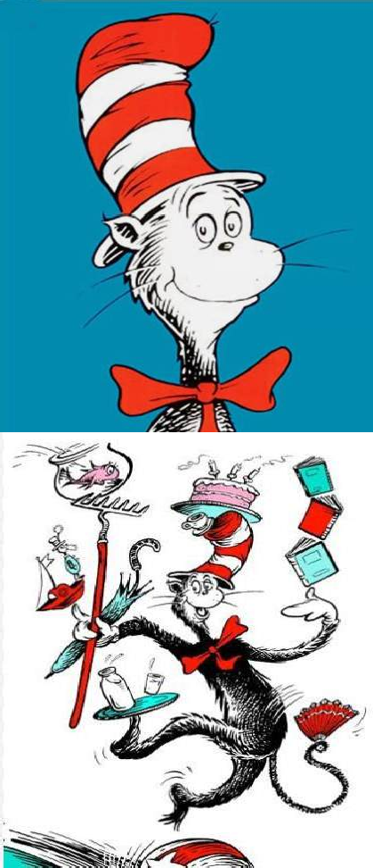




Slide 2
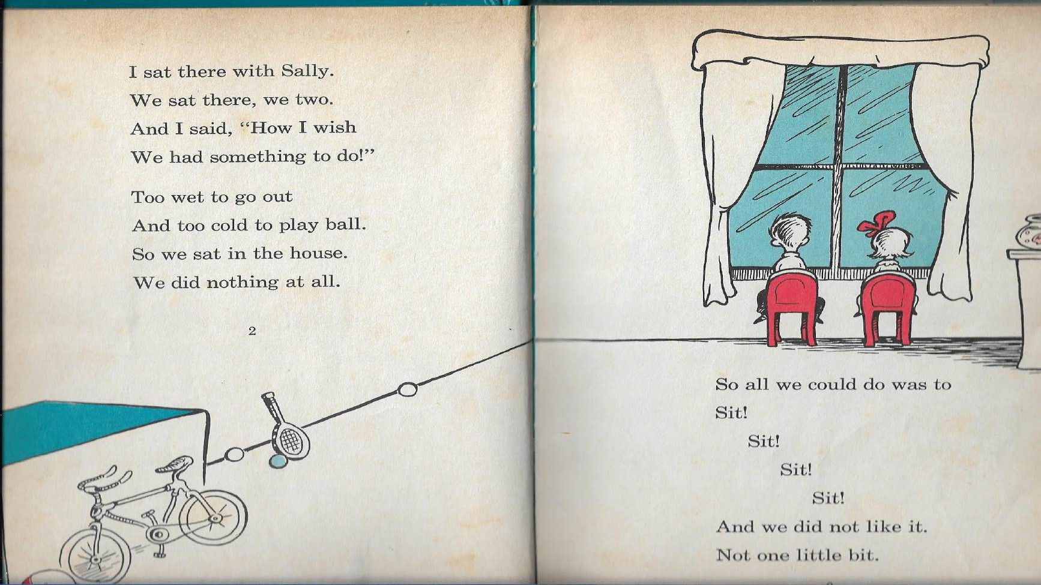

Slide 3

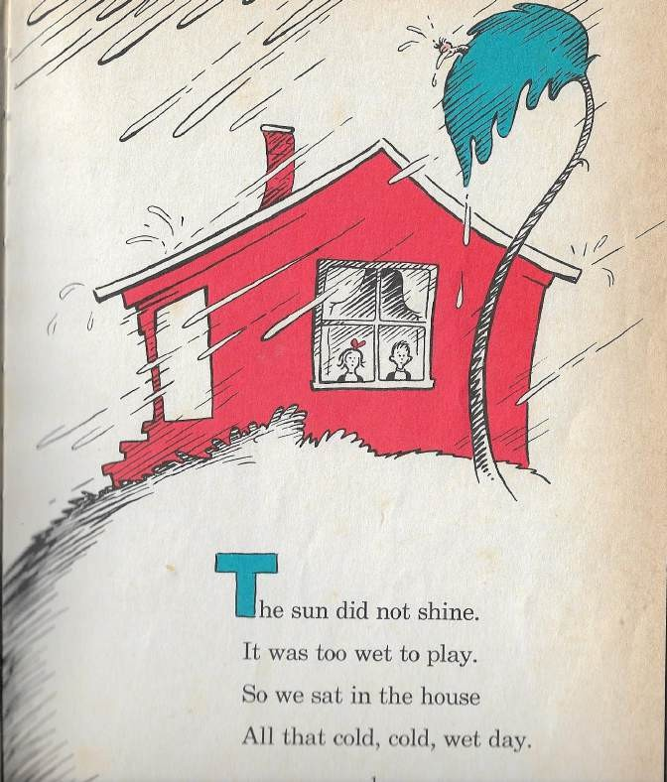
Was the sun shining?
Was it a hot, hot day?
Was it a good day for play? What did we do in the house?

Slide 4
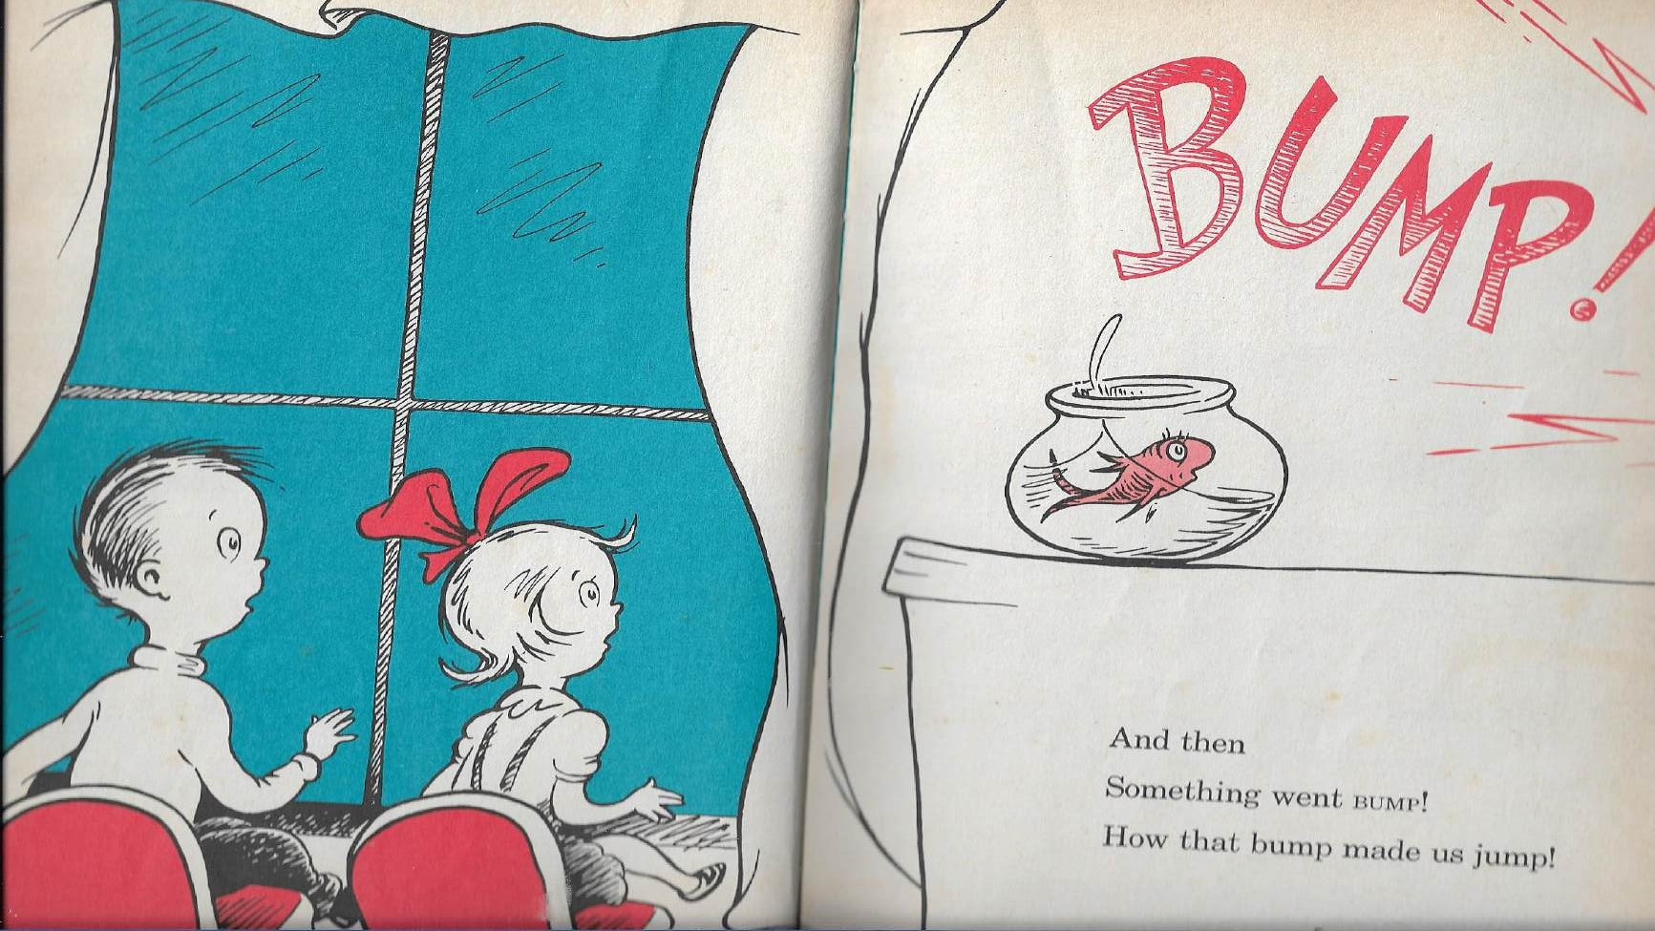

Slide 5
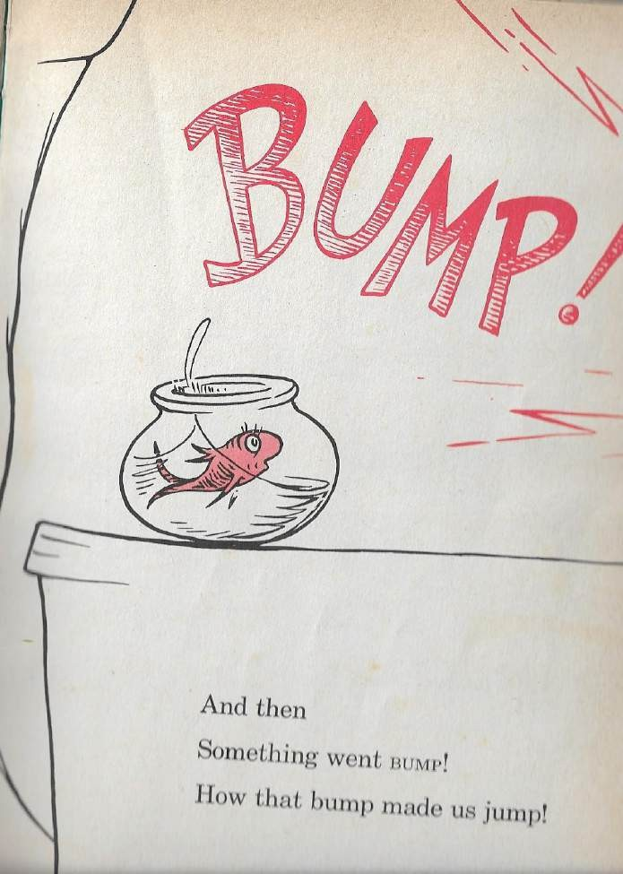
And then something was delivered to the house.
It made a big sound!
What sound did it make?
What did the sound make us do?

Slide 6

End of lesson No.1
Goodbye!
See you next lesson!

