Slide 1
Analytical chemistry
Basics
By Wael

Slide 2
Analytical chemistry is traditionally divided into two main areas:
1. Qualitative Analysis
What is it? This branch deals with the identification of the elements, ions, or compounds present in a sample.
Goal: To determine the identity of the chemical species.
Example: Determining that a sample contains lead ions Pb²⁺ or glucose.
2. Quantitative Analysis
How much is there? This branch deals with determining the numerical amount or concentration of a specific substance (the analyte) in a sample.
Goal: To determine the amount of the chemical species.
Example: Determining that the concentration of lead ions is 15 parts per billion (ppb).

Slide 3
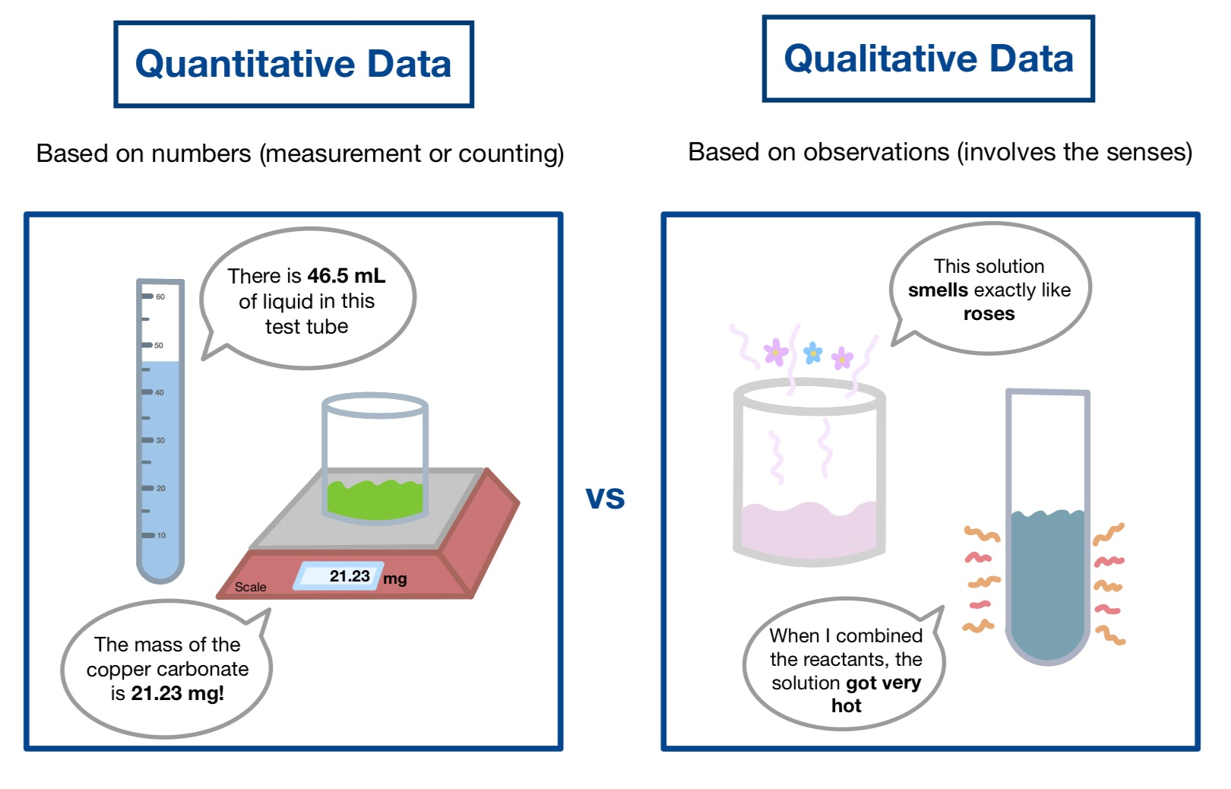

Slide 4
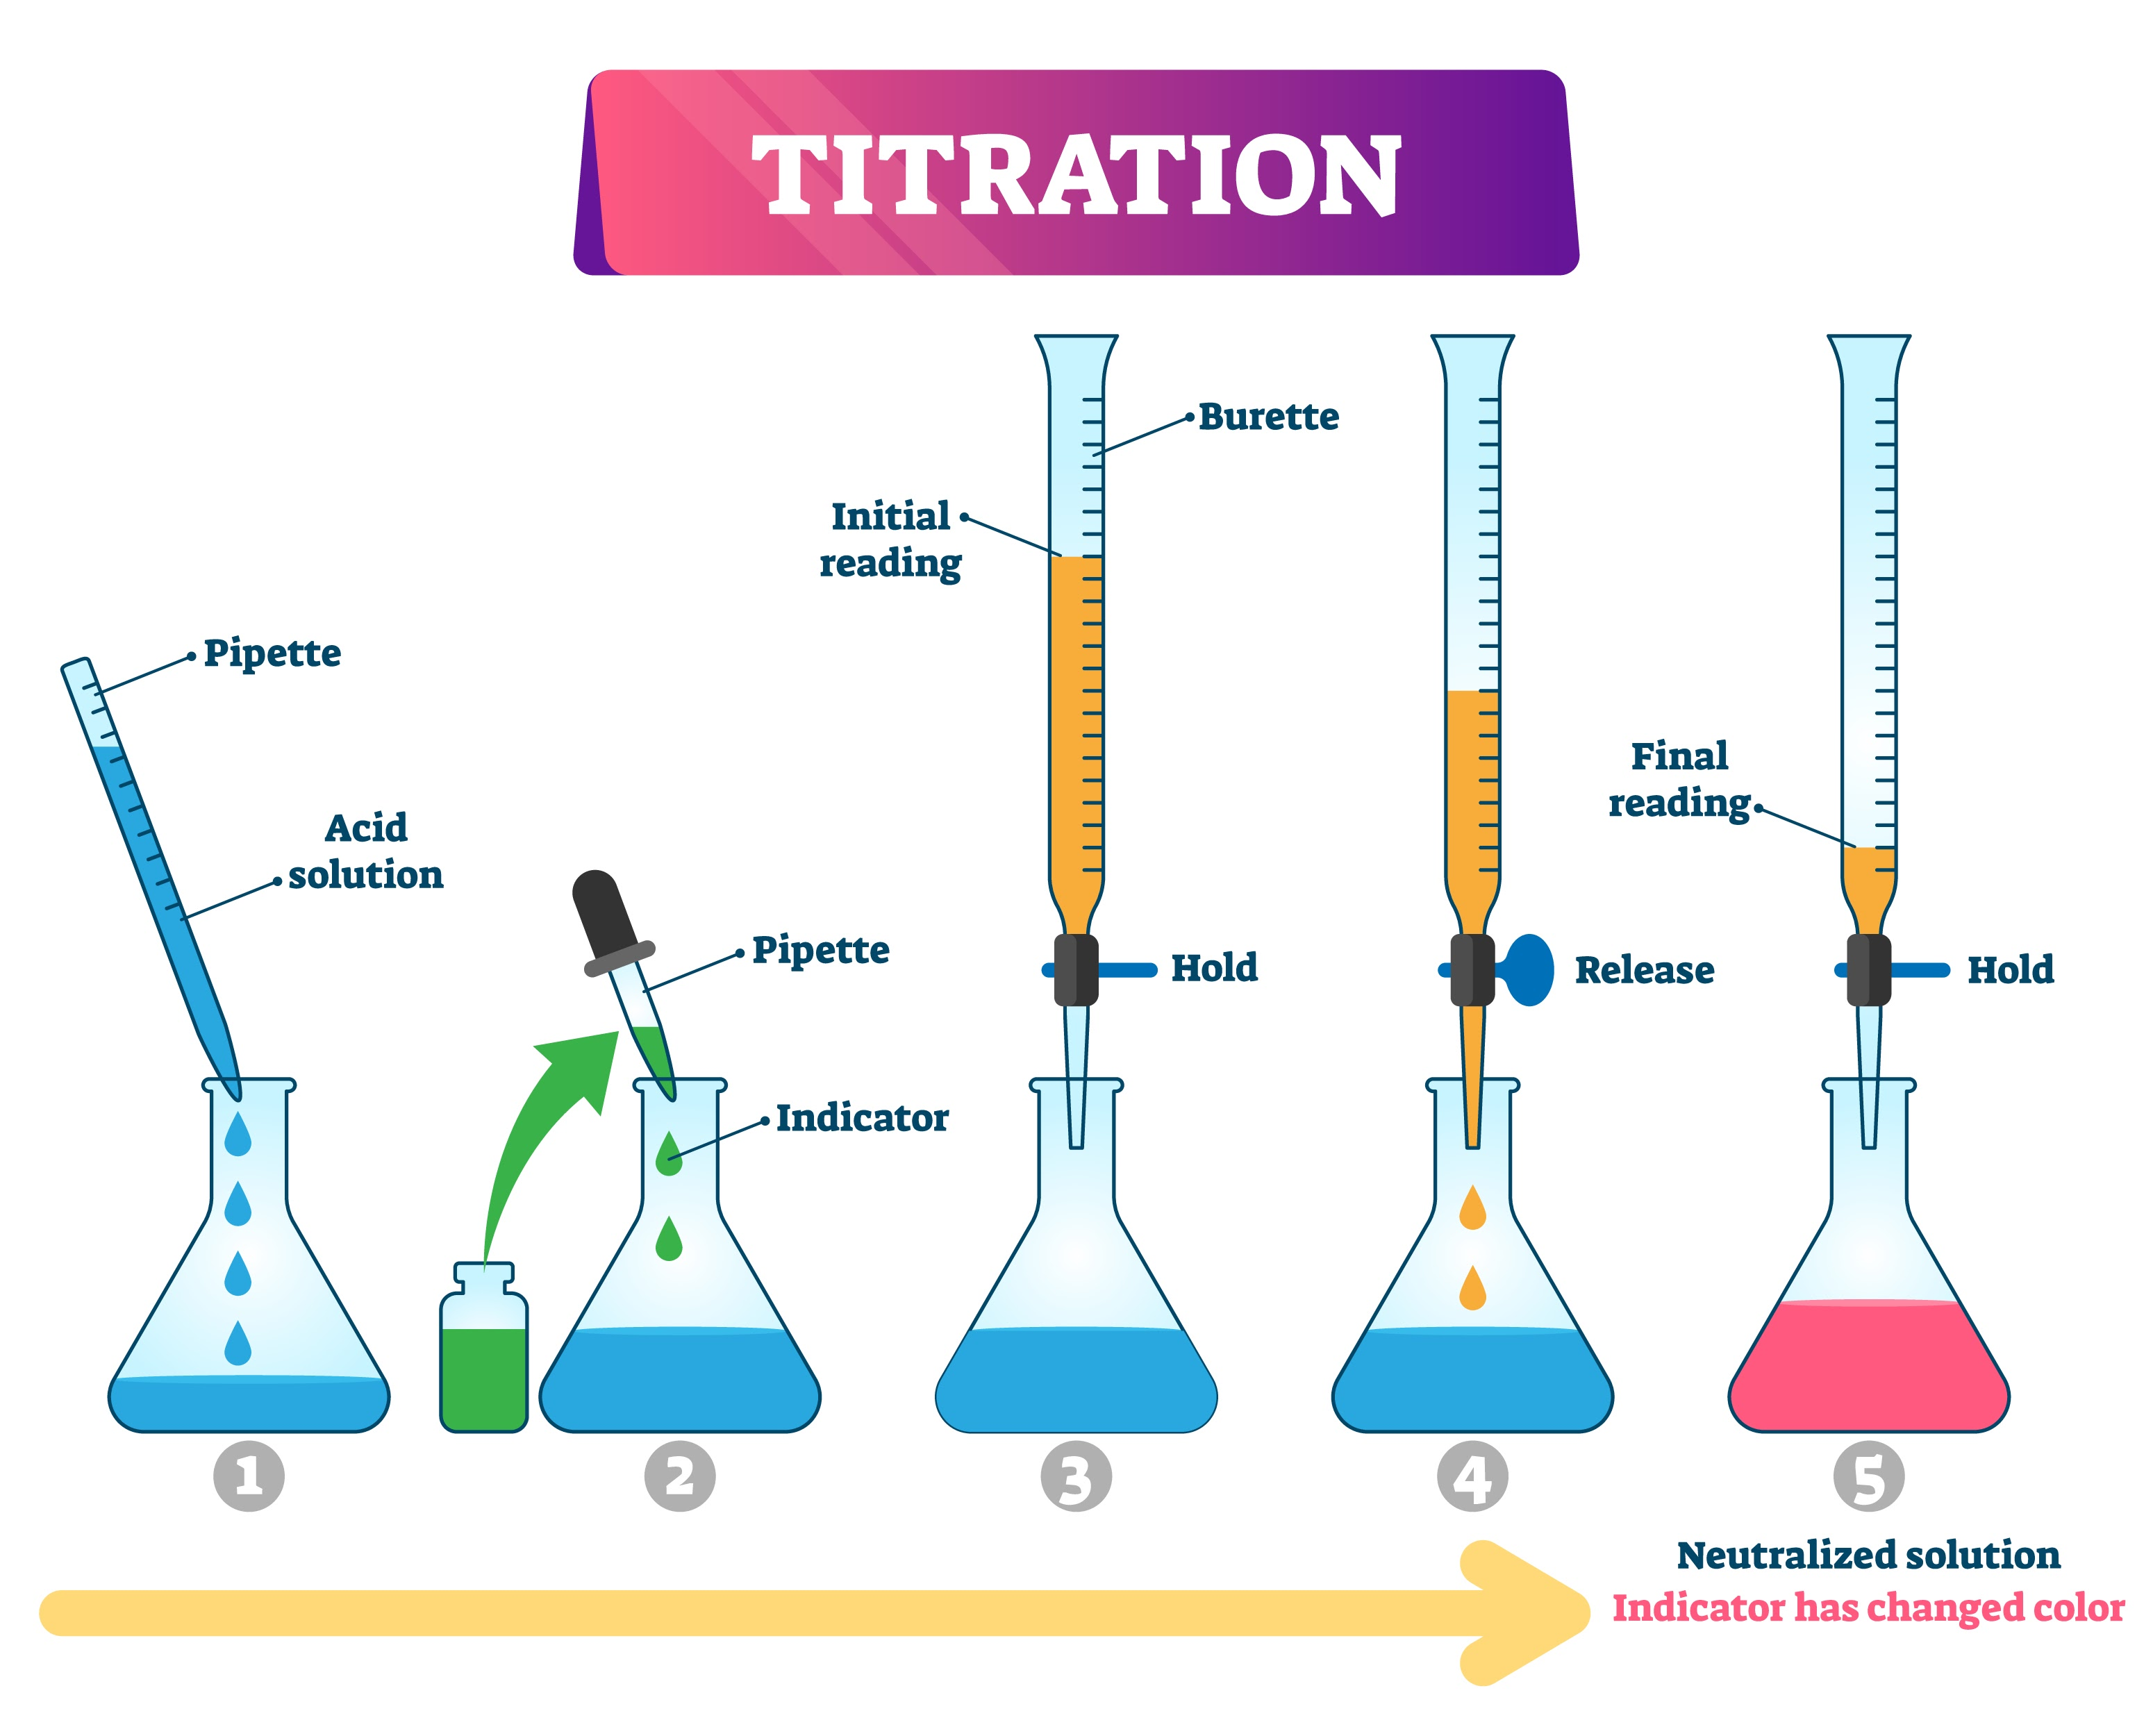
Modern analytical chemistry uses a variety of methods, which are broadly classified into two categories
1. Classical (Wet Chemistry) Methods
These methods often rely on chemical reactions, mass, or volume measurements. They are essential for understanding basic chemical principles and still used for standardization.
Gravimetric Analysis: Determines the amount of analyte by measuring the mass of a highly pure product formed from the analyte.
Volumetric Analysis (Titration): Determines the amount of analyte by measuring the volume of a standard solution (the titrant) required to completely react with the analyte.

Slide 5
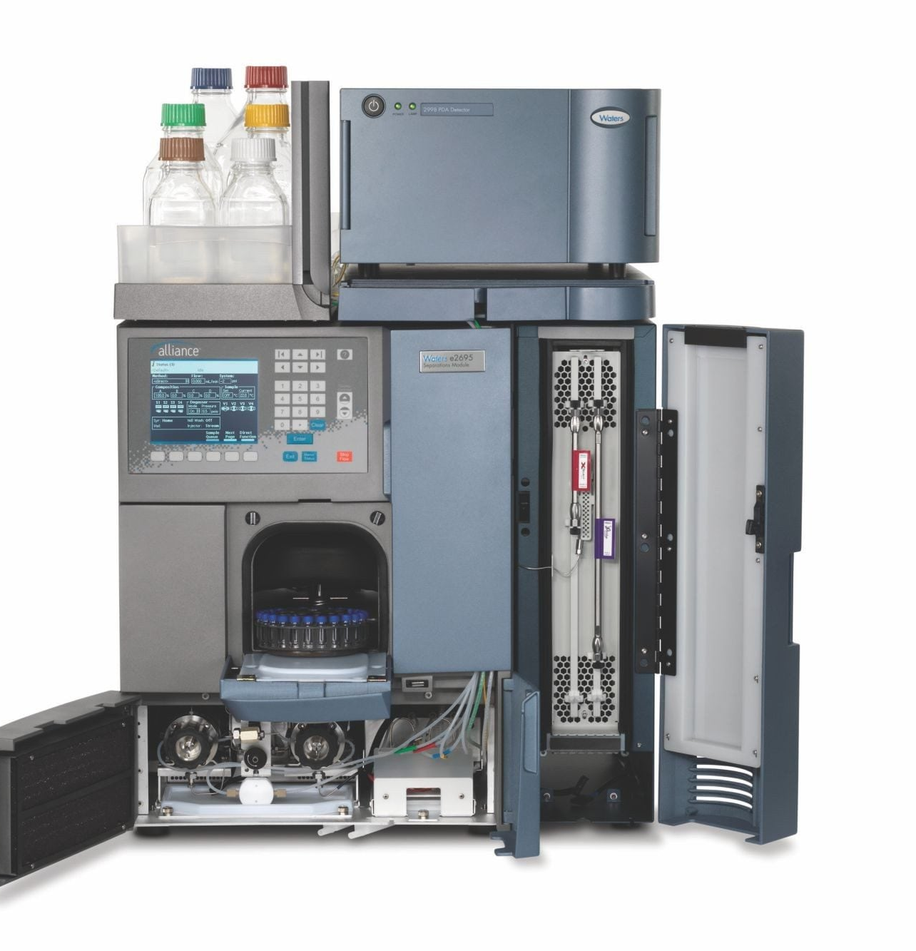
Modern analytical chemistry uses a variety of methods, which are broadly classified into two categories
2. Instrumental Methods
These methods use sophisticated instruments to measure a physical property of the analyte (like conductivity, light absorption, or mass-to-charge ratio) that is proportional to its concentration.
Spectroscopy: Measures the interaction between electromagnetic radiation and matter.
  Examples: UV-Vis (concentration based on light absorption), IR (functional groups), NMR (molecular structure).
Chromatography: Used for the separation of complex mixtures before quantitative analysis. The mixture is separated based on the differential distribution of components between a stationary phase and a mobile phase.
  Examples: High-Performance Liquid Chromatography (HPLC), Gas Chromatography (GC).
Electroanalytical Methods: Measures electrical properties like potential, current, or charge.
  Examples: Voltammetry, Potentiometry (e.g., pH measurement).

Slide 6
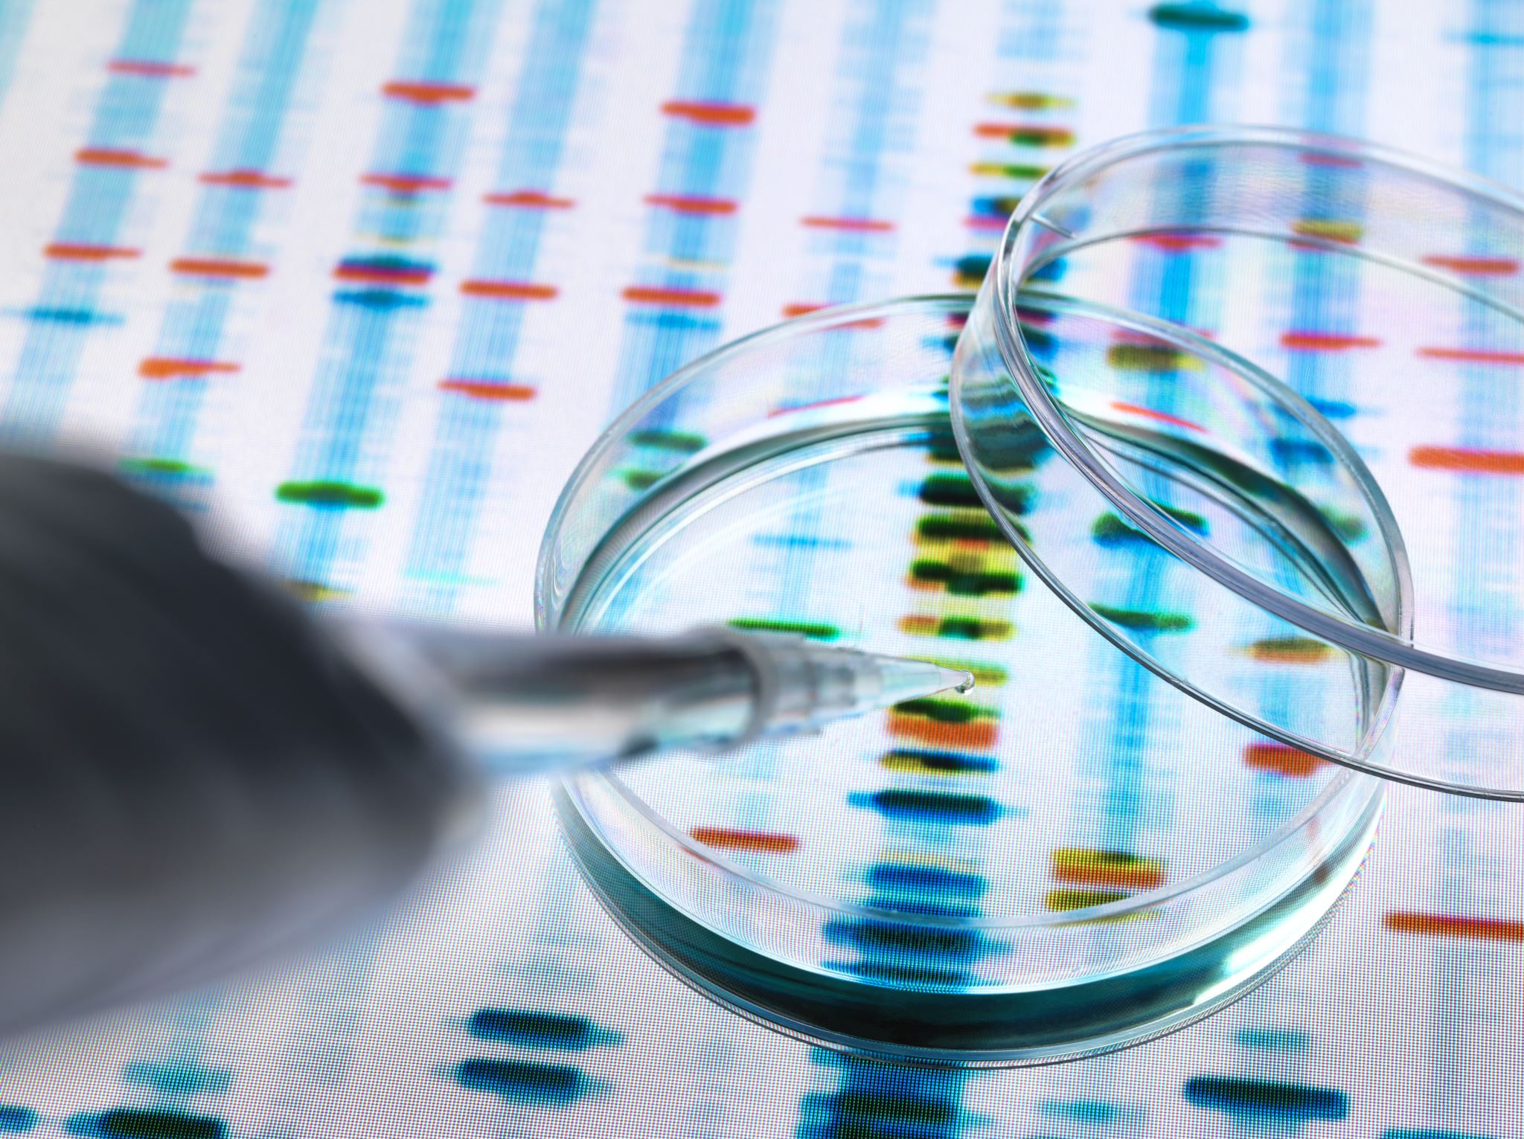
Key Analytical Concepts
Analyte: The specific substance or chemical component being measured or identified.
Matrix: All components of the sample other than the analyte. The matrix can often interfere with the analysis.
Sensitivity: The method's ability to detect small changes in analyte concentration.
Selectivity (or Specificity): The method's ability to measure or detect the analyte without interference from other components in the matrix.
Calibration: The process of relating the measured instrumental response to the known concentration of the analyte, often done by creating a standard curve (or calibration curve).
Accuracy: How close a measurement is to the true or accepted value.
Precision: How close multiple measurements are to each other (reproducibility).

Slide 7
