Slide 1

WELCOME TO YOUR
ENGLISH CLASS
with Teacher Angie

Slide 2
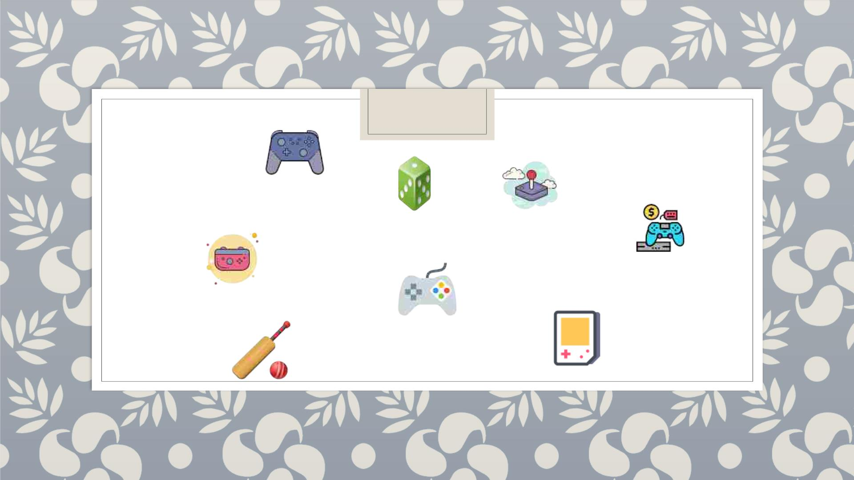
Let’s Play!

Slide 3

Tell me five (5).
Example: Tell me five (5) cities in Thailand.
1. Bangkok
2. Chiang Mai
3. Pattaya
4. Phuket
5. Chonburi

Slide 4
Tell me five (5) things you know about
OUR PLANET.

Slide 5

Climate Change
What is climate change?
- a change in the typical weather for a region — such as high and
low temperatures and amount of rainfall — over a long period of
time.

Slide 6
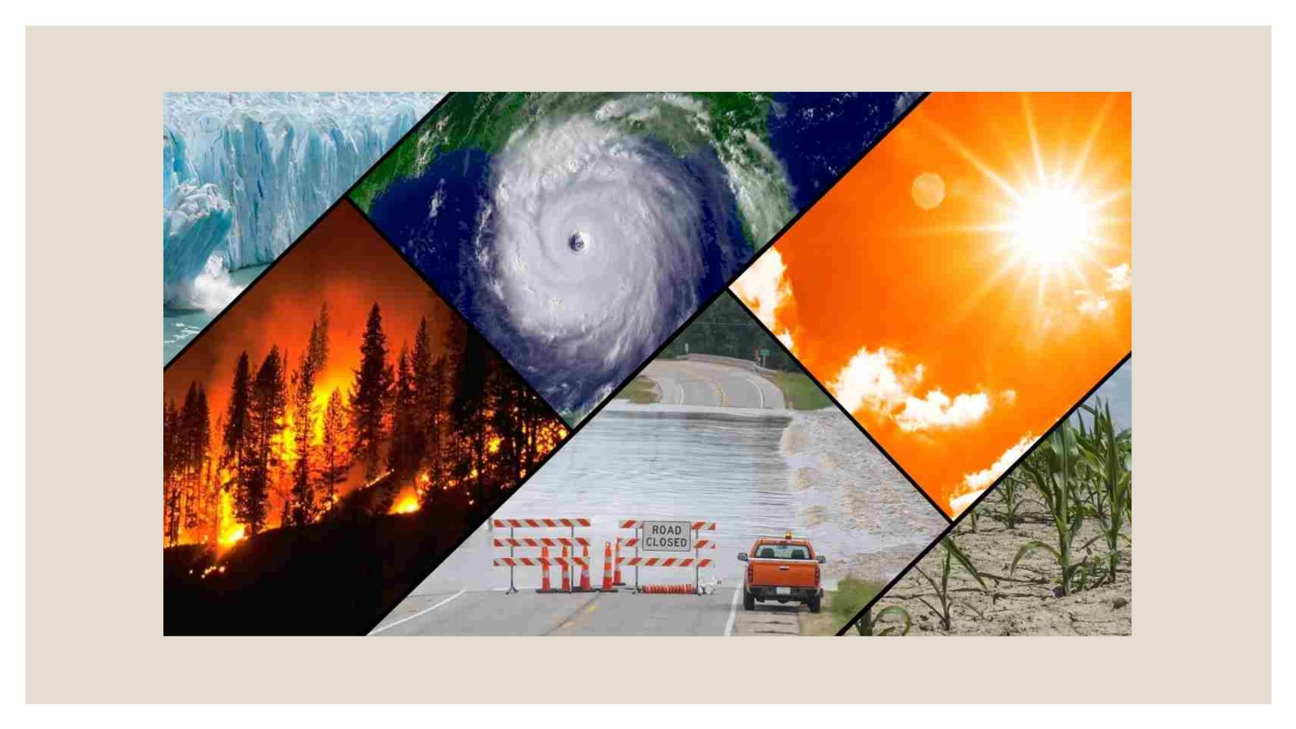

Slide 7
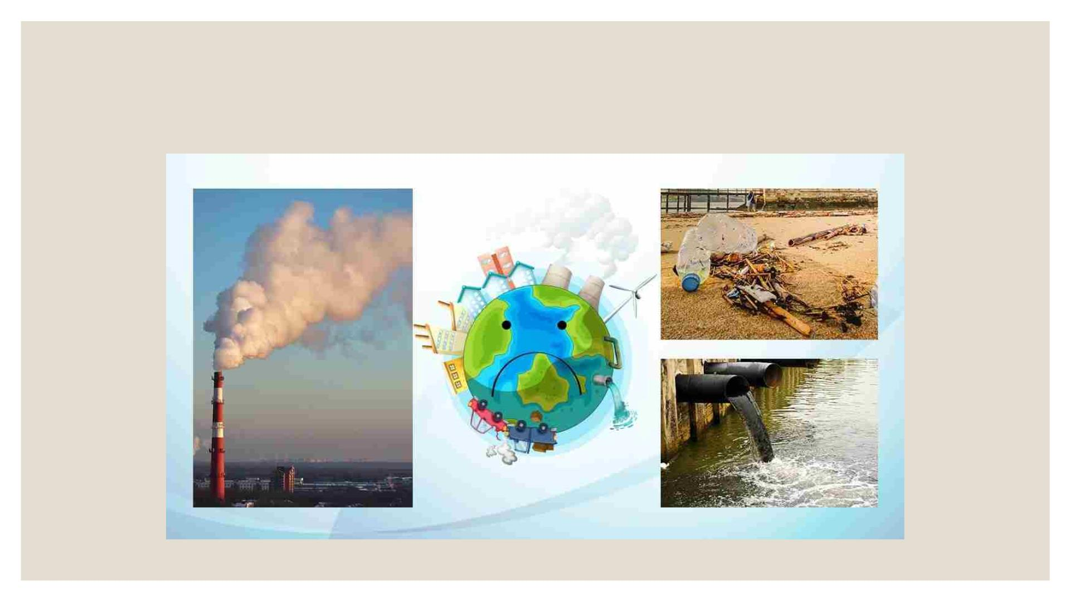
pollution

Slide 8
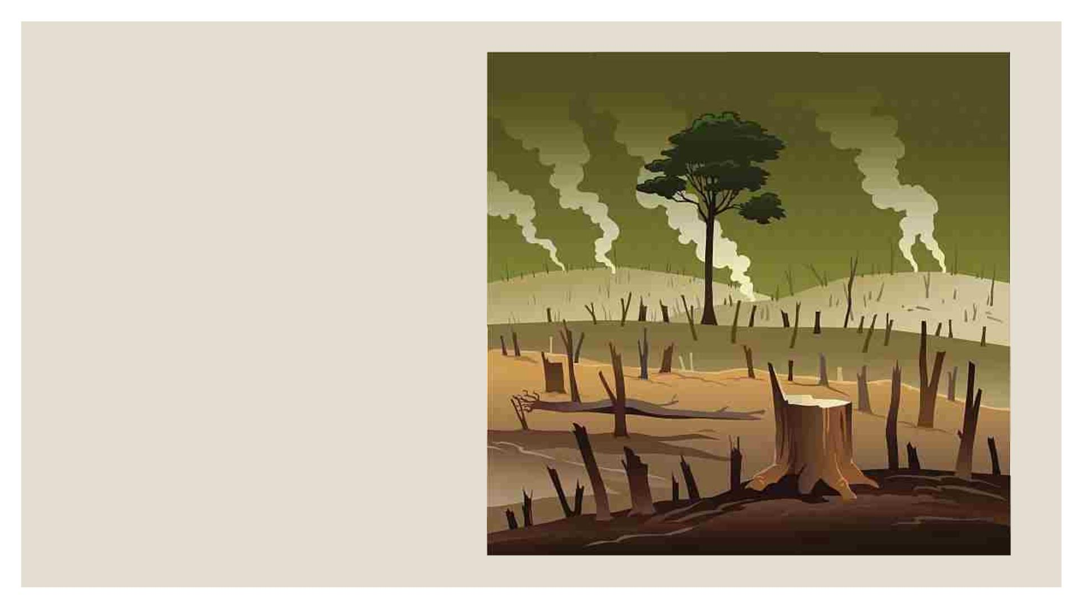
deforestation

Slide 9
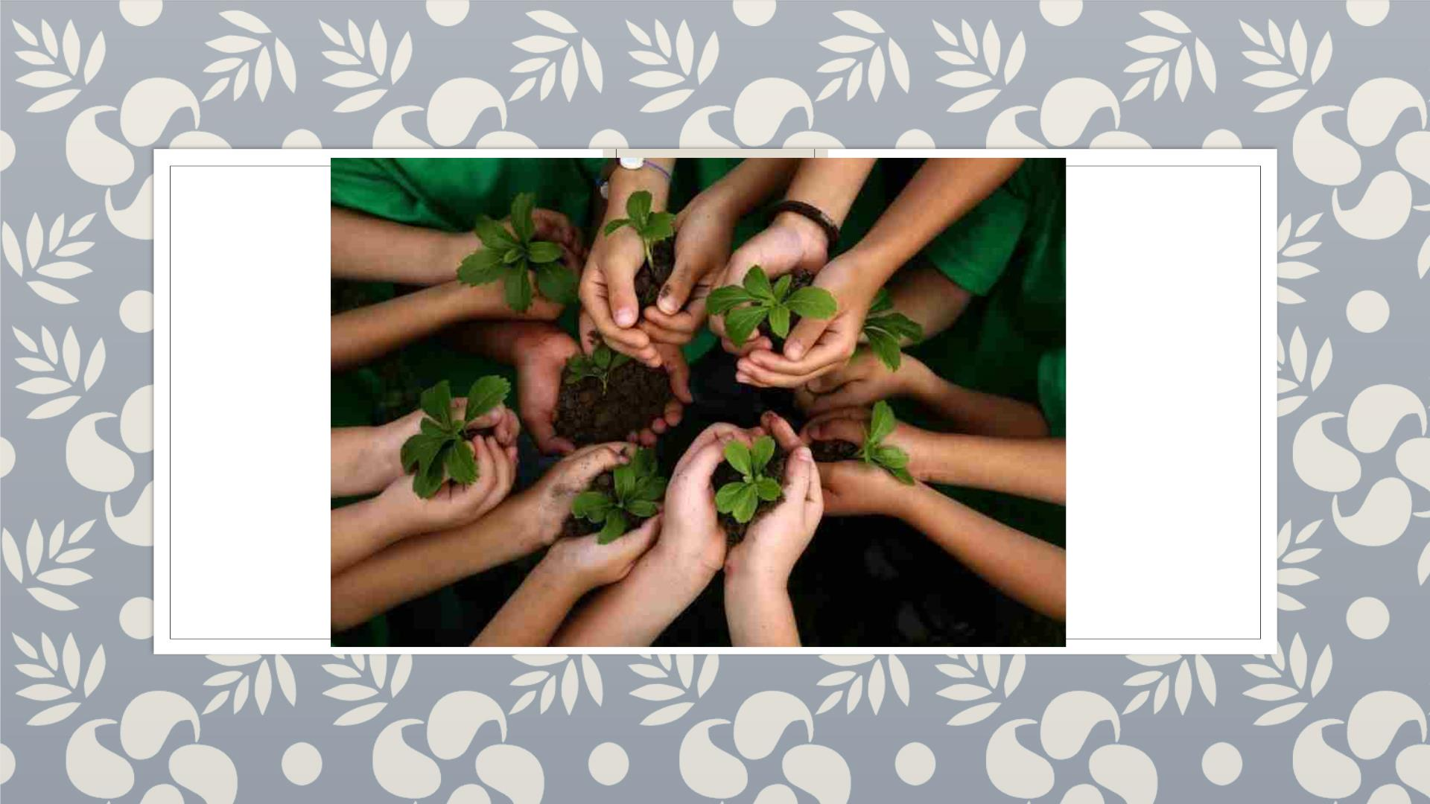
plant trees

Slide 10
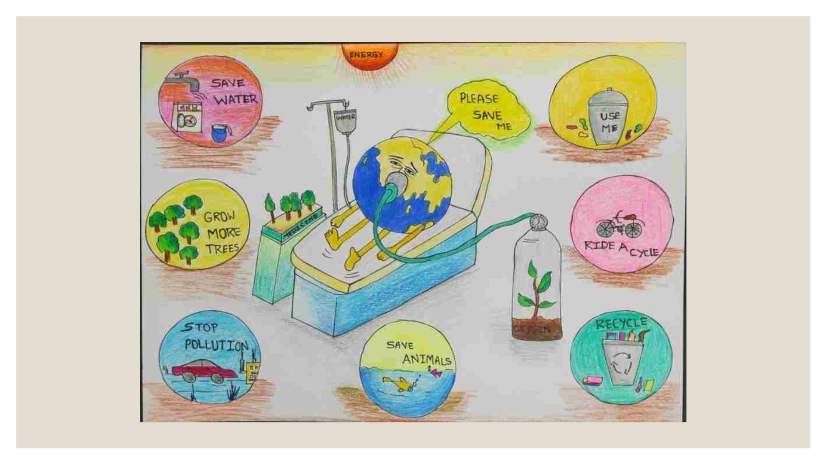

Slide 11
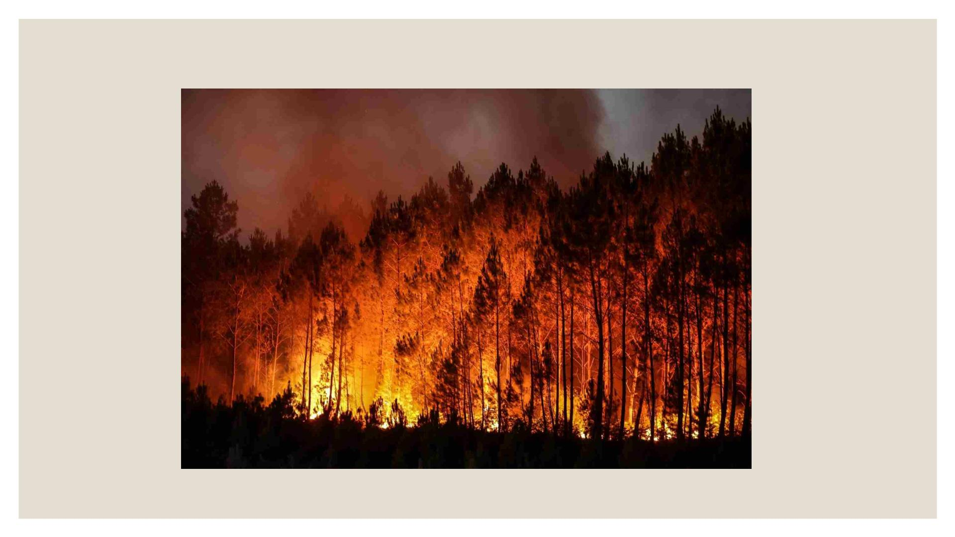
forest fire

Slide 12
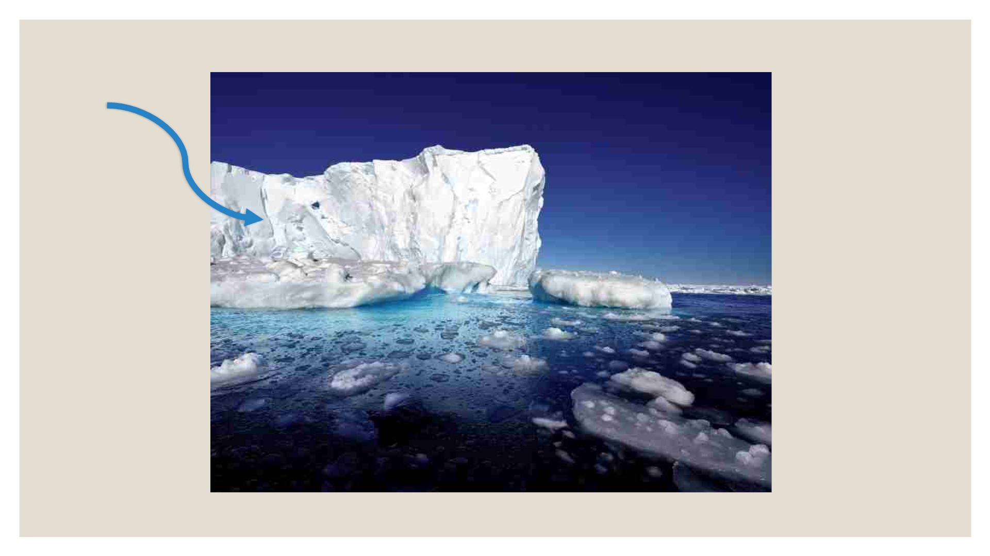
iceberg melting
iceberg

Slide 13
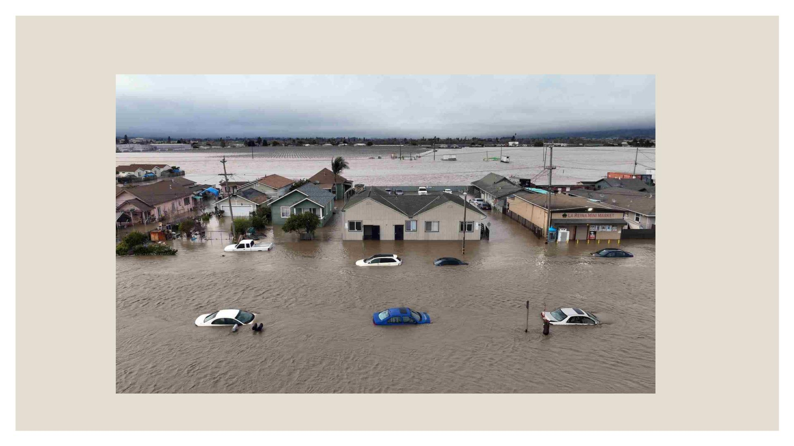
flooding

Slide 14


