Slide 1

The Importance of Measurement and Units
Welcome! Today we'll explore the fundamental concepts of measurement and units. Measurement is a cornerstone of science, engineering, and daily life, providing a common language to describe and quantify the world around us. We'll dive into the different types of measurement, customary and metric units, and the crucial aspects of accuracy, precision, and significant figures. Let's embark on this journey to understand the essential role of measurement in our world.
by Onyedikachi Ikenna Onwurah

Slide 2

What is Measurement?
Measurement is the process of determining the size, quantity, or amount of something. It involves comparing an object or quantity to a standard unit of measure. For example, we measure the length of a table using a ruler, which has standardized units like inches or centimeters.
Measurement allows us to quantify our observations and communicate them clearly. It is essential for tasks as simple as cooking or as complex as designing a skyscraper. We use measurement in every field, from physics and engineering to biology and medicine.

Slide 3
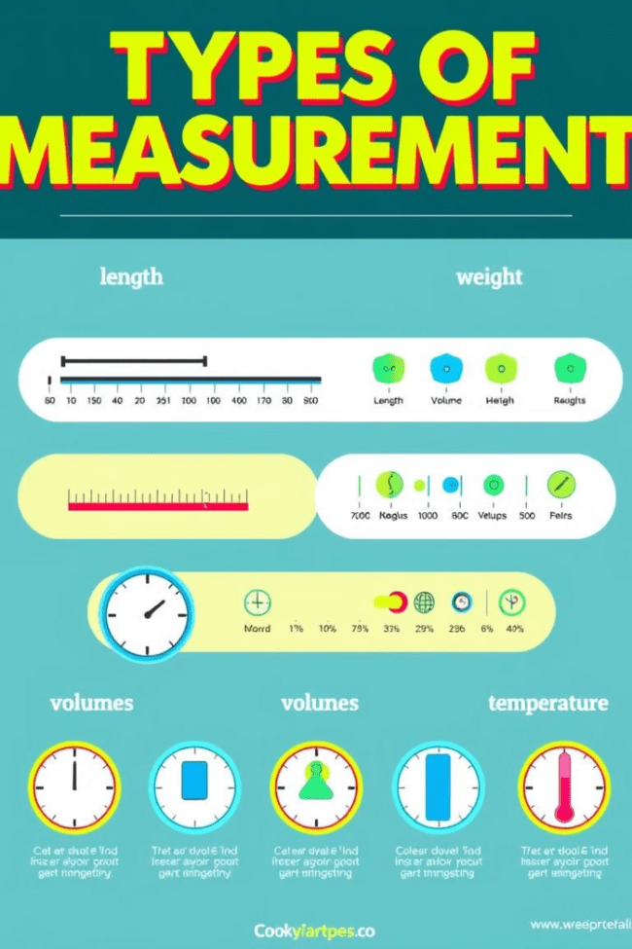
Types of Measurement
Length
Weight
Length measures the distance between two points. Common units include inches, feet, yards, and miles (customary) or millimeters, centimeters, meters, and kilometers (metric).
Weight measures the force of gravity acting on an object. Common units include ounces, pounds, and tons (customary) or grams and kilograms (metric).
Volume
Time
Volume measures the amount of space an object occupies. Common units include fluid ounces, cups, pints, quarts, and gallons (customary) or milliliters and liters (metric).
Time measures the duration of an event. Common units include seconds, minutes, hours, days, weeks, months, and years.

Slide 4
Customary Units
Origin
Units
The customary system, also known as the Imperial system, originated in England and is still used in the United States and a few other countries. It's a system of units based on historical measurements and traditions.
Customary units include inches, feet, yards, and miles for length; ounces, pounds, and tons for weight; and fluid ounces, cups, pints, quarts, and gallons for volume.

Slide 5
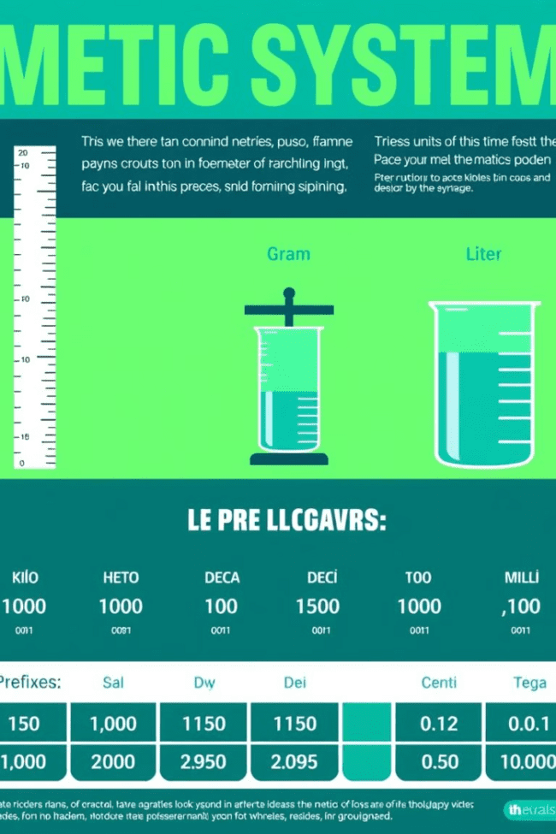



The Metric System
Meter
The base unit for length in the metric system, representing approximately 3.3 feet.
Gram
The base unit for mass in the metric system, approximately 1/28 of an ounce.
Liter
The base unit for volume in the metric system, slightly larger than a quart.

Slide 6

Converting Units
Converting between units is often necessary when working with different systems or when needing to express measurements in a specific unit. For example, we might need to convert inches to centimeters or kilograms to pounds.
When converting units, ensure you use the correct conversion factor and multiply or divide appropriately to get the desired result. Practice is key to becoming proficient in unit conversion.
1
2
3
Conversion involves using a conversion factor, which is a ratio that relates two equivalent units. For example, there are 2.54 centimeters in 1 inch, so we can use this ratio to convert inches to centimeters.

Slide 7




Accuracy and Precision
Accuracy
Accuracy refers to how close a measurement is to the true or accepted value. A measurement is considered accurate if it's close to the real value.
Precision
Precision refers to how close repeated measurements are to each other. A measurement is considered precise if repeated measurements are close together, even if they are not close to the true value.
Both Matter
Both accuracy and precision are important in scientific and engineering applications. You need accurate and precise measurements to ensure reliable results and draw valid conclusions.

Slide 8




Significant Figures
What They Are
Significant figures are the digits in a measurement that are considered reliable and contribute to its precision. They indicate the level of accuracy to which a measurement is known.
1
Rules to Follow
2
Specific rules determine which digits are considered significant. For example, non-zero digits are always significant, while leading zeros are not.
Why They Matter
3
Using the correct number of significant figures is crucial to accurately representing data and avoiding misleading conclusions.

Slide 9
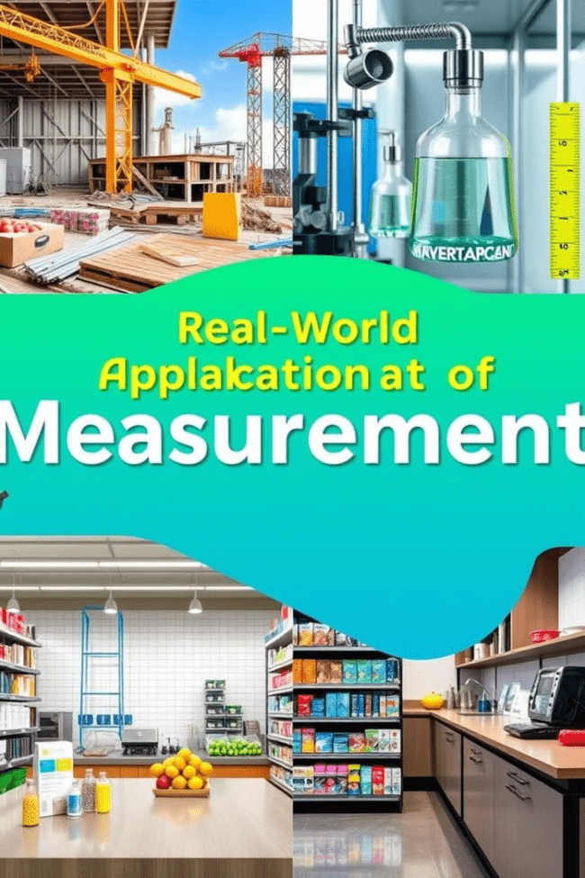

Applying Measurement Concepts
1
Science
Measurement is fundamental to all scientific disciplines, from physics and chemistry to biology and astronomy.
2
Engineering
Engineers rely heavily on accurate and precise measurements for designing and building structures, machines, and devices.
3
Daily Life
We encounter measurement in our daily lives, from cooking recipes and measuring ingredients to navigating with GPS and monitoring our health.

