Slide 1



English Class
with
Teacher Mady

Slide 2

CULTURE 1
UNDERSTANDING CULTURAL DIFFERENCES

Slide 3
VOCABULARY
Culture /ˈkʌl.tʃər/ | The way people live, think, and do things. Example: Every country has a different culture
Diversity /daɪˈvɜː.sɪ.ti/ | Variety; having many different kinds. Example: Cultural diversity makes a society more interesting.
Adapt /əˈdæpt/ | To change to fit a new situation or culture. Example: It takes time to adapt to a new culture

Slide 4
Useful Expressions
Showing Interest & Curiosity
Showing Respect
  I’d love to learn about that.
我很想了解那件事。
  That’s new to me.
我第一次听到。
  I understand it’s important to you.
我明白这对你很重要。
  Thank you for sharing that with me.
谢谢你和我分享这个。
Comparing Cultures
Apologizing or Clarifying
  It’s a bit different in my country.
在我的国家有点不同。
  That reminds me of...
那让我想起……
  I’m sorry, I didn’t mean to offend you.
对不起，我没有冒犯你的意思。
  I’m still learning about your culture.
我还在学习你的文化。

Slide 5
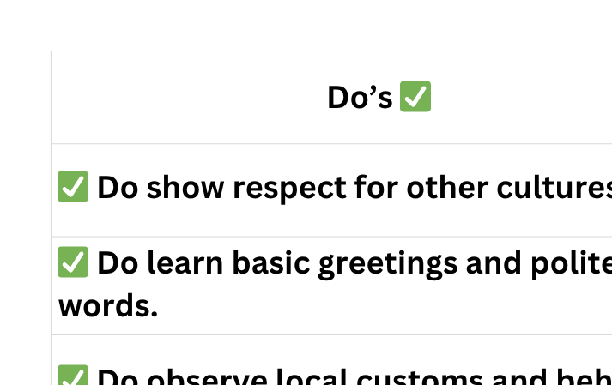
Do’s and Don’ts When Understanding Cultural Differences
What’s something unique about your country’s culture?

Slide 6

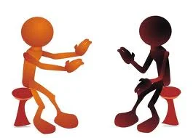
Situation:
Your foreign teacher is visiting your country. Share something special about your country (food, greeting, or festival). You can also ask questions about his/her culture.

