Slide 1
General Aptitude
Percentage
By Priyanka Gurbani

Slide 2
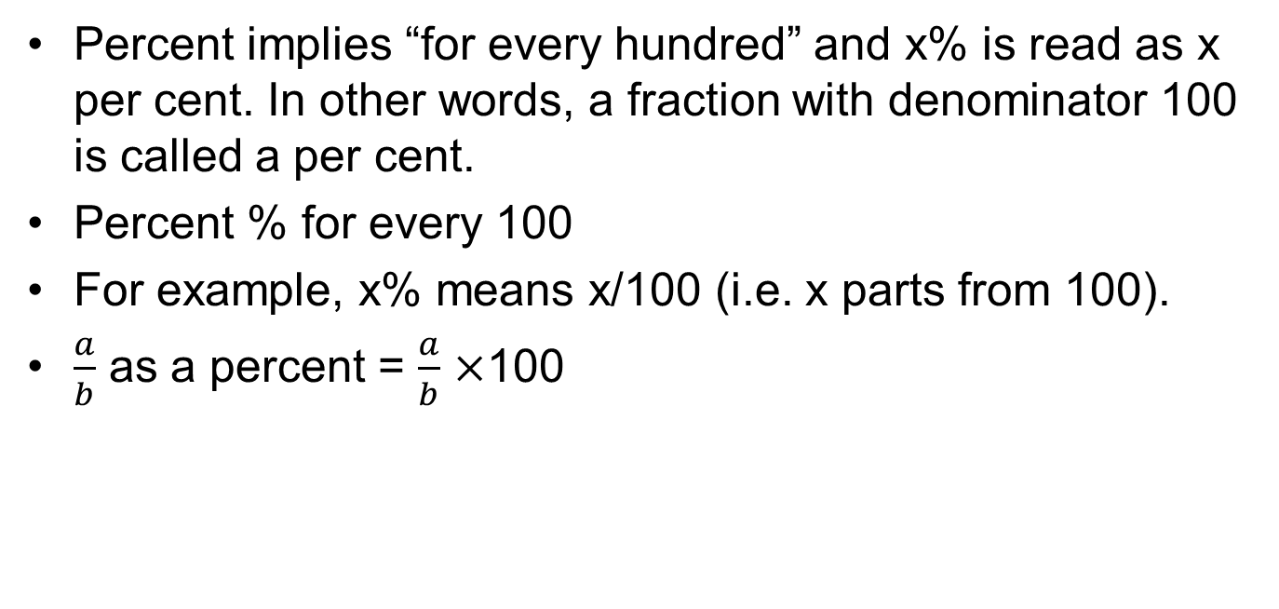
Percentage
Percent implies “for every hundred” and x% is read as x per cent. In other words, a fraction with denominator 100 is called a per cent.
Percent % for every 100
For example, x% means x/100 (i.e. x parts from 100).
$\frac{a}{b}$ as a percent = $\frac{a}{b}$ $×$100

Slide 3
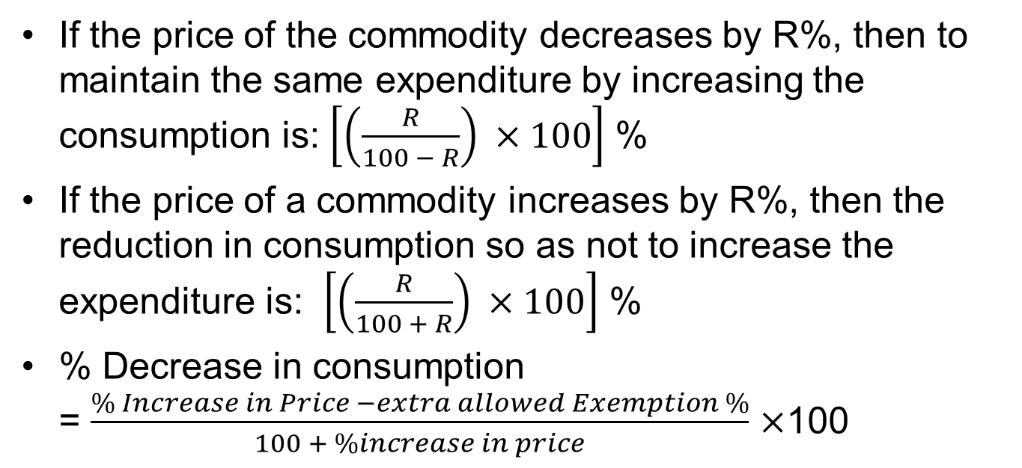
Commodity Price Increase/Decrease
If the price of the commodity decreases by R%, then to maintain the same expenditure by increasing the consumption is: $\left[\left(\frac{R}{100 − R}\right) ×100\right]$ %
If the price of a commodity increases by R%, then the reduction in consumption so as not to increase the expenditure is: $\left[\left(\frac{R}{100 + R}\right) ×100\right]$ %
% Decrease in consumption
= $\frac{\% Increase in Price −extra allowed Exemption \%}{100 + \%increase in price}$ $×$100

Slide 4
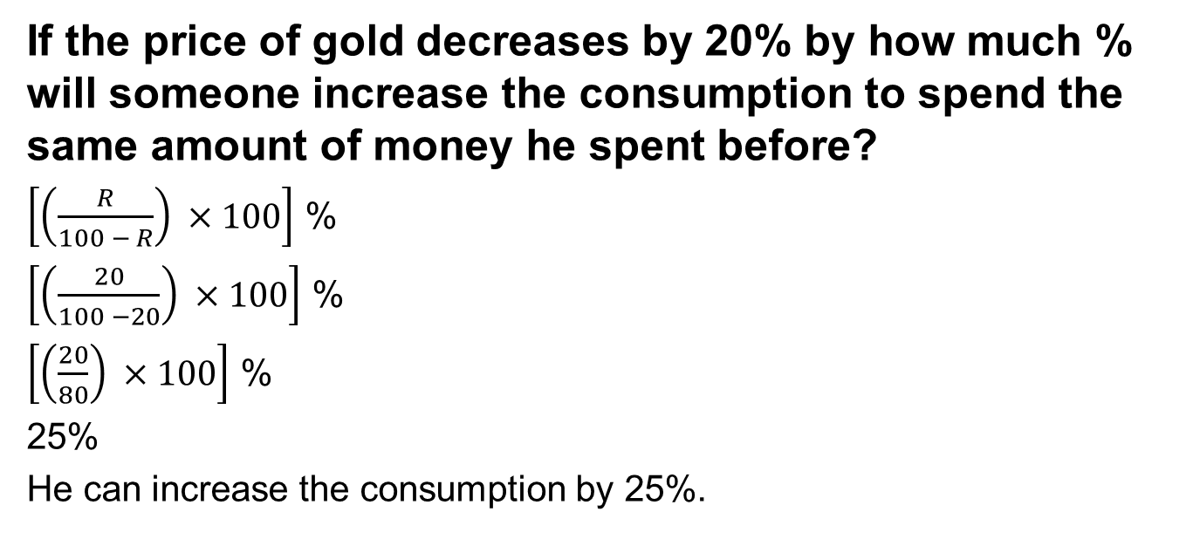
Example 1
If the price of gold decreases by 20% by how much % will someone increase the consumption to spend the same amount of money he spent before?
$\left[\left(\frac{R}{100 − R}\right) ×100\right]$ %
$\left[\left(\frac{20}{100 −20}\right) ×100\right]$ %
$\left[\left(\frac{20}{80}\right) ×100\right]$ %
25%
He can increase the consumption by 25%.

Slide 5
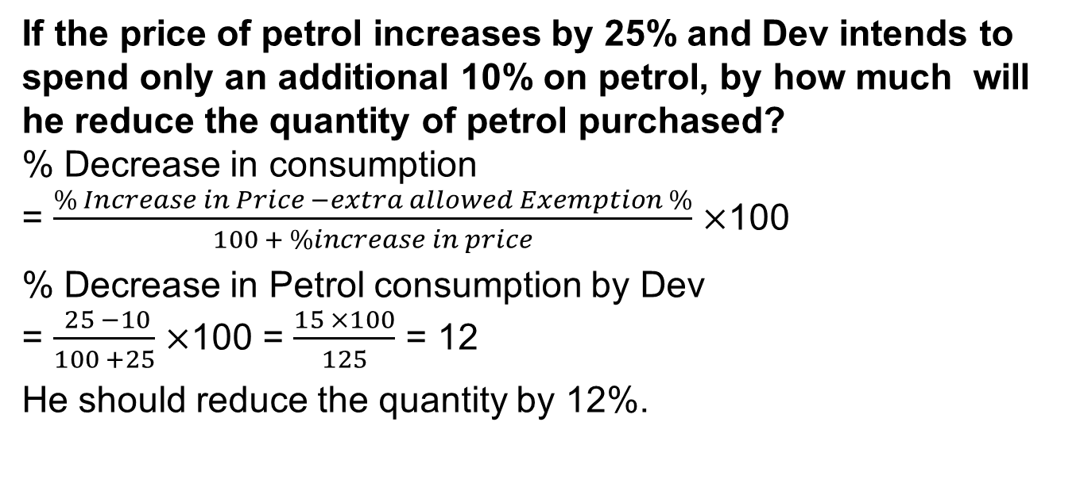
Example 2
If the price of petrol increases by 25% and Dev intends to spend only an additional 10% on petrol, by how much will he reduce the quantity of petrol purchased?
% Decrease in consumption
= $\frac{\% Increase in Price −extra allowed Exemption \%}{100 + \%increase in price}$ $×$100
% Decrease in Petrol consumption by Dev
= $\frac{ 25 −10}{100 +25}$ $×$100 = $\frac{15 ×100}{125}$ = 12
He should reduce the quantity by 12%.

Slide 6
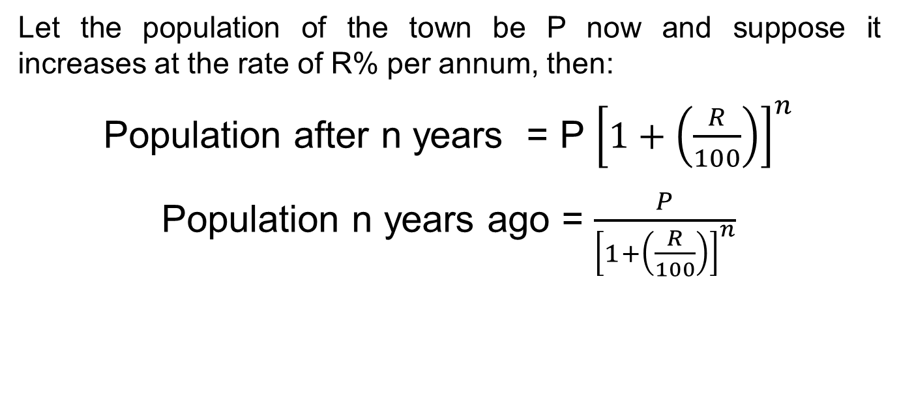
Population based questions
Let the population of the town be P now and suppose it increases at the rate of R% per annum, then:
Population after n years = P ${\left[1+\left(\frac{R}{100}\right)\right]}^{n}$
Population n years ago = $\frac{P}{{\left[1+\left(\frac{R}{100}\right)\right]}^{n}}$

Slide 7
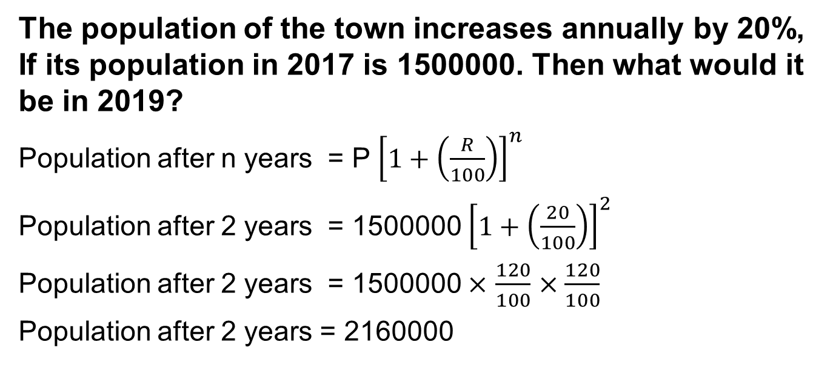
Example 3
The population of the town increases annually by 20%, If its population in 2017 is 1500000. Then what would it be in 2019?
Population after n years = P ${\left[1+\left(\frac{R}{100}\right)\right]}^{n}$
Population after 2 years = 1500000 ${\left[1+\left(\frac{20}{100}\right)\right]}^{2}$
Population after 2 years = 1500000 $×$ $\frac{120}{100}$ $×\frac{120}{100}$
Population after 2 years = 2160000

Slide 8
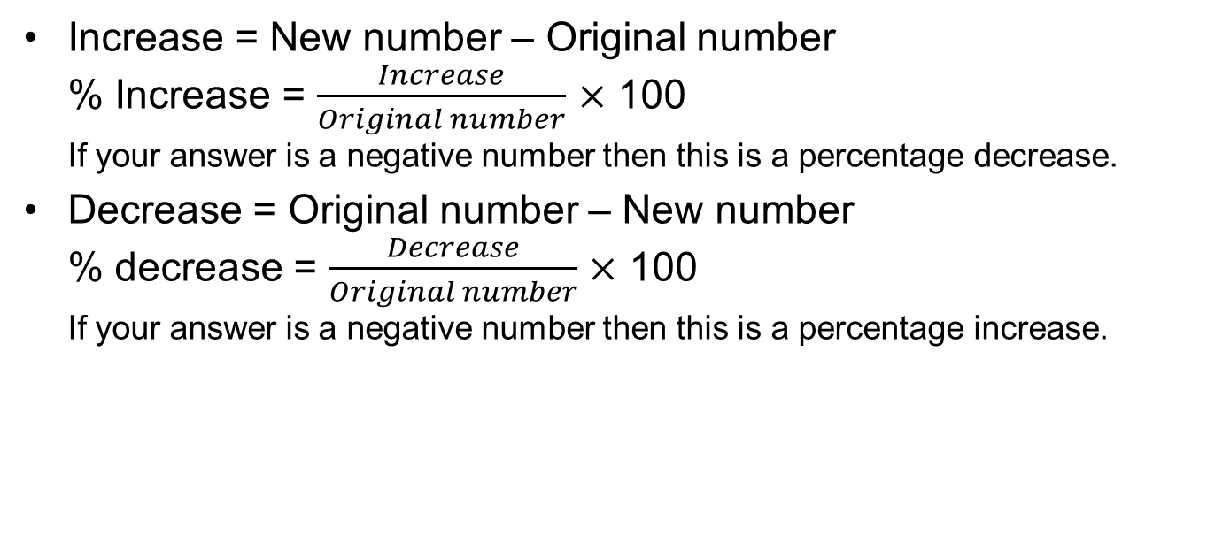
Percentage Increase/Decrease
Increase = New number – Original number
% Increase = $\frac{Increase}{Original number}$ $×$ 100
If your answer is a negative number then this is a percentage decrease.
Decrease = Original number – New number
% decrease = $\frac{Decrease}{Original number}$ $×$ 100
If your answer is a negative number then this is a percentage increase.

Slide 9
Practice Question 1
A report consists of 20 sheets each of 56 lines and each such line consists of 65 characters. This report is reduced onto sheets each of 65 lines such that each line consists of 70 characters. Find the percentage reduction in number of sheets.
No. of Characters in one line = 65
No. of characters in one sheet = No. of lines × No. of characters per line = 56 × 65
Total number of characters = No. of sheets × No. of characters in 1 sheet
= 20 × 56 × 65.
If the report is retyped -
New sheets have 65 lines, with 70 characters per line
No. of characters in one sheet = 65 × 70

Slide 10
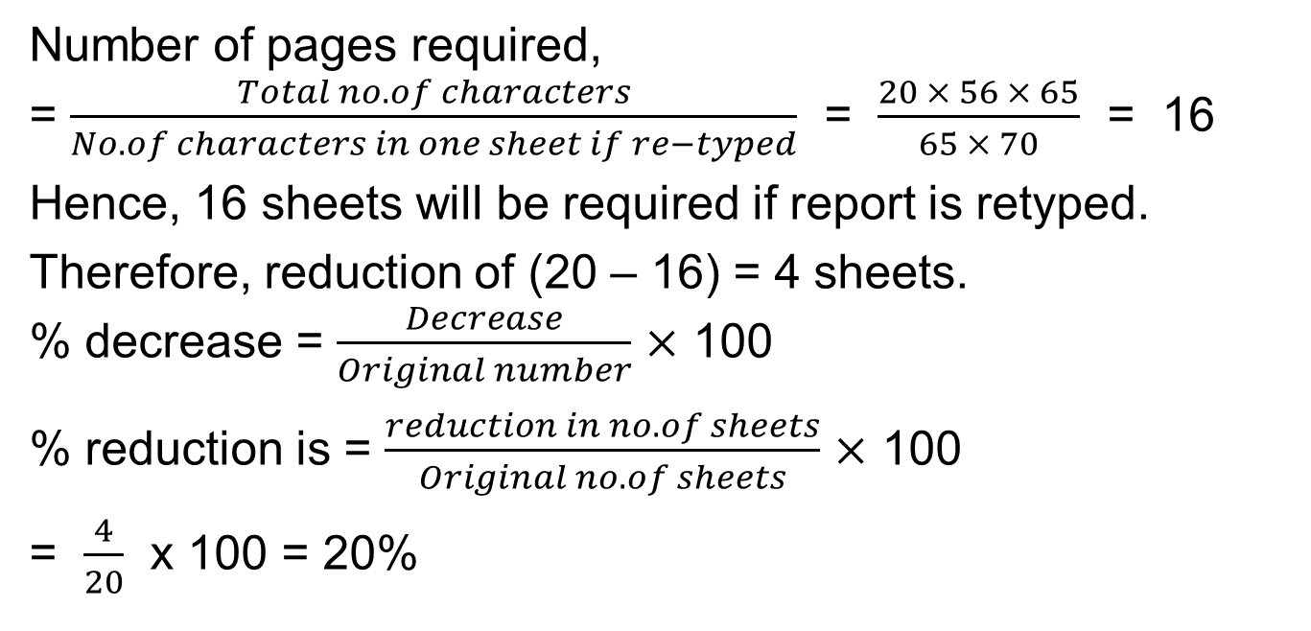
Number of pages required,
= $\frac{Total no. of characters}{No. of characters in one sheet if re−typed}$ = $\frac{20 × 56 × 65}{65 × 70}$ = 16
Hence, 16 sheets will be required if report is retyped.
Therefore, reduction of (20 – 16) = 4 sheets.
% decrease = $\frac{Decrease}{Original number}$ $×$ 100
% reduction is = $\frac{reduction in no. of sheets}{Original no. of sheets}$ $×$ 100
= $\frac{4}{20}$ x 100 = 20%

Slide 11
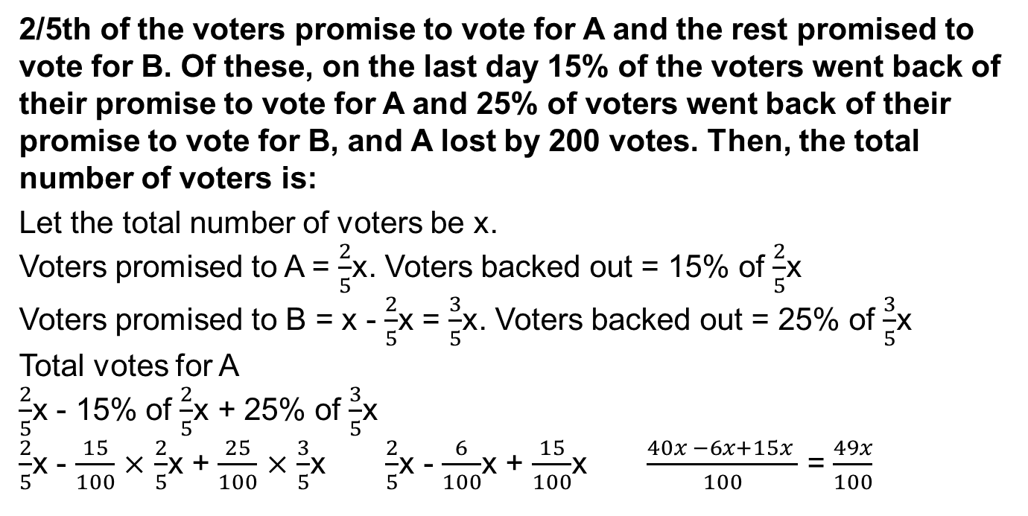
Practice Question 2
2/5th of the voters promise to vote for A and the rest promised to vote for B. Of these, on the last day 15% of the voters went back of their promise to vote for A and 25% of voters went back of their promise to vote for B, and A lost by 200 votes. Then, the total number of voters is:
Let the total number of voters be x.
Voters promised to A = $\frac{2}{5}$x. Voters backed out = 15% of $\frac{2}{5}$x
Voters promised to B = x - $\frac{2}{5}$x = $\frac{3}{5}$x. Voters backed out = 25% of $\frac{3}{5}$x
Total votes for A
$\frac{2}{5}$x - 15% of $\frac{2}{5}$x + 25% of $\frac{3}{5}$x
$\frac{2}{5}$x - $\frac{15}{100}$ $×$ $\frac{2}{5}$x + $\frac{25}{100}$ $×$ $\frac{3}{5}$x $\frac{2}{5}$x - $\frac{6}{100}$x + $\frac{15}{100}$x $\frac{40x −6x+15x }{100}$ = $\frac{49x}{100}$

Slide 12
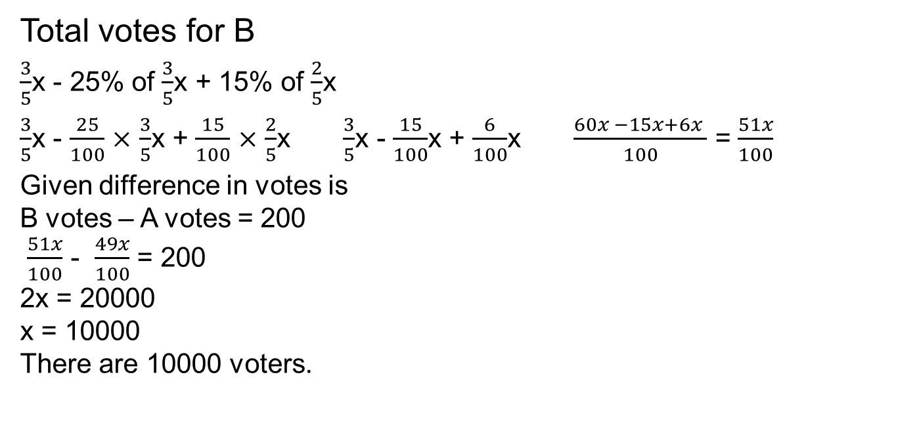
Total votes for B
$\frac{3}{5}$x - 25% of $\frac{3}{5}$x + 15% of $\frac{2}{5}$x
$\frac{3}{5}$x - $\frac{25}{100}$ $×$ $\frac{3}{5}$x + $\frac{15}{100}$ $×$ $\frac{2}{5}$x $\frac{3}{5}$x - $\frac{15}{100}$x + $\frac{6}{100}$x $\frac{60x −15x+6x }{100}$ = $\frac{51x}{100}$
Given difference in votes is
B votes – A votes = 200
$\frac{51x}{100}$ - $\frac{49x}{100}$ = 200
2x = 20000
x = 10000
There are 10000 voters.

Slide 13
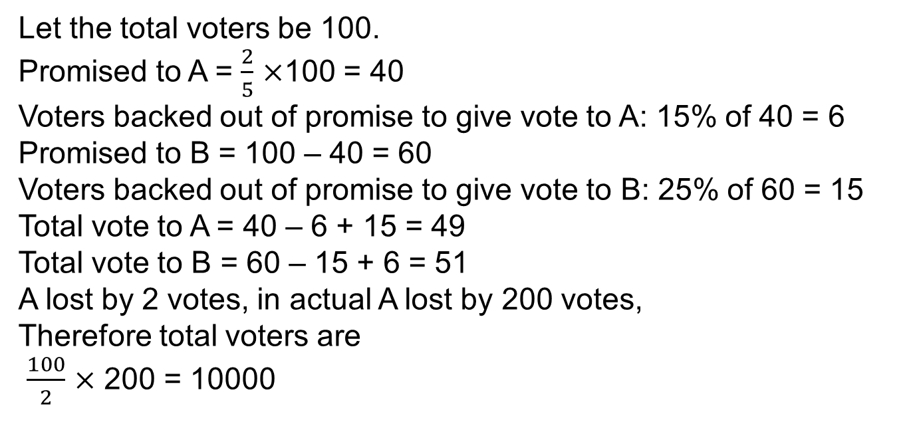
Alternate Method
Let the total voters be 100.
Promised to A = $\frac{2}{5}$ $×$100 = 40
Voters backed out of promise to give vote to A: 15% of 40 = 6
Promised to B = 100 – 40 = 60
Voters backed out of promise to give vote to B: 25% of 60 = 15
Total vote to A = 40 – 6 + 15 = 49
Total vote to B = 60 – 15 + 6 = 51
A lost by 2 votes, in actual A lost by 200 votes,
Therefore total voters are
$\frac{100}{2}$ $×$ 200 = 10000

Slide 14
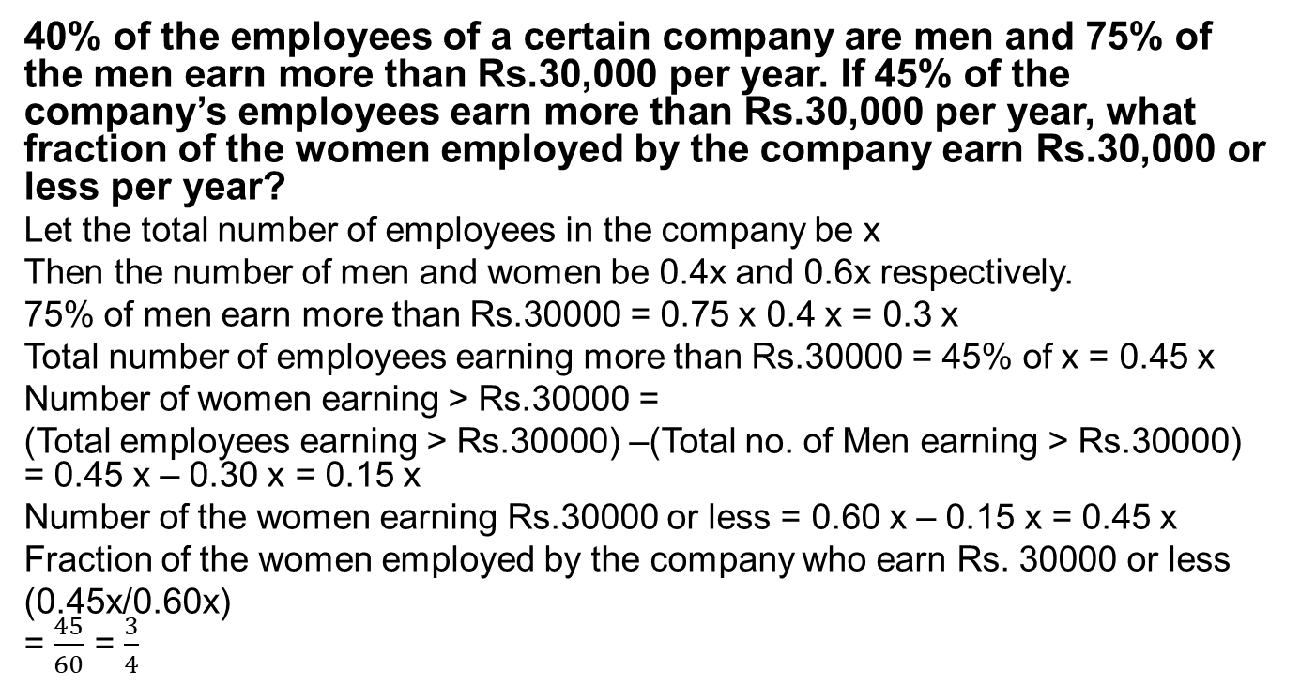
Practice Question 3
40% of the employees of a certain company are men and 75% of the men earn more than Rs.30,000 per year. If 45% of the company’s employees earn more than Rs.30,000 per year, what fraction of the women employed by the company earn Rs.30,000 or less per year?
Let the total number of employees in the company be x
Then the number of men and women be 0.4x and 0.6x respectively.
75% of men earn more than Rs.30000 = 0.75 x 0.4 x = 0.3 x
Total number of employees earning more than Rs.30000 = 45% of x = 0.45 x
Number of women earning > Rs.30000 =
(Total employees earning > Rs.30000) –(Total no. of Men earning > Rs.30000) = 0.45 x – 0.30 x = 0.15 x
Number of the women earning Rs.30000 or less = 0.60 x – 0.15 x = 0.45 x
Fraction of the women employed by the company who earn Rs. 30000 or less
(0.45x/0.60x)
= $\frac{45}{60}$ = $\frac{3}{4}$

Slide 15
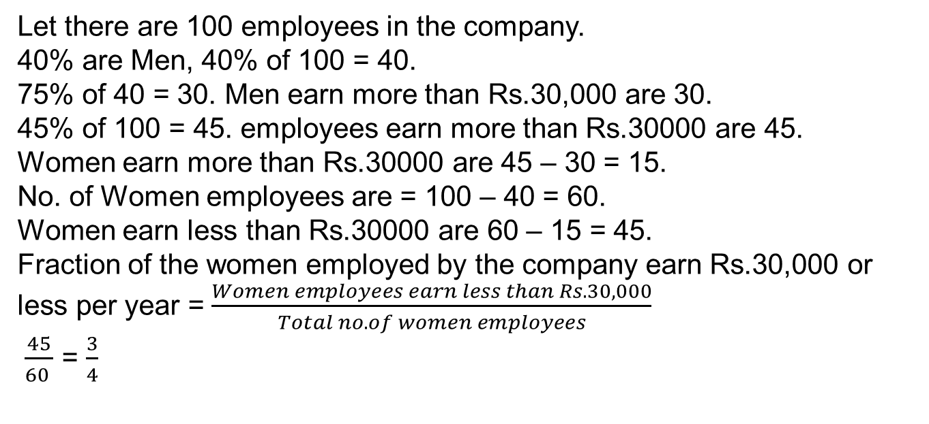
Alternate Method
Let there are 100 employees in the company.
40% are Men, 40% of 100 = 40.
75% of 40 = 30. Men earn more than Rs.30,000 are 30.
45% of 100 = 45. employees earn more than Rs.30000 are 45.
Women earn more than Rs.30000 are 45 – 30 = 15.
No. of Women employees are = 100 – 40 = 60.
Women earn less than Rs.30000 are 60 – 15 = 45.
Fraction of the women employed by the company earn Rs.30,000 or less per year = $\frac{Women employees earn less than Rs.30,000}{Total no. of women employees}$
$\frac{45}{60 }$ = $\frac{3}{4}$

Slide 16
Practice Question 4
A lady who has a certain amount with her goes to market. She can buy 50 oranges or 40 mangoes. She retains 10% of the amount for taxi fares and buys 20 mangoes and of the balance, She purchases oranges. Number of oranges she can purchase is:
Let the price of one orange be $x
Total amount the lady has = $50x
40 mangoes cost 50x, So one mango costs 1.25x
10% of the total amount is retained for taxi fare = 10% of 50x = 5x
20 mangoes bought for 20 x 1.25x = 25x
Money left with the lady = 50x – (Taxi fare) – (Mangoes cost)
= 50x – 5x – 25x = 20x
One Orange was for $x Therefore, 20 oranges can be bought with $20x. Thus, the lady bought 20 oranges.

Slide 17
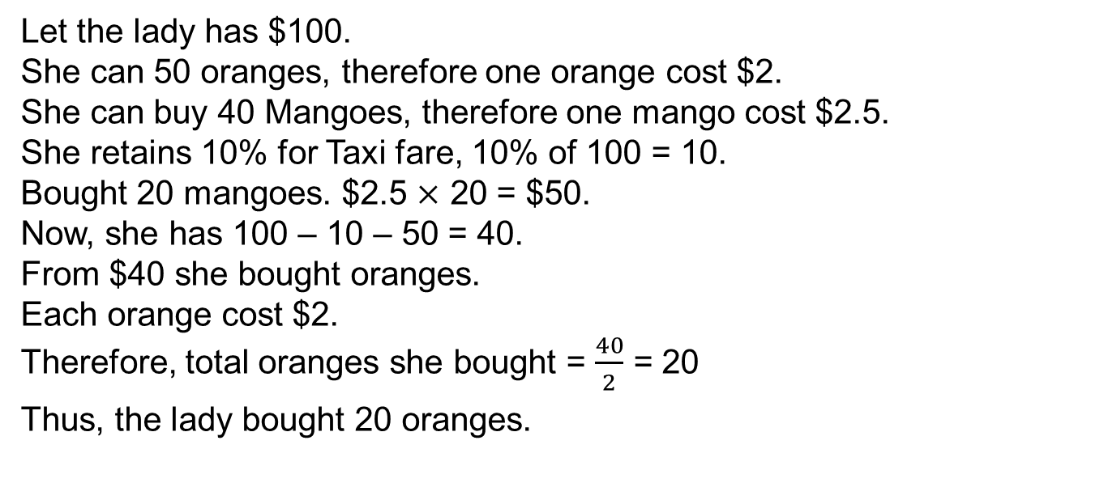
Alternate Method
Let the lady has $100.
She can 50 oranges, therefore one orange cost $2.
She can buy 40 Mangoes, therefore one mango cost $2.5.
She retains 10% for Taxi fare, 10% of 100 = 10.
Bought 20 mangoes. $2.5 $×$ 20 = $50.
Now, she has 100 – 10 – 50 = 40.
From $40 she bought oranges.
Each orange cost $2.
Therefore, total oranges she bought = $\frac{40}{2}$ = 20
Thus, the lady bought 20 oranges.

Slide 18
Practice Question 5
A candidate who gets 20% marks fails by 20 marks but another candidate who gets 42% marks gets 12% more than the passing marks. Find the maximum marks.
Let the maximum marks be x.
From the first statement passing marks is 20% of x + 20
From the given second statement pass percentage is 42%−12%=30%
20% of x + 20 = 30% of x or 30% of x – 20% of x = 20 (marks)
i.e., 10% of x = 20
(10/100) x = 20
x = (20)(10)
Therefore, x = 200 marks.
Maximum marks = 200.

Slide 19
Multiple Choice Question 1
Peter got 30 % of the maximum marks in an examination and failed by 10 marks. However, Paul who took the same examination got 40 % of the total marks and got 15 marks more than the passing marks. What were the passing marks in the examination?
(a) 75 (b) 250 (c) 85 (d) 100
Let the maximum marks be x.
From the first statement passing marks is 30% of x + 10
From the given second statement pass percentage is 40% of x - 15
40% of x - 15 = 30% of x + 10
40% of x – 30% of x = 15 + 10 (marks)
i.e., 10% of x = 25
(10/100) x = 25
x = (25)(10)
Therefore, x = 250 marks.
Maximum marks = 250.

Slide 20
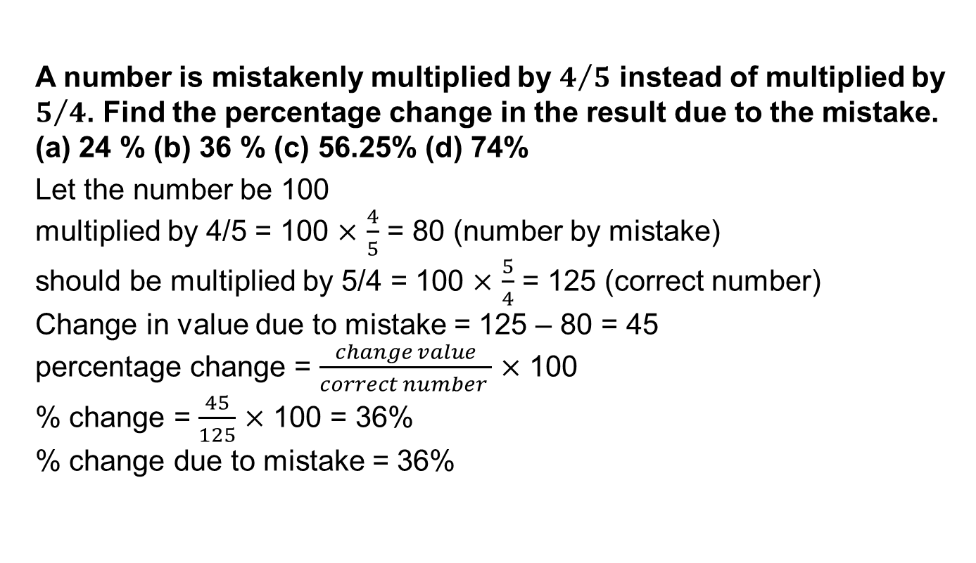
Multiple Choice Question 2
A number is mistakenly multiplied by $4/5$ instead of multiplied by $5/4$. Find the percentage change in the result due to the mistake.
(a) 24 % (b) 36 % (c) 56.25% (d) 74%
Let the number be 100
multiplied by 4/5 = 100 $×$ $\frac{4}{5}$ = 80 (number by mistake)
should be multiplied by 5/4 = 100 $×$ $\frac{5}{4}$ = 125 (correct number)
Change in value due to mistake = 125 – 80 = 45
percentage change = $\frac{change value}{correct number }$ $×$ 100
% change = $\frac{45}{125}$ $×$ 100 = 36%
% change due to mistake = 36%

Slide 21
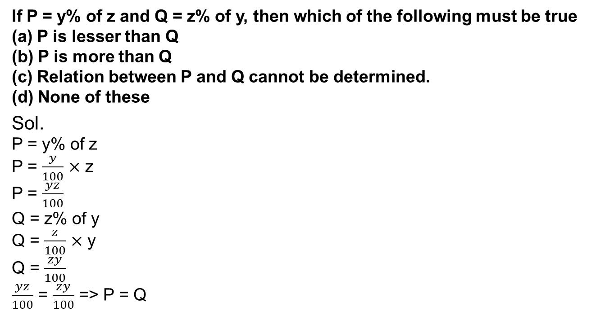
Multiple Choice Question 3
If P = y% of z and Q = z% of y, then which of the following must be true
(a) P is lesser than Q
(b) P is more than Q
(c) Relation between P and Q cannot be determined.
(d) None of these
Sol.
P = y% of z
P = $\frac{y}{100}$ $×$ z
P = $\frac{yz}{100}$
Q = z% of y
Q = $\frac{z}{100}$ $×$ y
Q = $\frac{zy}{100}$
$\frac{yz}{100}$ = $\frac{zy}{100}$ => P = Q

Slide 22
Multiple Choice Question 4
In ABC College, 65% of students are less than 20 years of age. The number of students more than 20 years of age is 2/3 of number of students of 20 years of age which is 42. What is the total number of students in the ABC College?
(a) 75 (b) 90 (c) 130 (d) 200
Sol.
Let the total number of students is x
Students less than 20 years of age = 65% => 65% of x = 0.65x
Students of 20 years of age = 42
Students more than 20 years of age = 2/3 of 42 => 28
x = 0.65x + 42 + 28
0.35x = 70
x = 200
Total number of students in ABC college is 200.

