Slide 1
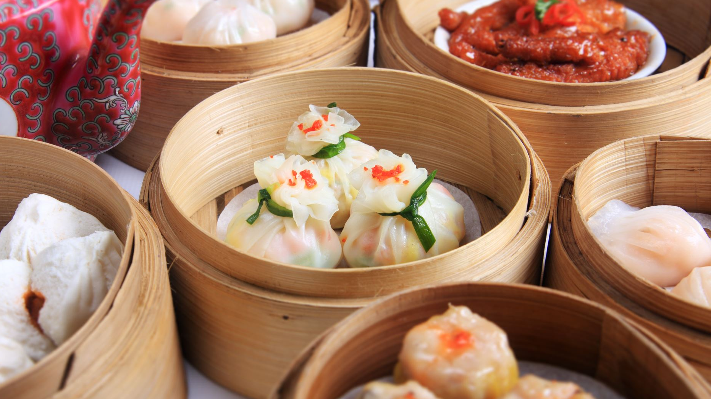
Cantonese Intensive Class (1)

Slide 2

Ice-breaking activities
-name
-interest
-favourite food

Slide 3
Learning goals
Basic knowledge about Cantonese

Slide 4
What is Cantonese
A language spoken in “Canton”（the former English name for Guangzhou 廣州 City), or Guangdong 廣東 Province1.
One of many dialects in China
Shares a similar writing system as the Chinese Language
A tonal language
There are various form of Cantonese, like the subtle differences between Cantonese in Guangzhou and Hong Kong
Full of slang and non-standard language
(Chow, 2005)

Slide 5
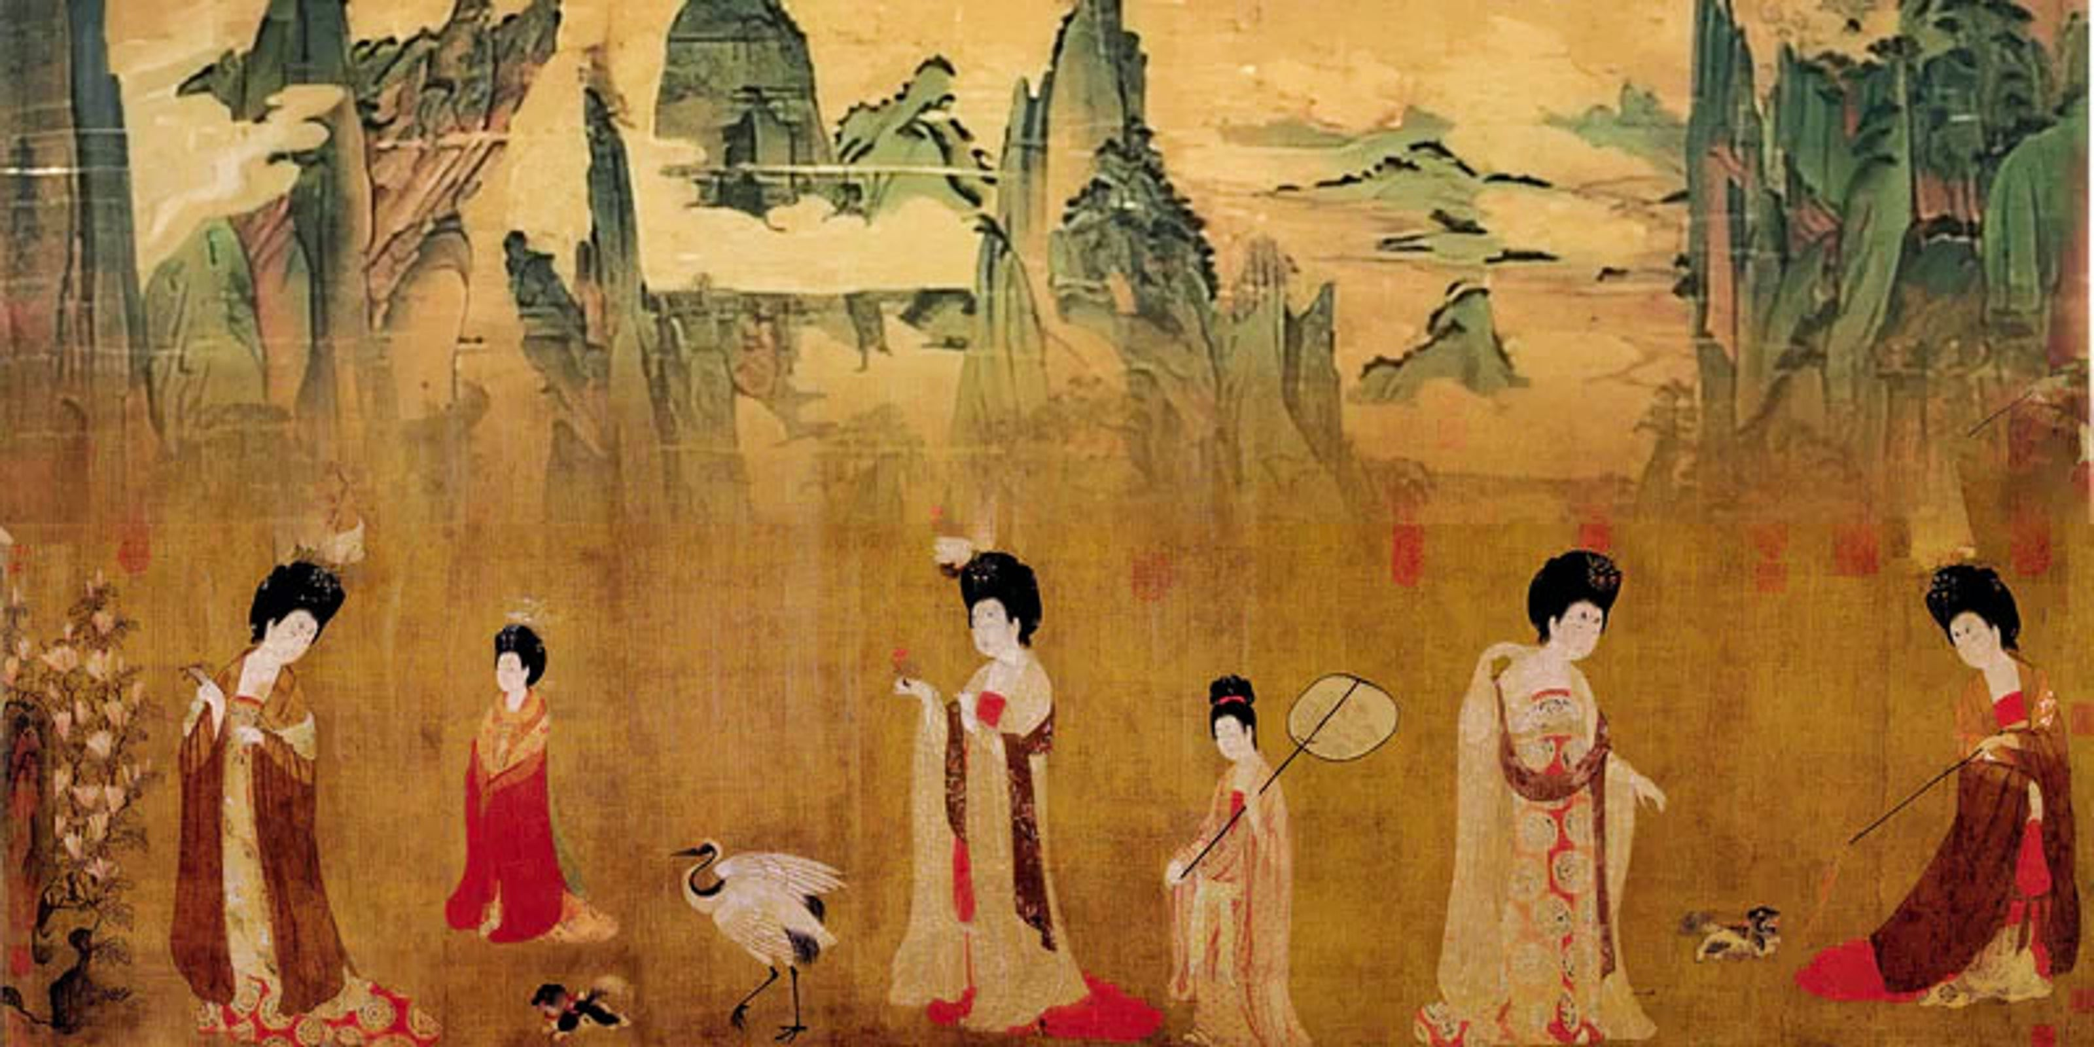
The origin of Cantonese
It was called as
  Guangdong Speech(廣東話)
  Guangzhou Speech(廣州話)
  Yue Language(粤語)
  Tang Speech(唐話)
  Plain Speech(白話)
  Hong Kong Speech(香港話)
  (Chow, 2005)
Source: Shuen Sun Collection

Slide 6
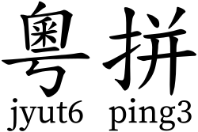
The systems for learning Cantonese
Jyutping(粵拼)
Cantonese pinyin( 廣東話拼音)
Yale Romantization(耶魯拼音)
In this lesson, we will learn Jyutping!
Reasons? Convenient, easy to learn
Source: Wikipedia

Slide 7
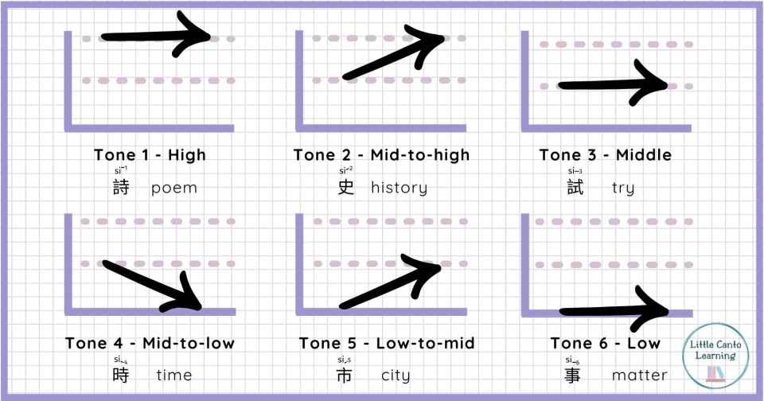
The basic structure of Jyutping
The basic structure of a word
It can be made up of
  Initial(聲母)
  Rime(韻母)
  Tone(聲調)

Slide 8
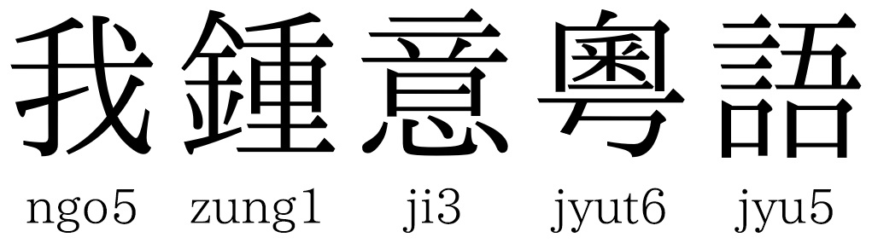
Overview on Jyutping
There are 19 initials and around 51 rimes and 6 tones
Initials + Rimes are not a must

Slide 9
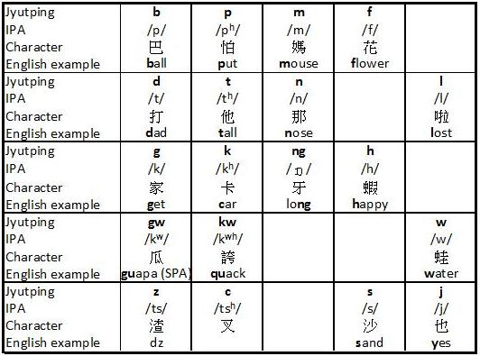
Initials
The nineteens initials in Cantonese
They can be divided into four groups:
  The aspirated initials
  The non-aspirated initials
  The three
Source: CantoneseEveryday

Slide 10
Categorization of initials
Initials
Bilabial initials
Labiodental initials
Alveolar initials
Fricative and Continuant
Glottal initials
Velar initials
B
P
m
f
D
T
N
L
F
S
h
gw
Kw
k

Slide 11
Bilabial initials: b, p, m, w
They are b, p, m
Examples of b: ball Cantonese words:
Examples of p: Paul Cantonese words:
Examples of m: mock Cantonese words: 冇
Examples of w: walk Cantonese words: 獲

Slide 12
Labiodental initials
Examples of f : fire
發火

Slide 13
Alveolar initials
They are d, t, n, l
Examples of d: dog
Examples of t: teach
Examples of n: need
Examples of l: luck

Slide 14
Velar initials: kw, gw, k, g
Examples of kw: squad
Examples of gw: ?
Examples of k: kick
Examples of g: get

Slide 15
Palatal initials : j, z
Examples of j: york
Chinese example: 一
Examples of z: joker
做

Slide 16
Glottal Initials: h
Examples of h: Hay
Examples in cantonese:
係:

Slide 17
Initials-nasal: ng
Examples of ng: bring

Slide 18
Sibilant initials: c, s
Examples of c: cheese
Examples of s: see

Slide 19
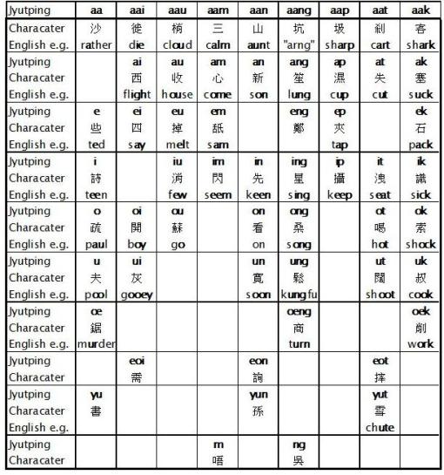
The 51 middle
Source:Cantonese Everyday

Slide 20
Tone
The six tones in Cantonese
The source of the problem?!

Slide 21
Basic rules about tones
There are nine tones in Putonghua
However, Jyutping only provides six tones.
They can be divided into two groups:
Yin/Ping: The first and the forth tone

Slide 22
Final test!

Slide 23
References
Cantonese For Everyone

