Slide 1




Welcome!
Today you will need:
*coloring pencils
*paper
*scissors

Slide 2

Take a Break!
Be Back in a few minutes!

Slide 3
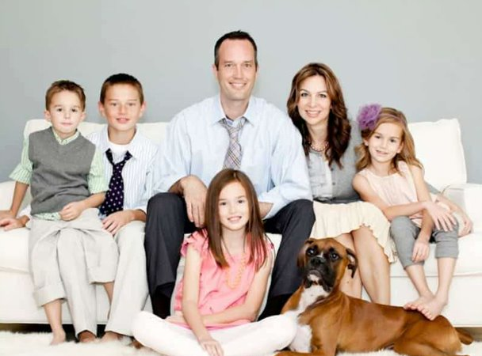

Slide 4


Mummy
Daddy

Slide 5
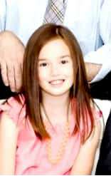



Brother / Brothers
Sister / Sisters

Slide 7





Slide 8

Are You My Mother?
Written By P.D. Eastman
Read By Misty Epperson

Slide 9
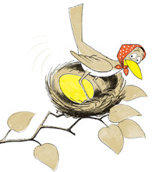
A mother bird sat on her egg. The egg jumped!

Slide 10
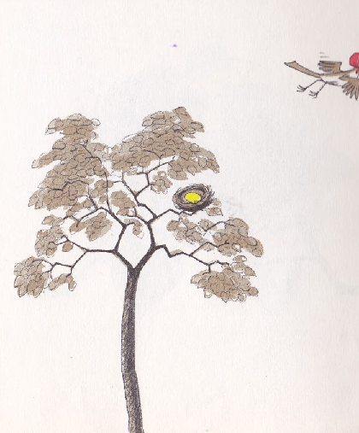
“I must get something for my baby bird to eat!” she said. So away she went.

Slide 11
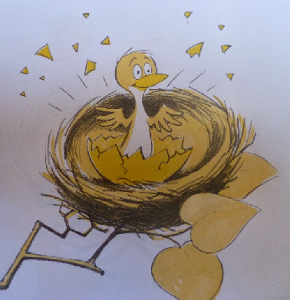
Inside the nest, the egg jumped. It jumped and jumped and jumped. Until…. Out came a baby bird!

Slide 12
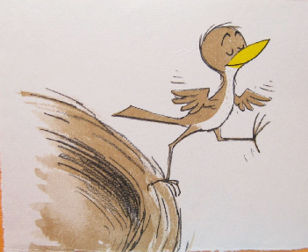
“Where is my mother? He said. He did not see her anywhere. “I will go and look for her,” he said.

Slide 13
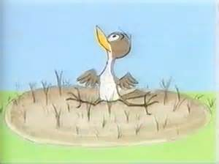
Out of the nest he went. Down, down, down! Plop!

Slide 14

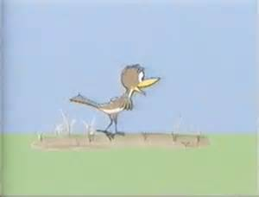
The baby bird could not fly. He could walk. “Now I will go and find my mother,” he said.

Slide 15
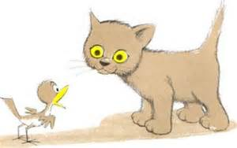
“Are you my mother?” the baby bird asked a kitten. The kitten just looked and looked. It did not say a thing.

Slide 16
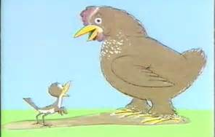
“Are you my mother?” the baby bird asked a hen. “No,” said the hen.

Slide 17
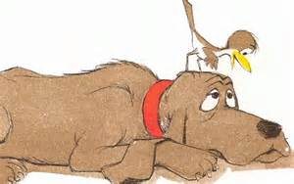
“Are you my mother?” the baby bird asked a dog. “I am not your mother. I am a dog,” said the dog.

Slide 18
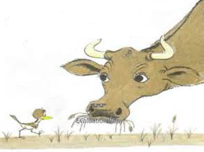
“Are you my mother?” the baby bird asked a cow. “How could I be your mother?” said the cow. “I am a cow.”

Slide 19
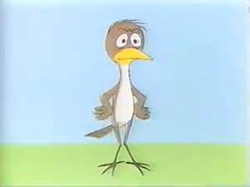
The baby bird stopped to think. The kitten and the hen were not his mother. The dog and the cow were not his mother. “I have a mother,” said the baby bird. “I know I do. I will find her. I will. I WILL!”

Slide 20
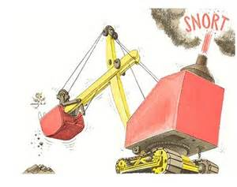
Just then the baby bird saw a big thing. “You are my mother!” he said. The big thing said, “SNORT!”

Slide 21
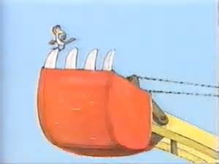
“Oh no!” said the baby bird. “You are not my mother. You are a scary Snort!” The Snort lifted the baby bird up, up, up.

Slide 22
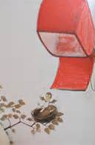
Then something happened. The Snort put the baby bird right back in the tree. The baby bird was home!

Slide 23
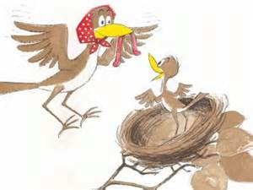
Just then the mother bird came back. “I know who you are,” said the baby bird.

Slide 24
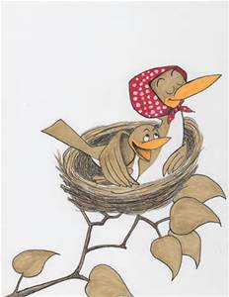
“You are not a kitten or a hen or a dog. You are not a cow or a Snort! You are a bird, and you are my mother!”

Slide 25
The End

Slide 26
First 1 Then 2

Slide 27
First 1 Then 2

Slide 28
First 1 Then 2

Slide 29
First 1 Then 2

Slide 30
First 1 Then 2

Slide 31
First 1 Then 2

