Slide 1
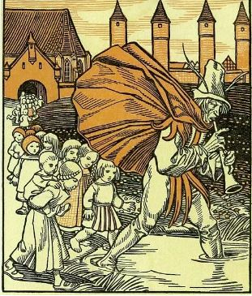


*
Strengthening Reading, Writing and Speaking Skills:
By studying celebrated fairy tales
Instructor: Andrew Ness

Slide 2
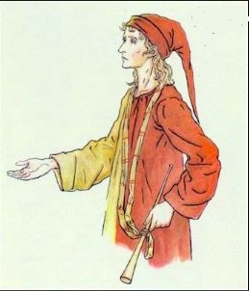
The very next day a stranger appeared in Hamelin; he was different to everyone else
The very next day a stranger appeared in Hamelin. He was different to everyone else. His clothes were colorful and seemed to come from many different places. He wore a hat covered with
feathers and shells and bones. From a long scarf hung a silver pipe. The stranger followed the carts up from the port and he saw the silos full of corn and the silos full of wheat and the mills and bakeries and shops and houses and people and rubbish and the rats.

Slide 3
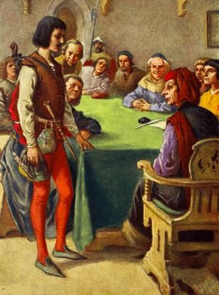
The stranger told the Mayor and his councillors that for a thousand gold guilders he could rid Hamelin of the rats that infested it.
He walked quietly to the Town Square and knocked on the big brass doors of the Town Hall. He told the Mayor and his councillors that for a thousand gold guilders he could rid Hamelin of the rats that infested it. The Mayor enthusiastically agreed and the Pied Piper stepped outside

Slide 4
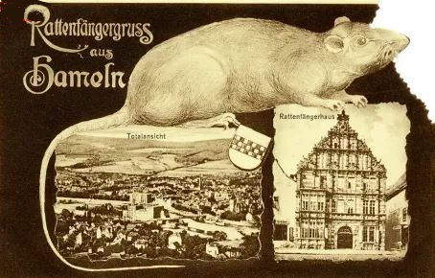
He blew a note on his silver pipe that spoke to the rats of far off places, of woods and forests and rocks and mountains.
He stood in the Square and looked quietly around. He took a deep breath and blew a note on his silver pipe that spoke to the rats of far- off places, of woods and forests and rocks and mountains. He blew another note that spoke to the rats of foxes and wolves and hawks and eagles. He blew a third note and all of the rats in Hamelin started to scurry towards the Pied Piper

Slide 5
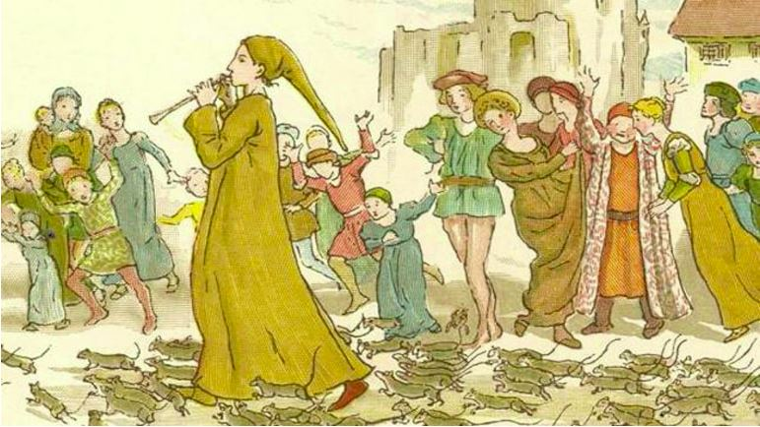
The rats scurried out of doors, out of windows, out of drains and out of holes
They scurried out of doors, out of windows, out of drains and out of holes. They scurried down the lanes and streets towards the square. Now the Pied Piper started to play a dancing tune and he danced out of the square and the rats followed along behind. They moved out of the town and towards the port

Slide 6
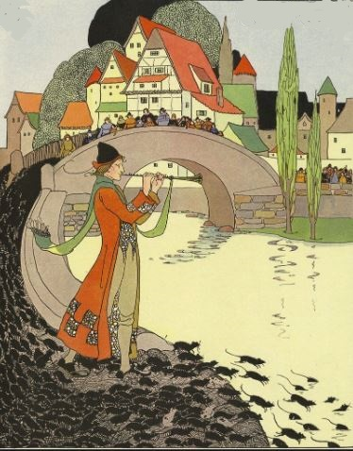
As the piper continued playing, the rats continued dancing across the wharves and into the river
At the river side the Piper stopped and he placed just one toe in the water and, as he continued playing, the rats continued dancing across the wharves and into the river. Rats by their thousands danced out of the town, across the wharves and splashed into the river where they were drowned. When the last one had disappeared beneath the waters of the river the Pied Piper stopped.

Slide 7
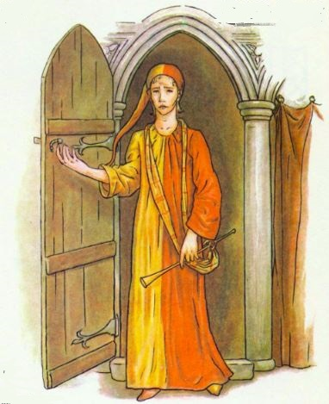
He stood quietly looking at the water for a while and then turned and walked back to the Town Square
He stood quietly looking at the water for a while and then turned and walked back to the Town Square. The good people of Hamelin were celebrating the victory against the rats. At last they were free of the pestilence.

