Slide 1

GRADE 2
Language Arts

Slide 2
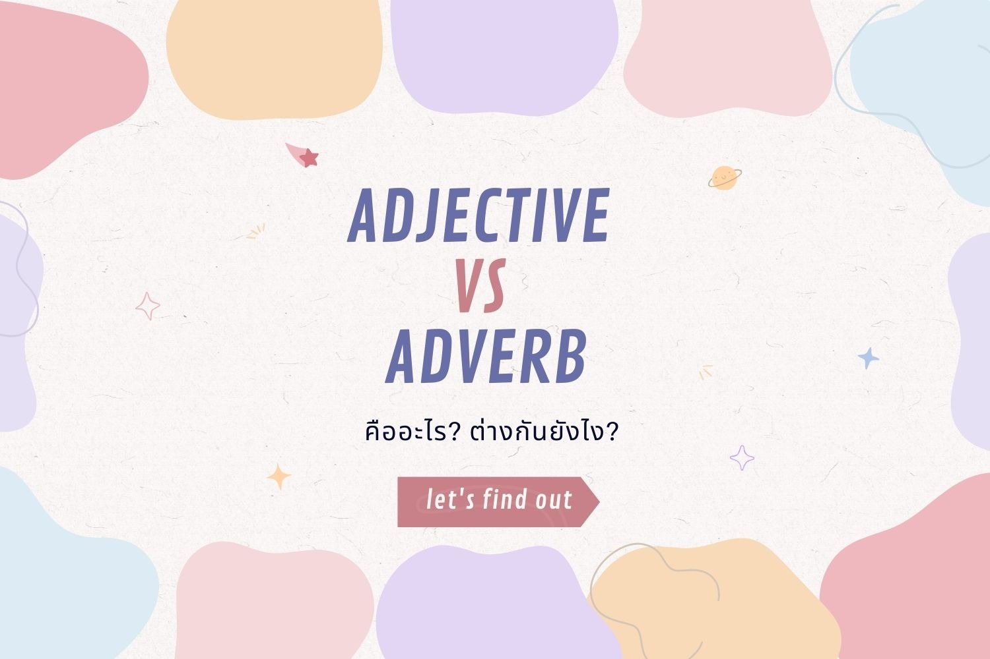

Slide 3
Adjective
An adjective is a word that describes a noun.
Comparative Adjective | Superlative Adjective
Use adjectives that end with er when comparing two nouns. | Use adjectives that end with est when comparing one noun to all the others.
example: | example:
Mel's garden is prettier than Alice's garden. | Mel's garden is the prettiest.

Slide 4
Adverb
Adverbs tell more about verbs or actions. It tells how, when, or where an action happens.
how: How did she sing? Alice sings softly.
when: When does he drink his milk? Ben drinks his milk at night.
where: Where did he hide? Tom hid under the table.

Slide 5
Activity 1
Wordwall
“Adverb or Adjective?”
(Individual Activity)
Let the students identify if the word used in the sentence is an adverb or adjective

Slide 6
Writing
Compare & Contrast

Slide 7
Compare and Contrast
Compare | Contrast
Give their similarities. (How things are the same.) | Give their differences. (How things are different.)
keywords: both alike similar the same just like also too as well as | keywords: different but however while unlike although on the other hand in contrast
example: Anna and Jane are both young. | example: Anna is tall but Jane is short.

Slide 8
Activity 2
“Build Sentences”
(Individual Activity)
List down topics and adjectives and let the students build compare and contrast sentences using the given adjectives.

Slide 9
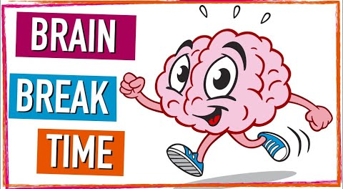

Slide 10


Slide 11
Context Clues
They are words or groups of words.
You can use them to help you know what a word means.
Definition Clues:
● Some context clues are definitions.
● They tell you what a word means.
example:
The mantle is behind the eyes of the octopus.
The mantle is a part of its body that looks like a bag.

Slide 12
Context Clues
They are words or groups of words.
You can use them to help you know what a word means.
Example Clues:
● Some context clues are examples.
● They tell you what the word is like or how it is used.
example:
Under the eyes of the octopus, there is a siphon,
which looks like a fat straw.

Slide 13
Context Clues
They are words or groups of words.
You can use them to help you know what a word means.
Explanation Clues:
● Some context clues are in the same sentence.
● They help you understand a word by how it is used in
the sentence.
example:
Each arm of the octopus has two rows of suction cups that can hold onto things.

Slide 14
Context Clues
They are words or groups of words.
You can use them to help you know what a word means.
Synonyms or Antonyms:
● Synonyms are words that mean almost the same thing.
● Antonyms are opposites.
example:
To swim, the octopus sucks in water and then spews, or squirts, the water out, and this makes it move.

Slide 15
Activity 3
Bamboozle
“Identifying Context Clues”
(Individual Activity)
Let the students identify the meaning of the underlined clues in the sentences.

