Slide 1
ACOUSTIC PHONETICS

Slide 2
ACOUSTIC PHONETICS
Study of the physical properties of speech sound.
Sound Waves – vibrations created by the vocal organs

Slide 3
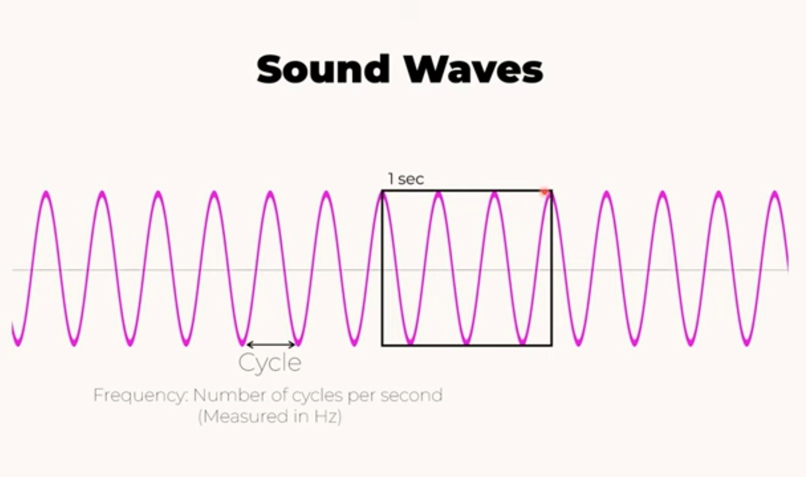
Sound Waves – measured in Hertz (Hz)
Frequency – pitch; the higher the frequency, the higher the pitch will be.

Slide 4
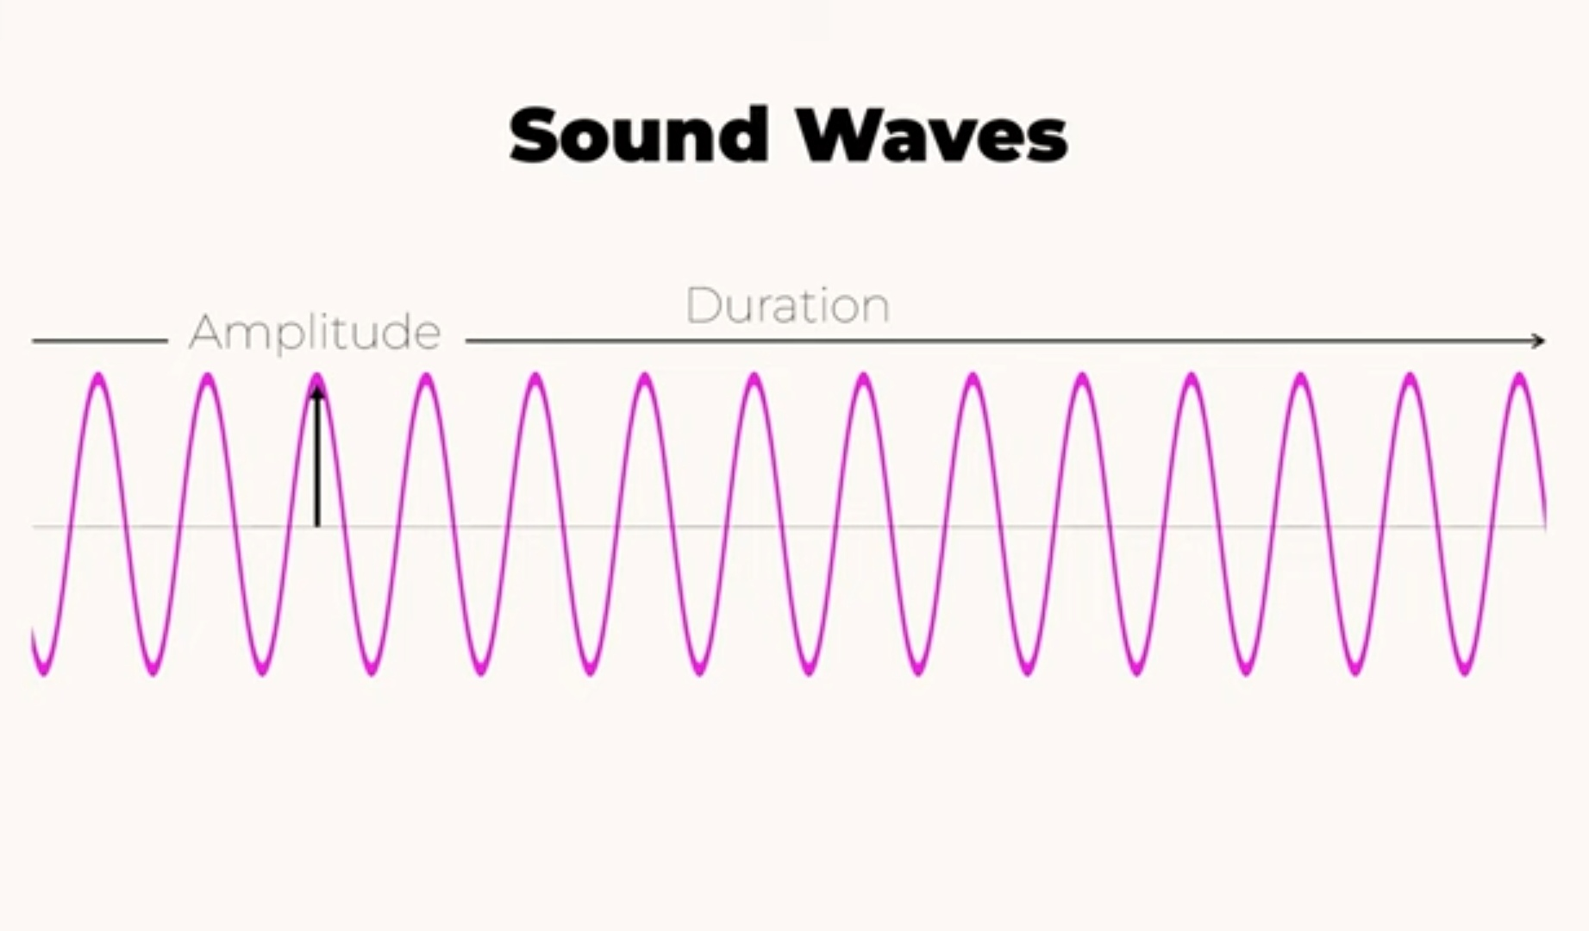
Amplitude – air pressure; loudness of a sound.
Duration – the length of time a particular sound lasts

Slide 5
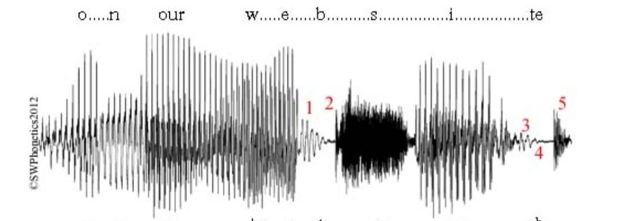
How is acoustic phonetics studied?
Waveforms – a visual representation of the variations in air pressure over time.

Slide 6
ACOUSTIC PHONETICS
Speech Properties – the physical characteristics of speech sounds
Fundamental frequency – Pitch; typically 100-120 Hz for men, 180-220 Hz for women.
Formant Frequencies – crucial for vowel quality
Amplitude – Loudness of the sound

Slide 7
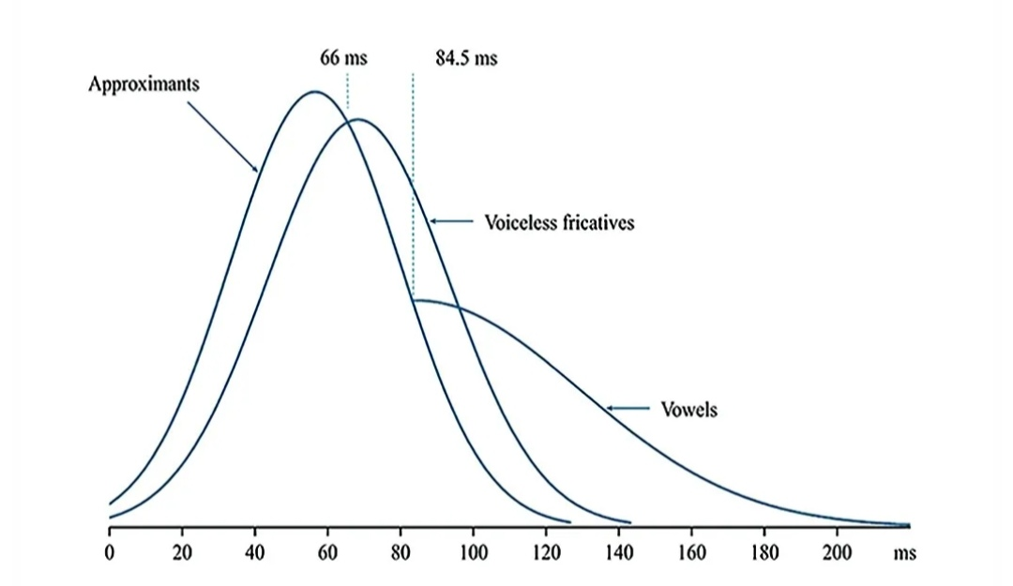
How is acoustic phonetics studied?
Acoustic Phonetic Parameters – frequency, amplitude, time, and formant.

Slide 8
1. Number of soundwave and is directly related to pitch.
a.) Amplitude
b.) Frequency
c.) Duration

Slide 9
b.) Frequency

Slide 10
2. A visual representation of the variations in air pressure over time.
a.) Duration
b.) Acoustic Phonetic Parameters
c.) Waveforms

Slide 11
c.) Waveforms

Slide 12
3. Study of the physical properties of speech sound.
a.) Frequency
b.) Acoustic Phonetics
c.) Waveforms

Slide 13
b.) Acoustic Phonetics

