Slide 1
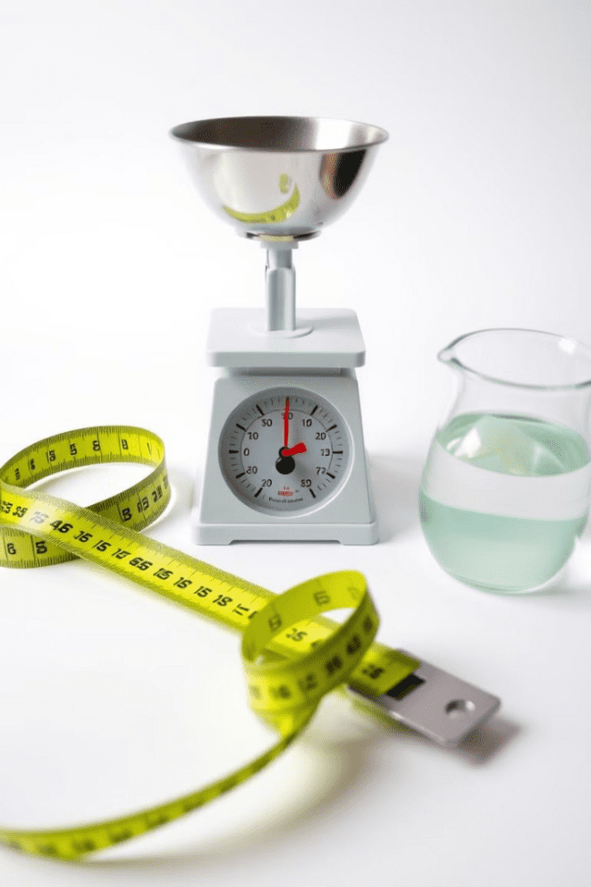

Measurement: Length, Mass, and Volume
Measurement is a fundamental concept in science, engineering, and our everyday lives. It allows us to quantify the physical properties of the world around us, enabling us to better understand and interact with our environment. In this presentation, we will explore the three primary types of measurement: length, mass, and volume, delving into their importance, units, and practical applications.
by Onwurah Onyedikachi

Slide 2
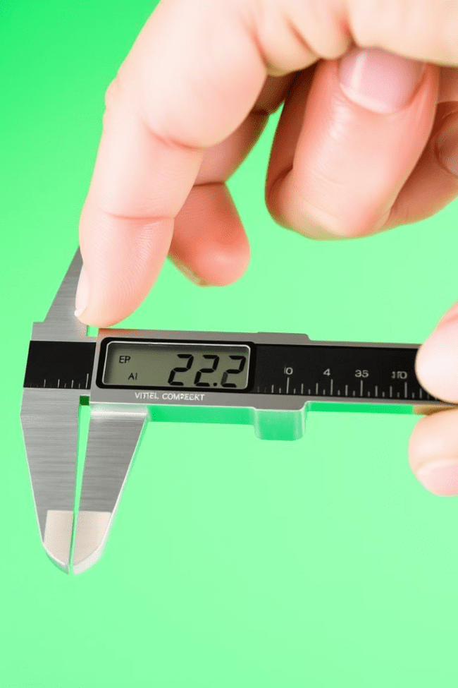

What is Measurement?
1
Quantifying Physical Properties
2
Enabling Scientific Advancement
Measurement is the process of assigning a numerical value to a physical quantity, such as the length, mass, or volume of an object. It allows us to describe and compare the physical world in a precise and standardized manner.
Accurate measurement is essential for scientific research, as it provides the data needed to test hypotheses, make observations, and draw conclusions. It underpins the development of new technologies and the advancement of knowledge.
3
Practical Applications
Measurement plays a crucial role in everyday life, from cooking and construction to transportation and commerce. It ensures consistency, accuracy, and fairness in various activities and transactions.

Slide 3

Measuring Length
Direct Measurement
Digital Measurement
The most common method of measuring length is to use a ruler or tape measure, which provides a direct comparison between the object and a standardized scale.
Modern technology has introduced digital tools like laser distance meters and ultrasonic sensors, which can provide highly accurate and precise length measurements, even for complex or hard-to-reach objects.
1
2
3
Indirect Measurement
In some cases, indirect methods may be used, such as triangulation or the use of specialized instruments like calipers or micrometers, to measure lengths that are not easily accessible or too small to be directly measured.

Slide 4

Units of Length
Metric System
Imperial System
Conversion Factors
The metric system is the most widely used system of measurement for length, with the primary unit being the meter (m). Smaller units include the centimeter (cm), millimeter (mm), and micrometer (μm).
The imperial system, commonly used in the United States, measures length in units such as inches (in), feet (ft), yards (yd), and miles (mi). These units have a less straightforward relationship to each other compared to the metric system.
Understanding the conversion factors between metric and imperial units is essential for accurately converting measurements and ensuring consistency in various applications, such as engineering, construction, and international trade.

Slide 5
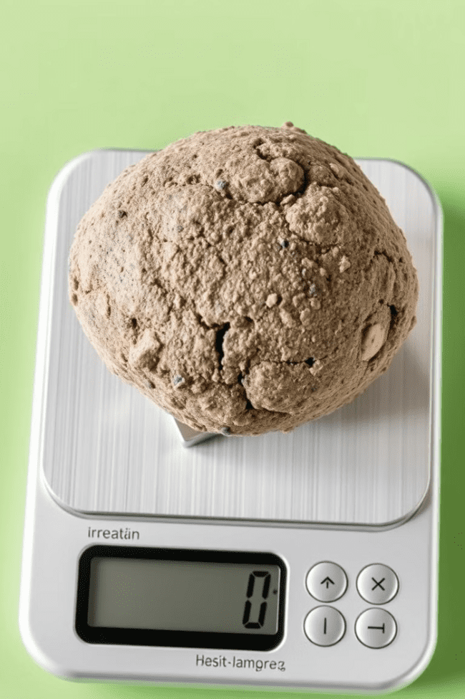
Measuring Mass
Direct Measurement
Indirect Measurement
Mass is typically measured using a scale or balance, which directly compares the weight of an object to a known standard. This method provides an accurate and reliable way to determine the mass of an object.
In some cases, indirect methods may be used to estimate the mass of an object, such as by measuring its volume and density or using specialized instruments like force sensors or load cells.
Calibration and Accuracy
Ensuring the accuracy of mass measurements is crucial, as it affects various applications, from scientific research to commercial transactions. Regular calibration of measuring instruments and understanding their limitations are essential for obtaining reliable mass measurements.

Slide 6




Units of Mass
Gram (g)
Ounce (oz)
Pound (lb)
Metric Ton (t)
The gram is the primary unit of mass in the metric system, used to measure the mass of smaller objects. Larger metric units include the kilogram (kg) and the metric ton (t).
The ounce is a unit of mass in the imperial system, commonly used to measure the mass of food and other small objects. It is a part of the pound (lb) system.
The pound is the primary unit of mass in the imperial system, used to measure the mass of larger objects. It is a widely used unit in the United States and other countries that have not fully adopted the metric system.
The metric ton is a larger unit of mass in the metric system, used to measure the mass of very heavy objects, such as cargo, vehicles, and large machinery.

Slide 7




Measuring Volume
Direct Measurement
Volume is typically measured using a graduated container, such as a beaker or a graduated cylinder, which provides a direct reading of the volume of a liquid or a solid object.
Indirect Measurement
In some cases, the volume of an object can be determined indirectly by measuring its dimensions and calculating the volume using geometric formulas, or by measuring the volume of water displaced by the object.
Specialized Techniques
For more complex or irregular-shaped objects, specialized techniques like water displacement or gas pycnometry may be used to accurately measure their volume.

Slide 8

Units of Volume
Liter (L)
The primary unit of volume in the metric system, used to measure the volume of liquids and gases.
Milliliter (mL)
A smaller unit of volume in the metric system, commonly used to measure the volume of smaller quantities of liquids.
Gallon (gal)
A unit of volume in the imperial system, primarily used to measure the volume of liquids, such as fuel and water.
Fluid Ounce (fl oz)
A unit of volume in the imperial system, used to measure the volume of smaller quantities of liquids, such as in cooking and beverages.

