Slide 1
Topic.4: Chemical Bonding and Structure

Slide 2
4.2 - Covalent Bonding

Slide 3
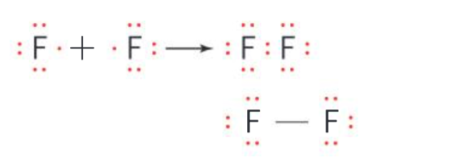
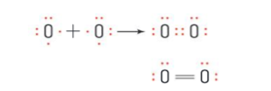
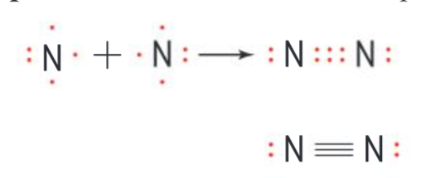
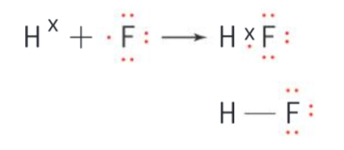
Definition and Lewis Structure:
Definition: Formed by the electrostatic attraction between a shared pair of electrons and the positively charged nuclei. Usually occurs with non-metals. Aim is to make a full outer shell.
  Lewis structure: a simple and convenient method of representing the valence electrons(outer shell of an element)
  Octet rule: most atoms form a stable arrangement with eight electrons in their outer shell.
  eg: F2, O2, N2, and HF
Fluorine (F2) : Group 17 - one more electron | Oxygen (O2): Group 16 - two more electrons | Nitrogen (N2): Group 15 - three more electrons | Hydrogen Fluoride (HF)
Shares one or more electrons to complete octet rule | Shares two electrons to complete octet rule | Shares three electrons to complete octet rule | Shares one more electron to complete octet rule
N.B: six non-bonding pairs of electrons (lone pairs) and one bonding pair of electrons). Single bond | N.B: four non-bonding pairs of e and two bonding pairs of e. Double bond | N.B: two non-bonding pairs of e and three bonding pairs of e. Triple bond | N.B: Hydrogen does not acquire octet rule. Can hold a maximum of two electrons in its valence level. Single b.

Slide 4
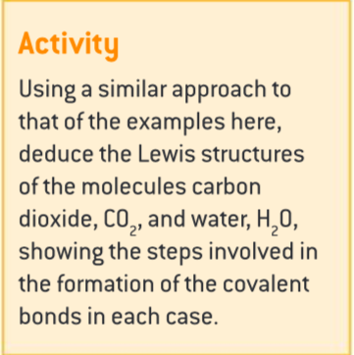
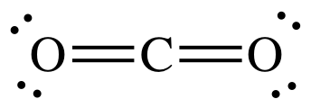
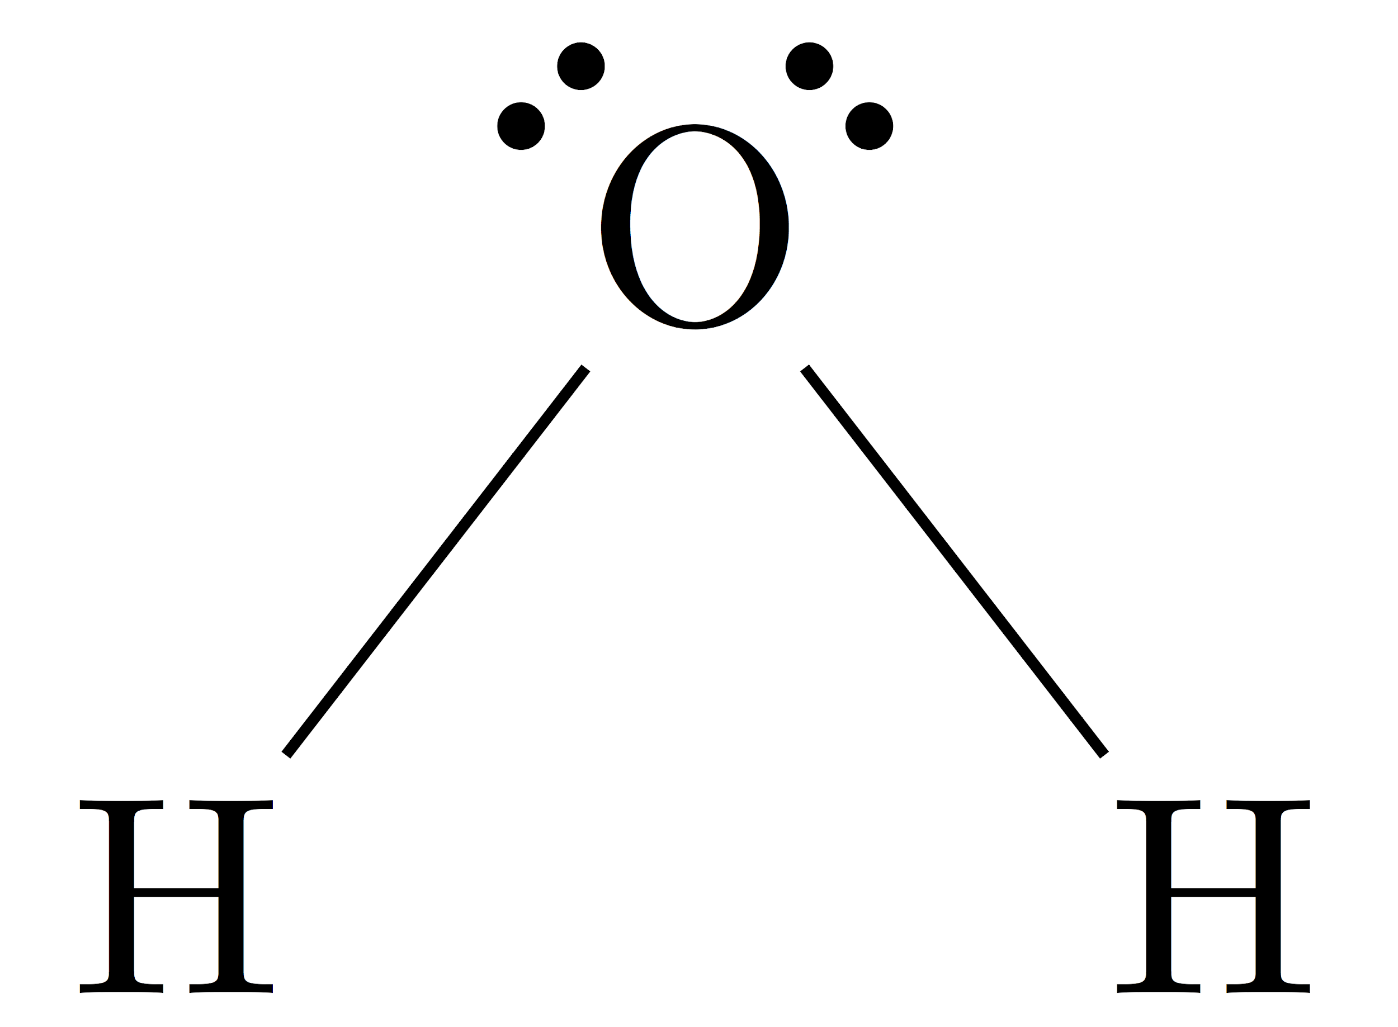
Quick Quiz: Lewis structure for CO2 & H2O
Solution:
Calculate the number of valence electrons
C- 4 electrons
O- 6 electrons
Therefore = 4 +6(2) = 16 electrons = 8 paired electrons
Carbon can have total four bonds & Oxygen can have two bonds
Calculate the number of valence electrons
H- 1 electron
O- 6 electrons
Therefore = 1(2) +6 = 8 electrons = 4 paired electrons
Hydrogen can have one bond & Oxygen can have two bonds
Bent shape - VSPER theory

Slide 5
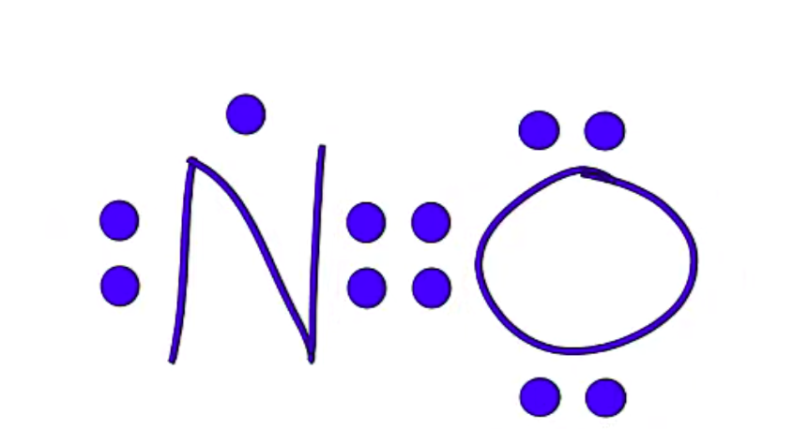
Exceptions to Octet rules: (Formal Charge)
Less than an octet - BeCl2 , BF3 (central atom very small), H (2 electrons and complete the noble gas configuration), He
Expanded octet - PCl5, Sf6 (central atom from third period or beyond), Xe, Br
Al & B only needs six valence electrons (formal charge-> best structure)
Odd Electron Compound: N
  eg) NO

Slide 6
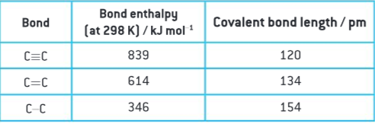
Bond Strength and Bond Length:
Three bonds for Covalent bonding: Single, Double, Triple
  Bond Strength Trend: Triple > Double > Single
  Bond Length Trend: Single > Double > Triple
(Table 10 of the data booklet shows the bond enthalpy which will be discussed in sub-topic 5.3. )

Slide 7

Bond angles in molecular geometries:
Lone pairs of electrons affect the bond angles in a molecule. Lone pairs occupy more space than bonding pairs, so they decrease the bond angle between bonding pairs.

Slide 8
Coordinate Covalent Bonding:
Definition: Another type of covalent bonding that is the shared pair of electrons comes from only one of the two atoms; this atom donates both electrons to the shared pair. = Only one of the two atoms shares the pair of electrons (donate both electrons).
    Examples of Coordinate Covalent Bonding:
      (NH4)+
      (H3O)+
      CO
      Al2Cl6
      The transition metal complexes (discussed in topic 13)

