Slide 1
Radioactivity

Slide 2
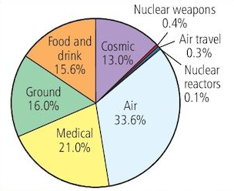
Radioactivity around us
When we use a Geiger counter, it clicks even without a radioactive source near it.
This is due to the background radiations from radioactive substances found naturally around us
Video

Slide 3
Why are some substances radioactive?
Every atom has a nucleus made up of proton and neutron
Electrons move about in the space surrounding the nucleus
Most atoms have stable nucleus that doesn’t change
But the atoms of a radioactive substance have a nucleus that is unstable
It becomes stable by emitting alpha, beta or gamma radiation
We say a unstable nucleus decays when it remits radiation
We cant say when an unstable nucleus will decay
It is random event that can happen without anything being done to the nucleus

Slide 4
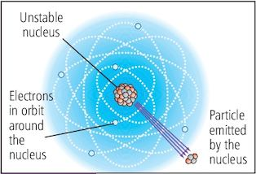

Slide 5
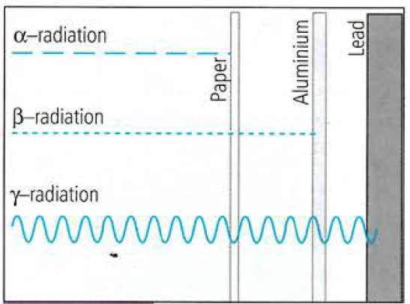
Investigating the properties of alpha, beta and gamma radiation
To test different material: We place different kind of material between the radioactive source and Geiger tube
To test the range: the Geiger tube is moved away from the source, till it can detect radiation

Slide 6
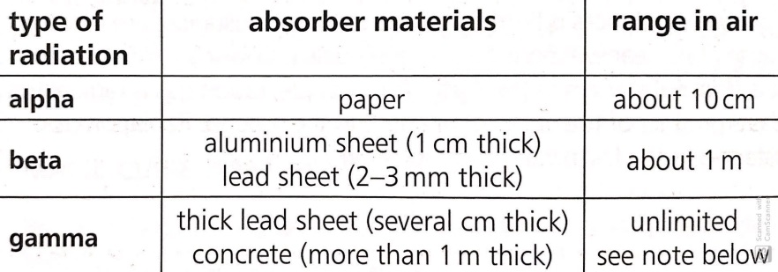
The table below shows the result of the test

Slide 7
What are alpha, beta and gamma radiation?
Alpha radiation consists of
  two protons and two neutrons
  so it is positively charged
Beta radiation consists of
  1 Electron
  so it is negatively charged
Gamma radiation is electromagnetic radiation and has no charge
    Video

Slide 8
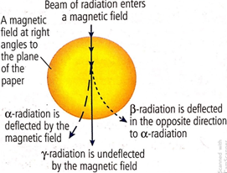
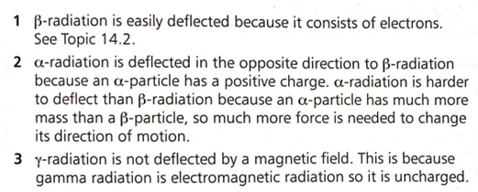
Deflection of radiations in magnetic field
Video

Slide 9
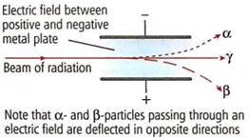
Deflection of radiations in electric field
Video

Slide 10
Ionisation
The radiations from radioactive substance knocks electrons out of atoms.
The atoms become charged as a result.
The process is called ionization
Alpha radiation had much greater ionizing effect than beta radiation, which has a much greater ionizing effect than gamma radiation
Note: Ionization in a living cell can damage or kill the cell. Damage to the gene in a cell can be passes on if the cell generates more cells.
Video

Slide 11
Ionization: Comparison of Radiations
Alpha radiation has much greater ionising effect than beta radiation. This because an alpha particle has much more mass than the beta particle and moves more slowly, so it has much more effect on the atoms it encounters
Beta radiation had a greater effect then gamma radiation because beta particle are charged whereas gamma radiation is uncharged

Slide 12
What is a Nuclide (Isotope)?
Every atom of any particular element always has
  same number of protons in its nucleus
  the number of neutron may differ
Each type are called nuclide
Since the number of protons are the same they are called nuclide (or isotopes)of the same element
For Eg
  Uranium (Protons= 92; Neutrons= 146) Some have 3 fewer neutrons
  Carbon (Protons=6, Neurons= 6 almost always) A very tiny proportion has 8 neutron

Slide 13
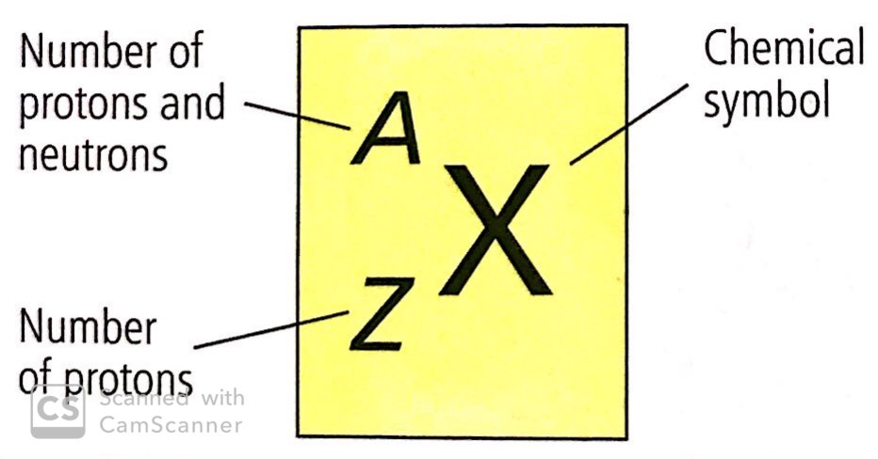
Atomic Number (Z): Proton number
  Charge of nucleus= Z x charge of a proton
Mass Number (A): Sum of the number of proton and neutron
  Since mass of proton is almost equal to the mass of neutron, so
  Mass of nucleus = A x mass of proton

Slide 14
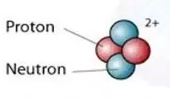

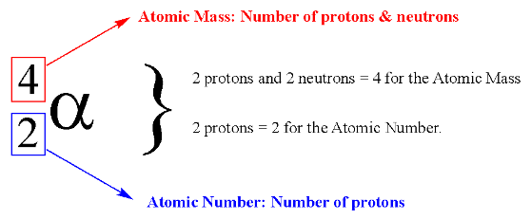
Symbol for alpha radiation
Alpha radiation, is a particle with 2 protons and 2 neutrons
Symbol for alpha particle:

Slide 15
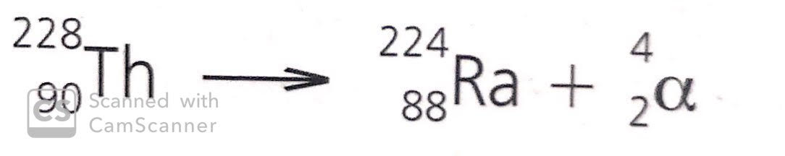
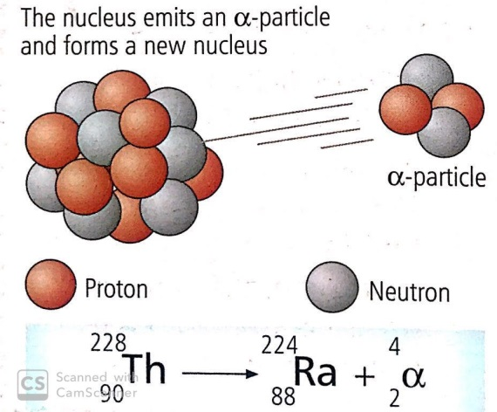
When alpha particle is emitted from an unstable nucleus
The nucleus loses 2 protons and 2 neutrons. Therefore
  The proton number decreases by 2 and its mass number decreases by 4
  It becomes a different element because it loses 2 protons
  Example:
  Total atomic number and mass number is
  the same before and after the change

Slide 16

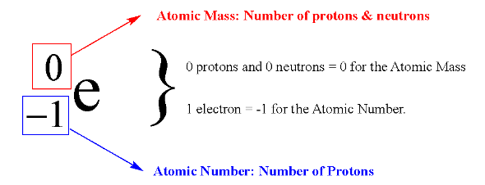

Symbol for beta radiation
A Beta radiation consists of single electron
Symbol for beta particle:
Z=-1 (its charge is equal and opposite to that of a proton)
A= 0 (it does not contain any proton or neutron

Slide 17
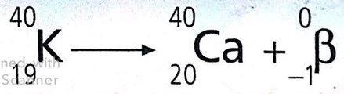
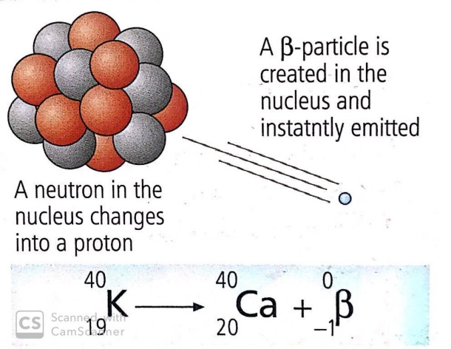
When a beta particle is emitted from an unstable nucleus
A neutron in the nucleus changes to proton, therefore
  Atomic number is increased by 1
  Mass number stays the same as the number of proton and neutron remains the same.
  It becomes a different element because proton is increased by 1
  Example:
    Calculate the no of proton and neutron before and after
    the change
  Atomic number changes but the atomic mass stays
  the same before and after the change

Slide 18
Gamma radiation
Is a high energy electromagnetic radiation
After an unstable nucleus has emitted alpha or beta particle, it sometimes has surplus energy.
It emits this energy as a gamma radiation

Slide 19
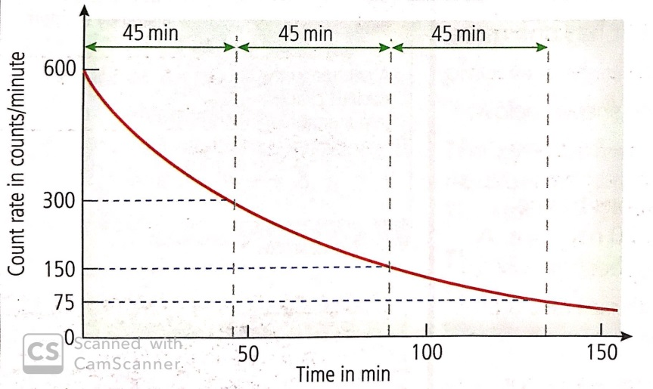
We can use the Geiger counter to monitor the activity of a radioactive sample
(take care to subtract the background count rate to obtain the count rate due to sample)
Refer the figure, counts per minute (cpm) falls from
  600 cpm to 300 cpm in first 45 mins
  300 cpm to 150 cpm in the next 45 mins
The time taken for the count to fall by half Is always the same. This time is called the half-time

