Slide 1
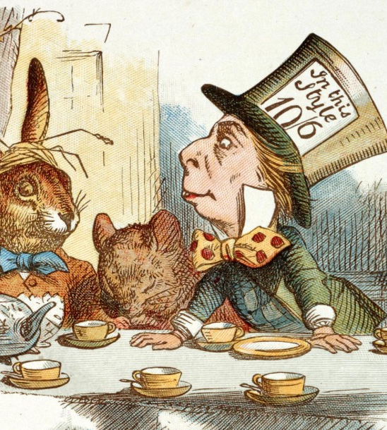

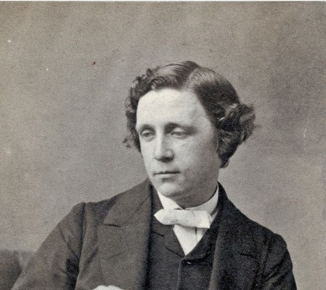
Honing Skills in Reading, Writing and Self Expression
Oedipus and the Sphinx
Instructor: Andrew Ness

Slide 2
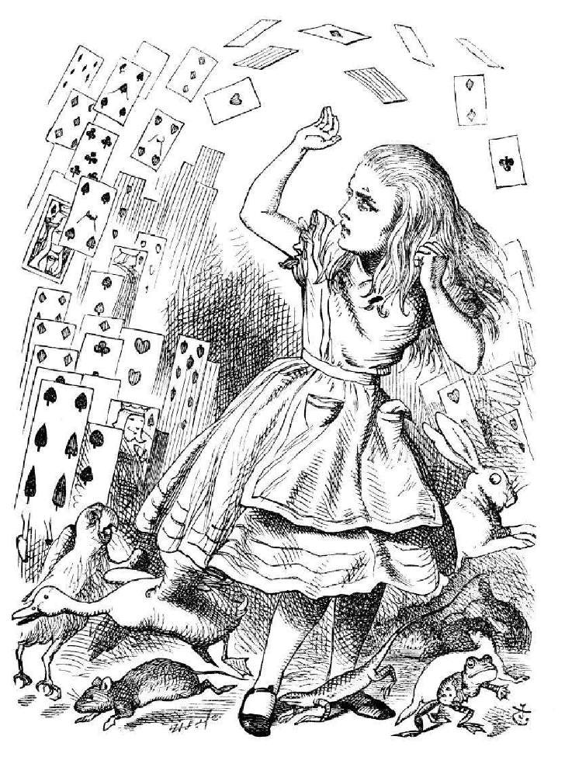
Alice
Alice is a sensible seven year old girl from a wealthy English family who finds herself in a strange world ruled by imagination and fantasy. Alice feels comfortable with her identity and has a strong sense that her environment is comprised of clear, logical, and consistent rules and features.
Alice believes that the world is orderly and stable, but Wonderland challenges and frustrates her perceptions of the world .

Slide 3

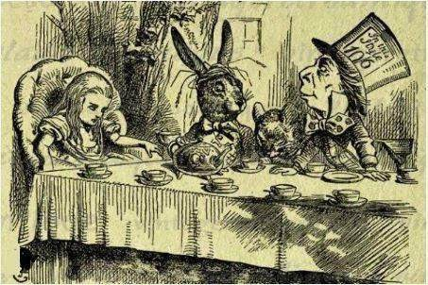
There was a table set out under a tree in front of the house
There was a table set under tree in front of the house, and the March Hare and the Hatter were having tea at it: a Dormouse was sitting between them, fast asleep, and the other two were using it as a cushion, resting their elbows on it, and talking over its head. “Very uncomfortable for the Dormouse,” thought Alice; “only, as it’s asleep, I suppose it doesn’t mind.”

Slide 4
Class discussion
How does the opening scene in the Mad Tea Party, in which the dormouse is used as a cushion by two other characters, support the assertion that the March Hare and the Mad
Hatter are little more than “aggressive nodes of selfhood.”
1. There is no tenderness in Carroll’s characters, all are sharp, forceful personalities, nodes of aggressive selfhood. The Alice books are glutted with rules of behavior, which pop up at unpredictable moments, but are mostly not observed

Slide 5
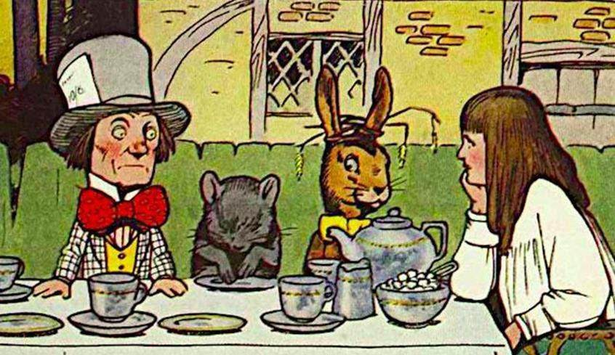
The table was a large one, but the three were all crowded together at one corner of it
The table was a large one, but the three were all crowded together at one corner of it: “No room! No room!” they cried out when they saw Alice coming. “There’s plenty of room!” said Alice indignantly, and she sat down in a large arm-chair at one end of the table.

Slide 6
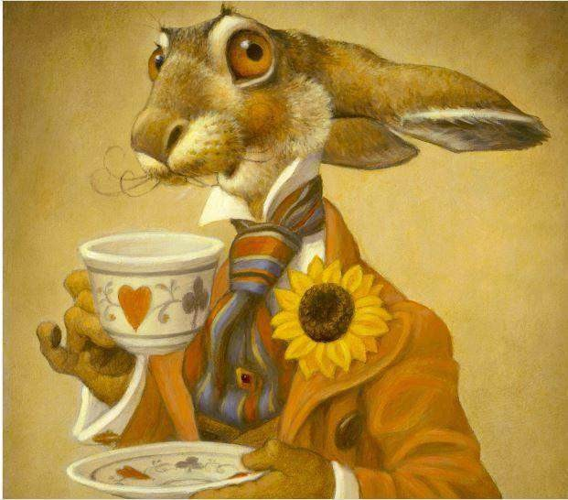
“Have some wine,” said the March Hare in
an encouraging tone
“Have some wine,” the March Hare said in an encouraging tone.
Alice looked all round the table, but there was nothing on it but
tea. “I don’t see any wine,” she remarked.
“There isn’t any,” said the March Hare.
“Then it wasn’t very civil of you to offer it,” said Alice angrily.
“It wasn’t very civil of you to sit down without being invited,” said
the March Hare.
“I didn’t know it was your table,” said Alice; “it’s laid for a great many more than three.”

Slide 7
Class discussion
When the March Hare offers Alice some wine and she becomes angry when she notes that there is no wine on the table, what is Lewis Carroll’s underlying joke about March Hare’s “display of good manners”?
3. The Alice books are a din of creatures, speaking as uncompromising social hierarchs. Hence, their display of “good manners” is purely artificial. At the tea party showing good manner is merely the display of the principle of decorum, which is nothing more than the public language of hierarchy.

Slide 8
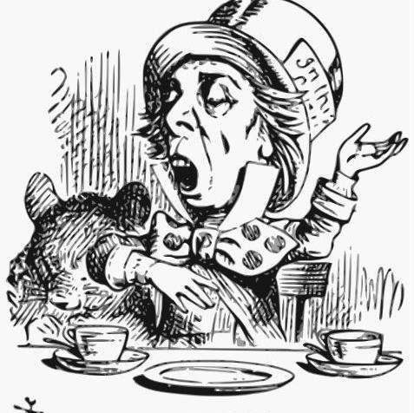
“Your hair wants cutting,” said the Hatter
“Your hair wants cutting,” said the Hatter. He had been looking at Alice for some time with great curiosity, and this was his first speech.
“You should learn not to make personal remarks,” Alice said with some severity; “it’s very rude.”

Slide 9
Class discussion
When the Mad Hatter addresses Alice for the first time and ventures to make the remark “Your hair wants cutting,” what was his intention in saying this and how would you
characterize Alice’s response?
4. All of Lewis Carroll’s characters speak as uncompromising social hierarchs. Any display of manners at the Tea Party is nothing more than an expression of the relations of status - a symbolic pantomime of mastery on the one hand and subservience on the other.

