Slide 1
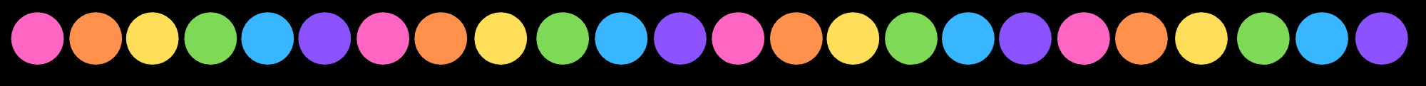

English

Slide 2

LO: To improve our writing by using conjunctions to extend sentences.

Slide 3
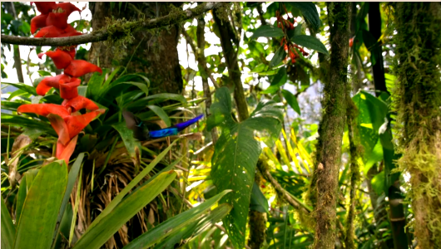
Let’s meet some hummingbirds
What do you already know about this amazing animal?
Click to watch…
Notes:
https://www.naturalcurriculum.co.uk/grammar/year-4-grammar-lessons/conjunctions-when-if-because-although/hummingbird/screen-1/

Slide 4
Can you list some words that accurately describe the hummingbirds’ behaviour?
Vicious
Sneaky
Bully
Cheeky
Rough
Aggressive
Savage
Quick
Rapid
Fighters
Speedy
Protective
Notes:
https://www.naturalcurriculum.co.uk/grammar/year-4-grammar-lessons/conjunctions-when-if-because-although/hummingbird/screen-1/

Slide 5

Comparing sentences
The wedge-billed hummingbird looks enchanting. Its behaviour is criminal.
Although the wedge-billed hummingbird looks enchanting, its behaviour is criminal.
Which of these is more effective and why?
Can you identify the subordinating conjunction?

Slide 6
Using conjunctions in sentences
Notice how the sentences below have been extended to include more than one clause (or section).
The words in bold are subordinating conjunctions and we can use them to add extra information to our sentences which make them more interesting.
Hummingbirds must compete with each other when plants produce nectar.
Each species has its own unique tactics to get the nectar because there isn’t enough for everyone.
If a hummingbird gets stung by a bee, it could be fatal.

Slide 7
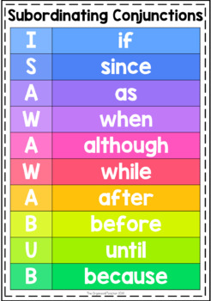
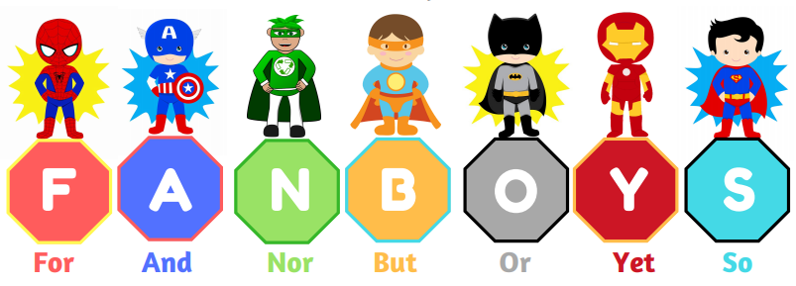
Mi ld | Add a conjunction to extend these sentences.
 | The hummingbirds look cute _____ they are vicious fighters. ______ the hummingbirds are competing for nectar, they show no mercy.
Med | Extend these sentence using a conjunction to add more detail.
 | Their brightly coloured feathers shine in the sunlight… Their rapidly beating wings…

Slide 8
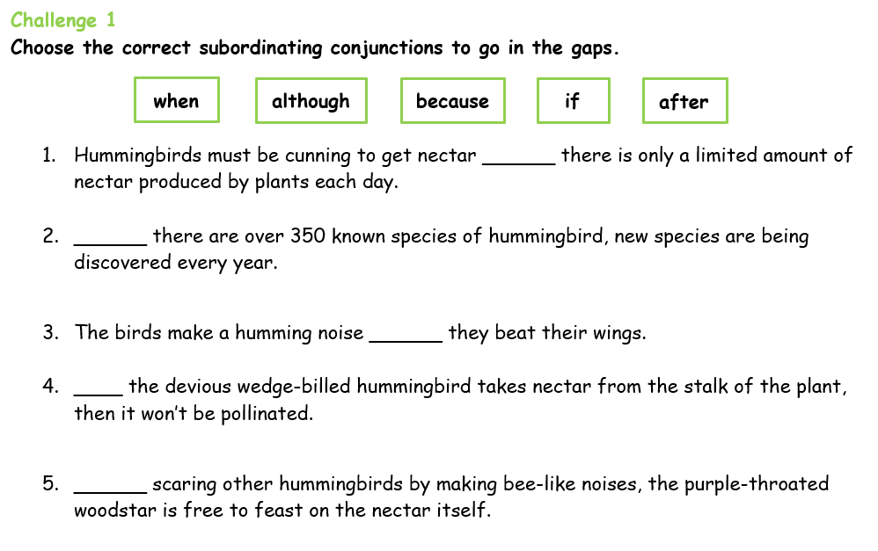
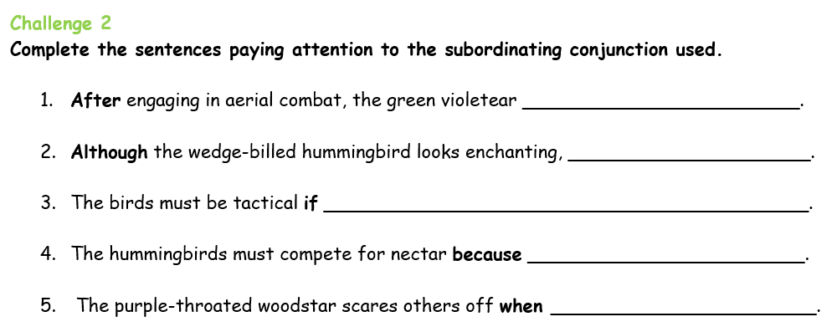
Go to your Google Classroom and choose a challenge to complete.

