Slide 1
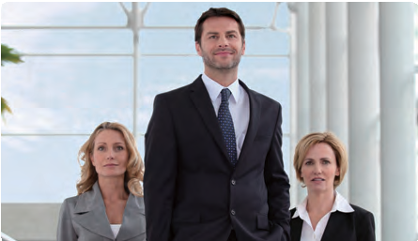
Welcoming
Visitors
Lesson
01
Learning Objectives
Upon completion of this lesson, you will be able to…
» greet and guide visitors to your company
» introduce yourself, the company and your colleagues
Overview
Getting Started
Language Practice
Situation & Dialogue
Case Scenarios
Business Basics
1 Getting Started
A B
Let's look at the image.
Discuss the following questions.
What can you do or say to make a visitor feel wel- comed at your company?
Describe the image in your own words for at least one minute.
How can you address a person when you meet them
for the first time at a business setting?
How do greetings differ in formal and informal set- tings?
Common Mistakes
Which is right?
Check the answers and explanations in the back of the book.
Everyone were/was convinced that he would win the negotiation.
I think every person in this room is/are happy.
Everybody have/has memories of their first love.

Slide 2







Lesson 01 / Welcoming Visitors 11
2 Language Practice
Business Expressions
Read the expressions and write your own sentence using the expression.
go the extra mile : to do more than one is required to do to reach a goal. Ex) I like doing business with that company; they always go the extra mile. Make your own:
back to square one : if you are back to square one, you have to start working on a plan from the beginning. Ex) I thought everything was setled, but now my clients say they’re not happy with the deal, so I’m back to square one. Make your own:
take matters into your own hands : to deal with a problem yourself because the people who should have dealt with
it have failed to do so.
Ex) Because Nick wasn’t able to finish the project on time, his boss decided to take maters into his own hands.
Make your own:
Key Patterns
Here are some key patterns that you can use when welcoming visitors or as a visitor.
I’m in charge of...
the R&D department
product marketing and advertising
the international cooperation team
Allow me to...
direct you to the waiting area
confirm your appointment
pass on your details
Could you direct me to...?
the HR office
the nearest restroom
the manager of this department
3
Situation & Dialogue
Quote
A
Answer the following questions using the information given below.
of the Day!
01 Look at the characters and describe the situation. 02 What is the relationship between the characters? 03 What do you think will happen next?
"A business that makes nothing but money is a poor business."
Henry Ford
Mr. Andes
In charge of the marketing department of Speed Tele- com. Company
"There are no secrets to success. It is the result of preparation, hard work, and learning from failure."
MISSION
Ask Mr. Smith who he is looking for and introduce Mr. Smith to Mr. Jones,
the new CTO of the company.
Colin Powell
Mr. Smith
An investor of Speed Telecom. Company
What does success mean to you?
What do you think are the "must-have qualities" to be successful? Make a list and share.
Do you think money always follows success? Why or why not?
MISSION
When Mr. Andes asks why you’re here, tell him you’re here for a busi-
ness meeting.
Mr. Jones
When Mr. Andes asks why you’re here, tell him you’re
here for a business meeting.
MISSION
Ask Mr. Smith who he is looking for and introduce Mr. Smith to Mr. Jones,
the new CTO of the company.

Slide 3

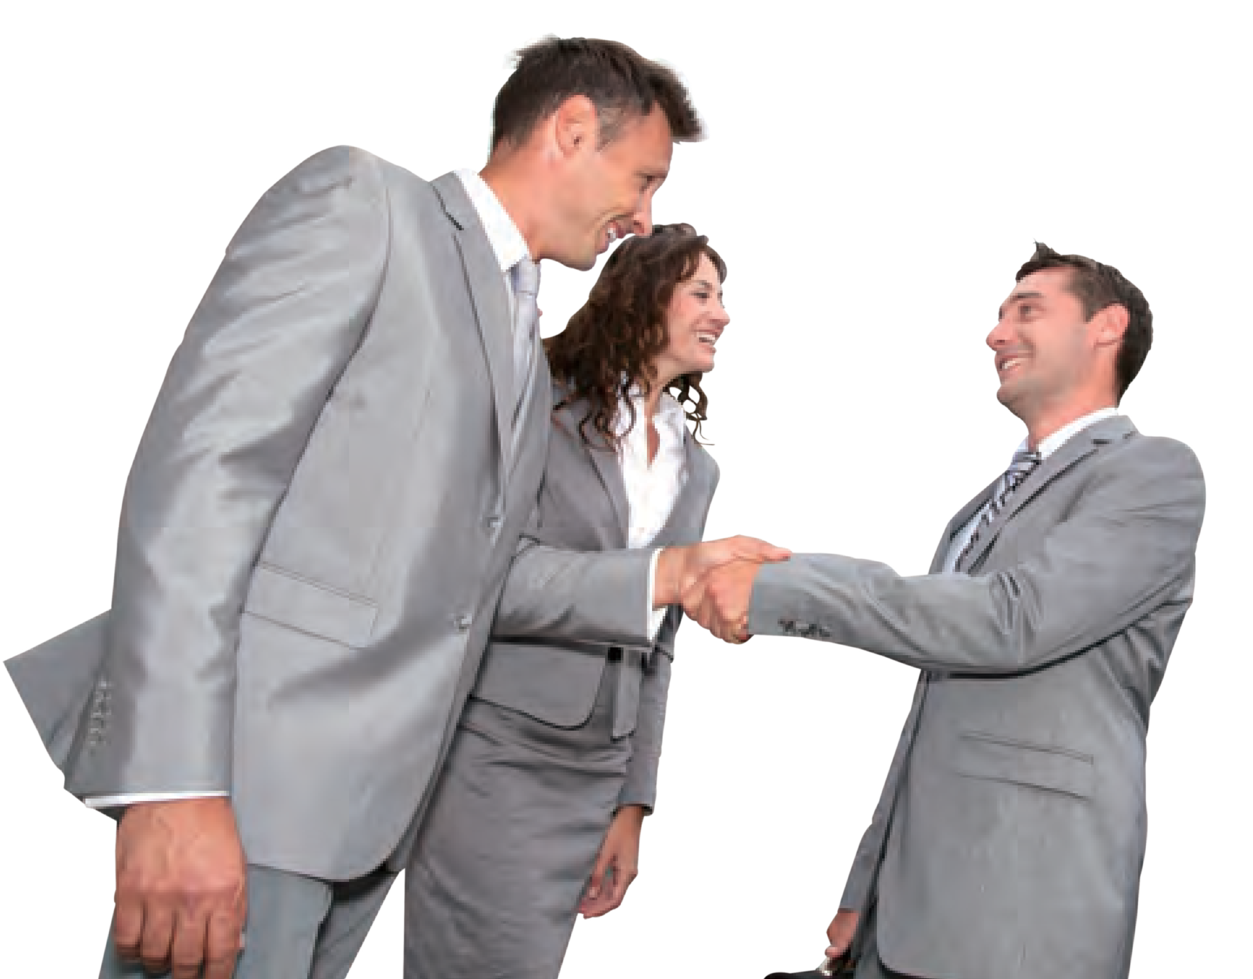
12 UNIT 1. Daily Office Routines
B Practice the dialogue with your partner.
Welcome to Our Company
C
Comprehension Questions
01 | What are some questions you can ask to make your visitor feel com- fortable?
Mr. Andes: Hello. You seem to be a visitor; could you tell me who you’re looking for?
02 | What are some important informa- tion to include when introducing somebody?
Mr. Smith:
Yes, I’m here for a business meeting with Mr. Andes of the marketing department.
Mr. Andes: Oh that would be me, and you must be Mr. Smith.
You’re here a little early for our meeting. That’s okay. Would you mind following me this way?
03 | Imagine you are Mr. Jones, the CTO of the company. What can you say to greet and welcome Mr. Smith?
Mr. Smith: Yes, thank you.
Mr. Andes: Did you have any problems finding our company?
Mr. Smith: No, it was quite easy to find.
Mr. Andes: Great. Now let me properly introduce myself. I’m John Andes and I’m in charge of the marketing department here. It’s a pleasure to meet you. I would also like to introduce you to our new CTO, Mr. Jones. Mr. Jones, this is Mr. Smith, one of our investors.
Mr. Jones:
Very nice to meet you Mr. Smith. I want to thank you for taking your time to visit our company. I hope today’s meeting produces positive outcomes.
4 Case Scenarios
Read the scenarios and complete each stage.
Scene 1 Scene 2
A professionally dressed man walks into your office. You think he is a visitor but you’re not sure. Ask him why he’s here and who he’s looking for. Greet the visitor and make him feel welcomed. Then guide him to the meeting area. Introduce yourself and tell him what you are in charge of.
Role A | Employee Role B | Visitor
Scene 1 Scene 2
An important business partner visits your company for the first time. Guide your partner to the meeting area. In- troduce yourself, the company, and your team members. Then introduce the visitor to everyone else.
Role A | Employee Role B | Visitor
01
Stage
Brainstorm the mission of each character.
>> Role A | Mission
>> Role B | Mission
02
How would you feel in each character’s posi-
tion? Explain.
Stage
03
Act out the situation. Make sure to complete the mission of each character and use the key patterns.
Stage

Slide 4




Lesson 01 / Welcoming Visitors 13
5 Business Basics
A
Cross Cultural Greetings
Greetings are crucial for leaving positive first impressions. Methods and styles of greeting vary greatly around the world, and you need to know which practices apply in different circumstances.
Country Greetings How They Greet
Arab countries
As-salaam (Peace be upon you)
Sabah el-khair (Good morning)
Masa' el-khair (Good evening)
They shake hands with the right hand only, for longer but less firmly than in the West. Contact between the opposite genders in public is considered obscene. Do not offer to shake hands with the opposite sex.
Philippines
Magandang umaga (Good morning)
Magandang hapon (Good afternoon)
English is widely spoken in the Philippines. English greetings are also accepted.
China
· Nǐ hǎo (Mandarin greeting)
In formal greetings, oldest person is always greeted first. Handshakes are the most common form of greeting with foreigners.
Greeting your Indian business colleagues with a "namaste" is considered a compliment. It sets the right tone for the rest of your meeting and
shows that you've taken time to understand Indian
exchanges.
India
· Namaste
(“I bow to divine you”)
Spain
· Hola, como esta? (Hello, how are you?)
Most Latinos are more accustomed to physical contact. Even people who know each other only slightly may embrace when greeting.
B
Share Your Thoughts
01 >> Try practicing each countries’ greetings with your
partner
Brain
Food
In general people shake hands when they meet for a business; however, knowing different cultural greetings may succeed in the inter- national business world. So let’s try to keep an open mind.
02 >> Imagine your partner is from abroad. Explain your country’s greeting. What is it? How do you say it? What gesture do you make?
03 >> Do you know any other greetings from a different culture? What do you think these different cultural greetings tell about each country?
Review Share 3 things you learned from this lesson
Sneak Peek
Do you have a comfortable relationship with your boss? What do you call your boss?
Have you been transferred to a different department before?

