Slide 1


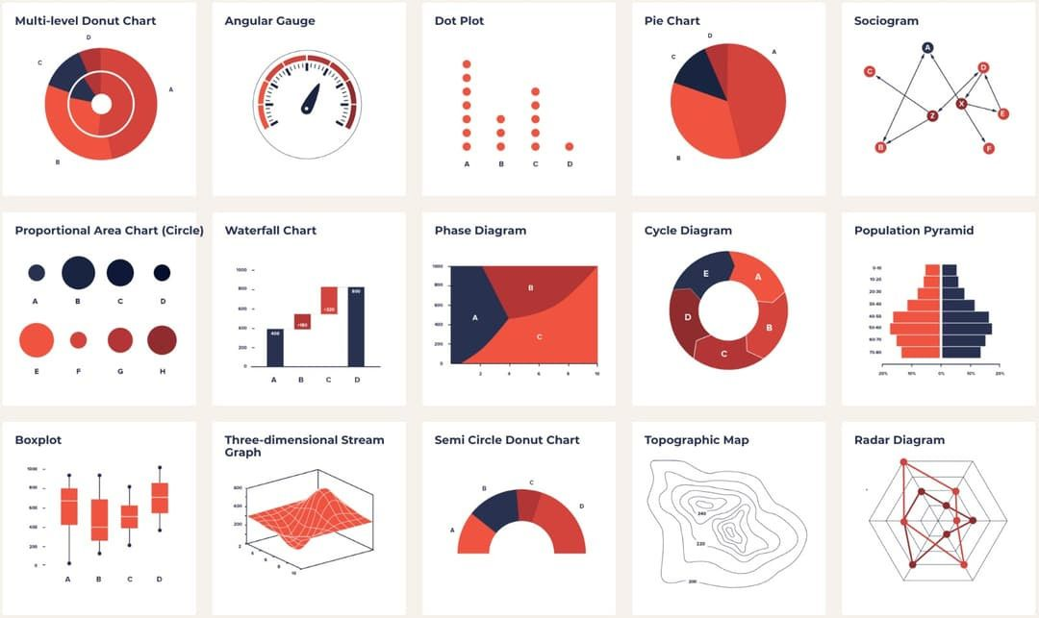
Table Charts
common types of presentations
Visualizing Data
  Graphs: Show relationships between variables (e.g., bar, line, pie).
  Charts: Organize and compare data.
  Tables: Present raw data in rows and columns.
  Diagrams: Illustrate processes, structures, or systems.

Slide 2
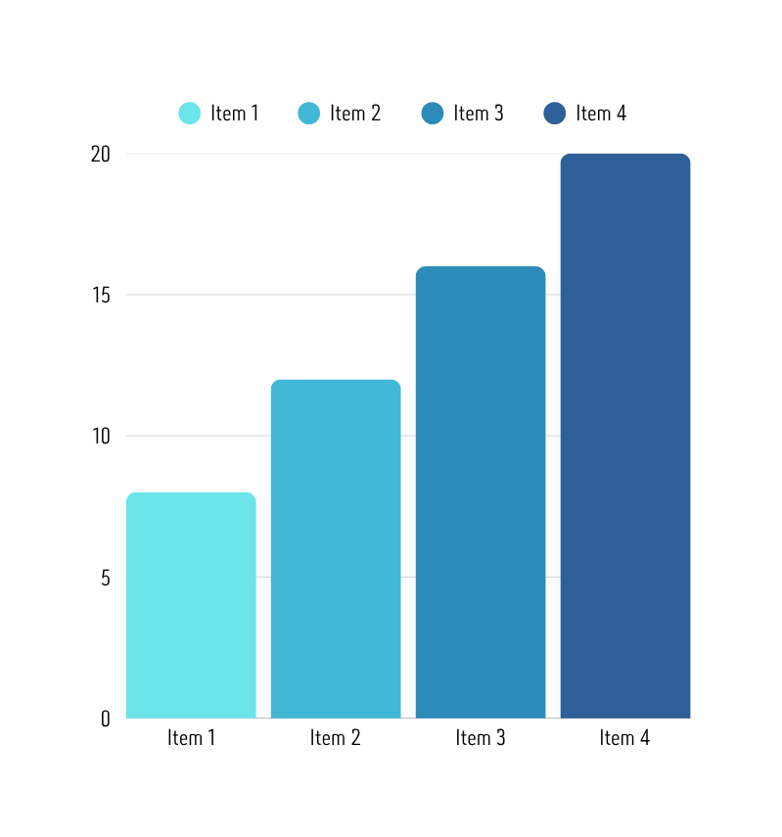

decoding graphs
Key Elements to Look For:
  Title: What is the graph about?
  Axes Labels: What do the horizontal (x) and vertical (y) axes represent? What are their units?
  Scale: What are the increments on each axis?
  Legend/Key: What do different colors, lines, or symbols mean?
  Trends: Is the data increasing, decreasing, staying stable? Are there patterns?

Slide 3



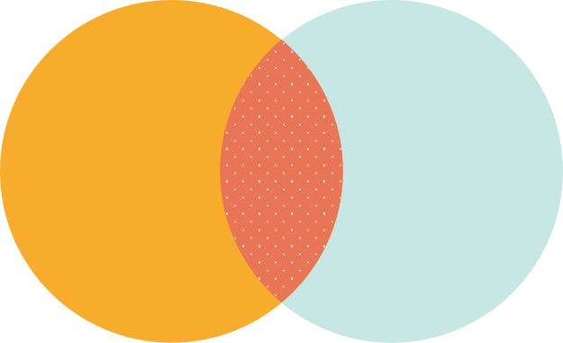
DIAGRAMS
Visualizing Processes & Structures
  Title/Caption: What is the diagram showing?
  Labels: Identify different parts or stages.
  Arrows: Indicate direction, flow, or relationships.
  Color-coding: Helps differentiate elements.
  Purpose: What is the main concept or process being illustrated?

Slide 4


The scientific method
A Systematic Approach
  A logical, step-by-step process used by scientists to investigate and answer questions about the natural world.
  It's not a rigid set of rules, but a flexible framework.
  Helps ensure experiments are fair and results are reliable.

Slide 5
points to remember
Limitations of the Scientific Method
Not a Perfect Tool (But the Best We Have!)
  Bias: Researcher bias can influence results.
  Ethics: Some questions cannot be tested due to ethical concerns.
  Complexity: Some phenomena are too complex to study with a single experiment.
  New Information: Conclusions can change with new evidence.
  Pseudoscience: Claims that appear scientific but lack empirical evidence or testability.
Reasoning with Scientific Information
Beyond Memorization
  It's not enough to just know facts; you need to understand how those facts were determined and what they mean.
  Involves evaluating information, identifying assumptions, and recognizing biases.
  Essential for making informed decisions.

Slide 6
evidence vs claims
Distinguishing Fact from Opinion
  Claim: A statement or assertion that something is true.
  Evidence: The data, observations, or facts that support or refute a claim.
  Key: A strong scientific claim is always backed by strong, reliable evidence.
  Be wary of claims without supporting evidence!

Slide 7
scientific ideas & vocab
Expressing and Applying Scientific Information
Sharing Your Understanding
  Science is a collaborative effort; effective communication is vital.
  Being able to clearly explain scientific concepts and findings.
  Using appropriate language and visuals.
Mastering Scientific Vocabulary
Speaking the Language of Science
  Science has its own precise terminology.
  Understanding key terms is essential for comprehension and communication.
  Example: "Photosynthesis," "mitosis," "density," "gravity."
  Use terms correctly and confidently.

Slide 8
scientific concepts & principles
Explaining Complex Ideas
Making it Understandable
  Break down complex ideas into simpler parts.
  Use analogies or examples to illustrate concepts.
  Focus on the "big picture" before diving into details.
  Tailor your explanation to your audience.
Applying Scientific Principles
Problem-Solving in Action
  Using your scientific knowledge to solve real-world problems.
  Analyzing situations, identifying relevant principles, and predicting outcomes.
  Example: Using knowledge of forces to design a bridge, or understanding ecosystems to address pollution.

Slide 9
mean, median, mode
Measures of Central Tendency
  Central Tendency:
  Mean (Average): Sum of values / number of values.
  Median: Middle value when ordered.
  Mode: Most frequent value.
  Data Spread:
  Range: Difference between highest and lowest values.
  Outliers: Data points significantly different from others.
  Visualization: Use bar, line, pie, or scatter graphs to represent data effectively.

Slide 10
PROBABILITY
  Definition: Measure of how likely an event is to occur (0 to 1, or 0% to 100%).
  Calculation:
P (event) = # of favorable outcomes
__________________
Total # of possible outcomes
Types:
  Theoretical: What should happen (e.g., coin flip is 1/2 heads).
  Experimental: What actually happens in trials.
Interpretation: Higher probability means a greater chance.

Slide 11

Error, Uncertainty & Significance
  Error: Difference between measured and true value (random or systematic).
  Uncertainty: Range within which the true value likely lies.
  Precision: Consistency of repeated measurements.
  Accuracy: Closeness to the true value.
  Statistical Significance: Indicates a result is unlikely due to random chance, making findings meaningful.

Slide 12
Scientific Formulas: Equations of Science
  Purpose: Describe relationships between quantities and calculate unknowns.
  Structure: Inputs (knowns) → Process (math) → Output (unknown).
  Variables: Quantities that change (e.g., m for mass).
  Constants: Fixed values (e.g., speed of light).
  Rearranging: Use inverse operations to solve for different variables (e.g., from D=m/V, m=D×V).

Slide 13
Common Formulas & Units
Key Formulas & Units
  Density: D=m/V (mass / volume)
  Speed: S=d/t (distance / time)
  Force: F=ma (mass × acceleration)
  Work: W=Fd (Force × distance)
  Units are CRITICAL: Always include units and ensure consistency; convert if necessary.

Slide 14
Practice Example (Formula Application)
Problem: A car travels at a speed of 60 km/h for 3 hours. How far did it travel?
  Given/Knowns:
    Speed (S=60 km/h)
    Time (t=3 hours)
  Unknown: Distance (d)
  Formula: S=d/t⟹d=S×t
  Calculation: d=60 km/h×3 h=180 km
  Answer: The car traveled 180 km.

