Slide 1
YEAR 6 MATHS
TERM 1 WEEK 1 INTRODUCTION TO ALGEBRA
Introduction to Algebra – vocabulary: term, expression, equation, formulae
Simplifying: collecting like terms incl. indices, + - and x ÷ then blending the terms or cancelling
Solving one step equations

Slide 2
Algebra (it’s just a missing number!)

Slide 3
LESSON 1 ALGEBRA
WHAT IS IT AND THE VOCABULARY

Slide 4
So what can we do with algebraic equations (sentences)?
Can you solve this?
6 + ? = 10
? = 4
Can you solve:
6 + c = 10
c = 4
So letters in Maths are just missing numbers.

Slide 5
Try some of these
Solve these:
4 + y = 13
t - 23 = 31
g + 14 = 21

Slide 6
So now that you have the basics of Algebra let’s move it along.
Let’s watch the Mathantics video explaining what the vocabulary of Algebra sounds like and what it means. Play it twice if you need to as you will be completing a worksheet once this is done.
Link to the video is https://mathantics.com/lesson/what-is-algebra

Slide 7
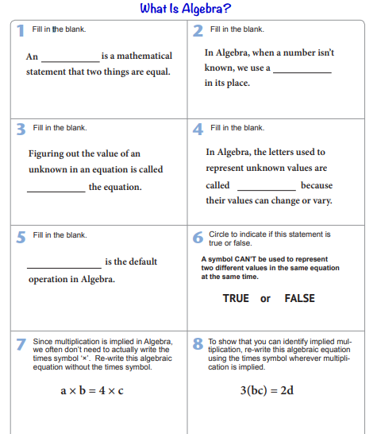

Slide 8
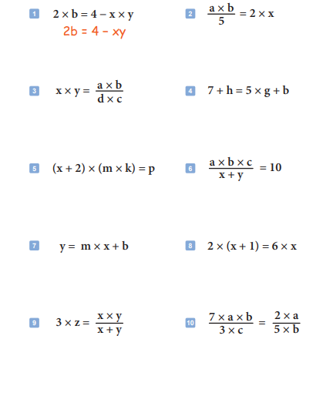
EXTENSION WORKSHEET

Slide 9
LESSON 2 ALGEBRAIC NOTATION

Slide 10
The next activity appeared in our worksheet yesterday, can you remember what we did when it came to multiplication signs in an algebraic sentence?

Slide 11
BEING EFFICIENT WITH ALGEBRA IS KEY.
We don’t need to write down multiplication signs in algebraic equations or expressions or sentences!
Look at this expression/ equation:
2 x b x c
There are a lot of multiplication signs and letters and numbers so let’s tidy this up.
When you multiply two or more things in an equation you just put them together without the times sign, like this:
2 x b x c = 2bc
You can also use brackets too if you wish!
2 x b x c = 2(bc)

Slide 12
BEING EFFICIENT WITH ALGEBRA IS KEY.
Or this one:
2 x b x c x 3
This is rewritten as:
2bc3
but be careful, we know that 2x3 is 6 so let’s write it as
2bc3 = 6bc

Slide 13
TODAY’S LESSON is about being able to translate a number sentence into an algebraic expression.
Remember when we don’t know a particular number we give it a letter.
Let’s watch a quick video first which explains this first.
https://vle.mathswatch.co.uk/vle/browse/644
“I am thinking of a number.
I add three to it, and it is now equal to twenty.”
Let’s call the number a.
I add 3 to it so that makes a+3.
It is equal to 20 so my algebraic equation is
a+3=20

Slide 14
“I am thinking of eighteen.
I subtract a number from it, and it is now equal to eleven.”
Let’s start with 18.
I subtract a number from it. Let’s call the number c.
So that gives me 18-c
It is equal to 11so my algebraic equation is
18-c=11

Slide 15
“I am thinking of a number.
I double it, and it is now equal to sixteen.”
Let’s start with a number and call it m.
If I double it I multiply it by 2 so that gives me 2m (remember from yesterday’s lesson?)
It is equal to 16 so my algebraic equation is
2m=16

Slide 16
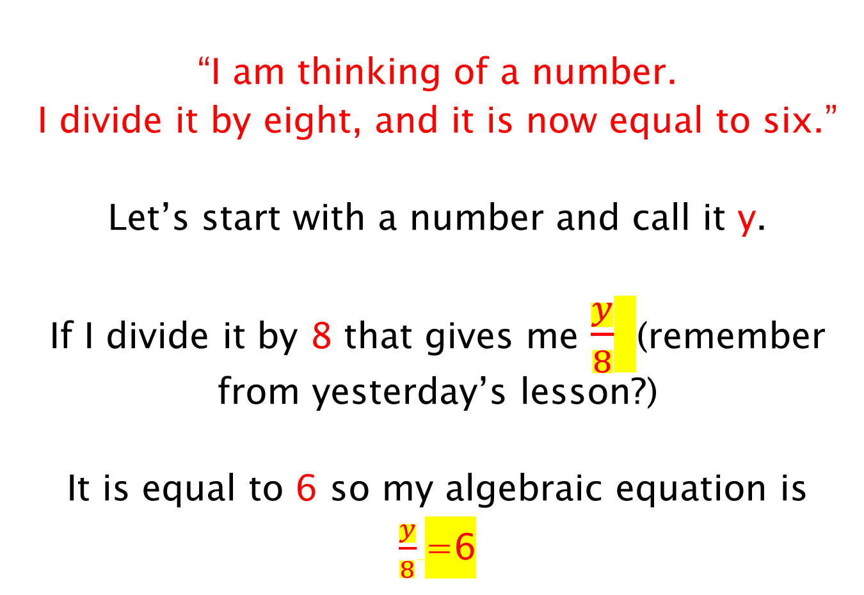
“I am thinking of a number.
I divide it by eight, and it is now equal to six.”
Let’s start with a number and call it y.
If I divide it by 8 that gives me $\frac{y}{8}$ (remember from yesterday’s lesson?)
It is equal to 6 so my algebraic equation is
$\frac{y}{8}$=6

Slide 17
“I am thinking of a number.
I double it, then add four. My answer is twenty”
Let’s start with a number and call it k.
If I double it then that gives me 2k
I then add 4 so I get 2k+4.
My answer is 20 so my algebraic equation is
2k+4=20

Slide 18
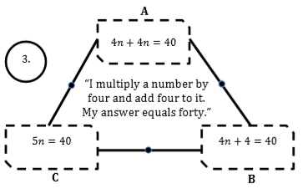
Which answer is correct here?

Slide 19
LESSON 3
COLLECTING LIKE-TERMS

Slide 20
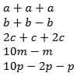
COLLECTING LIKE-TERMS
Like-terms are terms that have the same unknowns or letters.
Look at these:
3a
2b-b=b
5c
9m
8p-p = 7p

Slide 21
When you are asked to SIMPLIFY EXPRESSIONS……. it simply means to make the number sentence look tidy and neat.
So….. put all the same letters together and do the addition and subtraction too.
For example: a + a + b + b
= 2a + 2b
2m + 3m + 5k – 2k
= 5m + 3k
4g + 3s - 2g – s
= 2g + 2s

Slide 22
Now you try, this time with some numbers too!
12n + 3n + 18 + 2n – 6
Put all the like terms together
All the n’s go together and the numbers can go together too.
12n + 3n + 2n + 18 - 6
So my new expression is 17n + 12

Slide 23
Now you try!
3a + 3b + 3 + b
Put all the like terms together
All the a’s go together, the b’s go together and the numbers can go together too.
3a + 3b + b + 3
So my new expression is 3a + 4b + 3

Slide 24
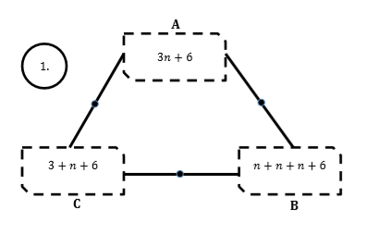
Which is the odd one out!

Slide 25
2y + 7h – 4y – 3h
2y – 4y +7h – 3h
-2y + 4h
6m – w – 12m + 5w
6m – 12m – 1w + 5w
-6m + 4w
-7u + 2f – 3f + 2u
-7u +2u +2f -3f
-5u - f

Slide 26
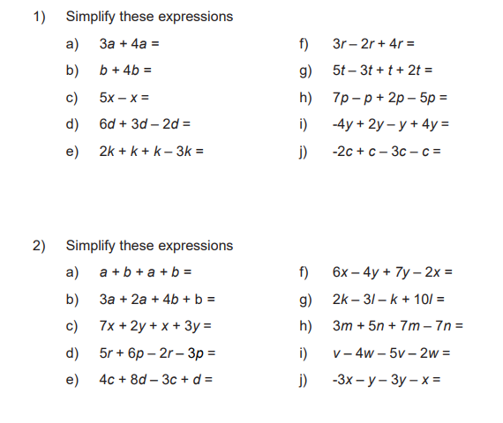
Try this worksheet to practice your skills of collecting like-terms

Slide 27
LESSON 4
SOLVING ONE STEP EQUATIONS

Slide 28
BRAIN IN GEAR
EXAMPLE
DITDIONA can be rearranged to make ADDITION
TASK
Work out the following Mathematical anagrams:
MERT
REXPENSSIO
TEANQIUO
Notes:
28

Slide 29
BRAIN IN GEAR
EXAMPLE
DITDIONA can be rearranged to make ADDITION
TASK
Work out the following Mathematical anagrams:
MERT
REXPENSSIO
TEANQIUO
Term
Expression
Equation
Notes:
29

Slide 30
TASK
Find the inverse/ OPPOSITE operation of the following:
+5
- 7
(c) ÷ 2
(d) X 9
Notes:
30

Slide 31
TASK
Find the inverse/ OPPOSITE operation of the following:
(c)
(d) X 9
+5
- 7
x 2
- 5
+ 7
÷ 9
Notes:
31

Slide 32
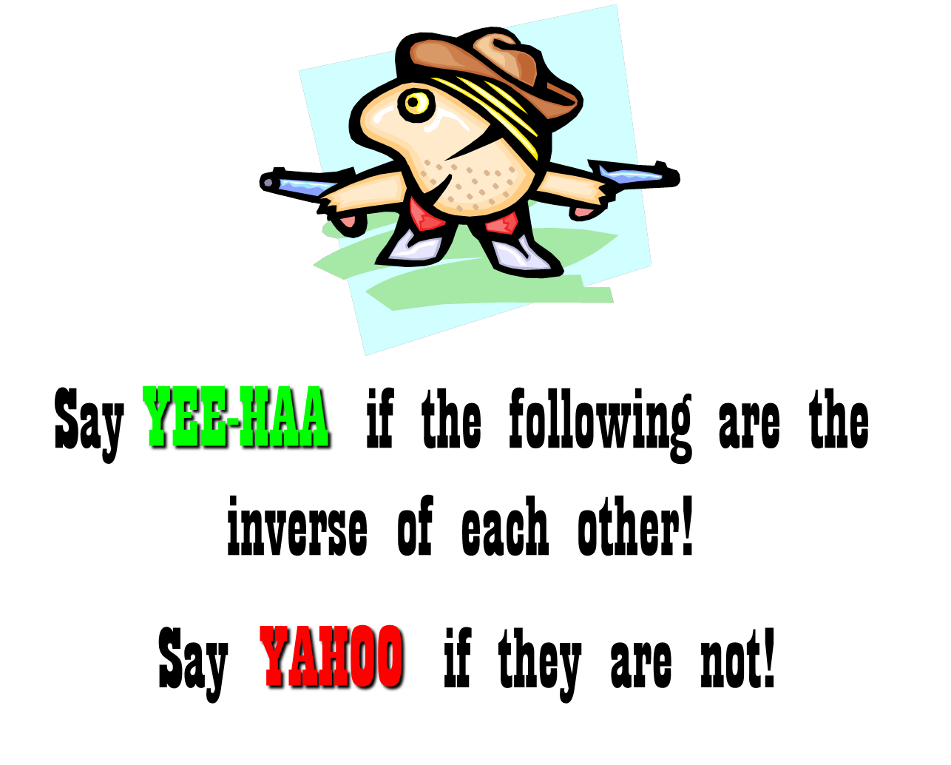
SOLVING ONE STEP EQUATIONS
SALOON SNAP
Notes:
32

Slide 33

SOLVING ONE STEP EQUATIONS
YEE-HAA or YAHOO
-9
+9
Notes:
33

Slide 34
SOLVING ONE STEP EQUATIONS
YEE-HAA or YAHOO
x8
√8
Notes:
34

Slide 35
SOLVING ONE STEP EQUATIONS
YEE-HAA or YAHOO
Notes:
35

Slide 36
SOLVING ONE STEP EQUATIONS
YEE-HAA or YAHOO
x6
-6
Notes:
36

Slide 37
SOLVING ONE STEP EQUATIONS
8x = -72
m + 18 = 3
We will use inverse or opposite operations to solve one-step equations.
x + 4 = 12
m – 18 = - 3
3p = - 27

Slide 38
An equation is like a balance scale because it shows that two quantities are equal.
What you do to one side of the equation must also be done to the other side to keep it balanced.

Slide 39

Keep the scale balanced.
If we add 3 apples to this side…
What must we do to this side?

Slide 40
Keep the scale balanced.
If we subtract 3 bananas from this side…
What must we do to this side?

Slide 41
SOLVING ONE STEP EQUATIONS
To solve one step equations, you need to ask three questions about the equation:
What is the variable or the unknown number?
What operation is being performed?
What is the inverse operation?

Slide 42
INVERSE OPERATIONS
The inverse operation of addition is…
SUBTRACTION
The inverse operation of subtraction is…
ADDITION
The inverse operation of multiplication is…
DIVISION
The inverse operation of division is…
MULTIPLICATION

Slide 43
And remember:
What you do to one side of the equation must also be done to the other side to keep it balanced.

Slide 44
One-Step Equations with addition
Example 1 Solve x + 4 = 12
What is the variable?
The variable is x.
What operation is being performed?
Addition.
What is the inverse operation?
Subtraction.
Using subtraction, subtract 4 from both sides of the equation.
x + 4 = 12
We subtract the same thing on both sides to keep the equation equal.
- 4
- 4
x
=
8
Now check ALL answers.
x + 4 = 12
Start with the original problem.
Plug in your answer.
CORRECT!
8
+ 4 = ?
12

Slide 45
Practice: One-step Equations with addition
1. m + 9 = 12
- 9 - 9
NOW check: 3 + 9 = ?
m = 3
12 = 12 ✓
2. c + 5 = 15
- 5 - 5
NOW check: 10 + 5 = ?
15 = 15 ✓
c = 10

Slide 46
One - Step Equations with subtraction
Example 2 Solve y – 7 = 13
What is the variable?
The variable is y.
What operation is being performed?
Subtraction.
What is the inverse operation?
Addition.
We add the same thing on both sides to keep the equation equal.
Using addition add 7 to both sides of the equation.
y – 7 = 13
+ 7
+ 7
y =
20
Now check your work!
Start with the original problem.
y – 7 = 13
Plug in your answer.
20 – 7 = ?
CORRECT!
13

Slide 47
Practice: One-step Equations with subtraction
1. n – 18 = 2
2. m – 11 = 1
Now check: 20 – 18 = ?
+ 18 +18
2 = 2 ✓
n = 20
+ 11 + 11
Now check: 12 – 11 = ?
m = 12
1 = 1 ✓

Slide 48
One-Step Equations with multiplication
Example 3 Solve 6a = 12
What is the variable?
The variable is a.
What operation is being performed?
Multiplication.
What is the inverse operation?
Division
Using division divide both sides of the equation by –6.
6 a = 12
We divide the same thing on both sides to keep the equation equal.
÷ 6
÷ 6
a
=
2
CHECK:
Start with the original problem.
6 a = 12
CORRECT!
6 ( ) = ?
Plug in your answer.
2
12

Slide 49
Practice: One-step Equations with multiplication
1. 3a = 18 2. 4n = 32
÷ 3 ÷ 3
÷ 4 ÷ 4
a = 6
n = 8
Now check: 3 (6) = ?
Now check: 4 (8) = ?
18 = 18 ✓
32 = 32 ✓

Slide 50
One - Step Equations with division
Example 4: Solve b ÷ 2 = 10
What is the variable?
b.
What operation is being performed?
Division.
What is the inverse operation?
Multiplication
Using multiplication multiply both sides of the equation by 2.
b ÷ 2 = 10
We multiply the same thing on both sides to keep the equation equal.
x 2
x 2
b
=
20
CHECK:
Start with the original problem.
b ÷ 2 = 10
Correct!
Plug in your answer.
20 ÷ 2 = ?
= 10

Slide 51
Practice: 1-step Equations with division
1.
b ÷ 3 = 6
x 3 x 3
2.
x ÷ 4 = 9
x 4 x 4
b = 18
x = 36
Now check:
Now check:
18 ÷ 3 = ?
36 ÷ 4 = ?
6 = 6 ✓
9 = 9 ✓

Slide 52
Summary
When solving one-step equations, always use the “inverse operation” to do the opposite to what was done to the variable in the first place.
ALWAYS CHECK YOUR WORK!

Slide 53
SOLVING ONE STEP EQUATIONS
Solve each of the following equations:
𝑥 - 9 = 2
𝑥
=
11
4)
5𝑥 = 40
𝑥 + 7 = 10
3)
1)
2)
4
Notes:
53

