Slide 1
Everyday Conversations:
Learning American English

Slide 2
Contents
1. INTRODUCTIONS AND SMALL TALK, PAGE 3
Dialogue 1-1: Formal Greetings
Dialogue 1-2: Informal Greetings and Farewells Dialogue 1-3: Formal Introductions
Dialogue 1-4: Informal Introductions Dialogue 1-5: What Time Is It?
Dialogue 1-6: A Telephone Call
Dialogue 1-7: Can You Say That Again? Dialogue 1-8: Coincidences
Dialogue 1-9: Weather Report
2. AROUND TOWN, PAGE 23
Dialogue 2-1: Ordering a Meal
Dialogue 2-2: At the Doctor’s Office Dialogue 2-3: Asking Directions
Dialogue 2-4: Calling for Help
Dialogue 2-5: At the Supermarket
Dialogue 2-6: Running Errands
Dialogue 2-7: At the Post Office
Dialogue 2-8: Catching Up After Class Dialogue 2-9: Shopping
Dialogue 2-10: Transportation
3. PASTIMES AND ACTIVITIES, PAGE 45
Dialogue 3-1: How Old Are You? Dialogue 3-2: At the Movies
Dialogue 3-3: What Are You Good At?
Dialogue 3-4: What’s Your Favorite Sport? Dialogue 3-5: A Night at the Theater
Dialogue 3-6: Taking a Vacation Dialogue 3-7: At the Pet Store
Dialogue 3-8: Giving Your Opinion Dialogue 3-9: Hobbies
Dialogue 3-10: Weddings
Dialogue 3-11: Giving Advice
1

Slide 3
1
Introductions and Small Talk
3

Slide 4
Dialogue 1-1: Formal Greetings
JAMES:
Good morning, Professor Austin, how are you doing?
PROFESSOR AUSTIN:
Good morning, James. I am doing well. And you?
JAMES:
I’m great, thank you. This is my friend Emma. She is thinking about applying to this college. She has a few questions. Would you mind telling us about the process, please?
PROFESSOR AUSTIN:
Hello, Emma! It’s a pleasure to meet you. I’m more than happy to speak with you. Please stop by my office next week.
EMMA:
It’s a pleasure to meet you, professor. Thank you so much for helping us.
PROFESSOR AUSTIN:
Don’t mention it. Hopefully, I will be able to answer your questions!
4

Slide 5

LANGUAGE NOTES
The greetings good morning/good afternoon/good evening are used at different times of the day to greet people. “Good evening” is often used after 6 p.m. or generally when the sun has set.
“Good night” is not a greeting: It is used when leaving a place or group of people.
Thank you and good night!/Good night, and see you tomorrow.
When people meet in the United States, it is customary for them to shake hands. A handshake should be firm and usually lasts for about two to three seconds — which allows enough time to say “Nice to meet you.”
“Don’t mention it” is another way of saying “You’re welcome.” The phrase “You are welcome” is more formal. However, responses such as Don’t mention it./No problem./ Happy to help. are informal ways of responding to a thank you.
5

Slide 6
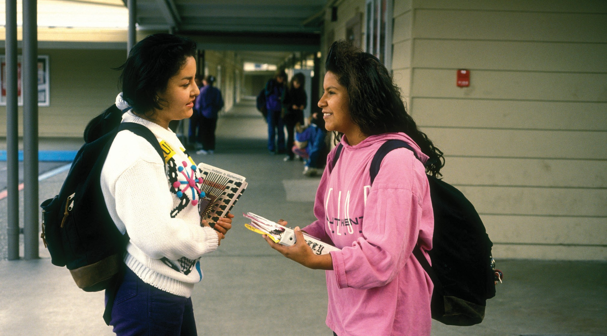
Dialogue 1-2: Informal Greetings and Farewells
6

Slide 7
Hi, Helen! How’s it going?
JANE:
HELEN:
Fine, thanks — and you?
JANE:
Just fine. Where are you off to?
HELEN:
To the library. I’ve got a history exam next week and need to start studying. Ugh.
JANE:
Oh, no. Well, I’ll see you later then. Good luck!
HELEN:
Thanks. See you later.
LANGUAGE NOTES
“Hi” is an informal way of saying “hello.” Notice that the “i” sound in “hi” is extended, to show that Jane is very pleased to see Helen.
“How’s it going?” is an informal way of saying “How are you?”
“Fine, thanks—and you?” Notice the rising intonation on “and you?” This shows that Helen is interested in what Jane has to say.
“Where are you off to?” is an informal way of saying “Where are you going?” Notice the falling intonation since this is an information question, not a “yes/no” question.
“To the library.” Notice that Helen does not say “I’m going” here because that information was already established in the question “Where are you off to?”
“Oh, no” is a way of saying “I sympathize with you” or “I understand you are not happy.”
“See you later” is an informal way of saying “goodbye.”
7

Slide 8
Dialogue 1-3: Formal Introductions
MARGARET:
Mr. Wilson, I’d like you to meet Dr. Edward Smith.
MR. WILSON:
It’s nice to meet you, Dr. Smith.
DR. SMITH:
Pleasure to meet you, too.
MARGARET:
Dr. Smith is an economist. He just finished writing a book on international trade.
MR. WILSON:
Oh? That’s my field, too. I work for the United Nations.
DR. SMITH:
In the Development Program, by any chance?
MR. WILSON:
Yes. How did you guess?
DR. SMITH:
I’ve read your articles on technical assistance. They’re excellent.
8

Slide 9
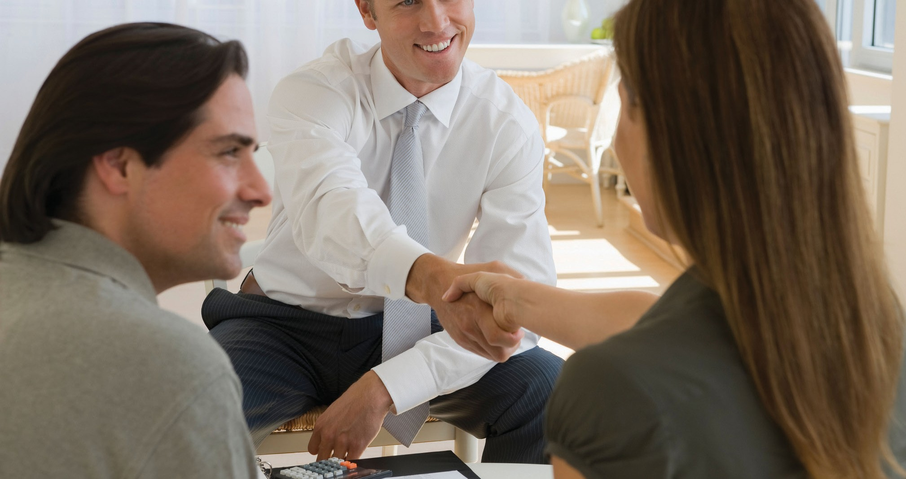
LANGUAGE NOTES
Mr. Wilson, I’d like you … Notice the rising intonation on “Mr. Wilson,” which is used to address someone. Listen for the “d” in “I’d like.” This means I would like, which is very different from I like. (“I’d like” means the same as “I would like” or “I want.”)
Dr. Smith is an economist. Notice the stress on “economist.” This content word has new information, so it is emphasized. There are four syllables in “economist,” with the stress on the second syllable (e-CON-o-mist).
He just finished writing … “just” means the very recent past. “Just” is usually used with a simple past verb because the action is complete. However, it can also be used with the present perfect (He’s just finished writing …).
Development program. Since these two words make a compound noun, the main stress falls on “development.”
By any chance? Means the same as “possibly.” Notice the rising intonation, which is used in yes/no questions to confirm that something is true.
9

Slide 10
Dialogue 1-4: Informal Introductions
JIM:
Who’s the tall woman next to Barbara?
CHARLES:
That’s her friend Mary. Didn’t you meet her at Steve’s party?
JIM:
No, I wasn’t at Steve’s party.
CHARLES:
Oh! Then let me introduce you to her now. Mary, this is my friend Jim.
MARY:
Hi, Jim. Nice to meet you.
JIM:
You, too. Would you like a drink?
MARY:
Sure, let’s go get one.
10

Slide 11


Embassy of the United States of America
U N I T E D S TAT E S D E P A R T M E N T O F S TAT E
B U R E A U O F I NT E R NA TI O NAL I N F O R MA TI O N P R O G R AM S B U R E A U O F E D U C A TI O NAL AN D C U L T U R AL AF F AI R S

