Slide 1
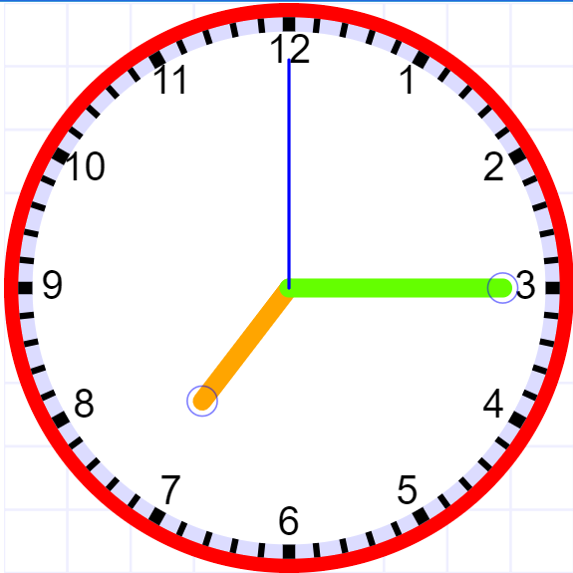

LO: To read and write time between analogue and digital 12- and 24 hour clocks.
What time does this clock show?
How would we write this time in words?
How would we write this time in digital?

Slide 2
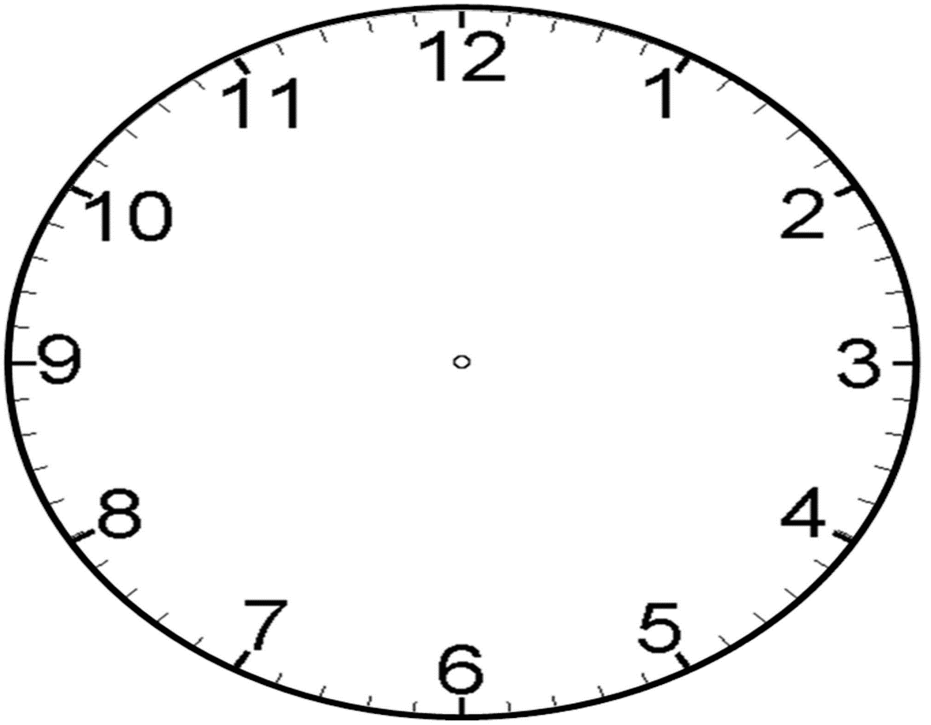
LO: To read and write time between analogue and digital 12- and 24 hour clocks.
Can you show the following time on your clock…
10:05
11:30
Twenty past 7

Slide 3
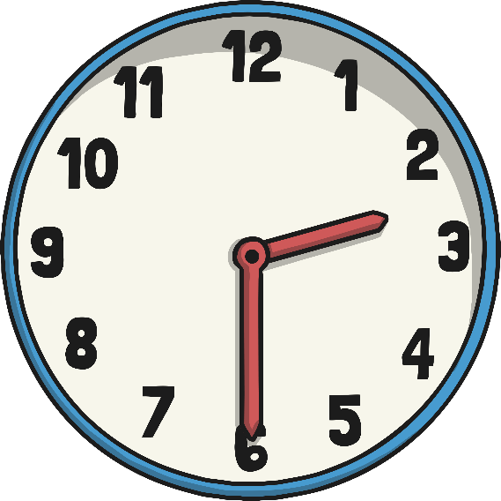
The 24 Hour Day
A day has 24 hours. A clock has 12 hours.
This means each time will happen twice every day.
half past 2 in the morning
half past 2 in the afternoon

Slide 4
a.m. and p.m.
We have to use a way to write these times differently. One way is to use a.m. and p.m.
a.m. (ante meridiem – before noon)
p.m. (post meridiem – after noon)
2:30 a.m.
2:30 p.m.

Slide 5
The 24 Hour Clock
Another way is to use a 24 hour clock.
This means the hours after 12 noon are converted to 13:00 to 23:00.
2:30
14:30
A 4 digit format is used. 2 digits for the hour, a colon (:) and 2 for the minutes.

Slide 6
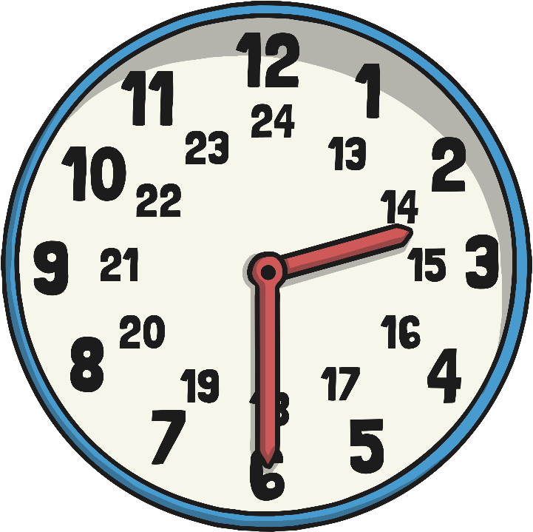
24 Hour Hours
This clock and table show the corresponding hours on a 24 hour clock.
00:00 = 12:00 AM | 12:00 = 12:00 PM
01:00 = 1:00 AM | 13:00 = 1:00 PM
02:00 = 2:00 AM | 14:00 = 2:00 PM
03:00 = 3:00 AM | 15:00 = 3:00 PM
04:00 = 4:00 AM | 16:00 = 4:00 PM
05:00 = 5:00 AM | 17:00 = 5:00 PM
06:00 = 6:00 AM | 18:00 = 6:00 PM
07:00 = 7:00 AM | 19:00 = 7:00 PM
08:00 = 8:00 AM | 20:00 = 8:00 PM
09:00 = 9:00 AM | 21:00 = 9:00 PM
10:00 = 10:00 AM | 22:00 = 10:00 PM
11:00 = 11:00 AM | 23:00 = 11:00 PM
12:00 = 12:00 AM | 24:00 = 12:00 PM
Midnight is referred to as both 00:00 and 24:00

Slide 7
24 Hour Time in the Morning
To convert between 12 and 24 hour time in the morning change the format.
6:00 a.m.
06:00
becomes
10:30
10:30 a.m.
becomes
The hours stay the same.

Slide 8

24 Hour Time in the Afternoon
To convert between 12 and 24 hour time in the afternoon add or subtract 12 hours and change the format.
6:00 p.m. becomes 18:00
22:30 becomes 10:30 p.m.

Slide 9
Convert 12 to 24 hour
Convert these times to 24 hour time
12 hour time
24 hour time
2:45 a.m.
02:45
10:20 a.m.
10:20
1:55 p.m.
13:55
3:05 p.m.
15:05
5:35 p.m.
17:35
8:40 p.m.
20:40
11:25 p.m.
23:25

Slide 10
Convert 24 to 12 hour
Convert these times to 12 hour time
24 hour time
12 hour time
03:15
3:15 a.m.
11:15
11:15 a.m.
14:45
2:45 p.m.
16:20
4:20 p.m.
18:55
6:55 p.m.
21:05
9:05 p.m.
22:35
10:35 p.m.

Slide 11
Timetables
Transport timetables often use 24 hour times. Here is an example of a bus timetable:
Service Number | 83 | 83a | 83 | 83a
Ecclesfield, Mill Rd | 17:10 | 17:21 | 17:35 | 17:41
Ecclesfield, High St | - | 17:24 | - | 17:44
Southey Green, Moonshine Ln | 17:22 | 17:33 | 17:47 | 17:53
Pitsmoor, Pinfold Ln | 17:34 | 17:45 | 17:59 | 18:05
Sheffield, Snig Hill | 17:42 | 17:55 | 18:07 | 18:15
Hunters Bar, Ecclesall Rd | 18:04 | 18:13 | 18:27 | 18:33
Fulwood, Crimicar Ln | - | 18:27 | - | 18:47
Bents Green, Ringinglow Rd | 18:15 | - | 18:38 | -

Slide 12
Timetables
Sometimes, 24 hour clock times appear without the separating colon (:). Here’s what the bus timetable would look like without the colon:
Service Number | 83 | 83a | 83 | 83a
Ecclesfield, Mill Rd | 1710 | 1721 | 1735 | 1741
Ecclesfield, High St | - | 1724 | - | 1744
Southey Green, Moonshine Ln | 1722 | 1733 | 1747 | 1753
Pitsmoor, Pinfold Ln | 1734 | 1745 | 1759 | 1805
Sheffield, Snig Hill | 1742 | 1755 | 1807 | 1815
Hunters Bar, Ecclesall Rd | 1804 | 1813 | 1827 | 1833
Fulwood, Crimicar Ln | - | 1827 | - | 1847
Bents Green, Ringinglow Rd | 1815 | - | 1838 | -

Slide 13
12 and 24 hour clock times
 | midnight | a.m. | noon | p.m.
12 hour | 12:00 a.m. | e.g. 5:15 a.m. | 12:00 p.m. | e.g. 4:15 p.m.
24 hour | 00:00 | e.g. 5:15 | 12:00 | e.g. 16:15

Slide 14
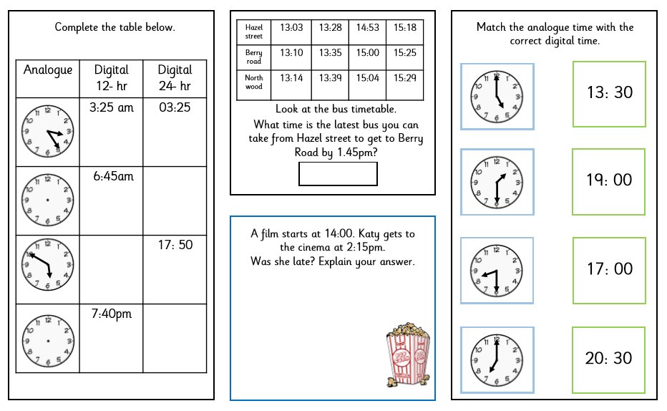
LO: To read and write time between analogue and digital 12- and 24 hour clocks.
INDEPENDENT CHALLENGE!
Extension Activity:
When you have finished, ask your teacher for the extension activity sheets.

Slide 15
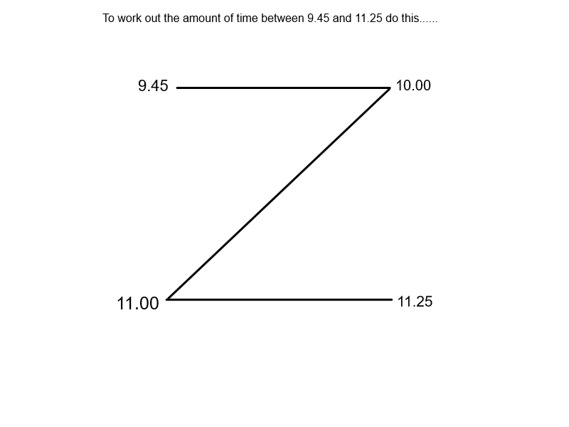
LO: To be able to calculate time intervals.
Lesson 2
USING THE Z-METHOD TO CALCULATE TIME INTERVALS.
Nada’s new chat show on BBC1 starts at 9:45am and ends at 11:25am. How long does it last?

Slide 16
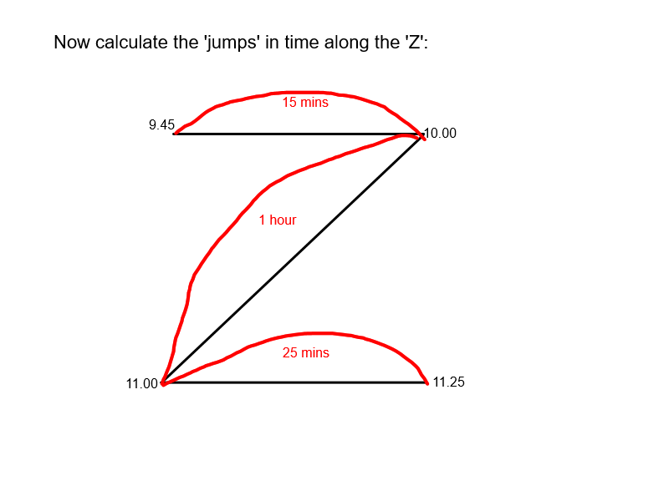
LO: To be able to calculate time intervals.
Lesson 2
USING THE Z-METHOD TO CALCULATE TIME INTERVALS.
Nada’s new chat show on BBC1 starts at 9:45am and ends at 11:25am. How long does it last?

Slide 17
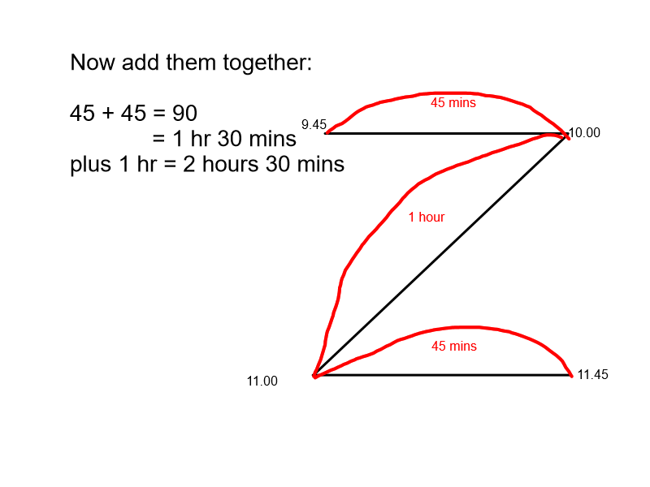
LO: To be able to calculate time intervals.
Lesson 2
USING THE Z-METHOD TO CALCULATE TIME INTERVALS.
Nada’s new chat show on BBC1 starts at 9:45am and ends at 11:25am. How long does it last?

Slide 18
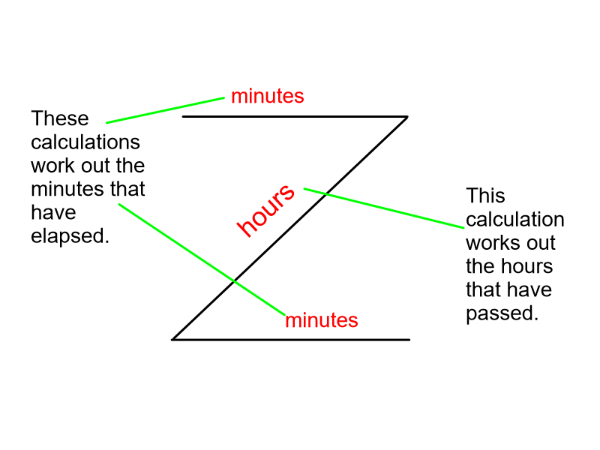
LO: To be able to calculate time intervals.
Lesson 2
USING THE Z-METHOD TO CALCULATE TIME INTERVALS.
Nada’s new chat show on BBC1 starts at 9:45am and ends at 11:25am. How long does it last?

Slide 19
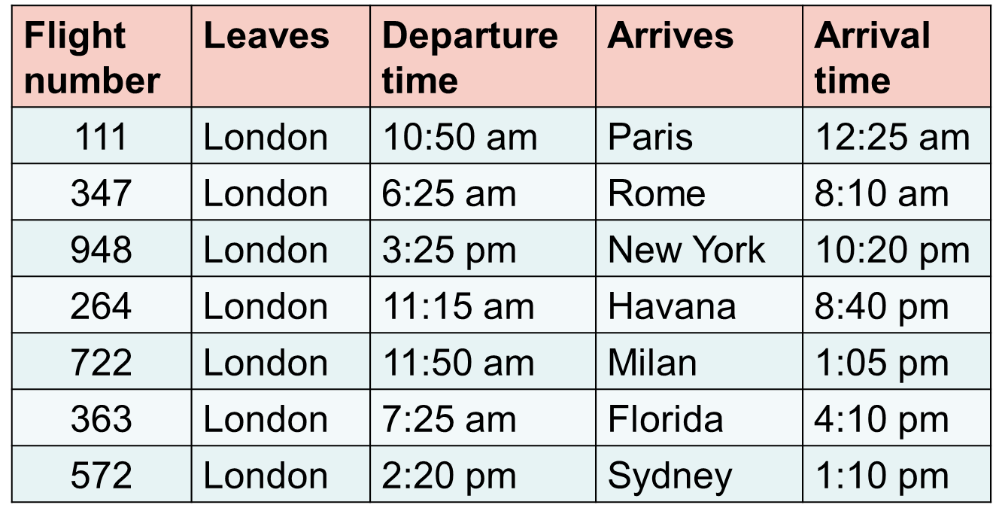
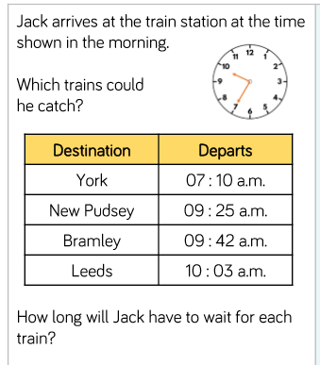
LO: To be able to calculate time intervals.
Using the Z-method, calculate the following elapsed time for flights from London.
Time intervals
Find the length of each flight.
Arrival time is given in UK time.
PROBLEM SOLVING

Slide 20
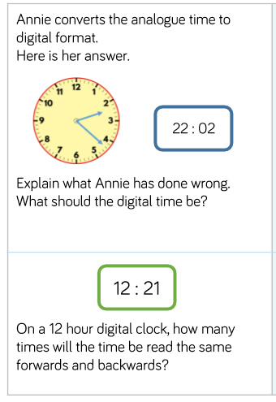
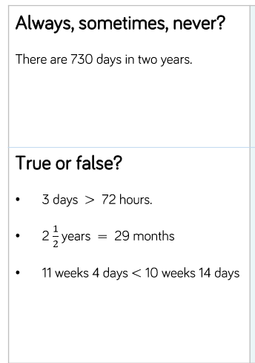
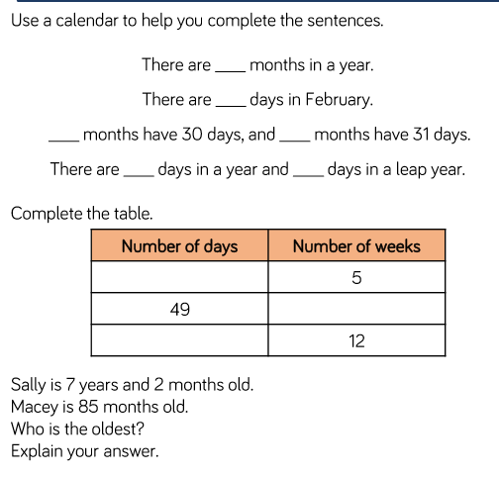
LO: To solve time problems
PROBLEM SOLVING AND REASONING

