Slide 1
















English with Ms Nicola!
Introductions and Getting to Know YOU!

Slide 2





What will we cover today?
01
02
03
04
QUESTIONS N GOALS
OBJECTIVES
METHODOLOGY
CONCLUSIONS
Getting to know you as a student.
Discovering your learning style.
Please let me know if you have any questions or goals as a student or parent.
Wrapping up!

Slide 3


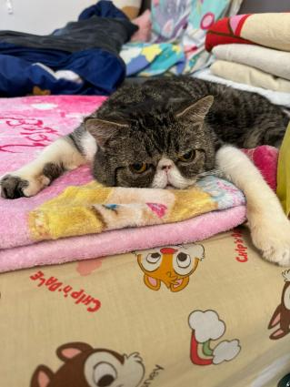



INTRODUCTION
A little bit about me!

Slide 4




01
YOUR TURN!
Please introduce yourself!
Hobbies? Passions? Likes and dislikes?

Slide 5













Learning styles!
visual?
auditory?
kinesthetic?
reading/writing?

Slide 6









QUESTIONS AND GOALS?

Slide 7






CONCLUSION + NEXT STEPS

Slide 8
