Slide 1



English Class
with
Teacher Mady

Slide 2

LESSON 1
INTRODUCTION TO THE IELTS SPEAKING TEST
These lessons are designed to help improve your speaking skills for the IELTS Speaking test.

Slide 3

OBJECTIVES
  In this lesson, you will learn the introduction of IELTS speaking test
  Understand what examiners are looking for.

Slide 4

INTRODUCTION
  The IELTS Speaking Test is a face-to-face interview with a certified examiner.
  It lasts 11 to 14 minutes and measures how well you can communicate in English in real-life situations.
  Your score is based on fluency, vocabulary, grammar, and pronunciation, not on your opinion or knowledge.
  The goal is to show that you can speak naturally and clearly, just like in a normal conversation.

Slide 5
Useful Expressions
🟡 Starting an Answer
🟡 Clarifying or Correcting
  That’s an interesting question.
  I haven’t thought about that before, but…
  Let me put it another way…
  Sorry, I meant to say…
🟡 Giving an Opinion
🟡 Concluding or Summarizing
  In my opinion…
  As far as I’m concerned…
  I believe that…
  Overall…
  To sum up…
  Generally speaking…

Slide 6
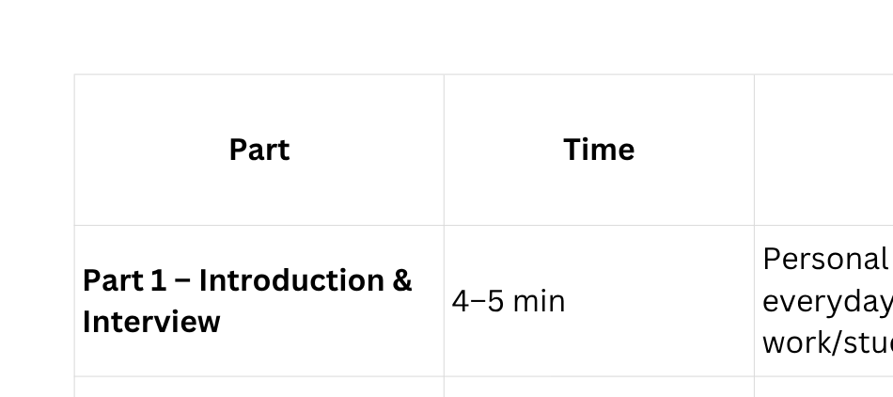
PRESENTATION: TEST FORMAT
The IELTS Speaking test has three parts. In each part, the examiner will ask different types of questions.

Slide 7





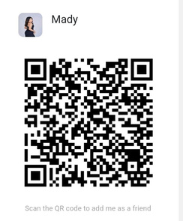
THANK
YOU !
wechat ID: TeacherMady_English
Classin:
Dingtalk:
Teacher Mady
email: teachermady.edu@gmail.com

