Slide 1
Sample chemistry tutorial

Slide 2
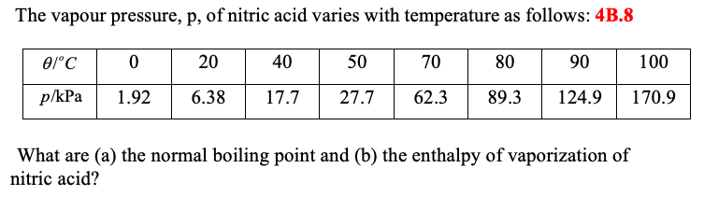
Problem
What are the enthalpy of vaporization and the normal boiling point of nitric acid?

Slide 3
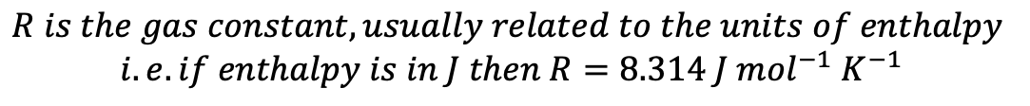
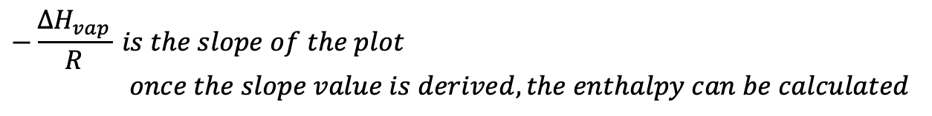

Solution
The problem has a vapor pressure-temperature matrix and the indicators of liquid-vapor transition (enthalpy of vaporization and boiling point) so it calls for the use of the Clausius-Clapeyron equation:
$$\ln\left(p\right)=−\frac{{∆H}_{vap}}{R}\left(\frac{1}{T}\right)$$
$$where p represents vapor pressure \left(regardless of the unit\right)$$
$$while T must be the temperature in Kelvin$$
$$R is the gas constant, usually related to the units of enthalpy$$
$$i.e. if enthalpy is in J then R=8.314 J {mol}^{−1} K^{−1}$$
$$−\frac{{∆H}_{vap}}{R} is the slope of the plot$$
    $$once the slope value is derived, the enthalpy can be calculated$$
Don’t forget to convert the temperature to Kelvin units and apply natural logarithm for every given pressure, then plot the ln (p) as y variable vs. 1/T as x variable

Slide 4
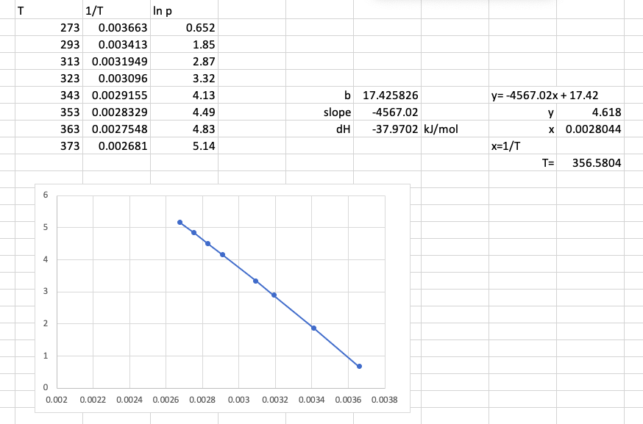


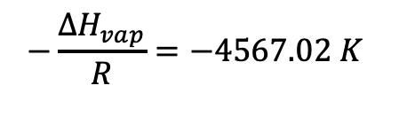

Solution
To solve for the enthalpy of vaporization, we need to get the ln(p) as y and 1/T as x in the given table followed by plotting.
$$The derived slope is −4567.02 K$$
$$so the slope expression gives,$$
$$−\frac{{∆H}_{vap}}{R}=−4567.02 K$$
${∆H}_{vap}=−4567.02 K$ * R
$${∆H}_{vap}=−4567.02 K×\left(8.314 x {10}^{−3} kJ{ mol}^{−1} K^{−1}\right)$$
$${∆H}_{vap}=38.0 kJ {mol}^{−1}$$

Slide 5





Solution
To solve for the normal boiling point, we need the integrated form of the Clausius-Clapeyron equation as shown below
$$\ln\left(\frac{p_{2}}{p_{1}}\right)=−\frac{{∆H}_{vap}}{R}\left(\frac{1}{T_{2}}−\frac{1}{T_{1}}\right)$$
$$where p and T are expanded into their different states \left(initial ,final\right)$$
We just need a pair of pressure and the their corresponding temperature from the table to calculate the normal boiling point
Recall that normal boiling point occurs at 1 atm pressure or 101.3 kPa, hence we now have:
$$p_{1}=6.38 kPa$$
$$p_{2}=101.3 kPa$$
$$T_{1}= 293 K$$
$$T_{2}= ?(normal boiling point)$$
Using the integrated form of Clausius-Clapeyron equation and applying the enthalpy obtained previously
$$\ln\left(\frac{101.3 kPa}{6.38 kPa}\right)=−\frac{38.0 kJ{mol}^{−1} K^{−1}}{8.314x {10}^{−3} kJ {mol}^{−1} K^{−1}} \left(\frac{1}{T_{2}}−\frac{1}{293}\right)$$
Hint: calculator could directly solve it, otherwise you should apply exponentials on both sides to eliminate the ln function and isolate T
Solving for T₂ gives the normal boiling point,
$$T_{2}=357 K (normal boiling point)$$

