Slide 1

MATHS
TEACHER JINKY

Slide 2

Paper Tower
Challenge

Slide 3

Materials
15 papers
tape
scissors

Slide 4
Objectives
to design and build the tallest free
standing tower using only scratch
papers and a tape.

Slide 5
Directions
Each team should be given 15 papers,
a pair of scissors, and a tape. Each team
will have 5 minutes to plan and design
their tower, and 30 minutes to execute
their design.

Slide 6
Competition
Each tower will be required to free stand
for a period of at least 1 minute. • The
height of each tower will be measured,
and the tallest tower will win.

Slide 7

Free standing for at
least 1 minute.
(cannot be attached
to the floor)

Slide 8
Paper Tower
Examples

Slide 9
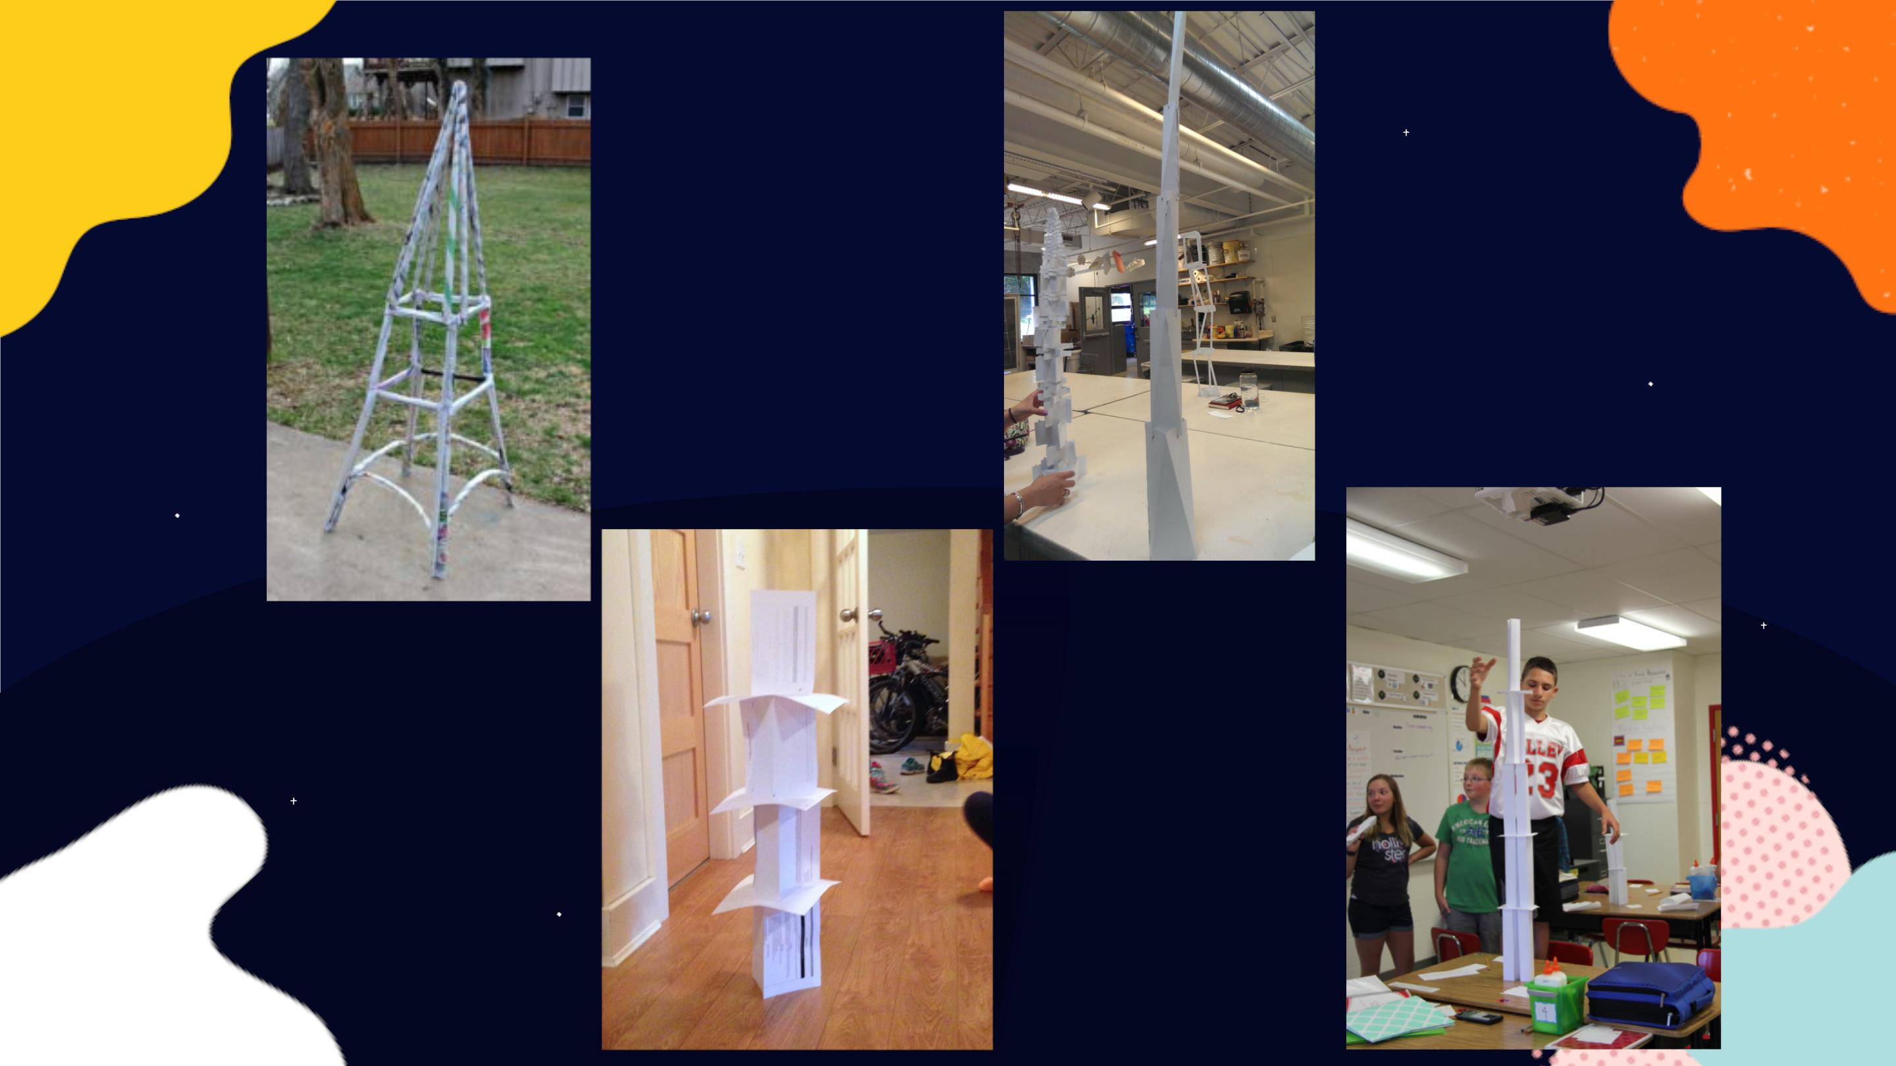

Slide 10


