Slide 1
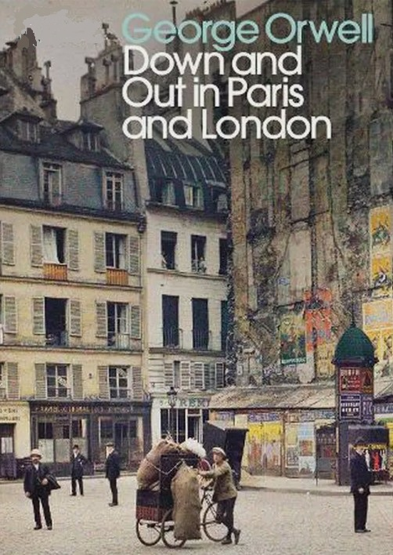

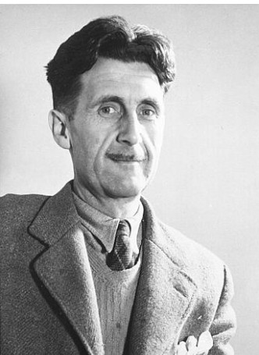
Secondary School Level
Building Basic Expository Writing Skills
By studying a masterpiece of autobiography
Instructor: Andrew Ness

Slide 2
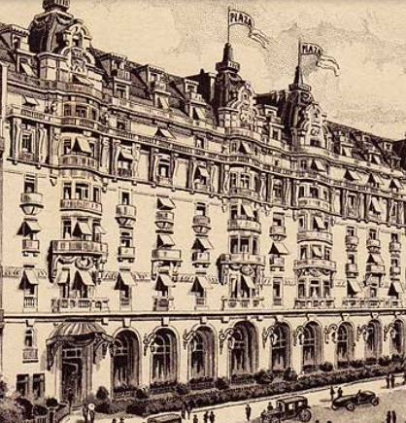
The Hotel X: first passage
The Hotel X was a vast grandiose place with a classical façade, and, at one side, a little dark doorway like a rat-hole, which was the service entrance. I arrived at a quarter to seven in the morning. A stream of men with greasy trousers were hurrying in and being checked by a doorkeeper who sat in a tiny office. I waited, and presently the chef du personnel, a sort of assistant manager, arrived and began to question me. He was an Italian, with a round, pale face, haggard from overwork. He asked me whether I was an experienced dishwasher, and I said that I was; he glanced at my hands and saw that I was lying, but on hearing that I was an Englishman he changed his tone and engaged me. “We have been looking for someone to practice our English on” he said. “Our clients are all Americans, and the only English we know is……..” He repeated something that little boys write on the walls in London. “You may be useful. Come downstairs.

Slide 3
Textual analysis no.1
The Hotel X was a vast grandiose place with a classical façade, and, at one side, a little dark doorway like a rat-hole, which was the service entrance
Vast, grandiose place (adverb, adjective, noun)
With a classical façade (façade= the principal front of a building, that faces on to a street or open space, a deceptive outward appearance.
A little dark doorway (adverb, adjective noun)
Like a rat-hole (like, a conjunction to replace “as if, as though”)
Which was the service entrance (“which” is a relative pronoun, and is subject of a relative clause – a part of a sentence which gives more information about the subject)

Slide 4
Textual analysis no.1
The Hotel X was a vast, grandiose place with a classical façade, and, at one side, a little dark doorway like a rat-hole, which was the service entrance.
In this passage, which is key to introducing the hotel, the writer uses the literary device of “identity by contrast” to indicate that the X hotel is a place where two kinds of identities are molded, produced and supported by the environment.
By what descriptive device does he accomplish this?

Slide 5
Textual Analysis No.2
A stream of men with greasy trousers were hurrying in and being checked by a doorkeeper who sat in a tiny office.
A stream of men (“of” preposition referring to an amount, “flock of gulls” “swarm of ants” “pride of lions”) (Humans not usually referred to as “a stream” unless the author wishes to depersonalize them. Human groupings more likely called nation, company, team, club, gang, mob, crowd, tribe)
With greasy trousers (why does Orwell pick out this detail?)
Were hurrying in (why doesn’t Orwell write “were walking in?”)
And being checked by a doorkeeper (why does Orwell switch to the past progressive Passive voice here?)
Who sat in a tiny office (why doesn’t Orwell describe the doorkeeper sitting in a spacious office?)

Slide 6
Textual Analysis No.2
I arrived at a quarter to seven in the morning. A stream of men with greasy trousers were hurrying in and being checked by a doorkeeper who sat in a tiny office.
Question: what facts does the author present to signal to us that he is A) describing a rat race, and to further indicate that this is the world of the urban poor?
What linguistic devices does the writer use to further support this impression.

Slide 7
Textual analysis no.3
I waited, and presently the chef du personnel, a sort of assistant manager, arrived and began to question me. He was an Italian, with a round, pale face, haggard from overwork
He was an Italian (why emphasize that he’s not French?)
With a round, pale face (suggests what about his physical condition?)
Haggard from overwork (from as a preposition of cause of something, “he looked peaked from his constant chain smoking”)
Question: What does the description of the assistant manager suggest about the Hotel X?

Slide 8
Textual analysis no.4
I waited, and presently the chef du personnel, a sort of assistant manager, arrived and began to question me. He was an Italian, with a round, pale face, haggard from overwork.
In this passage, the writer introduces facts to indicate that even medium level management positions in the hotel are not desirable, from the perspective of local Parisians. What are these facts?
The writer uses other observations to indicate that the place is a kind of sweat shop. What are these?

Slide 9
Textual analysis no.5
He asked me whether I was an experienced dishwasher, and I said that I was.
he glanced at my hands and saw that I was lying (why did the assistant manager only need to glance at the narrator’s hands, not examine them carefully)
Hearing that I was an Englishman, he changed his tone and engaged me. (Why is the assistant manager interested that the narrator is an Englishman?)

