Slide 1
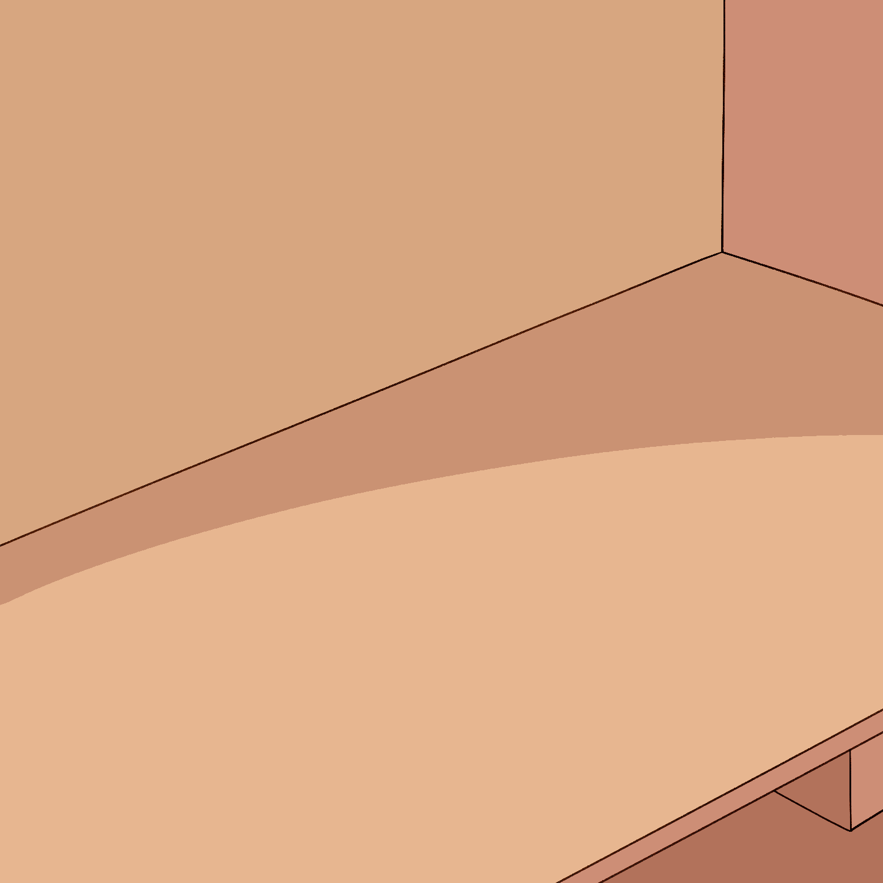
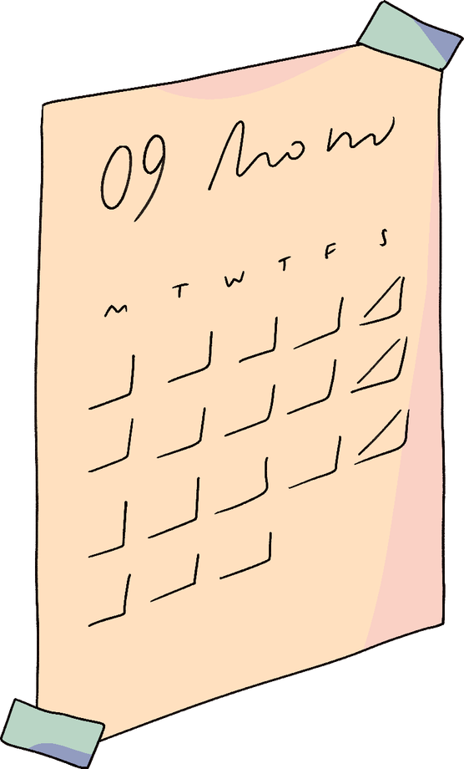
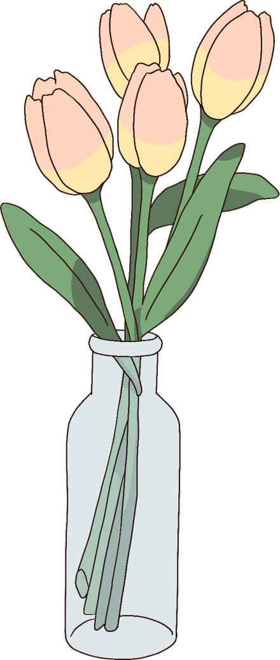
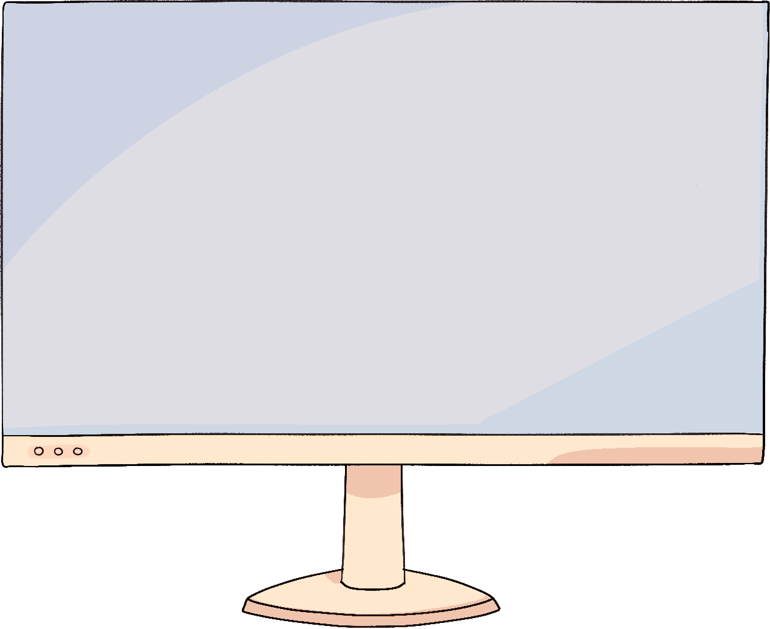

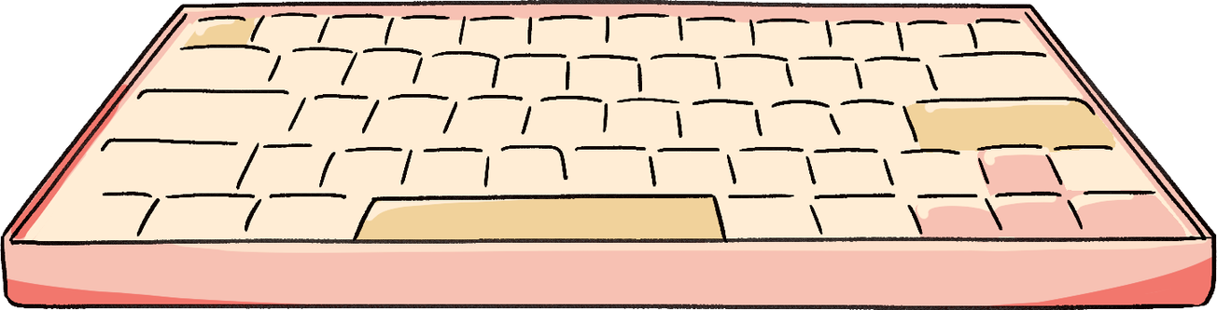
Sa
Paliparan
(At the airport)

Slide 2
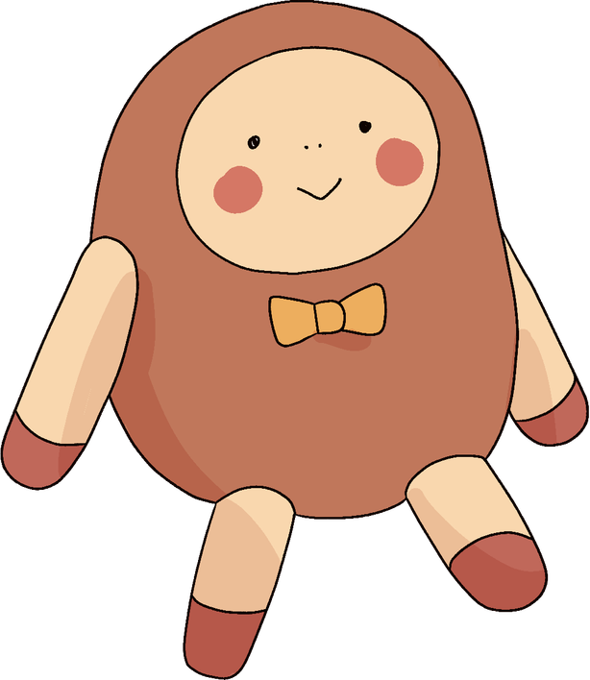
Objectives:
  Introduce yourself and address others
  Greet people at different times of the day
  form simple sentences

Slide 3
Dialogue 1
The Cook family has arrived at Ninoy Aquino International Airport (NAIA) in Manila. It is 7:30 in the evening. Afrindly customs official approaches them.
Opisyal- Magandang gabi po sa inyo. Kumusta kayo? Si Ginoong Santos ako. Anong pangalan ninyo?
Bill- Mabuti naman, salamat. Bill Cook ang pangalan ko.
Louise- Mabuti naman. Maraming salamat. Louise Cook ang pangalan ko.
Roy- Mabuti naman po. Salamat po. Roy Cook po ang pangalan ko.
Opisyal- Ikinagagalak ko kayong makilala.

Slide 4
TALASALITAAN
(Vocabulary)
  magandang gabi po
  sa inyo
  kumusta kayo
  anong pangalan ninyo?
  ang pangalan ko
  mabuti naman
  maraming salamat
  ikinagagalak ko kayong makilala
  mabuti rin naman
  mabuti po naman
  good evening (polite)
  to you (plural)
  how are you (polite)
  what’s your name? (formal)
  my name is ________.
  fine also
  thank you very much
  I’m pleased to meet you.
  I’m fine too.
  I’m fine too. (formal)

Slide 5
Translation
Officer- Good evening to you. How are you? I’m Mr. Santos.
Bill- I’m fine. Thank you. My name is Bill Cook.
Louise- I’m fine too. Thank you very much. My name is Louise Cook.
Roy- I’m fine too. My name is Roy Cook. Thank you.
Officer- I’m pleased to meet you.

Slide 6
Anong pangalan mo?
(What is your name?)
  Magandang umaga po
  Anong pangalan mo?
  Joe Bulman
  Sino ka?
  Si Phil ako.
  Sino po kayo?
  Si ginoong John Smith ako.
  Sino po kayo?
  Si Margaret Hough ako.
  Good morning.
  What’s your name?
  Joe Bulman
  Who are you?
  I am Phil.
  Who are you? (polite)
  I am John Smith.
  Who are you?
  I am Margaret Hough.

Slide 7
Addressing others
I, you, he/she etc.
SINGULAR PLURAL
1st person (speaker) ako (I) kami (we) excluding listener
tayo (we) including the listener
2nd person (spoken to) ka/ikaw (you) Kayo (you) plural
kayo (you)
3rd person( spoken about) siya (he/she) sila (they)

Slide 8
Exercise 1
Practice reading each sentence aloud. Follow the prounciation closely until you can repeat each word and sound with confidence.
TAGALOG
Si Mary Smith ako.
Si Letty ako.
Si Doktor Rivera kayo.
Si Ramon siya.
Pilipino kami.
Estudyante tayo.
Amerikano sila.
LITERAL TRANSLATION
Mary Smith I.
Letty I.
Doctor Rivera you.
Ramon he.
Filipino we.
Students we.
Americans they.
TRANSLATION
I am Mary Smith.
I am Letty.
You are Dr. Rivera.
He is Ramon.
We are Filipino.
We are students.
They are Americans.

Slide 9
Greeting people at different times of the day.
  Magandang umaga Good morning
  Magandang Tanghali Good noon
  Magandang Hapon Good afternoon
  Magandang Gabi Good evening
  6:00 am Good ________
  6:30 pm Good_________
  12:00 am Good _________
  3:00 pm Good _________

Slide 10
maraming
salamat

