Slide 1
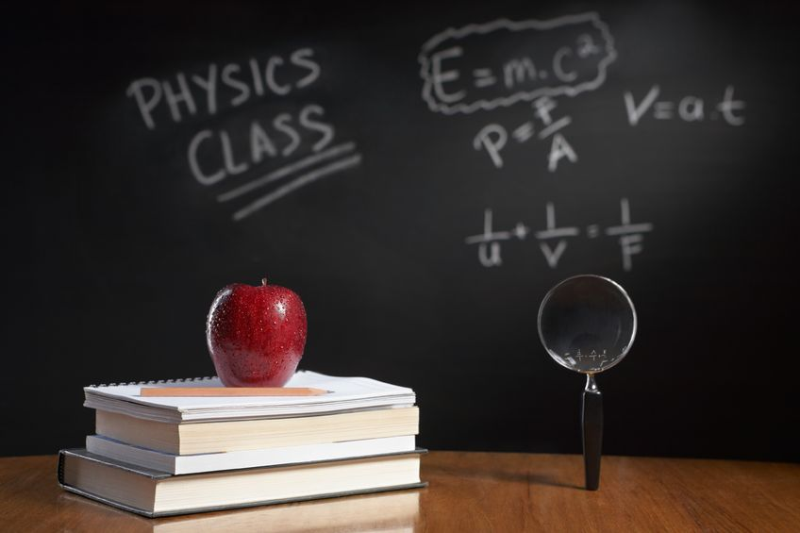
PHYSICS – Work and Power

Slide 2
LEARNING OBJECTIVES
1.7.3 Work Core • Demonstrate understanding that work done = energy transferred • Relate (without calculation) work done to the magnitude of a force and the distance moved in the direction of the force 1.7.4 Power Core • Relate (without calculation) power to work done and time taken, using appropriate examples | Supplement • Recall and use W = Fd = ∆E Supplement • Recall and use the equation P = ∆E / t in simple systems

Slide 3

Work, work, work ……

Slide 4
Work, work, work ……
When a force moves an object it does work and energy is transferred to the object.

Slide 5
When a force moves an object it does work and energy is transferred to the object.
Work, work, work ……
Energy supplied
Work done
Energy transferred

Slide 6
When a force moves an object it does work and energy is transferred to the object.
Work, work, work ……
Energy supplied
Work done
Energy transferred
Amount of energy transferred (J) = Work done (J)

Slide 7
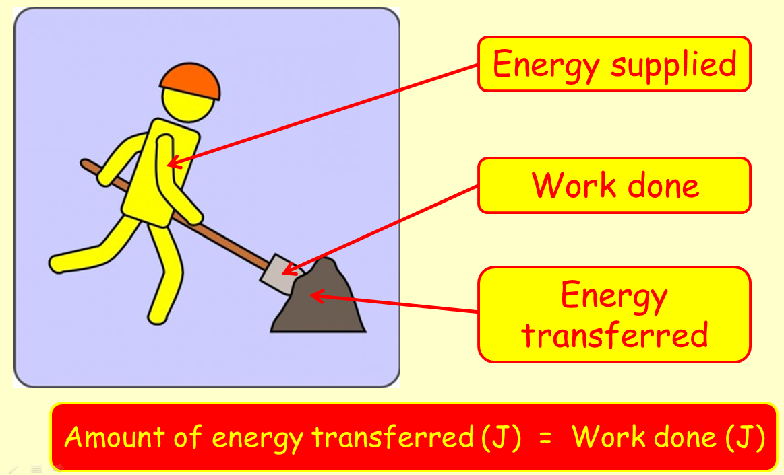
Work, work, work ……
When a force moves an object it does work and energy is transferred to the object.
The man shovelling is doing work. If he does 600J of work, then he loses 600J of energy. The substance being shovelled gains energy - but not the full 600J, as some is lost as sound and heat.

Slide 8
Work
Work is done whenever a force makes something move.

Slide 9
Work
Work is done whenever a force makes something move.
The greater the force, and the greater the distance moved, the more work is done.

Slide 10
Work
Work is done whenever a force makes something move.
The greater the force, and the greater the distance moved, the more work is done.
When work is done energy is transferred from one form into another.

Slide 11
Work
Work done = force x distance
W = F x d
Work is measured in Joules

Slide 12
Work
Work done = force x distance
Eg. if a 4 N force moves a distance of 3m
W = 4 x 3 = 12 J

Slide 13
Work
Work
W
Force
F
d
Distance

Slide 14
Work
Work
W = F x d
W
Force
F
d
Distance

Slide 15
Work
Work
W = F x d
W
F = W
d
Force
F
d
Distance

Slide 16
Work
Work
W = F x d
W
F = W
d
Force
F
d
d = W
F
Distance

Slide 17
Power and Efficiency

Slide 18
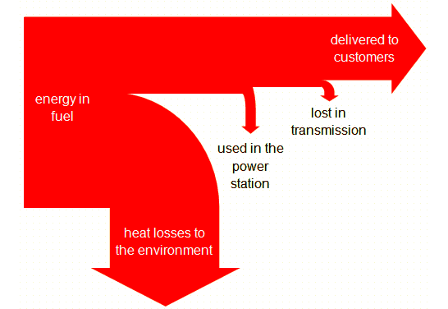
Power and Efficiency
efficiency = useful energy output
energy input × 100%

Slide 19
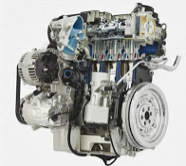
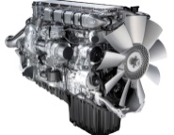
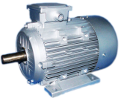

Power and Efficiency
Examples
Total energy input (J) | Engine / motor | Useful work done (J) | Efficiency (%)
100 |  | 25 | 25
100 |  | 35 | 35
100 |  | 80 | 80
100 |  | 15 | 15
Petrol engine
Diesel engine
Electric motor
Human body

Slide 20

Power and Efficiency
Power is the rate at which work is done.

Slide 21
Power and Efficiency
Power is the rate at which work is done.
The unit of power is the watt (w).

Slide 22
Power and Efficiency
Power is the rate at which work is done.
The unit of power is the watt (w).
One watt is energy transferred at the rate of one joule per second.

Slide 23
Power and Efficiency
power = work done
time taken

Slide 24
Power and Efficiency
power = work done
time taken
1000 W = 1 kilowatt (kW)

Slide 25
Power and Efficiency
power = work done
time taken
1000 W = 1 kilowatt (kW)
Typical power outputs:
Washing machine motor | 250 W
Athlete | 400 W
Small car engine | 35 000 W
Large car engine | 150 000 W
Large jet engine | 75 000 000 W

Slide 26
Power and Efficiency
power = energy transformed
time taken
power = E
t

Slide 27
Power and Efficiency
efficiency = useful power output
total power input × 100%

Slide 28
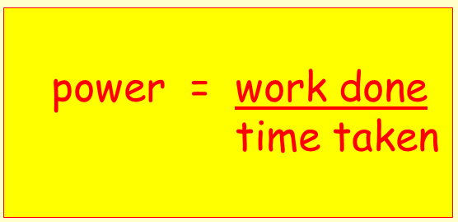
Power and Efficiency
Calculation examples
The weightlifter in the picture is pressing the weight above his head 50cm each time.
The weightlifter spends 3 minutes doing 60 lifts of 45 kg. Work out his power output.
convert the time to seconds, = 3 x 60 = 180s
work done = force x distance = 60 x 45 x 10 x 0.5 = 13 500 J
power = work done / time taken = 13 500 / 180 = 75 W

Slide 29
Power and Efficiency
Calculation examples
The weightlifter in the picture is pressing the weight above his head 50cm each time.
Work out the weightlifter’s total power output if he does 3 sets of 10 lifts with 70kg in 5 minutes.
convert the time to seconds, = 5 x 60 = 300s
work done = force x distance = (3 x 10) x 70 x 10 x 0.5 = 10 500 J
power = work done / time taken = 10 500 / 300 = 35 W

Slide 30
Power and Efficiency
Calculation examples
The weightlifter in the picture is pressing the weight above his head 50cm each time.
Over the next 10 minutes, he does 50 lifts of 40kg, 3 sets of 10 lifts with 75kg and 2 sets of 15 lifts with 60 kg. Work out his total power output to the nearest whole number.
convert the time to seconds, = 10 x 60 = 600s
total force = (50 x 40 x 10) + (30 x 75 x 10) + (30 x 60 x 10)
= 20 000 + 22 500 + 18 000 = 60 500
work done = 60 500 x 0.5 = 30 250 power = 30 250 / 600 = 50 W

Slide 31
Power and Efficiency
Calculation examples
The weightlifter in the picture is pressing the weight above his head 50cm each time.
The weightlifter’s maximum power output is 100 W. At maximum power, how many times can he lift 80kg in 4 minutes?
convert the time to seconds, = 4 x 60 = 240s
power = work done / time taken 100 = (n x 80 x 10 x 0.5) / 240
100 = (n x 400) / 240 100 x 240 = n x 400
(100 x 240) / 400 = n n = 24 000 / 400 = 60 reps

Slide 32
LEARNING OBJECTIVES
1.7.3 Work Core • Demonstrate understanding that work done = energy transferred • Relate (without calculation) work done to the magnitude of a force and the distance moved in the direction of the force 1.7.4 Power Core • Relate (without calculation) power to work done and time taken, using appropriate examples | Supplement • Recall and use W = Fd = ∆E Supplement • Recall and use the equation P = ∆E / t in simple systems

Slide 33
PHYSICS – Work and Power

