Slide 1
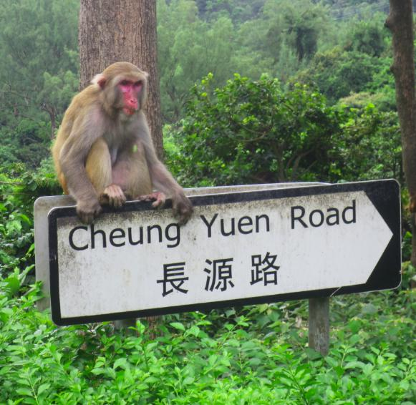

P3-P4
Reading and Writing skills
Instructor: Andrew Ness

Slide 2
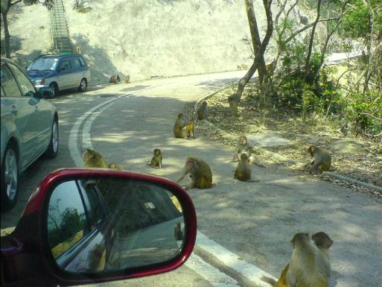
Why choose Kam Shan Country Park?
Amazing fauna: Hong Kong’s largest population of feral Macaques
Unusual flora: attractive wild flowers/plants:
Very scenic: presence of four waterfalls give it extraordinary water features
Panoramic views of Hong Kong: from the slopes of Kam Shan (Golden Hill)
Convenient transportation connectivity
Good walking trails: only moderately difficult ascent in walking uphill

Slide 3
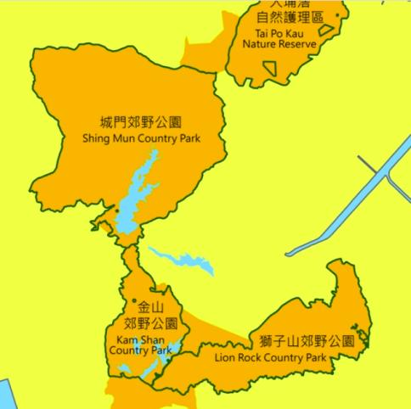
Where is Kam Shan Country Park located?
Occupying 339 hectares and tucked away in the hills behind northwestern Kowloon and Sha Tin lies a hidden wealth of picturesque landscapes shrouded in thick jungle.
interspersed with azure lakes, the Kam Shan Country Park lies mainly in reservoir catchment areas. Named after its populations of wild monkeys, Kam Shan Country Park (Monkey Hill) is the domain of Hong Kong’s feral Rhesus Macaques.

Slide 4
Questions for Slide Six
How large is Kam Shan Country Park?
Where is Kam Shan Country Park located?
What is the Kam Shan Country Park’s predominant natural feature?
Why is Kam Shan sometimes referred to as “Monkey Hill”?

Slide 5

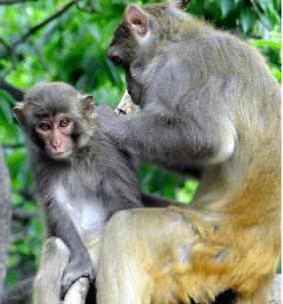
Kam Shan: Hong Kong’s leading macaque kingdom
Kam Shan, or Monkey Hill to most locals, is a famous macaques kingdom in Hong Kong.
The macaques are the largest group of mammals in the park. The most significant species occurring here are rhesus macaque (Macaca mulatta) and long-tailed macaque (Macaca fascicularis). These monkeys are probably descendants of monkeys released in the 1910s, whereas the original wild macaque groups native to Hong Kong have almost disappeared due to habitat destruction and over-hunting.
Apart from monkeys, this Country Park is also a shelter of squirrels and many bird species. There are about 2,100 wild monkeys in Hong Kong, about 1,800 of them in Kam Shan country park

Slide 6
Questions for Slide Seven
Why is Kam Shan Park sometimes referred to as “the largest monkey kingdom in Hong Kong?”
Are the macaques living here the descendants of the original wild monkeys, native to this region? If not, then why not?
Apart from macaques, what other kinds of wildlife can be seen in Kam Shan Country Park?

Slide 7
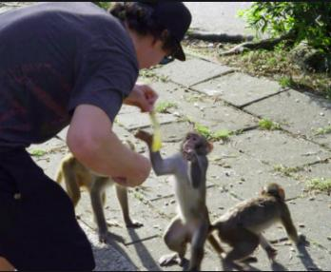
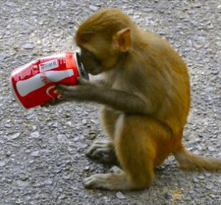
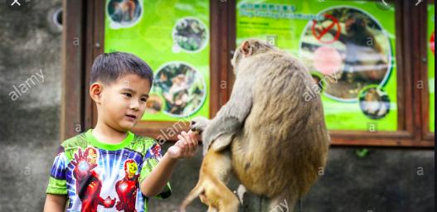
Many signs warn visitors: DO NOT FEED THE MONKEYS
.
There are many signs warning visitors to NOT feed the monkeys. Apparently, many people don’t understand this, as I saw a man feeding bananas to some macaques from his van. This has become a huge problem over the years and is clearly why these monkeys will get up close and personal when they see humans around.
If you are carrying a bag containing food, or which even looks like it might contain food, the macaques can become quite aggressive and will snatch the plastic bag out of your hand thinking that it may contain delicious treats. You should also probably not stare at them, which I learned the hard way.

Slide 8
Questions for Slide Eight
Why are there numerous signs posted warning visitors DO NOT FEED THE MONKEYS posted all over the park?
Do all visitors to the park generally obey the warning sign’s instructions?
With respect to the park’s large monkey population, are they generally shy when they see humans around?
If one wishes to avoid attracting the attention of the park’s macaques, what are two thing which one must avoid doing?

