Slide 1
Mathematics: applications and interpretation
(sample)

Slide 2
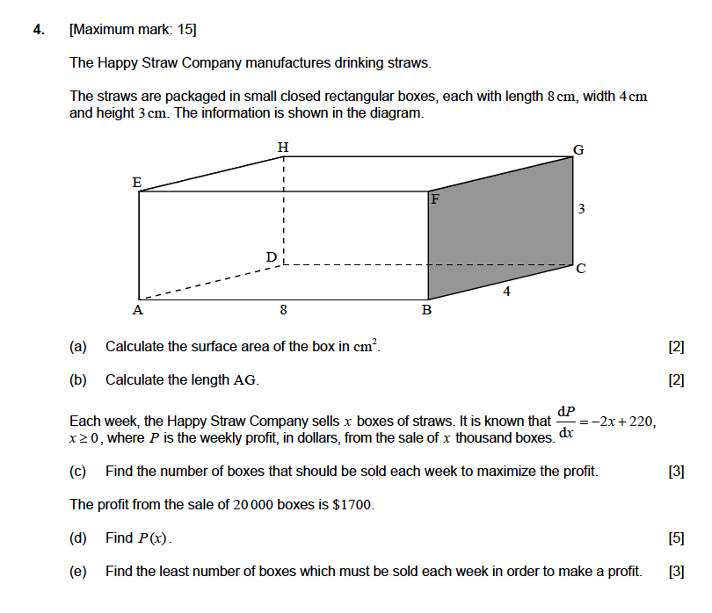
Question

Slide 3












Solution
a.) The surface area of the box can be solved by the equation
$$SA=2 (l∗w+l∗h+w∗h)$$
$$SA=2 (8∗4+8∗3+4∗3)$$
$$h$$
$$SA=2 (32+24+12)$$
$$SA=2 (68)$$
$$w$$
$$l$$
$$SA=136 {cm}^{2}$$
b.) Label the xyz coordinates of points A and G, with A at the origin. Apply the distance formula of a 3D plane.
$$AG=\sqrt{{\left(x_{2}−x_{1}\right)}^{2}+{\left(y_{2}−y_{1}\right)}^{2}+{\left(z_{2}−z_{1}\right)}^{2}}$$
(0,4,3)
(8,4,3)
(0,0,3)
$$AG=\sqrt{{\left(8−0\right)}^{2}+{\left(4−0\right)}^{2}+{\left(3−0\right)}^{2}}$$
$$AG=\sqrt{{\left(8\right)}^{2}+{\left(4\right)}^{2}+{\left(3\right)}^{2}}$$
$$AG=\sqrt{64+16+9}$$
(8,4,0)
(0,0,0)
(8,0,0)
$$AG=\sqrt{89}$$
$$AG=9.43 cm$$

Slide 4


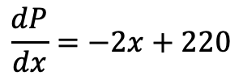



Solution
c.) The number of boxes to maximize the profit can be calculated through the derivative (dP/dx). Set the derivative to zero and solve for x.
$$\frac{dP}{dx}=−2x+220$$
$$−2x+220=0$$
$$220=2x$$
$$x=110$$
Quick verification via derivative substitution
$$x<110, m>0$$
$$x>110, m<0$$
Hence, 110 gives maximum P
Since the question asked about the number of boxes and x represents thousand boxes,
$$110∗1000$$
$$the maximum profit per week can be achieved at 110000 boxes$$

Slide 5


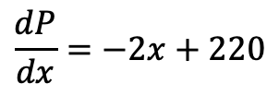


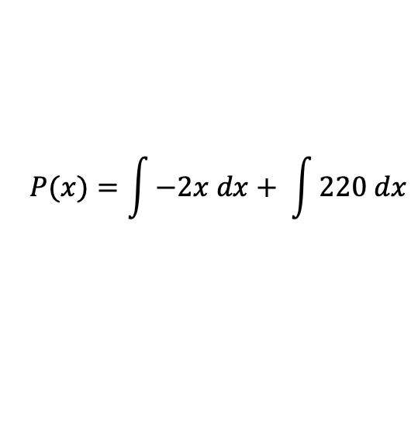

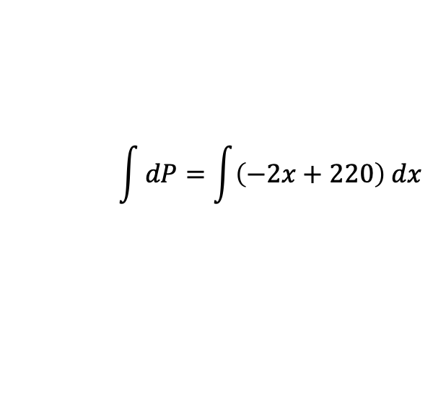



Solution
d.) Finding the function (i.e. equation) from the derivative calls the indefinite integral approach, then solve the integration constant ”c” to complete the function
$$\frac{dP}{dx}=−2x+220$$
$$\int{dP=\int{\left(−2x+220\right) dx}}$$
$$dP=\left(−2x+220\right) dx$$
$$P(x)=\int{−2x dx+ \int{220 dx}}$$
$P(x)=−2$ $\left(\frac{x^{1+1}}{1+1}\right)+220x+c$
$P(x)=−2$ $\left(\frac{x^{2}}{2}\right)+220x+c$
$P(x)=−$ $x^{2}+220x+c$
P= 1700 when x= 20 (20000 boxes), solve for c
$1700=−$ (${20)}^{2}+220 (20)+c$
The complete function is,
$$1700=−400+4400+c$$
$P(x)=−$ $x^{2}+220x−2300$
$$c=−2300$$

Slide 6




e.) The least number of boxes required to make a profit can be solved by equating the profit function to 0 and solve for x
$P(x)=−$ $x^{2}+220x−2300$
$−$ $x^{2}+220x−2300=0$
(Solve for the roots using GDC)
$$x_{1}=11.0051$$
$$x_{2}=208.995$$
Between the two values of x, 208.995 does not make sense since we know in part c that the maximum profit can be achieved at x = 110. Hence, 11.0051 would be a better candidate for the least number of boxes to make a profit.
Since x represents thousand boxes,
$$number of boxes=11.0051∗1000=11, 005$$
But the question requires us to make a profit, adopting 11,005 would only give zero based on the roots. Hence,
$$the least number of boxes to make a profit:11, 006 boxes$$

