Slide 1
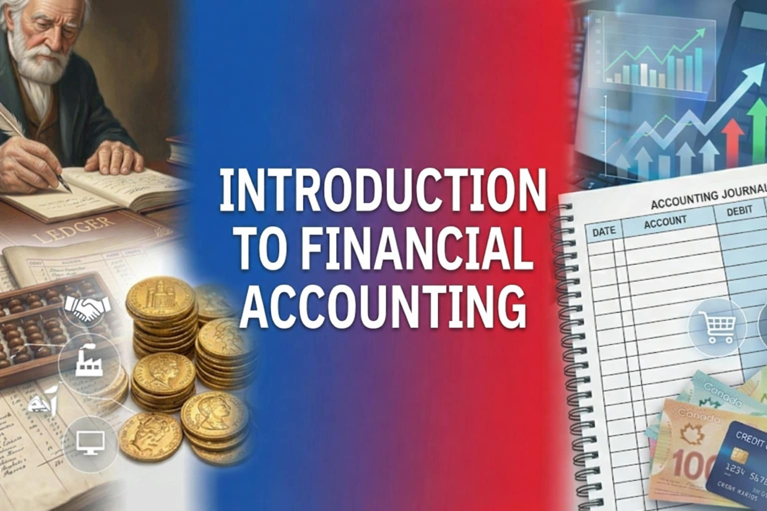

Slide 2
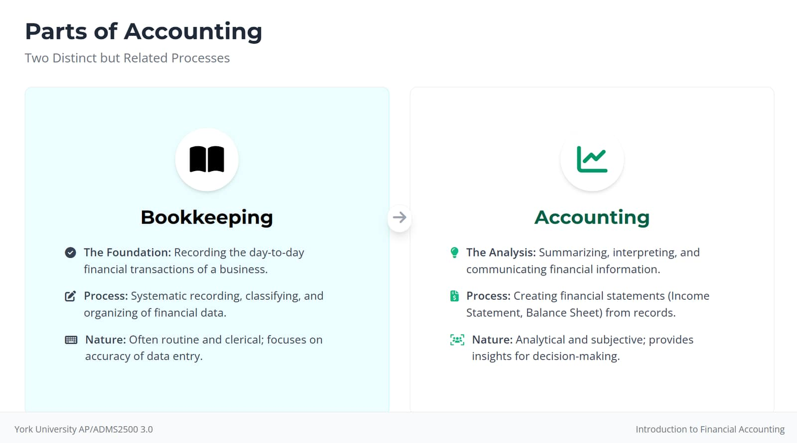

Slide 3
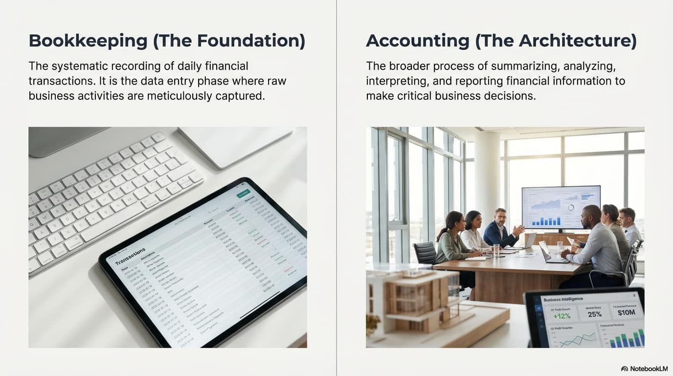

Slide 4
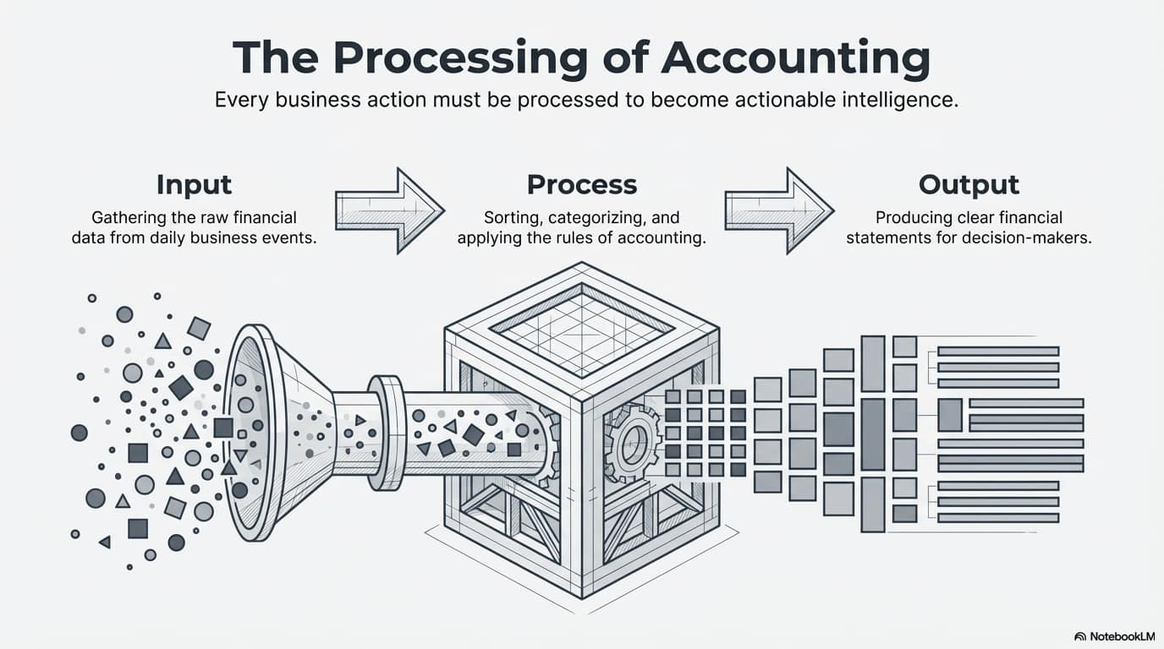

Slide 5
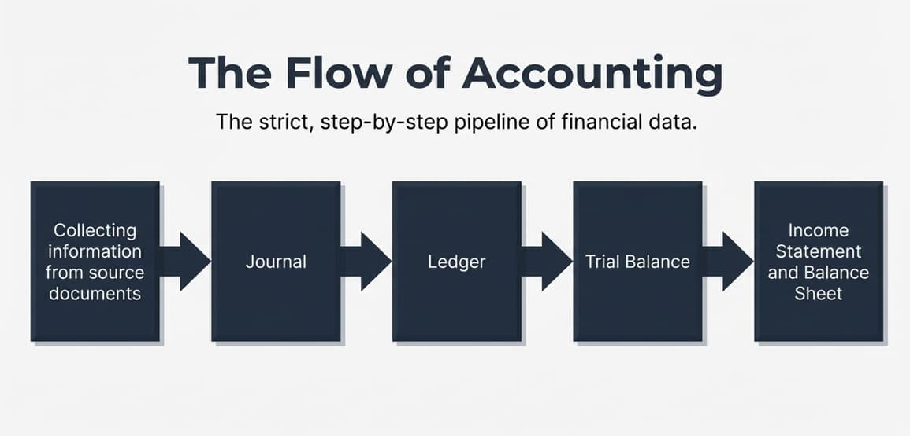

Slide 6
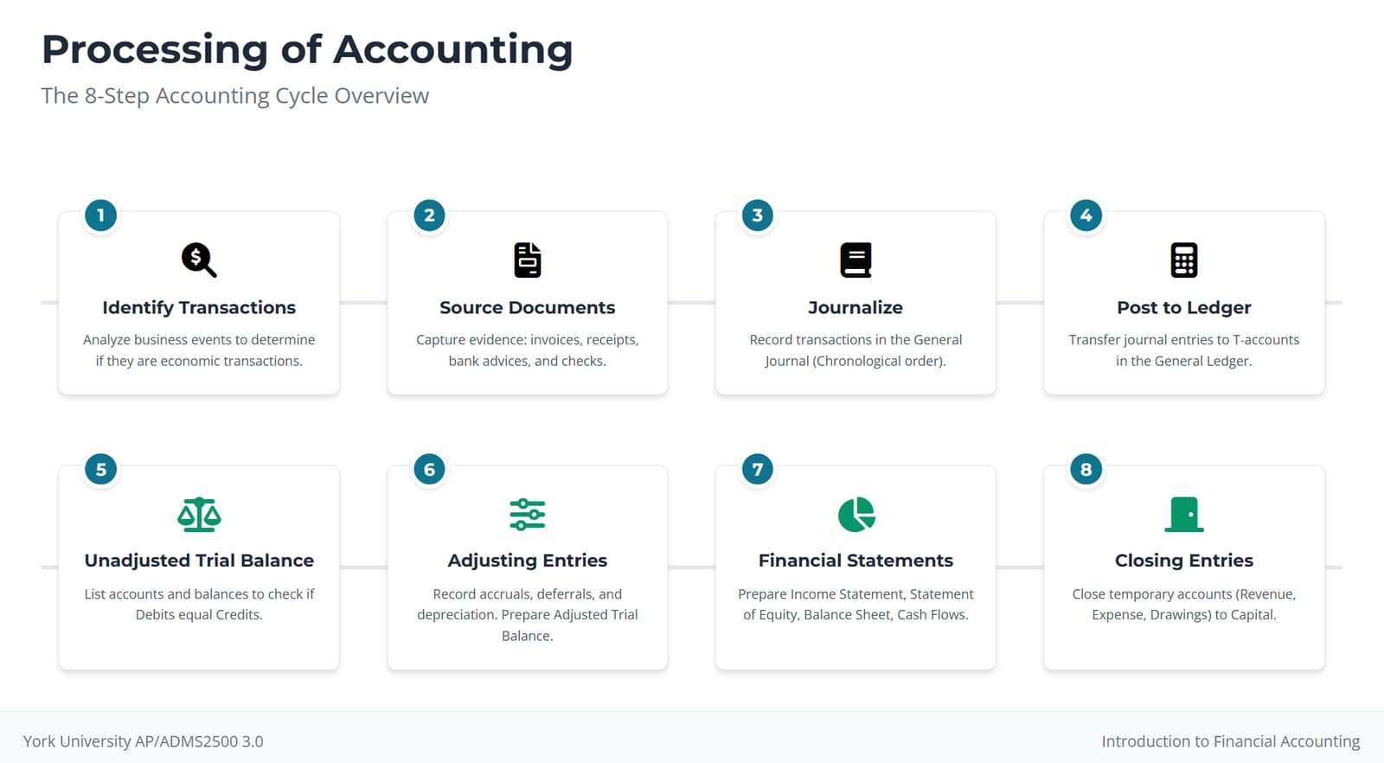

Slide 7
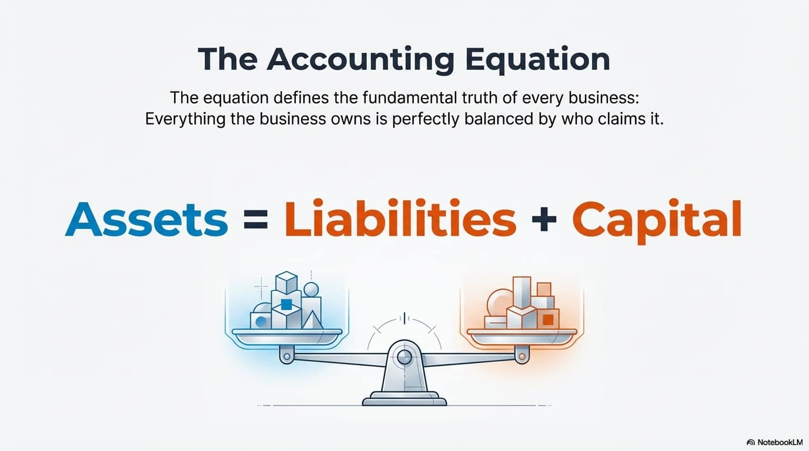

Slide 8
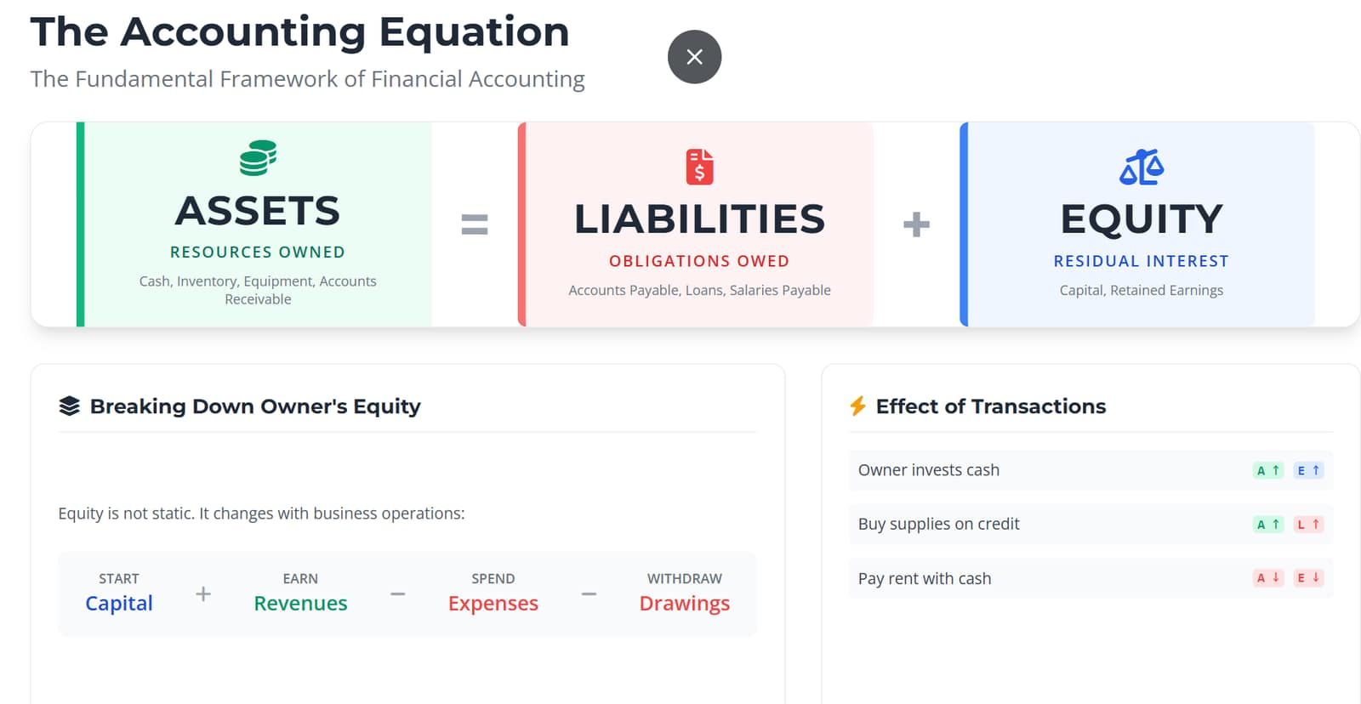

Slide 9
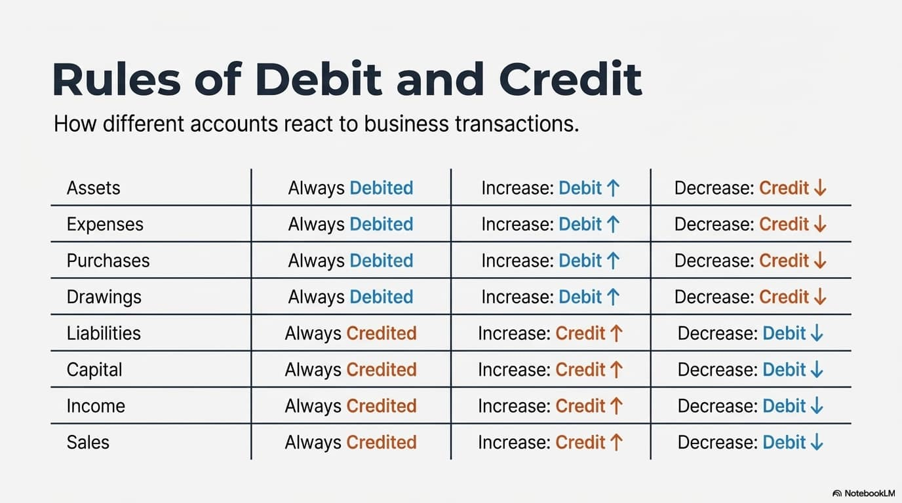

Slide 10
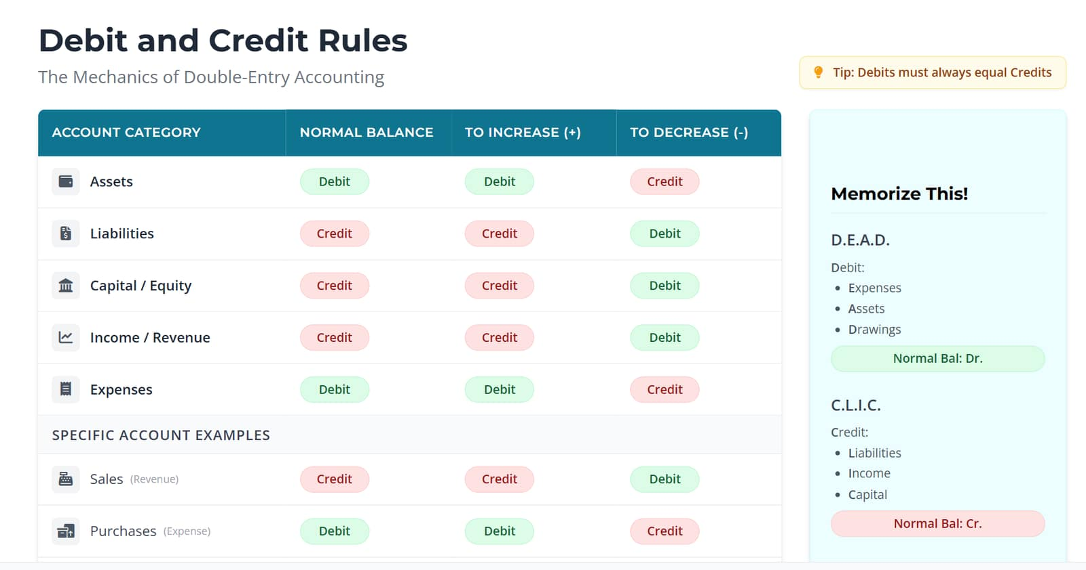

Slide 11
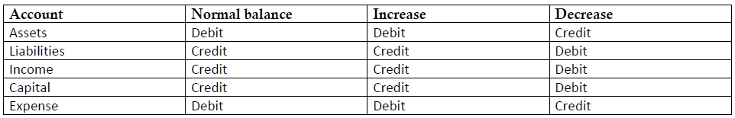
ALICE

Slide 12
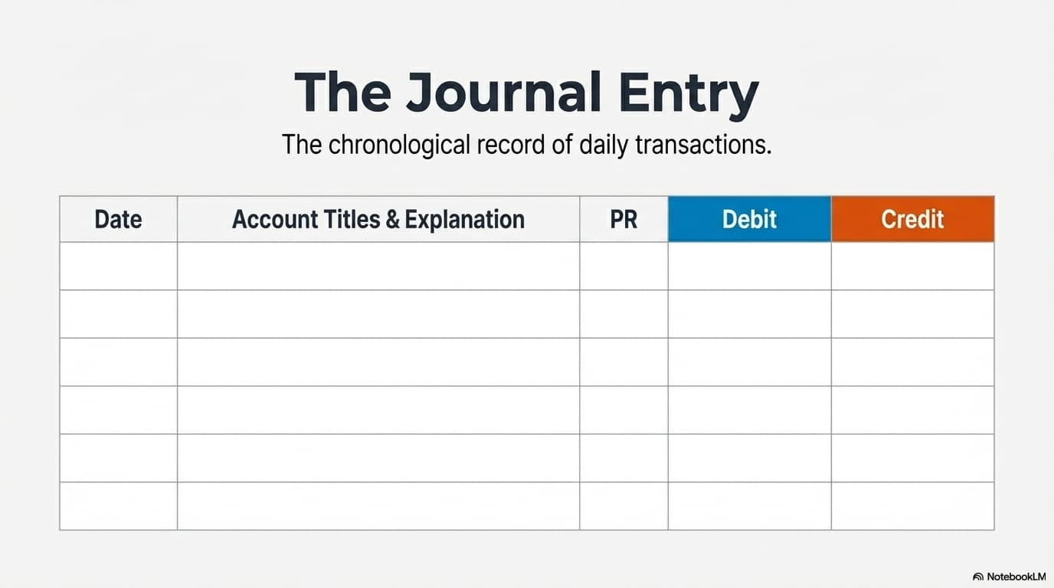

Slide 13
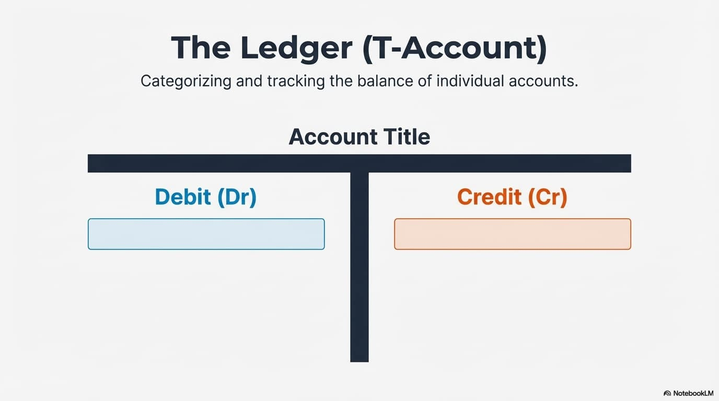

Slide 14
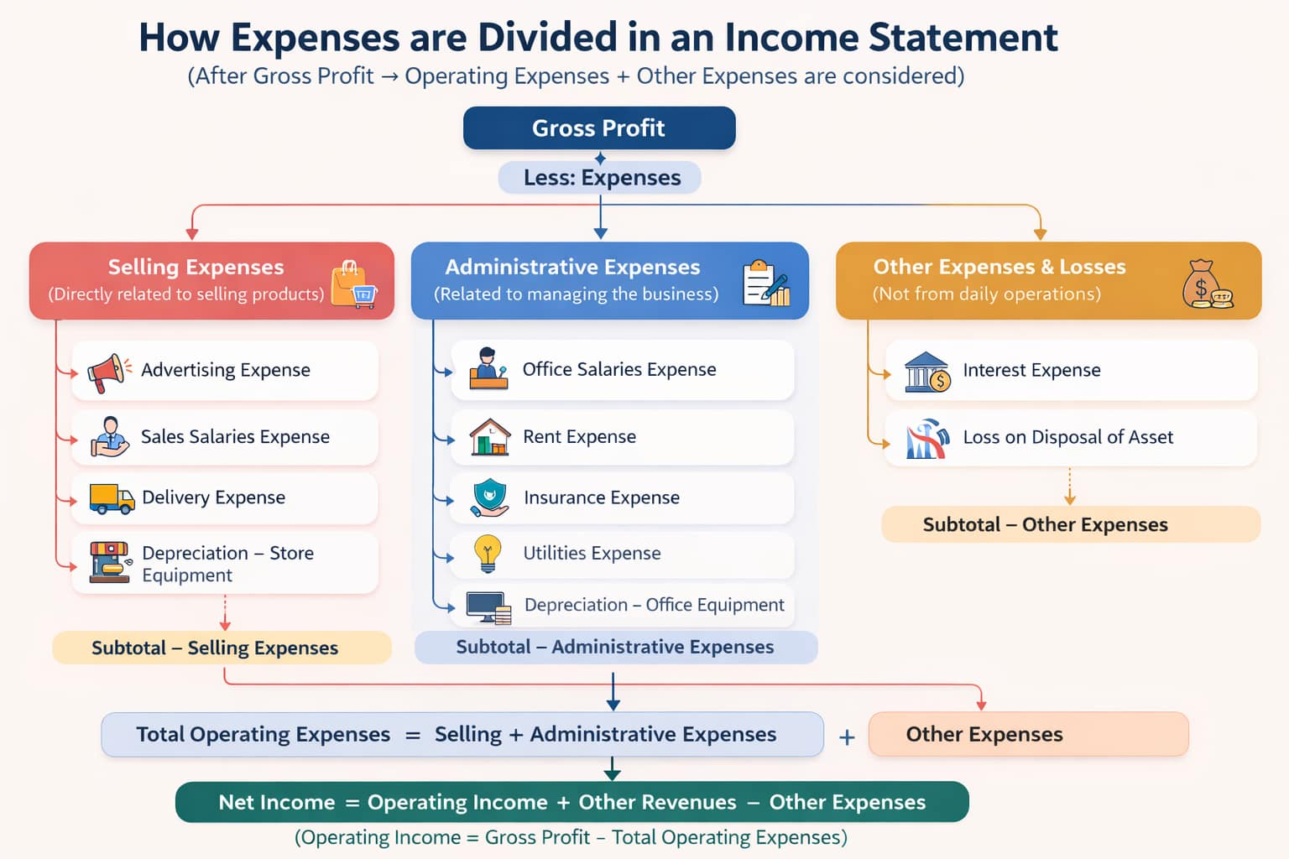

Slide 15
Income Statement Step by Step
Calculate Net Sales
Sales Revenue − Sales Returns − Sales Discounts
2) Calculate Cost of Good Sold
=>Beginning Inventory +Purchases +Freight-in - Purchase Returns
− Purchase Discounts
3) Calculate Gross Profit
Net Sales- Cost of Goods Sold
4) Calculate Operating Income
=> Gross Profit - Operating Expenses(Selling+Admin)
5) Net Income
=> Operating Income + other Income – Other expense

Slide 16
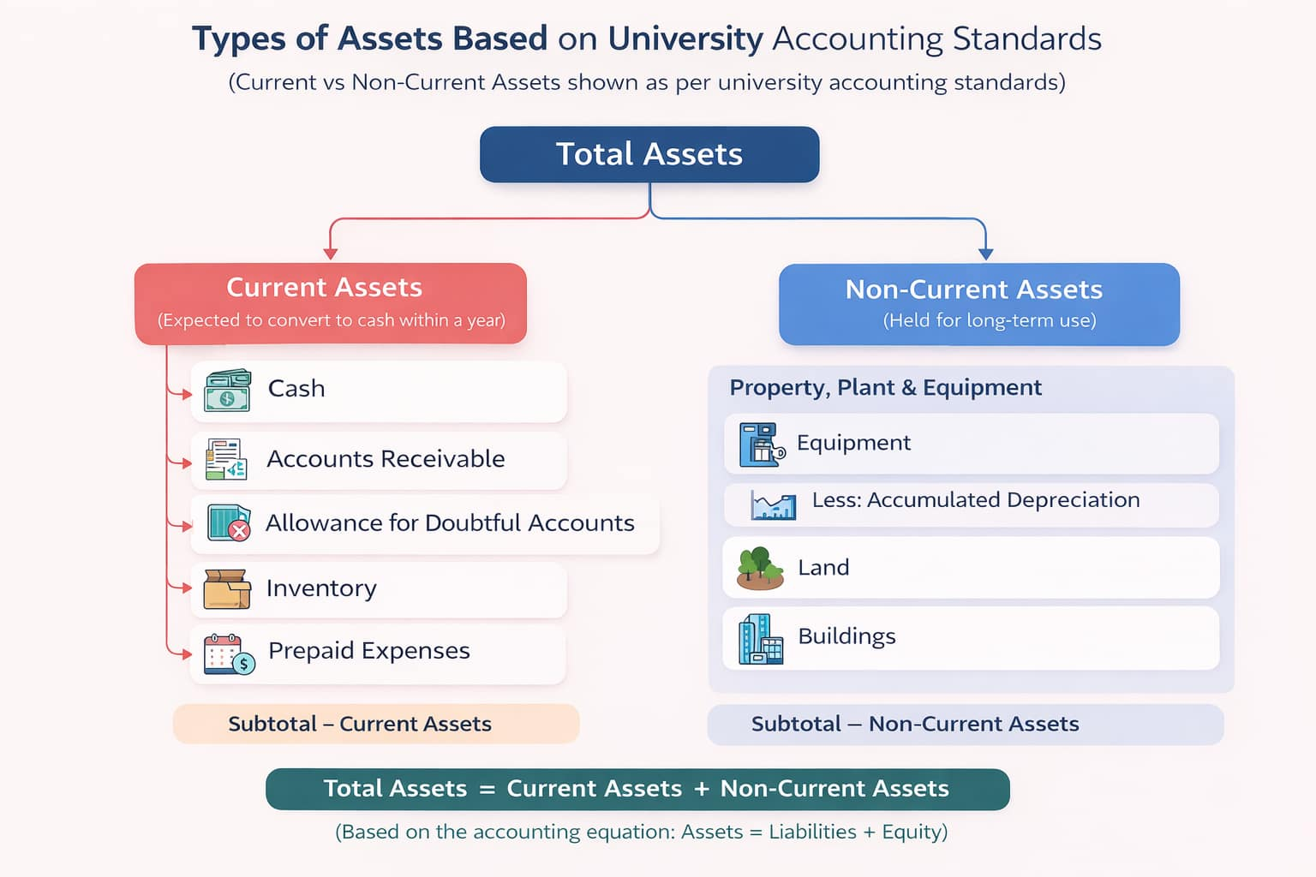

Slide 17
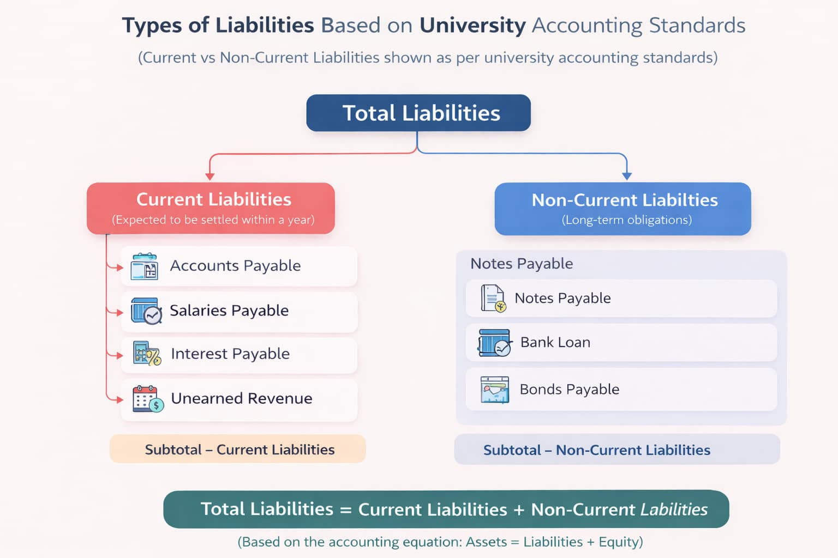

Slide 18
Balance Sheet Step by Step
Calculate Total Assets
Current Assets + Non- Current Assets
2) Calculate Liabilities
=>Current Liabilities + Non- Current Liabilities
Calculate Capital
=> Opening Capital + Net Income( profit) - Drawings
4) ASSETS= LIABILITIES+CAPITAL

Slide 19
Acknowledgement of Sources
This presentation includes selected images and concepts adapted from textbooks and educational resources to support student understanding. All rights and credit belong to the respective authors and publishers.

