Slide 1



English for Adult Learners:
Basic Language Skills
Instructor:
Andrew Ness

Slide 2

Table of contents
The five “W” questions + “How”
  Who?
  What?
  Where?
  When?
  Why?
  How?

Slide 3

The Five W questions + How?

Slide 4
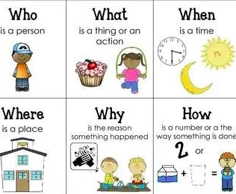
What are the 5 W questions + How ?

Slide 5

Who? questions
Who? questions 誰提問

Slide 6
Who told you about this job opportunity?
Example:
Question: Who told you about this job opportunity?
Answer: My Aunt Mary read about it on Indeed. com informed me by WhatsApp
Exercise:
Student 1 ask a “Who” question
Student 2 answer the “Who” question

Slide 7
More examples of Who? questions
Teacher’s examples
Who called our home last night at 11:00 pm?
Who did you invite to your birthday party?
Who is currently ranked the No.1 male tennis player in the world?
Who do you think will become our company’s next managing director, now that Nigel has retired?

Slide 8

Pose some of your own “Who?” questions
Who did you invite, when you took your friends out for dinner last night?
Your answer:

