Slide 1
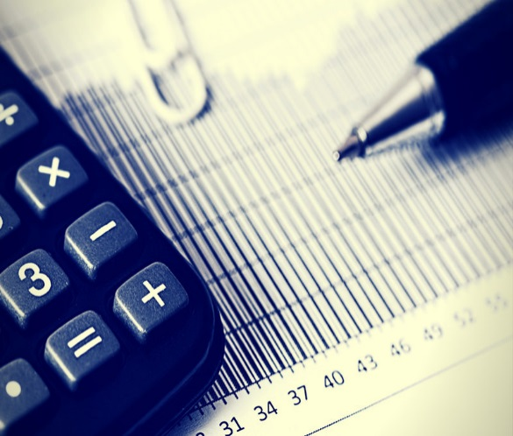
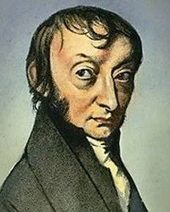
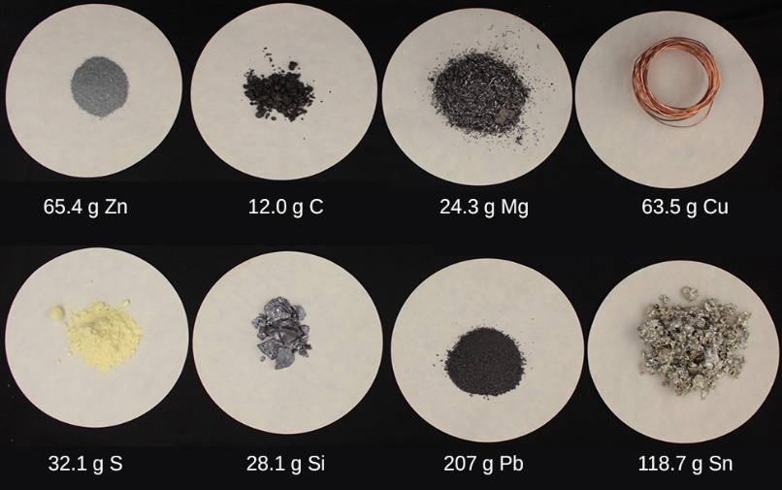
Chemistry Calculations - Moles
Chemistry – mole calculations
Lesson to teach pupils (i) Relative formula mass (ii) Avogadro’s number (iii) mole calculations of masses via:
Teacher led explanation of concepts
Teacher led worked examples of calculations
Pupil exercises (mini whiteboard use encouraged)

Slide 2
Chemistry Calculations - Moles
Learning Intentions:
Explain what is meant by and be able to calculate the relative formula mass of compounds
Be able to explain what is meant by a mole in terms of Avogadro’s number
Be able to calculate masses from moles and vice versa

Slide 3
Part 1: Relative Formula Mass (M_{r})
Each element has a Relative Atomic Mass (A_{r}).
This shows an element’s mass compared to others.
Use the periodic table to complete the table
Element | Relative Atomic Mass
Ca
Cl
S
Ar

Slide 4
Relative Formula Mass (M_{r})
If we add up all the A_{r} numbers present in a chemical we
get the Relative Formula Mass (M_{r})
Example:
H₂O =
2 X Hydrogen + 1 X Oxygen
A_{r} numbers
= (2 X 1) + (1 X 16)
= a relative formula mass of 18

Slide 5
Relative Formula Mass (M_{r})
Example 2:
NaOH =
1 X sodium + 1 X oxygen + 1 X hydrogen
= (1 X 23) + (1 X 16) + (1 X 1)
= a relative formula mass of 40

Slide 6
Relative Formula Mass (M_{r})
On your mini whiteboards complete the Mr for the following chemicals
Chemical | M_{r}
HCl
O₂
HNO₃
H₂SO₄
(NH₄)₃PO₄

Slide 7
Relative Formula Mass (M_{r})
On your mini whiteboards complete the Mr for the following chemicals
Chemical | M_{r}
HCl | 36.5
O₂ | 32
HNO₃ | 63
H₂SO₄ | 98
(NH₄)₃PO₄ | 149

Slide 8
(NH₄)₃PO₄
Sometimes it’s easier to split the chemical into 2 halves
1) (NH₄)₃
N = 14 X 1
H = 1 X 4
NH₄ = 18
(NH₄)₃ = 18 X 3 = 54
2) PO₄
P = 31 X 1
O = 16 X 4
PO₄ = 95
54 + 95 = a relative formula mass of 149

Slide 9
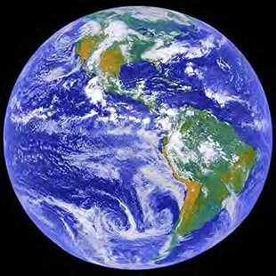
Part 2: The Mole
The mole is a word that presents a number.
We use it to tell us how many particles there are in a substance.
If you had 1 mole of apples you would have 602,214,150,000,000,000,000,000 (6.02 X 10²³) apples
This is approximately the same size as

Slide 10
How big is a mole?
A mole of sand grains would cover the United States in approximately one centimetre of sand.
A human body contains roughly one hundred trillion cells; there are roughly six billion people on Earth; so the total number of human cells on the planet is very close to one mole.
If you had exactly one mole of sheets of paper, you could make one million equal stacks from sea level on the earth that would pass the sun.
If you had a mole of pennies, you could give out enough money to everyone in the world so that they could spend a million dollars every hour, day and night, for the rest of their lives.

Slide 11
Avogadro’s Constant
This number, 6.02 X 10²³, is known as
Avogadro’s Constant
If you have 6.02 X 10²³ of anything you
have 1 mole of it
1 mole of H₂O is 6.02 X 10²³ water molecule.
1 mole of O₂ is 6.02 X 10²³ oxygen molecules
1 mole of apples is 6.02 X 10²³ apples

Slide 12
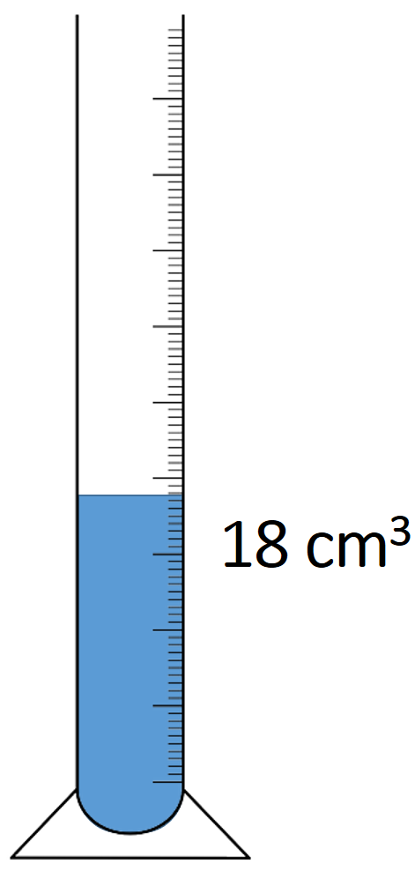
The Mole
The mass of 6.02 X 10²³ molecules of water is 18g
What is the relative formula mass of water?
18
What is the relationship between the M_{r}
and 1 mole of a chemical?
1 mole of a chemical is equal to the Relative Formula Mass in grams

Slide 13

The Mole
Each of the following contain 1 mole of atoms, 6.02 X 10²³

Slide 14
The Mole
I have 40g of NaOH
The Relative Formula Mass (M_{r}) is = 40
Therefore I have 1 mole NaOH
M_{r} = 40
1 mole = 40g
0.5 moles = 20g
0.25 moles = 10g

Slide 15
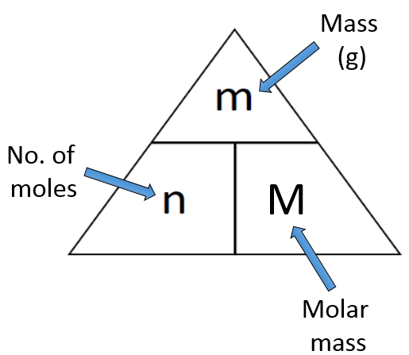
Part 3: Mole Calculations
We can use moles, n, and M_{r} to work out mass of chemicals needed/used in an experiment
m = n X M_{r}
n = m/ M_{r}
M_{r} = m/n
r

Slide 16
Mole Calculations
If I have 9g of water, how many moles do I have?
n = m/M_{r}
n = 9g/18
n = 0.5
What is the mass of
0.25 moles N₂?
r
m = n X M_{r}
m = 0.25 X 28
m = 7g

Slide 17
Mole Calculations
Complete these on your whiteboards (show your working)
1. If I have 36g water how many moles do I have?
2. If I have 5g NaOH how many moles do I have?
3. What is the mass of 0.5 moles O₂?
4. What is the mass of 0.3 moles ZnCO₃

