Slide 1
Coordination Chemistry
Part 1

Slide 2
Transition Elements
Possessing properties “transitional” from one row to the next
Elements with d or f electrons
d-block elements or d-block metals

Slide 3
Occurrence
Wide distribution throughout crust and oceans
First row d-block elements higher in the human body than in ocean water
Mammalian biochemical importance of iron
Molybdenum is required for life

Slide 4
Color Formula Name
Yellow CoCl₃·6NH₃ Luteocobaltic chloride
Purple CoCl₃·5NH₃ Purpurocobaltic chloride
Green CoCl₃·4NH₃ Praseocobaltic chloride

Slide 5
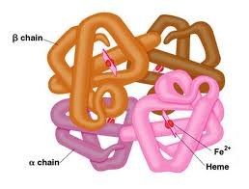
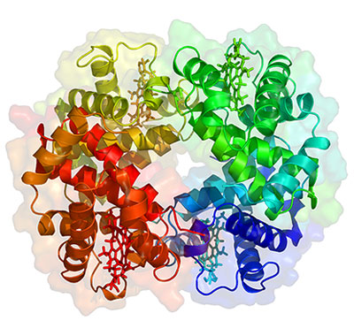
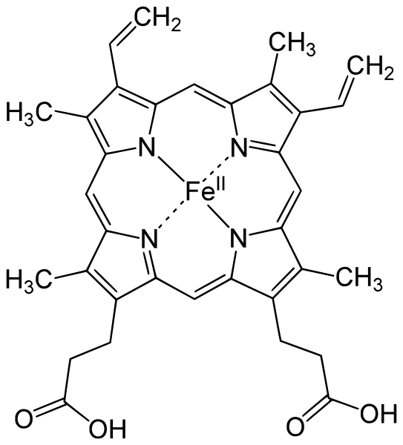
Hemoglobin
porphyrin

Slide 6
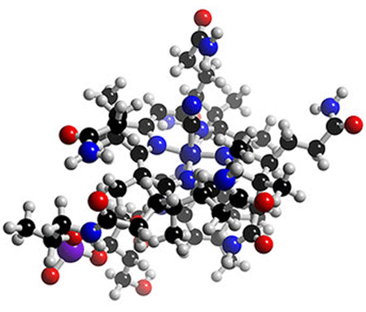
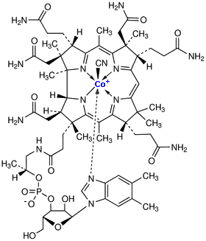
Vitamin B₁₂
cyanocobalamin

Slide 7
Observations
Deep blue CoCl₂ turn red in solution
Green black FeCl₃ turn yellow
Golden yellow NiBr₂ turn green
Evaporation of the respective solutions give
CoCl₂⋅6H₂O
FeCl₃⋅6H₂O
NiBr₂⋅6H₂O

Slide 8
Complexes
Werner’s formulation | Current formulation | Color | Original name
CoCl₃∙6NH₃ | [Co(NH₃)₆]Cl₃ | Yellow | Luteocobaltic chloride
CoCl₃∙5NH₃ | [Co(NH₃)₅]Cl₃ | Purple | Purpureocobaltic chloride
CoCl₃∙4NH₃ | [Co(NH₃)₄]Cl₃ | Violet | Violeocobaltic chloride
CoCl₃∙4NH₃ | [Co(NH₃)₄]Cl₃ | Green | Praseocobaltic chloride
CoCl₃∙6NH₃ + Ag⁺ → 3AgCl↓
CoCl₃∙5NH₃ + Ag⁺ → 2AgCl↓
CoCl₃∙4NH₃ + Ag⁺ → 1AgCl↓
Primary and secondary valencies
Oxidation and coordination numbers

Slide 9
Six-coordinate Isomers
Formula | Octahedral | Prism | Hexagonal
MX₅Y | 1 | 1 | 1
MX₄Y₂ | 2 | 3 | 3
MX₃Y₃ | 2 | 4 | 3

Slide 10
Lewis Model
Central metal ion or atom surrounded by a set of ions or molecules (ligands)
2-electron coordinate covalent (dative) interaction
Ligands must possess lone pairs
:NH₃ + BF₃ → H₃N−BF₃
(Lewis acid-base adduct)

Slide 11
Lewis Model
M L
Does not explain magnetic data nor electronic spectra

Slide 12
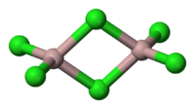
Ligands
Attached to the metal via one atom (donor atom)
Monatomic or polyatomic ions, neutral molecules, π-bonds (resulting in C₂M units) (* catalytic activation of alkenes by d-block metals or compounds)
atoms with more than one electron pair sometimes form two bonds with metal centers (bridging)

Slide 13
Ligand Names
Water: “aqua”, Ammonia, “ammine”, Carbon monoxide bonded via carbon: "carbonyl“, Nitrogen monoxide bonded via nitrogen: "nitrosyl“
anion with name ending in –ide is changed to end in –o
anion names ending in -ite, -ate are named as ligands by changing to -ito, -ato

Slide 14

Ambidentate ligands
bond to a metal center through more than one kind of atom

Slide 15
Polydentate ligands
Ligands with more than one atom with lone pairs can bind to the metal through both atoms (or more)
Donor Atoms | Name
2 | Didentate
3 | Tridentate
4 | Tetradentate
5 | Pentadentate
6 | Hexadentate

Slide 16
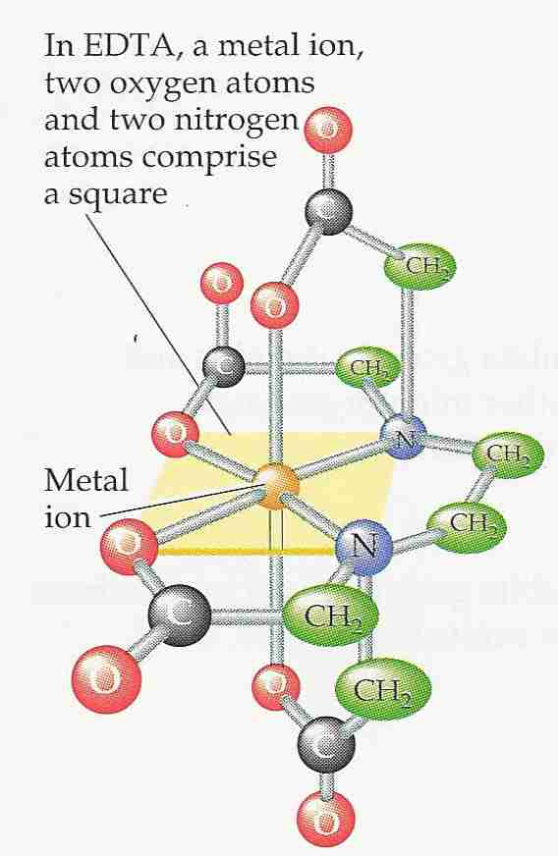
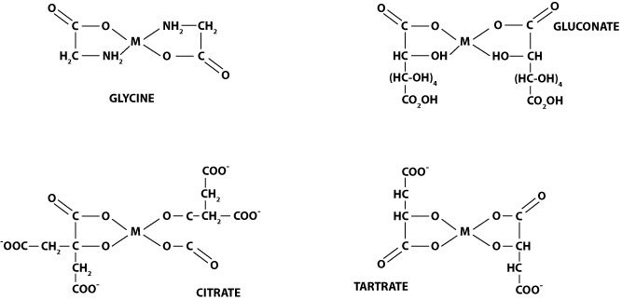
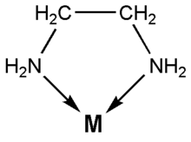
Chelate
A metal bound to polydentate ligands forms a ring system containing the metal

Slide 17
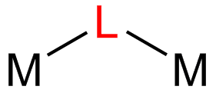
Bridging ligands
ligand that connects two or more metal atoms (ions).

Slide 18
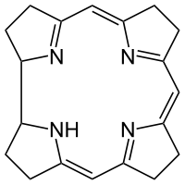
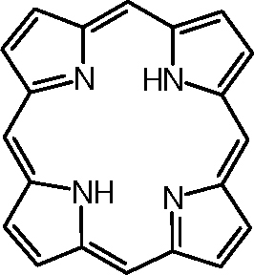
Macrocyclic ligands
Rings at least nine atoms large with at least three donor atoms for stable complexes with transition metals

Slide 19
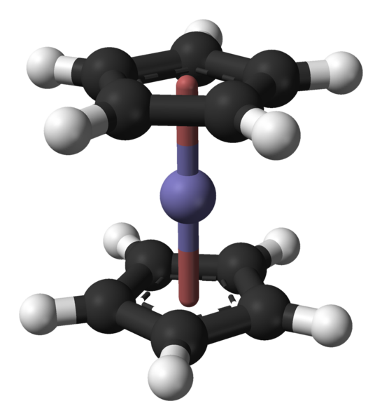
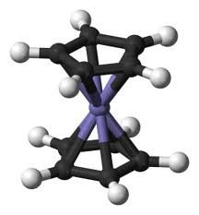
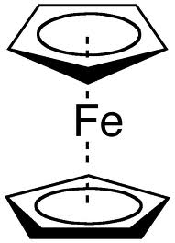
Pi systems
Double bonds in polyalkenes are capable of binding to metals just like lone pairs with each bond occupying a coordination site (6-coordinate Fe in ferrocene)

Slide 20
Nomenclature
The name of the positive ion is written before the name of the negative ion.
The name of the ligand is written before the name of the metal to which it is coordinated.

Slide 21
Nomenclature
The names of negative ligands always end in o, as in fluoro (F⁻), chloro (Cl⁻), bromo (Br⁻), iodo (I⁻), oxo (O²⁻), hydroxo (OH⁻), and cyano (CN⁻).
A handful of neutral ligands are given common names, such as aqua (H₂O), ammine (NH₃), and carbonyl (CO).

Slide 22
Nomenclature
The Greek prefixes mono-, di-, tri-, tetra-, penta-, hexa-, and so on are used to indicate the number of ligands when these ligands are relatively simple. The Greek prefixes bis-, tris-, and tetrakis- are used with more complicated ligands.

Slide 23
Nomenclature
Ligands are listed in alphabetical order.
The oxidation number of the metal atom is indicated by a Roman numeral in parentheses after the name of the metal atom.

Slide 24
Nomenclature
The names of complexes with a net negative charge end in -ate. Co(SCN)₄²⁻, for example, is the tetrathiocyanatocobaltate(II) ion. When the symbol for the metal is derived from its Latin name, -ate is added to the Latin name of the metal. Thus, negatively charged iron complexes are ferrates and negatively charged copper complexes are cuprates.

Slide 25
[Cr(OH)₄]⁻
complex is an anion
There is only one monodentate ligand, hydroxide. There are four of them, so we will use the name "tetrahydroxo“
The metal is Chromium, but since the complex is an anion, we will have to use “chromate“
The oxidation state of the metal is 3, therefore, this coordination complex is called tetrahydroxochromate (III)

Slide 26
[CuCl₄]²⁻
Tetrachlorocuprate (II)

Slide 27
[Pt(NH₃)₄)][Pt(Cl)₄]
NH₃ is neutral, and Cl has -1 charge.
  Therefore, you will write the complex with NH₃ first, then Cl last.
  coordination compound is called tetraammineplatinum (II) tetrachloroplatinate (II)

Slide 28
Practice set
[Cr(NH₃)₃(H₂O)₃]Cl₃
[Pt(NH₃)₅Cl]Br₃
[Pt(H₂NCH₂CH₂NH₂)₂Cl₂]Cl₂
Co(H₂NCH₂CH₂NH₂)₃]₂(SO₄)₃
K₄[Fe(CN)₆]
Na₂[NiCl₄]
Pt(NH₃)₂Cl₄
Fe(CO)₅

Slide 29
Stability constants
Stepwise substitutions of complexed water
Equilibrium processes with respective equilibrium constants
Overall equilibrium constant is called stability constant or formation constant

Slide 30
Factors affecting structure
Number of bonds (exothermic bond formation)
VSEPR (simpler cases of main groups)
Occupancy of d orbitals (tetrahedral vs square planar)
Steric interferences of large ligands
Crystal packing effects in solids (sizes of ions and complexes may lead to distortions)

Slide 31
Low Coordination
CN 1 is rare, except in ion pairs in the gas phase
Tl(I) and In(I)
complexes of
2,6-Trip₂C₆H₃

Slide 32
Low Coordination
CN 2 is also rare
[Ag(NH₃)₂+] with the d¹⁰ Ag⁺ ion (spherical)
[CuCl₂]⁻, Hg(CN)₂, [Au(CN)₂]⁻

Slide 33
Low Coordination
CN 3 is also more likely with d¹⁰ ions with trigonal planar structure most common
[Au(PPh₃)₃]⁺ where bulky ligands prevent larger coordination numbers
All first row transition metals except Mn(III) either with 3 identical ligands or two of one ligand and one of the other
MnO₃⁺, HgI₃⁻, [Cu(SPMe₃)Cl]₃

Slide 34
NBu₄[Cu(CN)₂]
Anion has chain-like
structure with the Cu
trigonally coordinated
Ligands bridge two
metals
Danger of extrapolating
solid state coordination
from stoichiometry

Slide 35
Coordination Number 4
Smallest common coordination
Tetrahedral and square planar (with intermediate and distorted geometries)
d⁸ metals are square planar
Steric effects from small metal or large ligands compensate for the advantage of forming more M-L bonds

Slide 36
RhCl(CO)₂
2-pyridylmethylbis(2-ethylthioethyl)amine

Slide 37
Coordination Number 5
Trigonal bipyramidal and square pyramidal
Marginal energy difference between the two allow for easy intercoversion
Intermediate geometries
Ligands exchange between sites in fluxional compounds

Slide 38
[Fe(CO)₄(PPh₃)]
[Co(CNPh)₅](ClO₄)₂

Slide 39

Coordination Number 6
Most common coordination number
Octahedral geometry, but also occasionally trigonal prismatic (d⁰)
[Re{S₃(CH₂)₃CMe}₂]⁺

Slide 40
Higher Coordination
Less common
Ligand-ligand interactions become more important so smaller ligands allow these coordination numbers

Slide 41
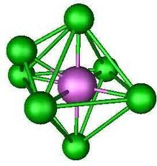
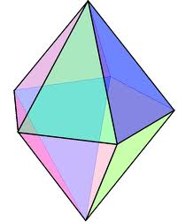
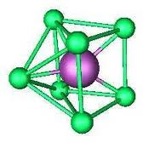
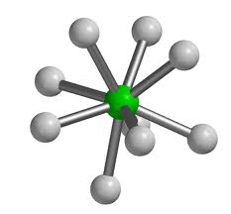
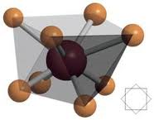
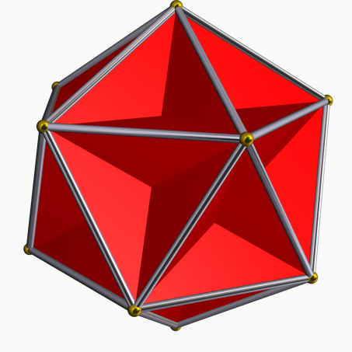
Capped octahedron
Pentagonal bipyramid
Capped trigonal prism
Square antiprism
Dodecahedron
Tricapped trigonal prism

