Slide 1
NMR Spectroscopy
Nuclear Magnetic Resonance

Slide 2
What is NMR Spectroscopy
NMR Spectroscopy is a technique used to analyze hydrogen-containing compounds in organic chemistry.
It enables the number of unique hydrogen or proton environments in a molecule to be determined and information about possible groups bonded to these hydrogen environments can be predicted, giving useful information about the structure of a compound.

Slide 3
Vocabulary
Hydrogen (proton) environment: A hydrogen atom and its bond to another atom.
Unique hydrogen environment: A hydrogen atom is bonded to different atoms or groups compared to other hydrogen atoms in the molecule.
The number of unique chemical environments in a molecule is governed by the (a)symmetry within that molecule

Slide 4
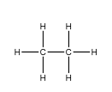
Example
Ethane
6 hydrogen (proton) environment
There are six hydrogen atoms and therefore six hydrogen or proton environments
ONLY 1 unique hydrogen (protron) environment
All six hydrogen atoms are bonded to the exact same atoms and groups
  A carbon atom bonded to two other hydrogen atoms and a CH₃ group

Slide 5
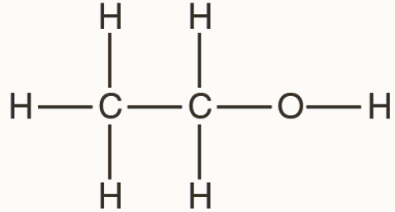
Example
Ethanol
6 hydrogen (proton) environment
There are six hydrogen atoms and therefore six hydrogen or proton environments
3 unique hydrogen (protron) environment
All six hydrogen atoms are bonded to the exact same atoms and groups
  A carbon atom bonded to two other hydrogen atoms and a CH₃ group

Slide 6
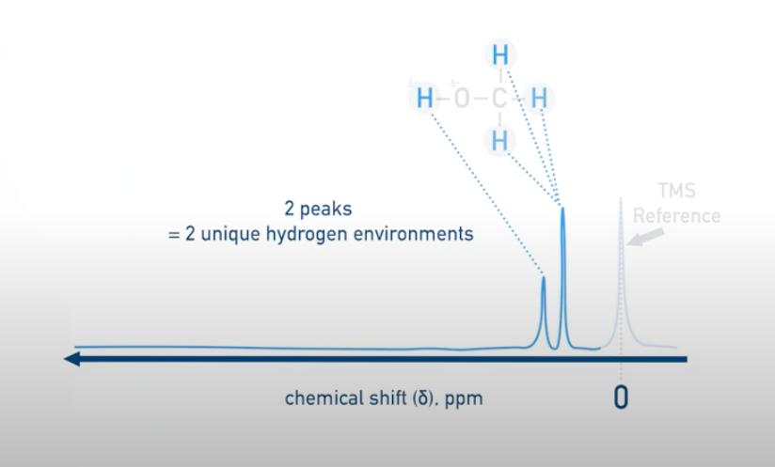
PPM aka Chemical Shift
Number of peaks = number of unique hydrogen environments

Slide 7
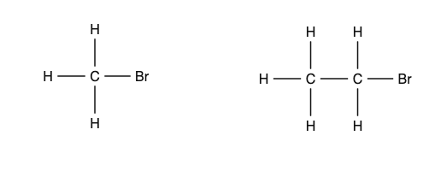
Practise
3 hydrogen environments
1 unique hydrogen environment
5 hydrogen environments
2 unique hydrogen environment
1 peak in the NMR spectrum
2 peaks in the NMR spectrum

Slide 8
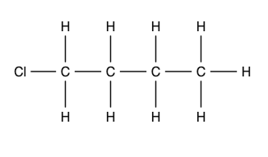
Practise
9 hydrogen environments
4 unique hydrogen environment
4 peaks in the NMR spectrum

Slide 9

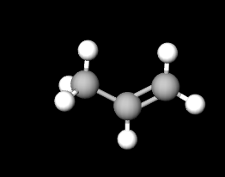
Practise
9 hydrogen environments
4 unique hydrogen environment
10 hydrogen environments
2 unique hydrogen environment
8 hydrogen environments
2 unique hydrogen environment
6 hydrogen environments
4 unique hydrogen environment
CH₃ is cis to one hydrogen and trans to the other hydrogen, therefore different spatial relationship therefore different environments
8 hydrogen environments
3 unique hydrogen environment
16 hydrogen environments
4 unique hydrogen environment

Slide 10

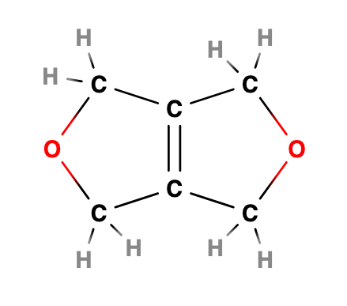
Paper Paper Questions
A
Only 29% of students got this answer correct

Slide 11
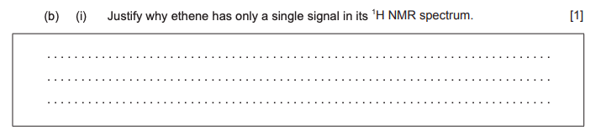
Paper Paper Questions
Hydrogen atoms/protons are in the same environment

Slide 12
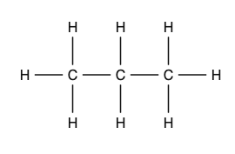
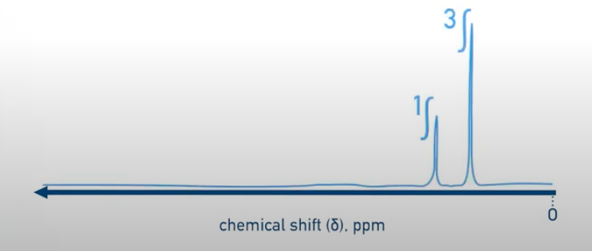
PPM aka Chemical shift
2 unique hydrogen environments
6 hydrogens in 1 unique environment
2 hydrogens in 1 unique environment
Therefore there’s a 3:1 ratio

Slide 13
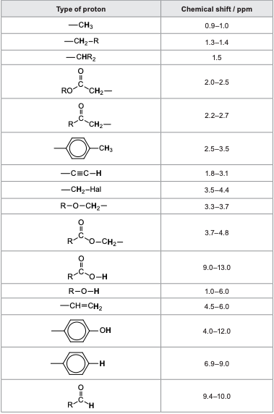
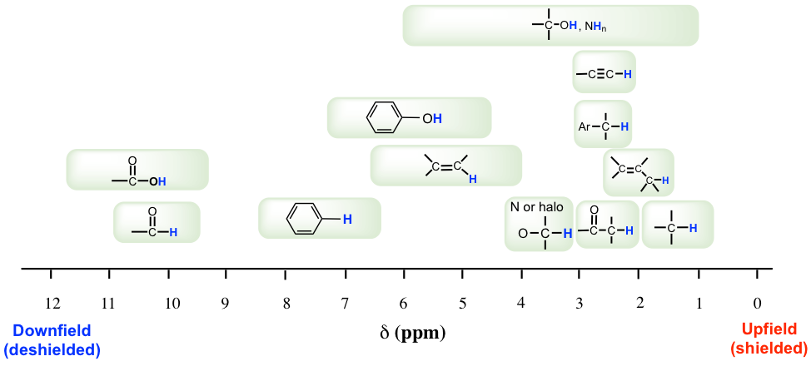
PPM aka Chemical Shift
The more electronegative the atom is → The lower the electron density is around hydrogen → The greater the chemical shift (ppm)

Slide 14
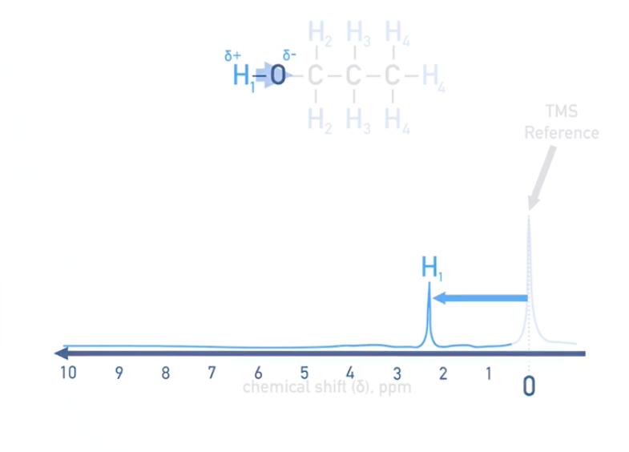
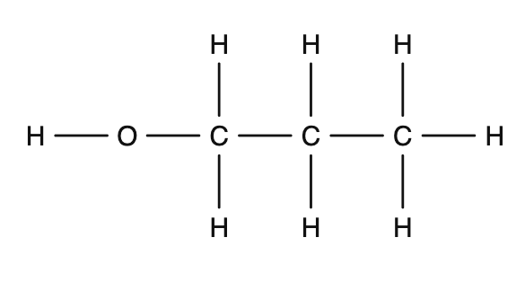
Example (Propanol)
4 unique hydrogen environments

Slide 15
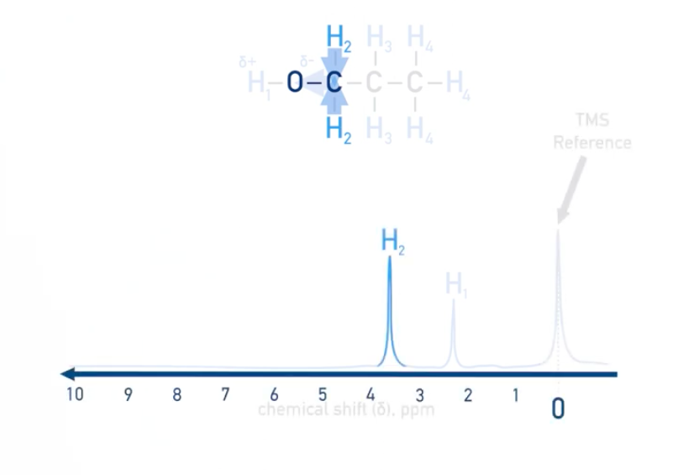
Example (Propanol)
4 unique hydrogen environments

Slide 16
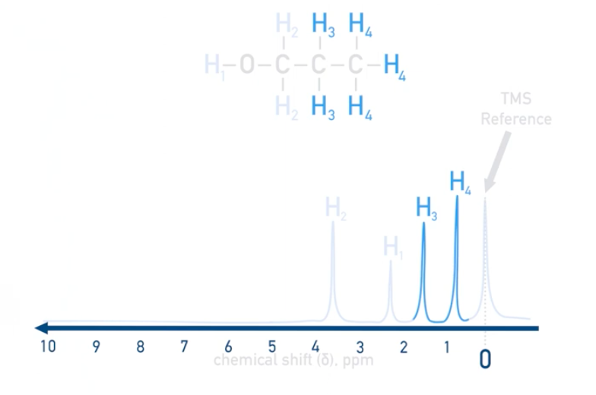
Example (Propanol)
4 unique hydrogen environments

Slide 17
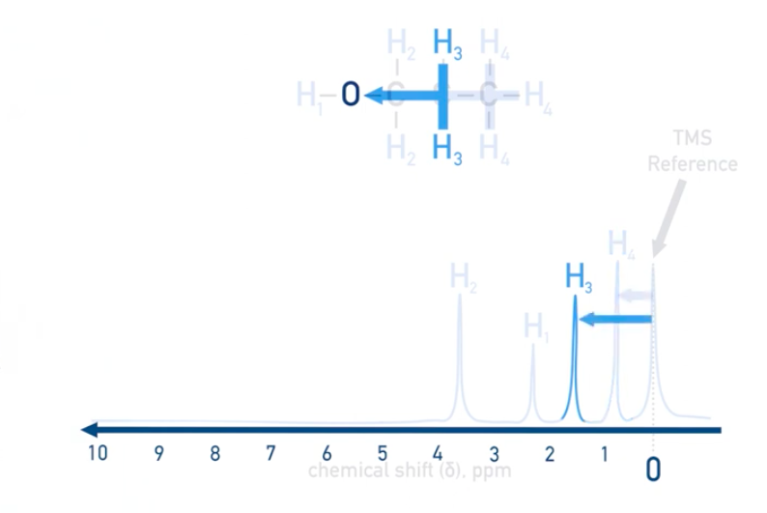
Example (Propanol)
4 unique hydrogen environments
To get the full understanding of the structure, we would have to get the integration ratios at each peak

Slide 18
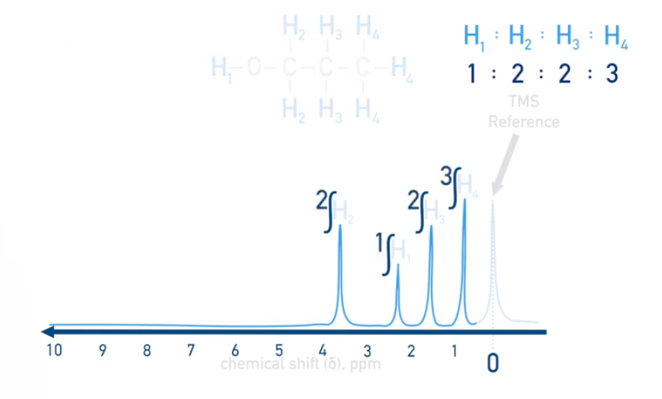
Example (Propanol)
4 unique hydrogen environments

Slide 19
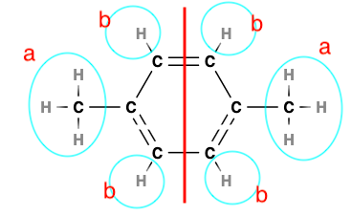
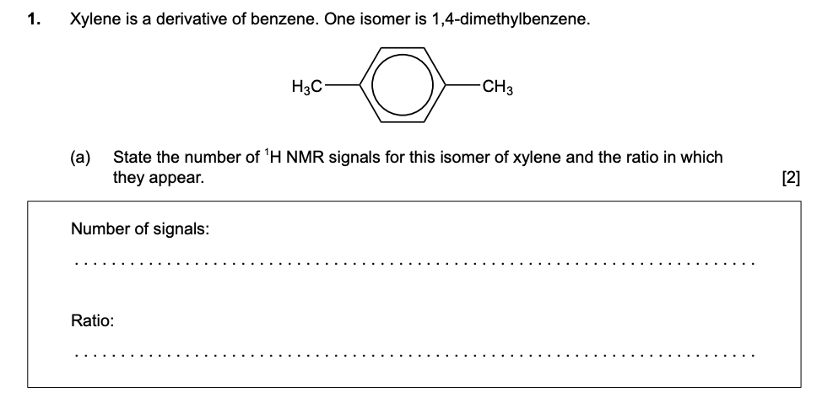
Past Paper Questions
2
3 : 2 or 6 : 4

Slide 20
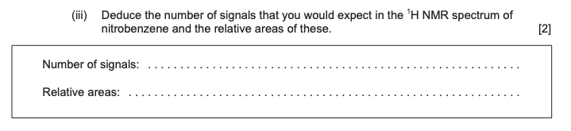
Paper Paper Questions
Number of signals = three
Relative areas = 2 : 2 : 1

Slide 21
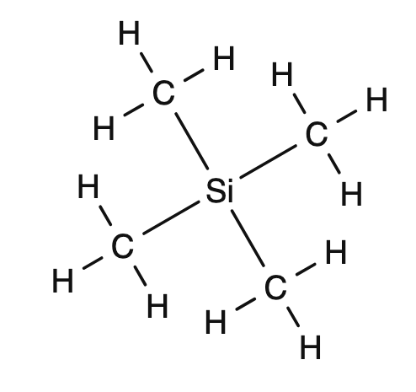
TMS reference
Tetramethylsilane (TMS) is a common standard used
Only 1 unique hydrogen environment
Si has low electronegativity ∴High electron density around ¹H nucleus → shielded from external magnetic field → Lower frequency radio wave absorbed for ‘resonance’
(that’s why it appears at “0” on the PPM spectrum)

Slide 22
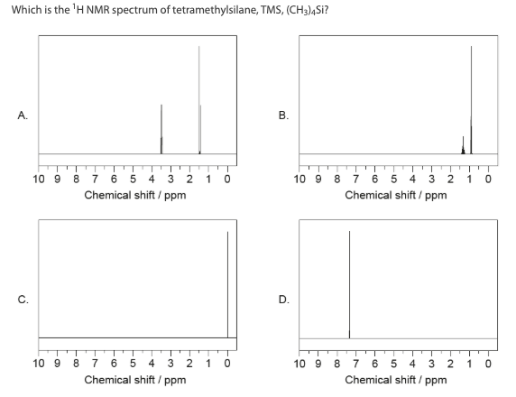
Paper Paper Questions

Slide 23
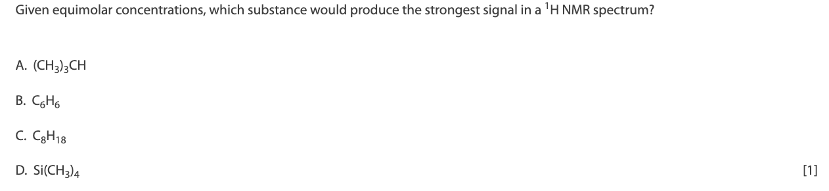
Paper Paper Questions
D
The "strongest signal in a 1H NMR spectrum" indicates the presence of the highest number of equivalent hydrogen atoms in a molecule, which results in a more intense peak in the spectrum.
Equivalent hydrogen atoms = hydrogen atoms in a molecule that are in the same chemical environment and experience the same magnetic field
Only 47% of students got this question correct

Slide 24
Peak Splitting

Slide 25
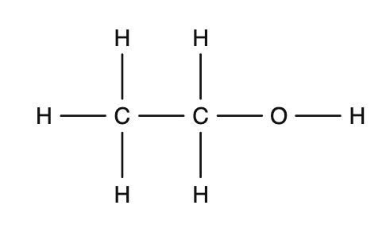
Peak Splitting
Peak splitting gives information about hydrogen atoms bonded to adjacent, non-equivalent carbon atoms.
Peak splitting gives information about hydrogen atoms bonded to adjacent, non-equivalent carbon atoms.
Adjacent = carbon “next door”
Non-equivalent = bonded to different atoms and groups
Adjacent Carbon
Bonded to 3 H atoms ∴bonded to different atoms and groups to the first ∴Non-equivalent

Slide 26
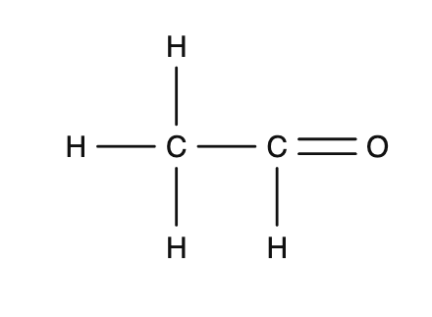
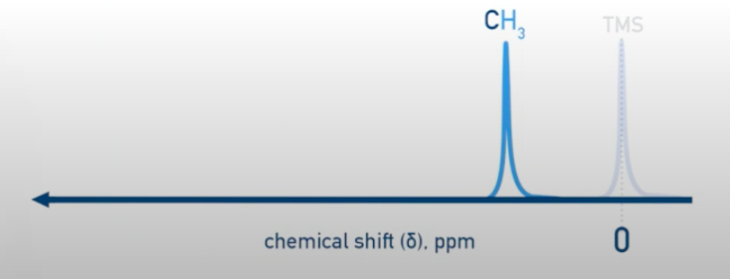
Example (Ethanal)
Let’s take a look at the CH₃ group in ethanal
This would give a large peak in an NMR spectrum

Slide 27
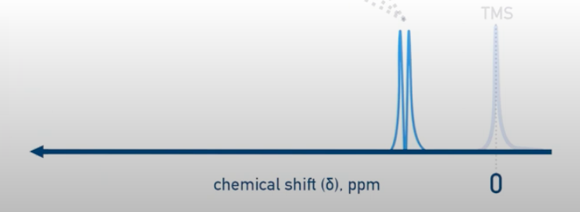
Example (Ethanal)
The splitting can only be seen if a high resolution is used
Adjacent Carbon and non-equivalent
The adjacent non-equivalent carbon causes the CH₃ peak to split into two

Slide 28
Peak Splitting
Different number of hydrogen atoms on adjacent non-equivalent carbon atoms
=
Different peak splitting patterns
Number of times a peak is split = n + 1
n = number of hydrogen atoms bonded to adjacent non-equivalent carbon atoms

Slide 29

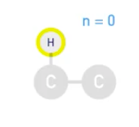
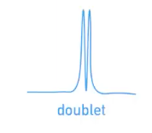
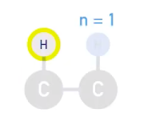
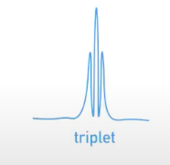
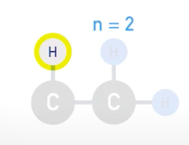
n + 1 rule
If n = 0, peak isn’t split
0 + 1 = 1
If n = 1, peak is split into two
1 + 1 = 1
If n = 2, peak is split into three
2 + 1 = 1
Four peaks = quartet

Slide 30
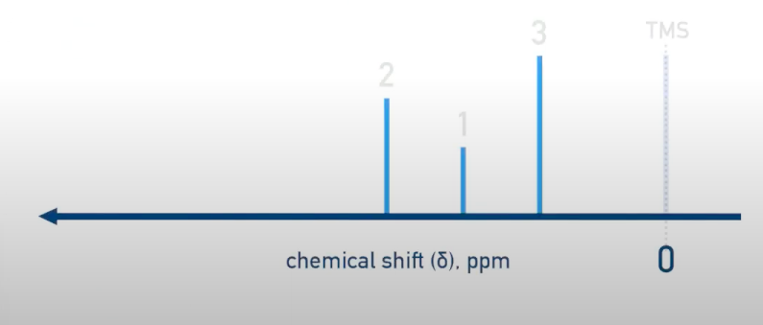
n + 1 Rule (example: Ethanol)
Unique hydrogen environment = 3
∴3 peaks in the NMR spectra

Slide 31
n + 1 Rule (example: Ethanol)
H isn’t bonded to a carbon, therefore there are no adjacent carbons bonded to it either
∴n = 0, meaning there is only one peak
(0 + 1 = 1)

Slide 32

n + 1 Rule (example: Ethanol)
H does have adjacent non-equivalent carbon atom (CH₃)
∴n = 3, meaning there is only four peaks
(3 + 1 = 4)
Adjacent Carbon and non-equivalent

Slide 33
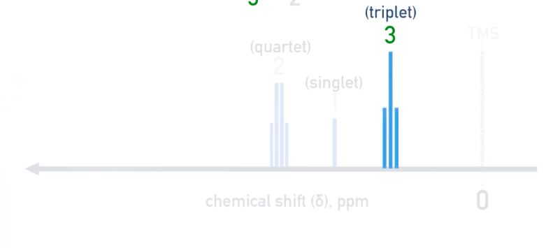
n + 1 Rule (example: Ethanol)
H does have adjacent non-equivalent carbon atom (CH₂)
∴n = 2, meaning there is only three peaks
(2 + 1 = 3)
Adjacent Carbon and non-equivalent
Remember that the splits are based purely on the number of hydrogens ON the adjacent non-equivalent carbon

Slide 34
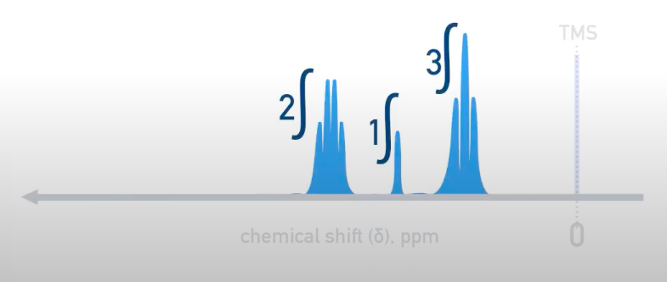
n + 1 Rule (example: Ethanol)
Remember that the splits are based purely on the number of hydrogens ON the adjacent non-equivalent carbon
You only get that information from the ratio of areas under each peak in the spectra

Slide 35
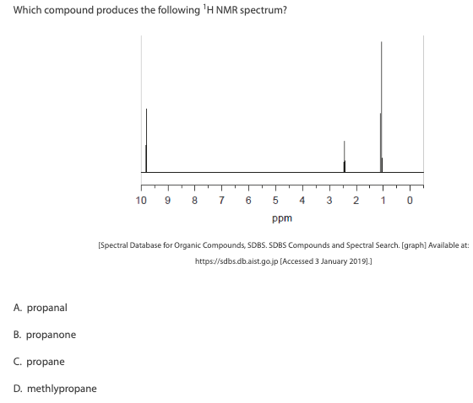


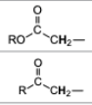
Past Paper Questions
Not possible, since aldehyde is at the very end already
Majority of students got this question correct

Slide 36
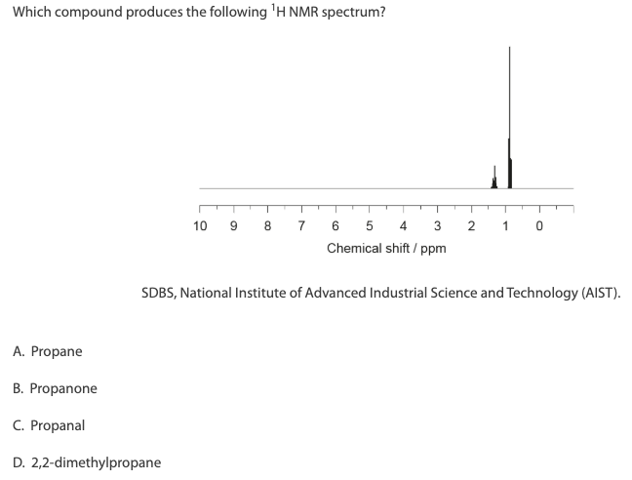
Past Paper Questions

Slide 37
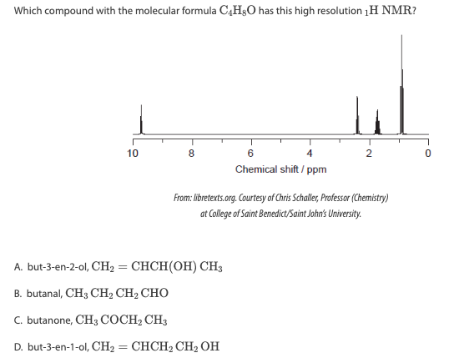
Past Paper Questions
Just over 50% of students got this answer correct

Slide 38
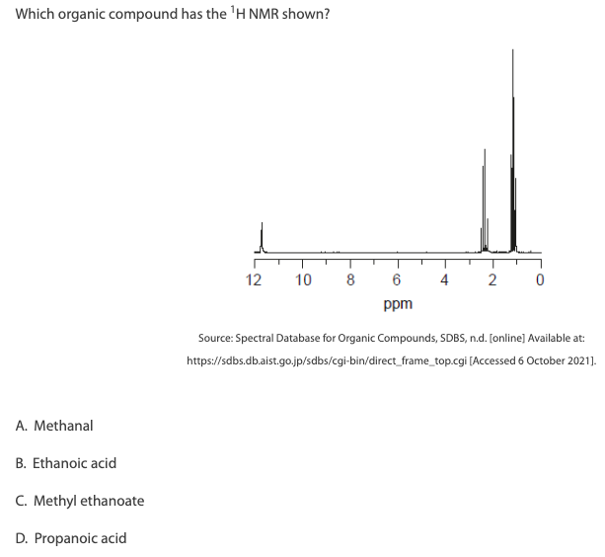
Past Paper Questions
Just under 70% of students identified the correct answer

Slide 39
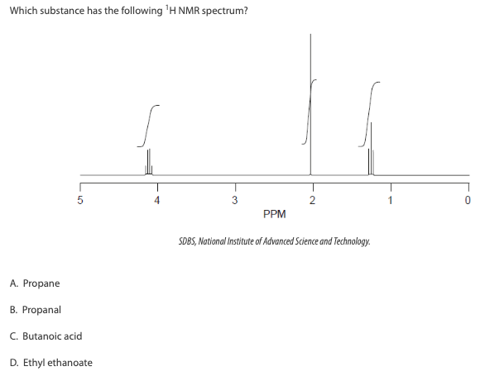
Past Paper Questions

Slide 40
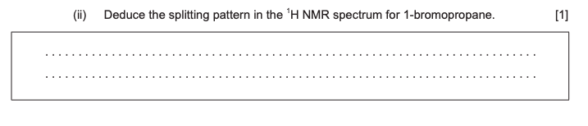
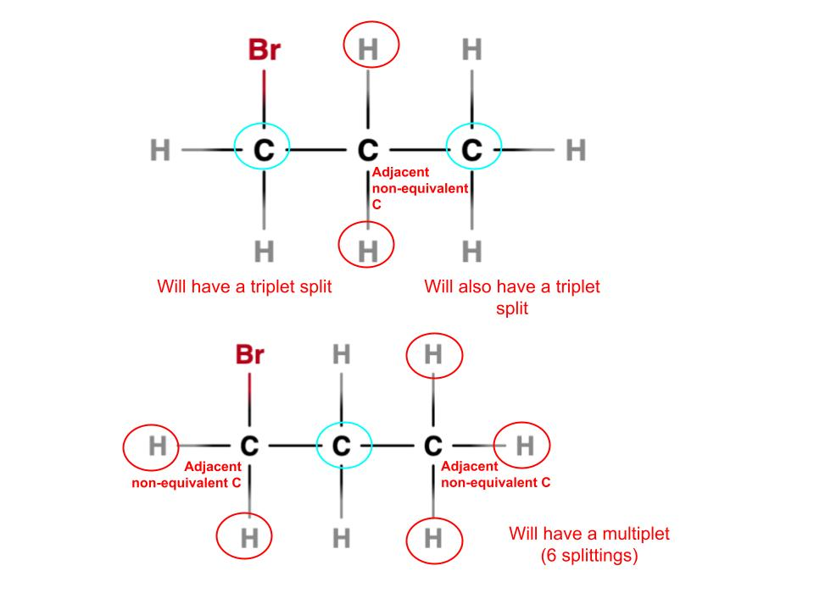

Past Paper Questions

Slide 41
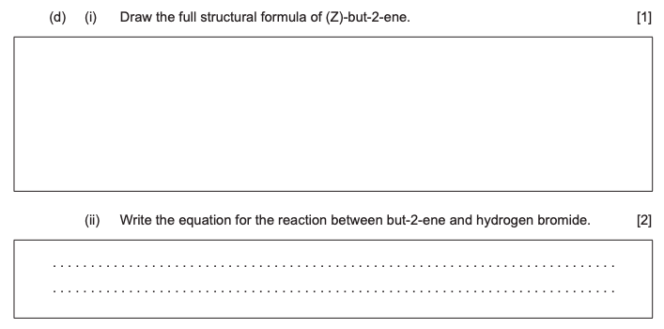
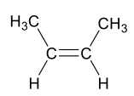

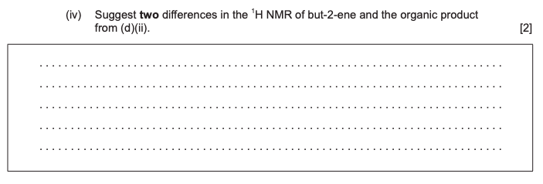
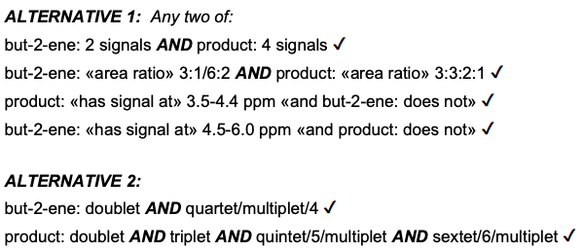
Past Paper Questions

