Slide 1
Useful English Phrases
Conversation Practice

Slide 2
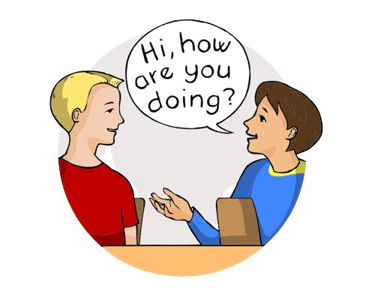

Slide 3
Common phrases to ask how someone is:
What’s up?
What’s new?
What have you been up to lately?
How’s it going?
How are things?
How’s life?

Slide 4
Common phrases to say how you are:
I’m fine, thanks. How about you?
Pretty good.
Same as always
Not so great.
Could be better
Can’t complain

Slide 5
Common phrases to say thank you:
I really appreciate it.
I’m really grateful
That’s so kind of you.
I owe you one. (this means you want/need to do a favor for the other person in the future)

Slide 6
Common phrases to respond to thank you:
No problem.
No worries
Don’t mention it.
My pleasure.
Anytime.

Slide 7
Common phrases to end a conversation politely:
It was nice chatting with you.
Anyway, I should get going.

Slide 8
Common phrases to ask for information:
Do you have any idea…?
Would you happen to know…? (when you’re not sure if the other person has the information.)
I don’t suppose you (would) know…? (when you’re not sure if the other person has the information.)

Slide 9
Common phrases to say I don’t know:
I have no idea/clue.
I can’t help you there.
(informal) Beats me.
I’m not really sure.
I’ve been wondering that, too.

Slide 10
Common phrases for not having an opinion:
I’ve never given it much thought.
I don’t have strong feelings either way.
It doesn’t make any difference to me.
I have no opinion on the matter.

Slide 11
Common phrases for agreeing:
Exactly.
Absolutely.
That’s so true.
That’s for sure.
I agree 100%
I couldn’t agree with you more.
(informal) Tell me about it! / You’re telling me!
(informal) I’ll say!
I suppose so. (use this phrase for weak agreement – you agree, but reluctantly)

Slide 12
Common phrases for disagreeing:
I’m not so sure about that.
That’s not how I see it.
Not necessarily

Slide 13
Common phrases to respond to great news:
That’s great!
How wonderful!
Awesome!

Slide 14
Common phrases to respond to bad news:
Oh no…
That’s terrible.
Poor you. (Use this to respond to bad situations that are not too serious)
I’m so sorry to hear that.

Slide 15
Common phrases to invite someone somewhere:
Are you free… [Saturday night?]
Are you doing anything… [Saturday night?]
. (informal) Do you wanna… [see a movie?]
(formal)Would you like to… [join me for dinner?]

Slide 16
Common phrases for food:
I’m starving! (= I’m very hungry)
Let’s grab a bite to eat.
How about eating out tonight? (eat out = eat at a restaurant)
I’ll have… (use this phrase for ordering in a restaurant)

Slide 17
Common phrases for price:
It cost a fortune.
It cost an arm and a leg.
That’s a rip-off. (= overpriced; far more expensive than it should be)
That’s a bit pricey.
That’s quite reasonable. (= it’s a good price)
That’s a good deal. (= a good value for the amount of money)
It was a real bargain.
It was dirt cheap. (= extremely inexpensive)

Slide 18
Common phrases for weather:
It’s a little chilly.
It’s freezing. (= extremely cold)
Make sure to bundle up. (bundle up = put on warm clothes for protection against the cold.)
It’s absolutely boiling! (boiling = extremely hot)
it scorching hot outside

Slide 19
Common phrases for being tired:
I’m exhausted.
I’m dead tired.
I’m beat
I can hardly keep my eyes open
I’m gonna hit the sack. (hit the sack = go to bed)

Slide 20
Practice:
1. What have you been up to lately?
2. I bought your favourite snacks.
3. I am really grateful of you for taking care of me.
4. Do you agree with same-sex marriage?
5. My dog was hit by a car last night.
6. (Invite me somewhere.)
7. The bag costs 110 000 $.
8. I won 10 million dollars from the lottery!
9. Do you agree with euthanasia?
10. (Describe the weather in your area.)

Slide 21
Conversation Practice
Use the phrases that you have learned in responding to the speaker.
Example:
A: Hi Victor! How are you?
B: I’m fine thanks. How about you?
A: Pretty good.

Slide 22
¡Adiós!
¡Nos vemos de nuevo!

