Slide 1









Scientific Notation
IB Math AI SL
Topic 1: Number and Algebra
by @TUTORIO.MATH

Slide 2
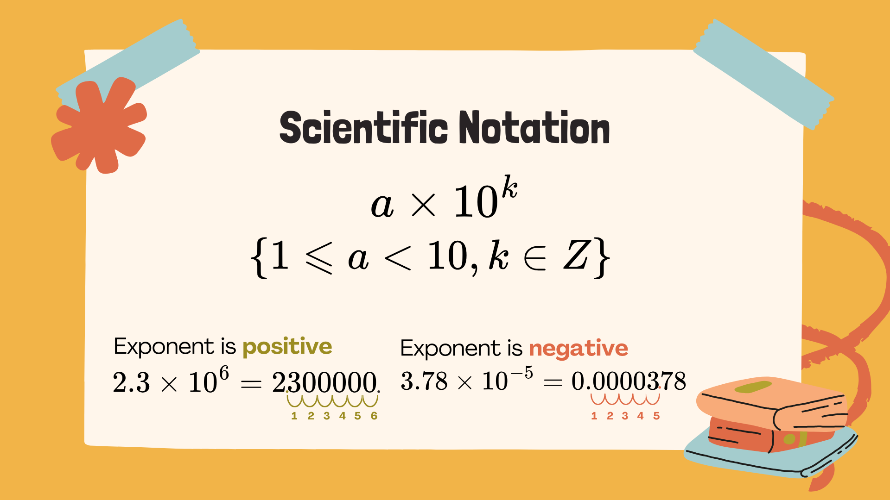
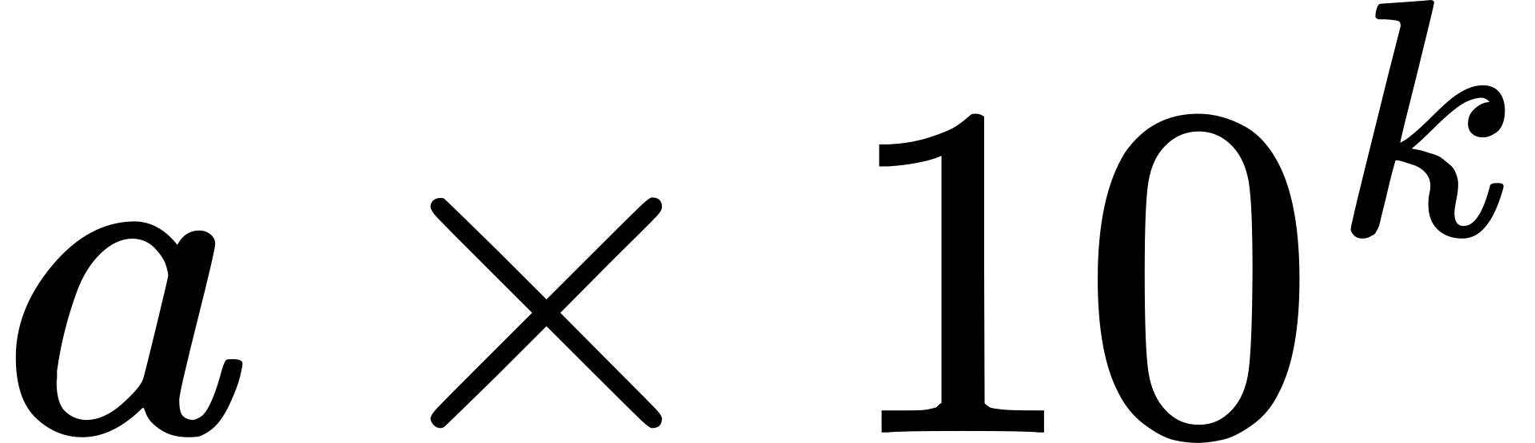
Scientific Notation

Slide 3




Practice 1
Write in scientific notation:
a. 44000
b. 0.0000684
c. 526000000

Slide 4
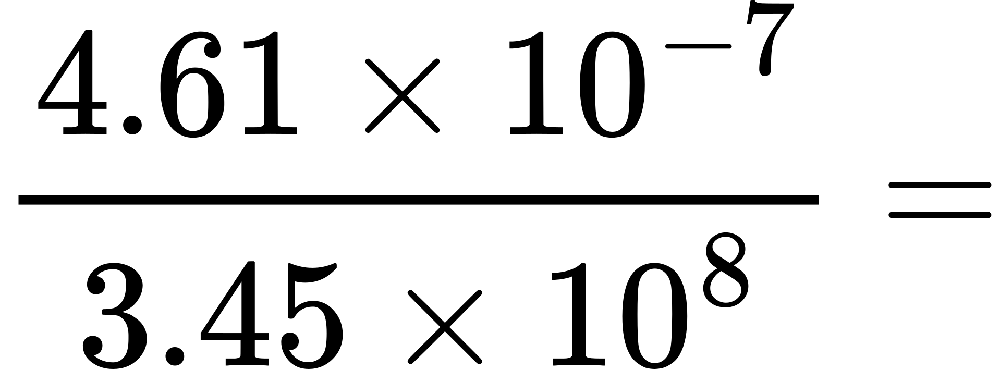
Practice 2
Use calculator to evaluate, then give your answers in scientific notation.

