Slide 1



weather idioms

Slide 2
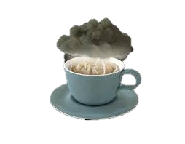
Storm in a teacup
What does this really mean?
It means :Great outrage or excitement about a trivial matter.

Slide 3
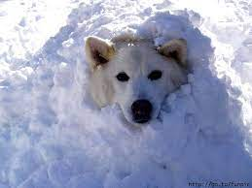
Snowed under
What does this really mean?
It means : To be overwhelmed with a very large amount of something, especially work.

Slide 4

Lightning never strikes the same place twice
What does this really mean?
It means : A lucky or unusual situation or event is unlikely to happen again in exactly the same circumstances or to the same person.

Slide 5
The calm before the storm
What does this really mean?
It means : A period of unusual tranquillity or stability that comes before difficult times.

Slide 6
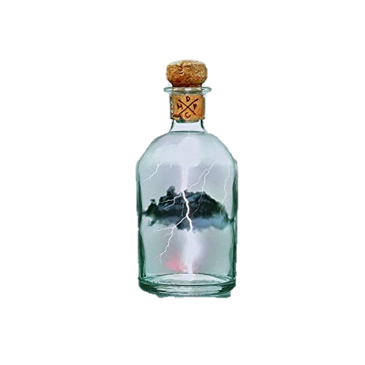
To catch lightning in a bottle
What does this really mean?
It means : to succeed in a way that is very lucky or unlikely..

Slide 7
Rain or shine
What does this really mean?
It means : Whatever the weather or circumstance.

Slide 8

On cloud nine
What does this really mean?
It means : To be extremely happy.

Slide 9
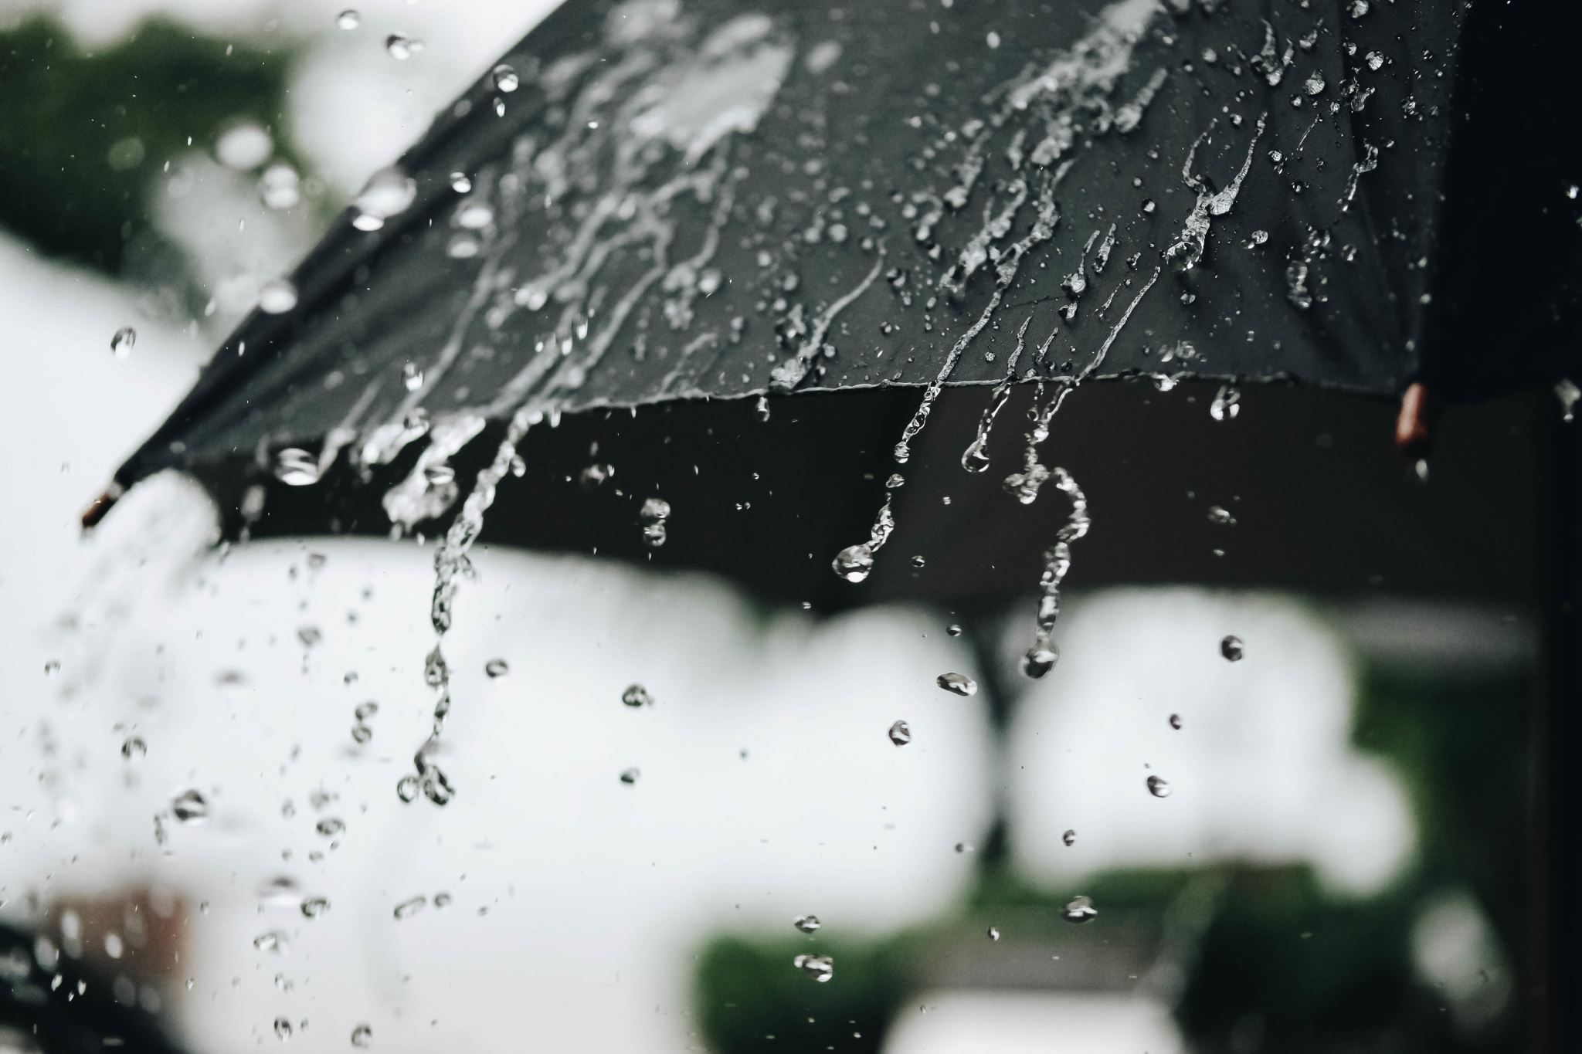
Rain on someone’s parade
What does this really mean?
It means : To prevent someone from enjoying an event; spoil someone’s plans.

Slide 10

Throw caution to the wind
What does this really mean?
It means : To act in a completely reckless manner.

Slide 11
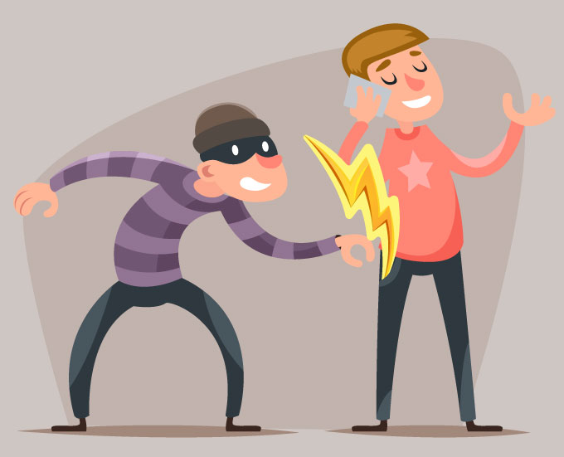
Steal someone’s thunder
What does this really mean?
It means : To prevent another person from getting success or attention by doing or saying something they were planning to do; to take credit for someone else’s idea, or to overshadow someone.

Slide 12
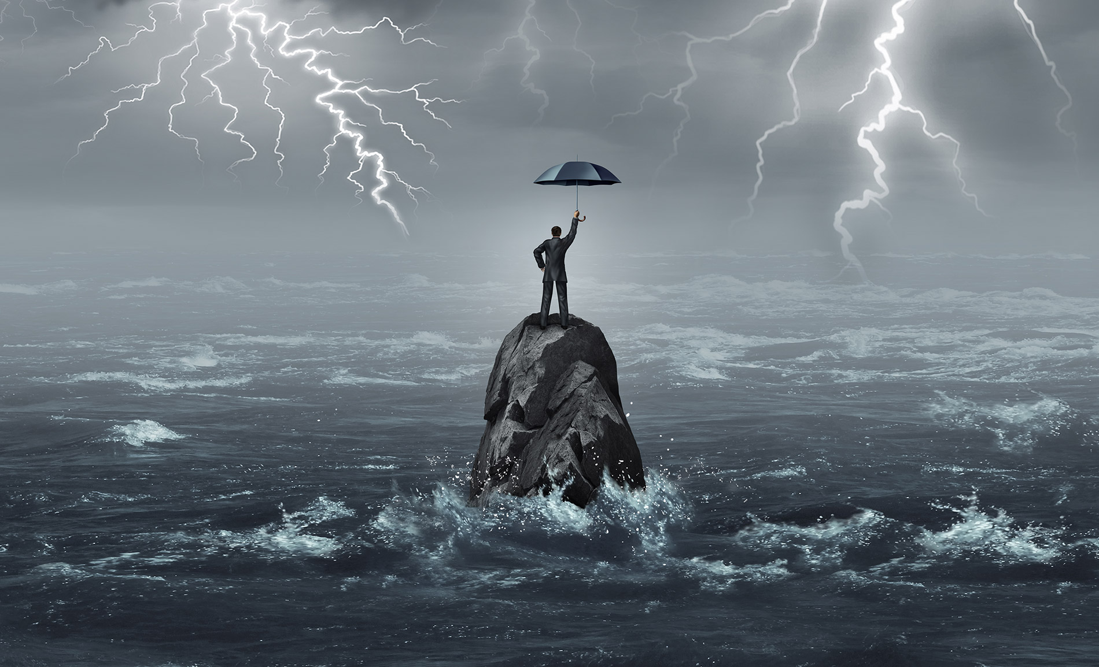
Weather the storm
What does this really mean?
It means : To deal with a difficult situation without being harmed or damaged too much.

Slide 13
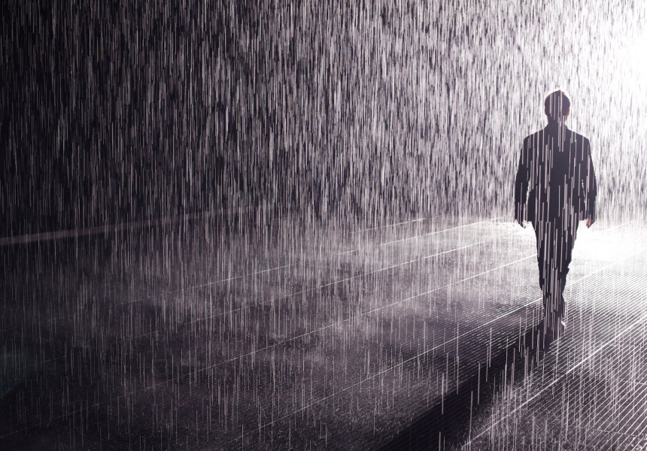
When it rains, it pours
What does this really mean?
It means : Misfortunes or difficult situations tend to follow each other in rapid succession or arrive all at the same time.

Slide 14
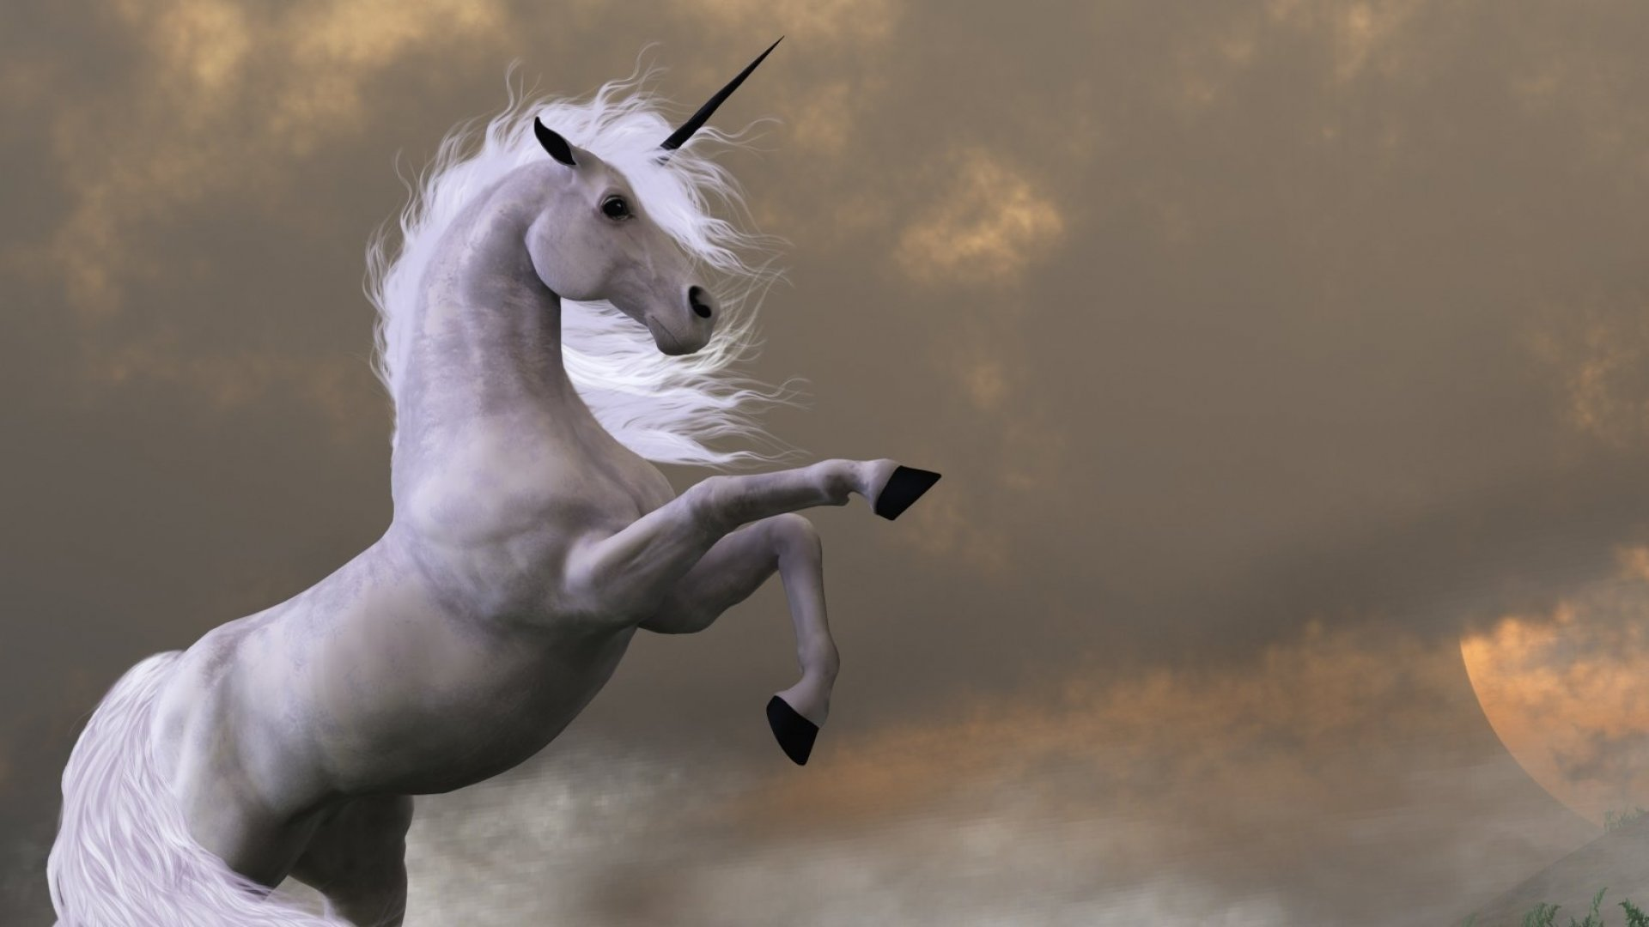
Life isn’t all rainbows and unicorns
What does this really mean?
It means : Real life does not just consist of innocent, carefree happiness; there is more hardship or suffering in reality than one realises.

Slide 15

It’s a breeze
What does this really mean?
It means : very easy to do or achieve.

