Slide 1
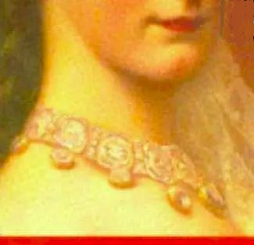

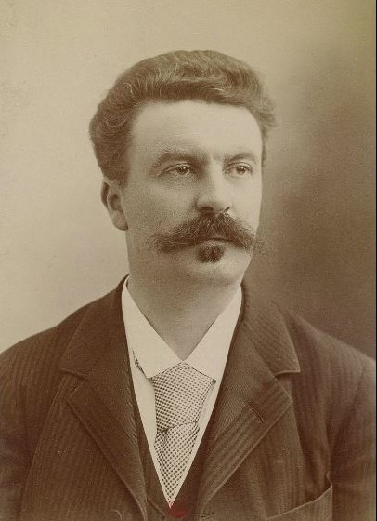
Strengthening Reading, Writing and Speaking Skills:
Through studying masterpieces of short story writing
Instructor: Andrew Ness

Slide 2
Guy de Maupassant: 19th c. master of short story form
Guy de Maupassant (1850 -1893) was a 19th-century French author, remembered as a master of the short story form, and as a representative of the Naturalist school, who depicted human lives and destinies and social forces in disillusioned and often pessimistic terms.
Maupassant was a protégé of Gustave Flaubert and his stories are characterized by economy of style and efficient, seemingly effortless dénouements. Many are set during the Franco-Prussian War of the 1870s, describing the futility of war and the innocent civilians who, caught up in events beyond their control, are permanently changed by their experiences. He wrote 300 short stories, six novels, three travel books, and one volume of verse. His first published story, "Boule de Suif" ("The Dumpling", 1880), is often considered his masterpiece.

Slide 3
She was born, as if by an error of fate, into a family of clerks
She was one of those pretty and charming girls born, as if by an error of fate, into a family of clerks. She had no dowry, no expectations, no means of becoming known, understood, loved or wedded by a man of wealth and distinction; and so she let herself be married to a minor official at the Ministry of Education.

Slide 4
Guy de Maupassant, fatalism and his view of the lot of women in 19th century France
She was one of those pretty and charming girls born, as if by an error of fate, into a family of clerks.
Question 1: What are the implications of GMD s writing that Mathilde Loisel was “born into a family of clerks?
In the short story the Necklace, Guy de Maupassant draws on the recurring theme that humans are victims of fate, especially women in the mid-nineteenth century. So, The Necklace is viewed as a deeply fatalistic work. Let’s explore the text for evidence of this fatalism.
Fatalism is any view emphasizing the futility of human will. According to this view, human beings are powerless to do anything other than what they actually do. Included in this is the belief that humans have no power to influence the future or indeed the outcome of their own actions

Slide 5
Guy de Maupassant understands the lot of women in 19th century France, especially those without means
She had no dowry, no expectations, no means of becoming known, understood, loved or wedded by a man of wealth and distinction; and so she let herself be married to a minor official at the Ministry of Education.
Question 2: What is the implications, for a young woman who cannot afford to pay a dowry? How is this a key element, in determining Mathilde’s fate?
A dowry is a payment, such as property or money, paid by the bride's family to the groom or his family at the time of marriage. ... The custom of dowry is most common in cultures that are strongly patrilineal and that expect women to reside with or near their husband's family

Slide 6
She was as unhappy as if she had once been wealthy
She dressed plainly because she had never been able to afford anything better, but she was as unhappy as if she had once been wealthy. Women don't belong to a caste or class; their beauty, grace, and natural charm take the place of birth and family. Natural delicacy, instinctive elegance and a quick wit determine their place in society, and make the daughters of commoners the equals of the very finest ladies.

Slide 7
GDM explains how it was understandable how a woman of beauty, grace and charm might fancy herself a kind of “aristocrat”
GDM writes:
Women don't belong to a caste or class; their beauty, grace, and natural charm take the place of birth and family. Natural delicacy, instinctive elegance and a quick wit determine their place in society, and make the daughters of commoners the equals of the very finest ladies.
Question 4: In writing this passage, is GMD being ironic, sexist, or is he rather describing Mathilde’s own view of herself, her gender and social position?

Slide 8
She was as unhappy as if she had once been wealthy
She dressed plainly because she had never been able to afford anything better, but she was as unhappy as if she had once been wealthy. Women don't belong to a caste or class; their beauty, grace, and natural charm take the place of birth and family. Natural delicacy, instinctive elegance and a quick wit determine their place in society, and make the daughters of commoners the equals of the very finest ladies.
GDM writes this, but even as he writes, he is aware that Women in the mid-nineteenth century were discriminated against by the ideology of domesticity, where they were expected to look after the household and the children. Therefore, GDM understands that women were restricted from entering the work force. The story does not explicitly state that. Mathilde did not have the authority to get a job, education, or change to climb the economic ladder. Thus, she had no way of obtaining the dazzling things that were easily obtainable to rich women like her rich friend Madame Forestier
H
Q.3 But Mathilde’s huge problem is that she simply does not accept “her lot of in life, “ but instead suffers from an acute feeling of deprivation. How, exactly does GDM sum this up?

Slide 9
She suffered endlessly, feeling she was entitled to all luxuries of life
She suffered endlessly, feeling she was entitled to all the delicacies and luxuries of life. She suffered because of the poorness of her house as she looked at the dirty walls, the worn-out chairs and the ugly curtains. All these things that another woman of her class would not even have noticed, tormented her and made her resentful. The sight of the little Brenton girl who did her housework filled her with terrible regrets and hopeless fantasies.

Slide 10
She suffered endlessly, feeling she was entitled to all luxuries of life
She suffered endlessly, feeling she was entitled to all the delicacies and luxuries of life. She suffered because of the poorness of her house as she looked at the dirty walls, the worn-out chairs and the ugly curtains.
All these things that another woman of her class would not even have noticed, tormented her and made her resentful. The sight of the little Breton girl who did her housework filled her with terrible regrets and hopeless fantasies.
Question 5: It is Mathilde’s personality, or rather a quirk or flaw in her personality which is the main instigator of all the action which subsequently unfolds in The Necklace. Is this, in fact, the case? How would you describe her personality?

