Slide 1




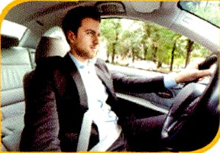
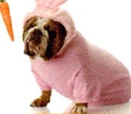


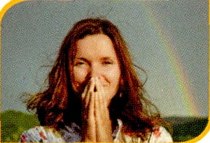




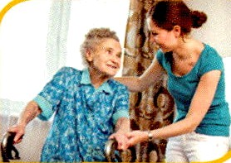



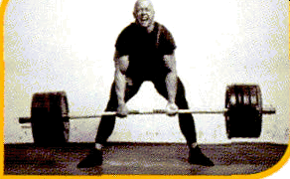


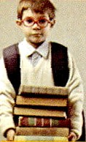

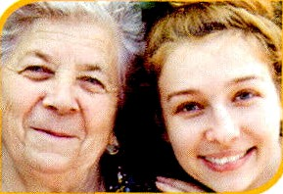

•
Learn the words. Write the meanings in your own language.
CF [kFålt
to show sadness
He cries when he is sad.
drive td LIV
to make a car move
He drives to work.
gg
pg
causing to laugh
The dog looks funny.
hope [houp]
to want something to happen
She LioR£?sthe sun comes out.
laugh [læf]
to show how happy you are
Jon laughs a lot.
nice[nas] kind
iVlary is very nice.
smile småIJ
to make a happy face
She alwoys smiles.
powerful
iVly uncle is very strong.
student stu:dnt]
a person who poes to school
The student hos many books.
young j q]
living only a short time so far
The yoong girl loves her grondmo.

Slide 2
€Xer¢ise 1
Look at the word. Circle the word or phrase with the SAME meaning.
learner
not weak
o|d
sing
old
table
young
strong
move
funny
pen
not nice
tall
sleep
new
gonne
not funny
friendly
cry
nice
FXer¢ise €
+ Match the words with the correct definitions.
funny • • a. to wish for something to be true
cry • • b. making us smile and laugh
hope • • c. to show that something is funny
laugh • • d. to make the sides of the mouth go up
smile • • e. to make a sad sound

Slide 3
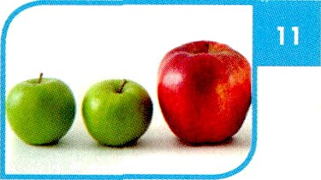


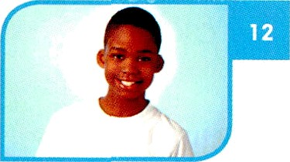

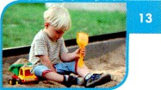

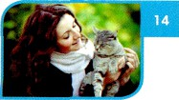
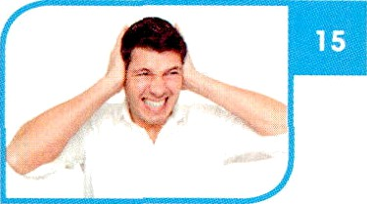

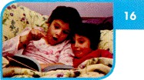




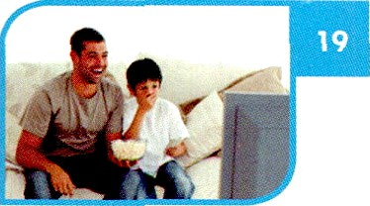

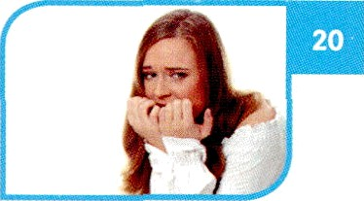


C Learn the words. Write the meonings in your own languoge.
adj. farge
The red apple is big.
[bc ]
n. a young male
The boy is ten years old.
[tja Id] (plural: children)
n. a young boy or girl
The child ploys in the sand.
[hæv]
v. to own something
She hos o cat.
g
[laud]
odj. making a lot of sound
The music is too loud.
aa
n. the events in a book
We read a story at bedtime.
[swzm]
v. to move through water using the arms and legs
He can swim.
[ta'deI]
adv. on this day
’that day is it today?
t+a,tj;
v. to look at something
They watch a movie.
+z
v. to feel troubled about something
She olwoys worries before o test.
8

Slide 4

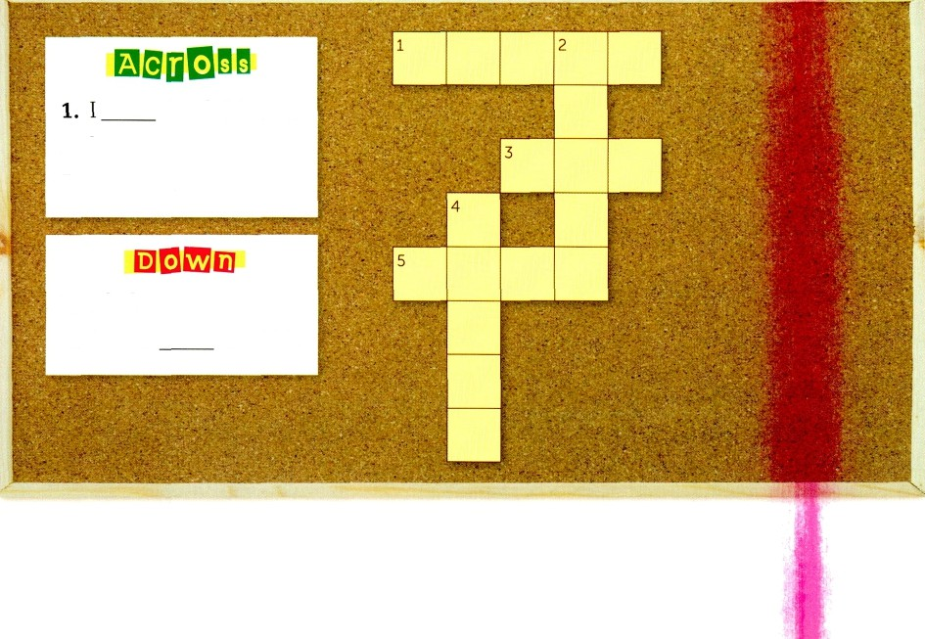
+ Complete the sentences with the correct words from the box.
boy
have
todoy
swim
story
The teacher reads a to the class.
We a blue car.
The is very strong.
It is my birthday
I like to in the lake.
+ Use the hints and the words in the box to complete the puzzle.
child
big worry loud watch
the child swim.
3. huge
S. not quiet
2. a kid
4. Do not
. It is OK.
9

Slide 5
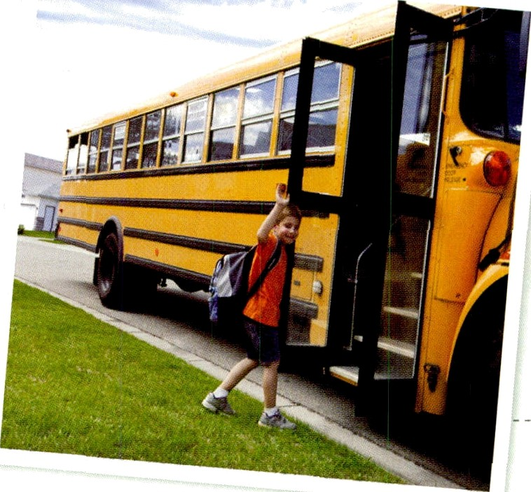
A. Read the passage.
First Day of School
Sam watches the big yellow bus. It stops, and the bus driver opens the door. He smiles and says, “Good morning!” Sam gets on the bus. It is very loud on the bus. The children talk and laugh. They are happy to see their friends.
Sam sits next to a young student. He looks like a nice boy. Sam looks at his mother and little sister, Jill. Jill makes a funny face, and Sam laughs. His mother cries. Jill
hugs her and says, “Don't worry, Mom.” Jill hopes school is fun for Sam today.
B. Circle T for true or F for false.
\ . The children on the bus are loud.
2. Sam's mother laughs.
T T
F F
C. Choose the correct answers.
1. Who does Sam sit next to?
a. A young boy
b. A strong girl
2. Why does Sam laugh?
a. Jill tells a funny story.
b. JilI makes a funny face.
1 0

Slide 6

A. Change the bold words. Write true sentences about the reading.
1. A small yellow bus stops in front of Sam.
2. It is nice on the bus.
3. The young student looks like a strong boy.
4. “Don't smile," Jill says to her mom.
5. Jill hopes school is fun for Sam tomorrow.
B. Fill in the blanks to complete the summary of the reading. Use the words in the box.
cries
hopes
today
young
It is Sam's first day of school He gets on the bus. He sits next
to a boy. Sam laughs, but his mother . Jil I
school is fun.
1 1

