Slide 1
Danse de la fureur, pour les sept trompettes

Slide 2
Use of modes
Measure nos. | Name of mode used:
1-4 | Mode 1 or 6
5-6 | Mode 2
7-8 | Mode 1 or 6
9-10 | Mode 2
11 | Mode 2 (and mode 2 transposed)
12-13 | Similar to modes 3 and 7
14-17 | Mode 6 or 1
18-19 | Mode 2
20-21 | Mode 1 or 6
22-24 | Mode 2

Slide 3
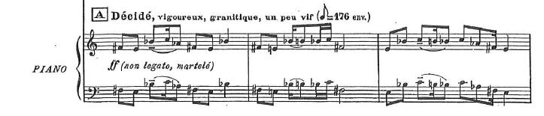
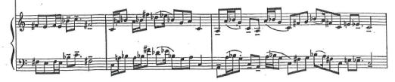
17
17
18
19
21
40

Slide 4

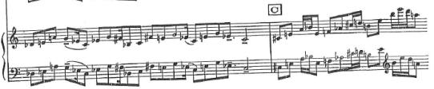

Musical material in section A versus sections B and C
Opening four bars truncated.
Concluding phrase expanded.

Slide 5
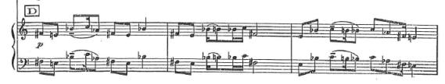
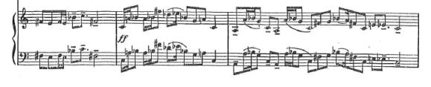
Section A versus section D

Slide 6
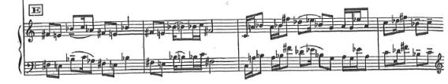
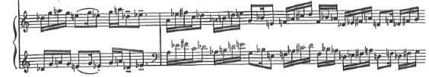
Section A versus section E

Slide 7
Sections A through E
Nearly identical
A – B/C – D - E
Similar in treatment of material from A

Slide 8
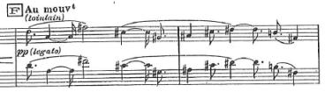
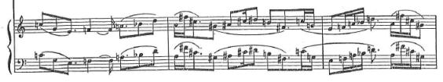
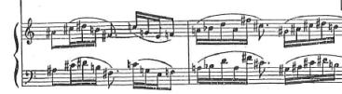
Section f
Indicates point
Of symmetry

Slide 9
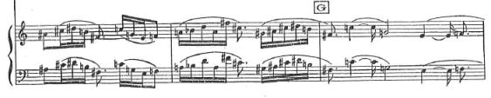
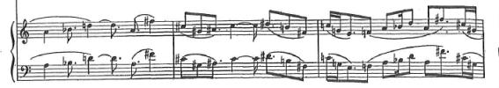
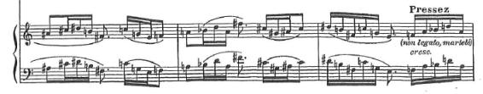
Section f and g
D
A
F#
C#
G#
A#
C#
D#
B
F#
C
G
E
F
A
Bb

Slide 10

Section A versus Section I

Slide 11
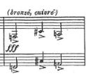
The F – C# - A interruption
Initial statement
The interruption first appears four measures after rehearsal mark i.
The initial presentation of this figure has the rhythmic structure 8 – 4 – 8 if semiquavers are used as the unit of measurement.
Messiaen applies various rhythmic augmentations and diminiutions to the interruption.

Slide 12
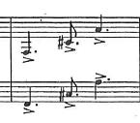
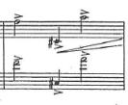
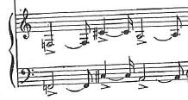
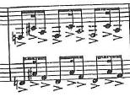
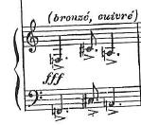
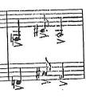
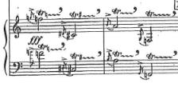
The F – C# - A interruption
Initial statement
Change in register and direction of line
Augmentation and diminution
Final statement
- Rhythmically liquidated
- Ornamented

Slide 13
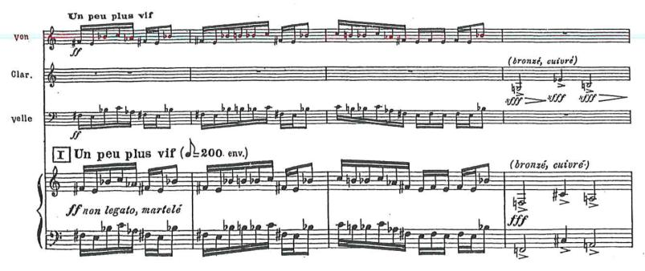
8 – 4 – 8

Slide 14
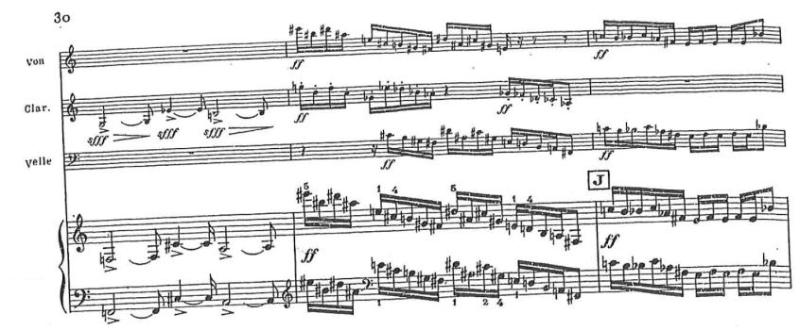
10 – 5 – 10
(add ¼ value)

Slide 15
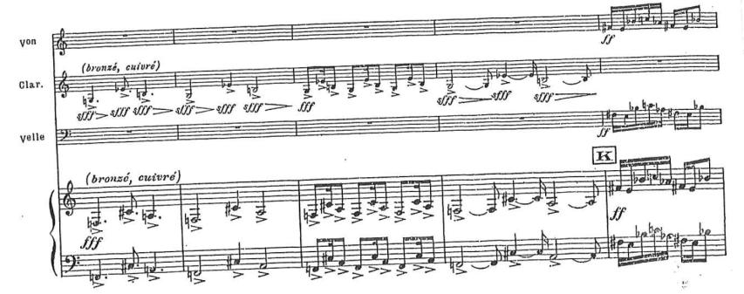
6 – 3 – 6
(withdraw ¼ value)
8 – 4 – 8
2 – 1 – 2
(withdraw ¾ value)
10 – 5 – 10

Slide 16
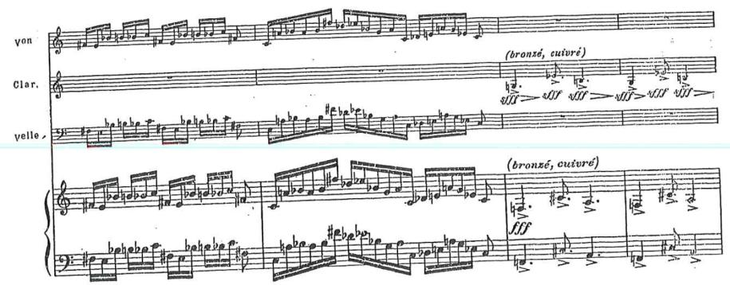
4 – 2 – 4
(classic diminution)

Slide 17
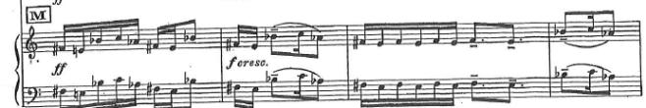
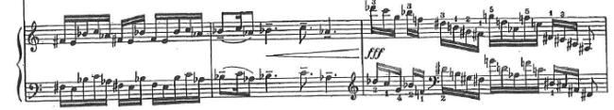
Section A versus secition M

Slide 18
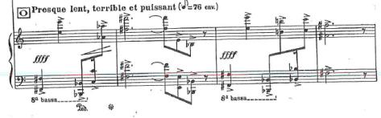
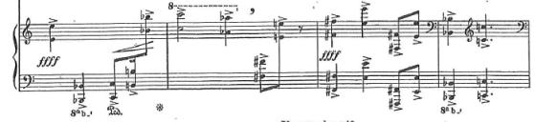

Section A versus section O
Theme to be taken twice as loud
Rhythmic values augmented
Wide shifts in register

Slide 19
A – B/C – D – E – F – G – H - I – J – K – l – m – n – o - p
Rhythmic liquidation of thematic material
Interruption introduced and developed
Variation in phrase lengths
Coda: paraphrases entire movement
Main modal material and
Thematic material
introduced
16 note pitch cycle introduced against
Non-retrogradable rhythmic cycles
Some rhythmic elements re-introduced
Final statement of interruption

