Slide 1
Basic
Business Mathematics
Simple Interest

Slide 2
Illustration of Simple Interest
Due to COVID-19 pandemic Miss Dada a female resident of Brgy. May Pagkakaisa somewhere in Quezon Province thinks of a business that can provide for her needs as well as the need of her neighbors so she can be of help
even in this trying time. Since she doesn’t have money on hand, she decided to borrow from a bank as the
start-up capital of ₱50,000.00 at 7% simple interest rate payable within 5 years.
Compute for the interest yield.

Slide 3
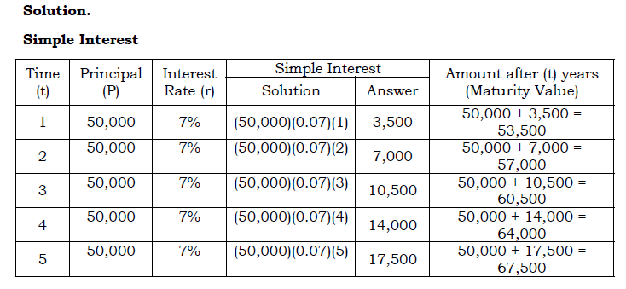

Slide 4
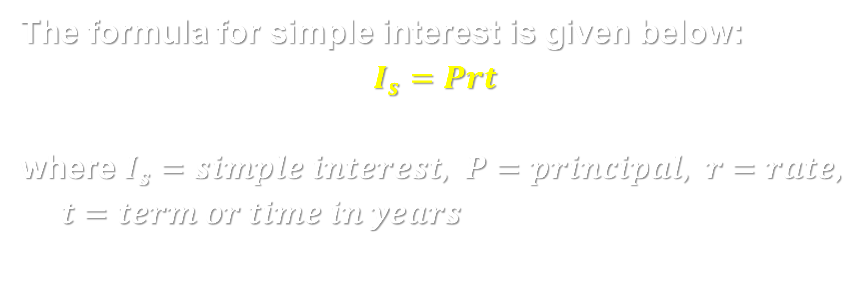
An annual simple interest is based on three factors:
Principal which is the amount invested or borrowed
Simple interest rate, usually expressed in percent
Time or term of loan, in years
The formula for simple interest is given below:
$$I_{s}=Prt$$
where $I_{s}=simple interest, P=principal, r=rate, t=term or time in years$

Slide 5
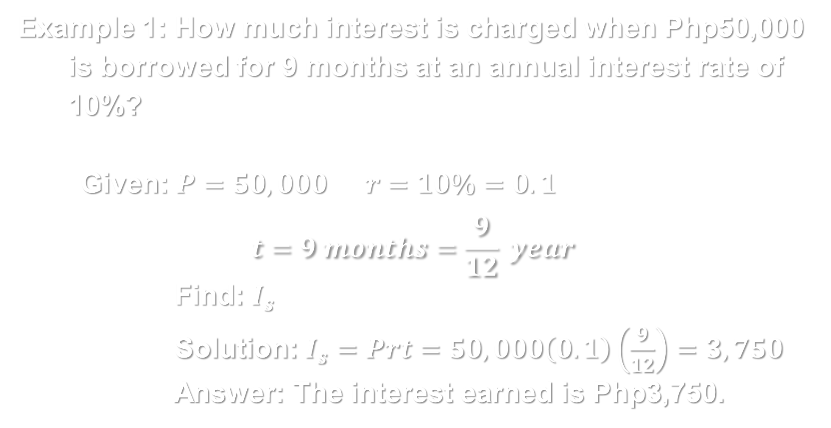
Example 1: How much interest is charged when Php50,000 is borrowed for 9 months at an annual interest rate of 10%?
Given: $P=50,000 r=10\%=0.1$
$$t=9 months=\frac{9}{12} year$$
Find: $I_{s}$
Solution: $I_{s}=Prt=50,000\left(0.1\right)\left(\frac{9}{12}\right)=3,750$
Answer: The interest earned is Php3,750.

Slide 6
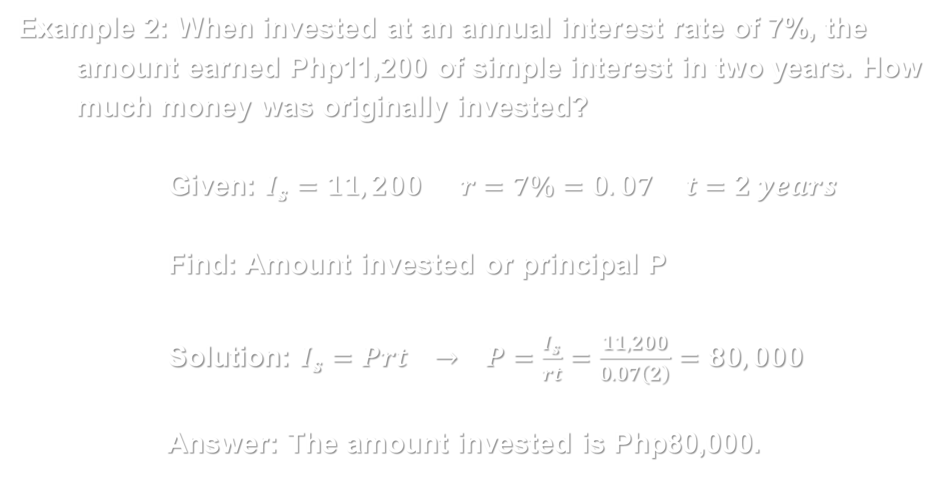
Example 2: When invested at an annual interest rate of 7%, the amount earned Php11,200 of simple interest in two years. How much money was originally invested?
Given: $I_{s}=11,200 r=7\%=0.07 t=2 years$
Find: Amount invested or principal P
Solution: $I_{s}=Prt → P=\frac{I_{s}}{rt}=\frac{11,200}{0.07\left(2\right)}=80,000$
Answer: The amount invested is Php80,000.

Slide 7
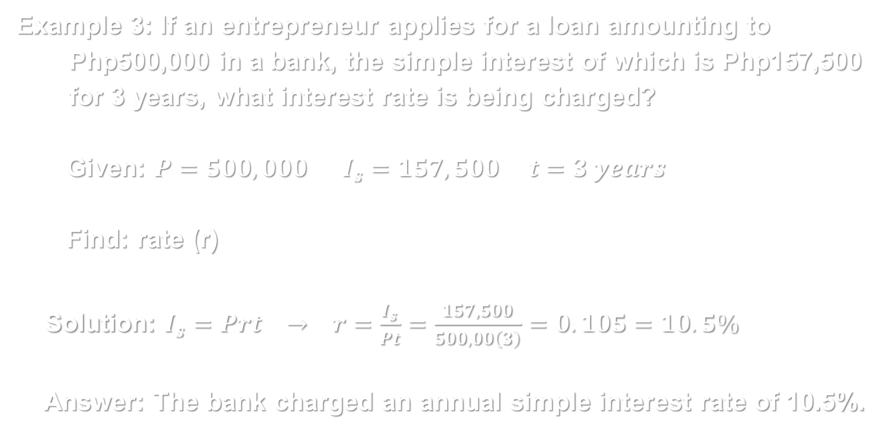
Example 3: If an entrepreneur applies for a loan amounting to Php500,000 in a bank, the simple interest of which is Php157,500 for 3 years, what interest rate is being charged?
Given: $P=500,000 I_{s}=157,500 t=3 years$
Find: rate (r)
Solution: $I_{s}=Prt → r=\frac{I_{s}}{Pt}=\frac{157,500}{500,00\left(3\right)}=0.105=10.5\%$
Answer: The bank charged an annual simple interest rate of 10.5%.

Slide 8
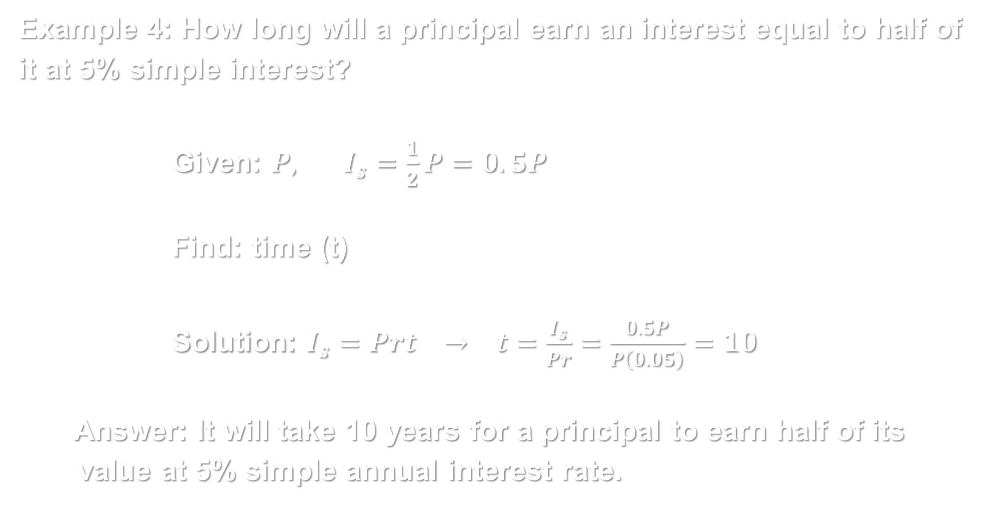
Example 4: How long will a principal earn an interest equal to half of it at 5% simple interest?
Given: $P, I_{s}=\frac{1}{2}P=0.5P$
Find: time (t)
Solution: $I_{s}=Prt → t=\frac{I_{s}}{Pr}=\frac{0.5P}{P\left(0.05\right)}=10$
Answer: It will take 10 years for a principal to earn half of its value at 5% simple annual interest rate.

Slide 9
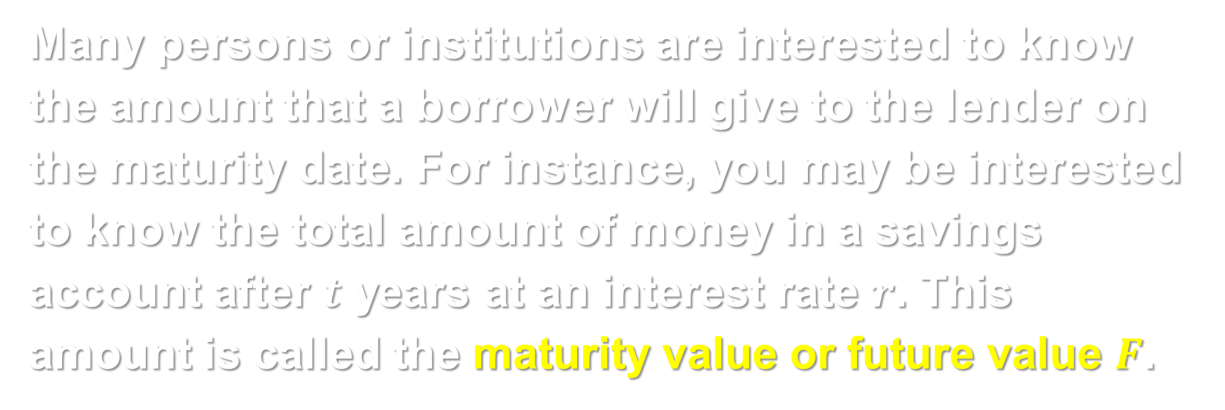
Many persons or institutions are interested to know the amount that a borrower will give to the lender on the maturity date. For instance, you may be interested to know the total amount of money in a savings account after $t$ years at an interest rate $r$. This amount is called the maturity value or future value $F$.

Slide 10
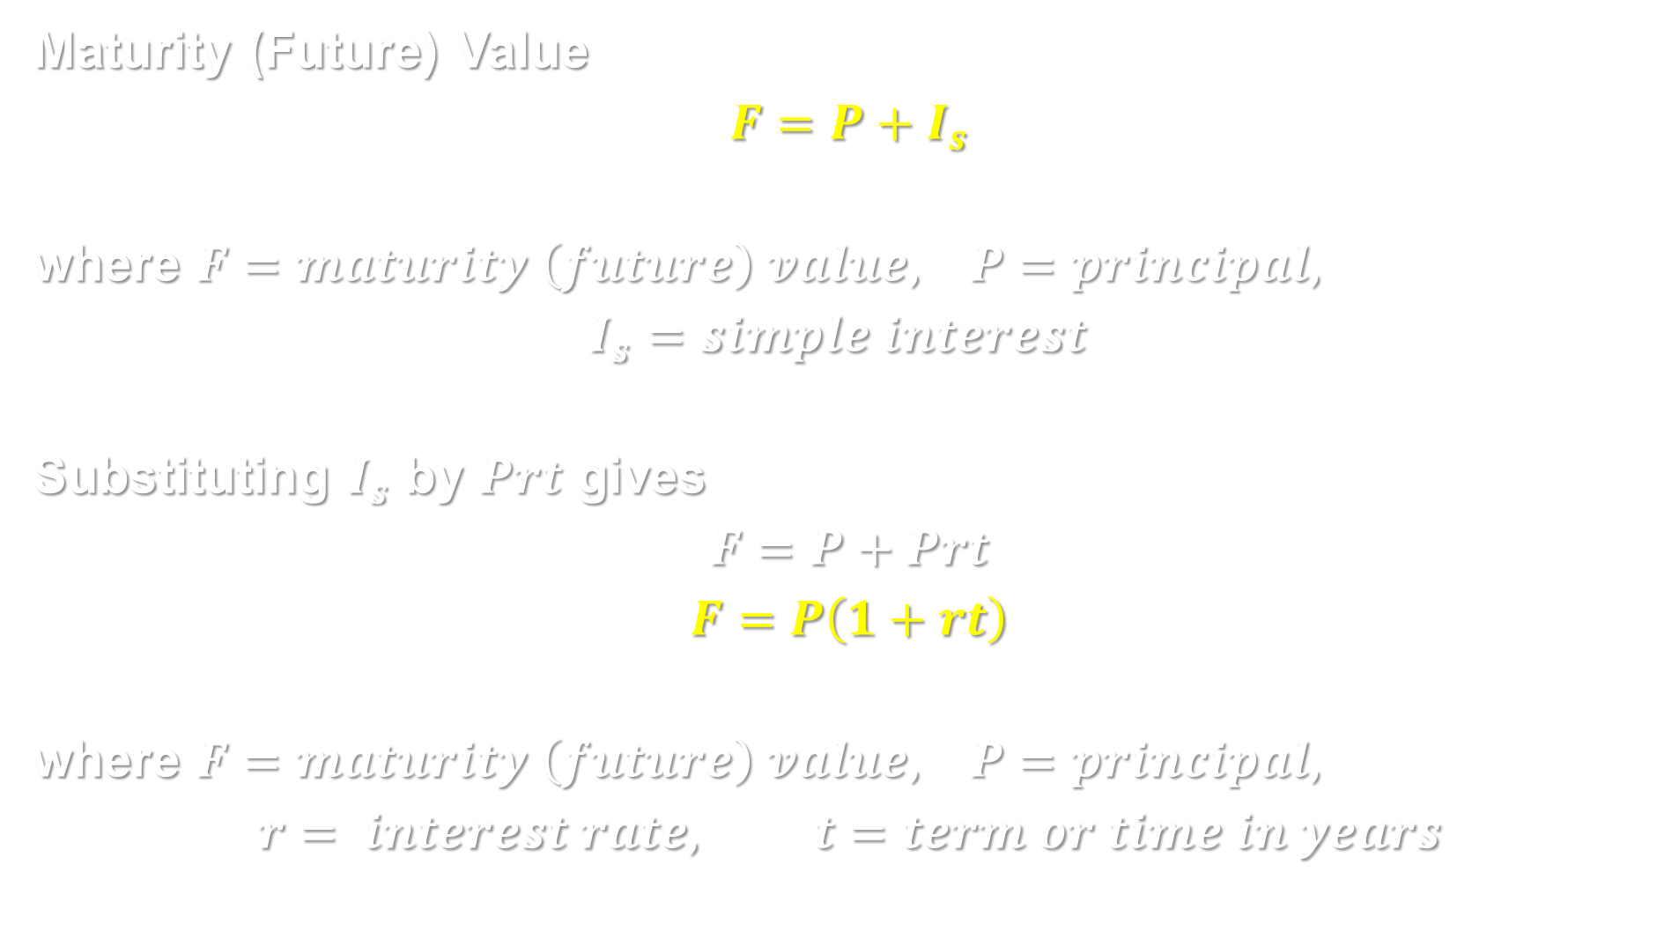
Maturity (Future) Value
$$F=P+I_{s}$$
where $F=maturity \left(future\right) value, P=principal,$
$$I_{s}=simple interest$$
Substituting $I_{s}$ by $Prt$ gives
$$F=P+Prt$$
$$F=P\left(1+rt\right)$$
where $F=maturity \left(future\right) value, P=principal,$
$$r= interest rate, t=term or time in years$$

Slide 11
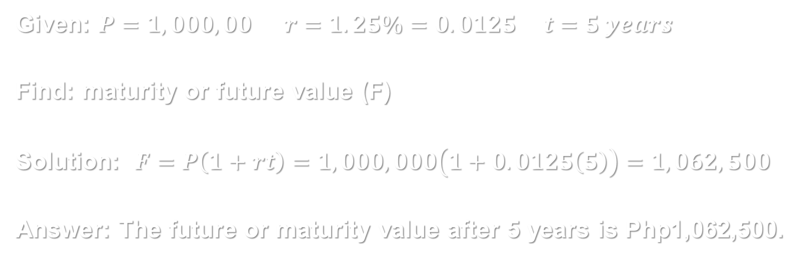
Example 5: Find the maturity value if 1 million pesos is deposited in a bank at an annual simple interest rate of 1.25% after 5 years?
Given: $P=1,000,00 r=1.25\%=0.0125 t=5 years$
Find: maturity or future value (F)
Solution: $F=P\left(1+rt\right)=1,000,000\left(1+0.0125\left(5\right)\right)=1,062,500$
Answer: The future or maturity value after 5 years is Php1,062,500.

