Slide 1
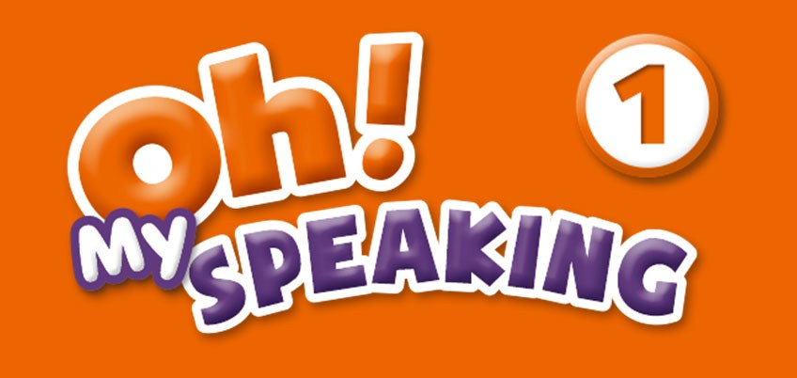




U N IT 0 1
Unit 1 Lesson 1
K EY PATTER N S
It's a r o b o t
It's not a backpack

Slide 2
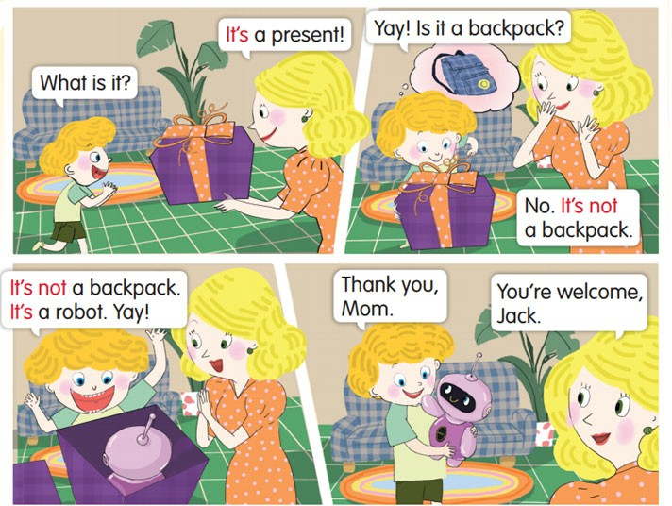


Listen and sa y.

Slide 3
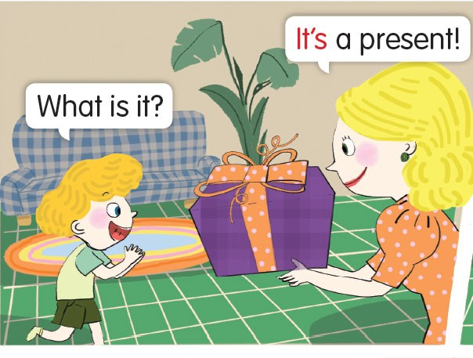


Listen and sa y.– Listen and rep ea t.

Slide 4

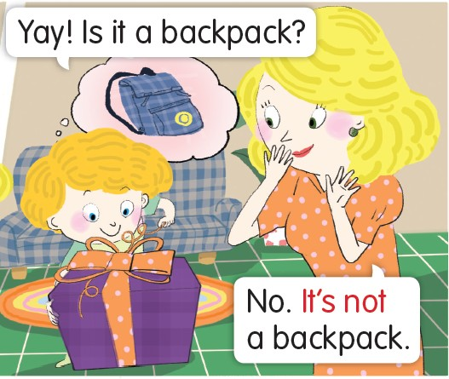

Listen and sa y.– Listen and rep ea t.

Slide 5
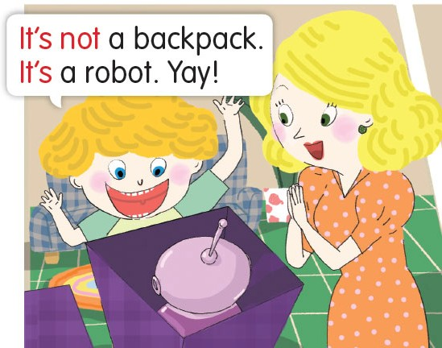

Listen and sa y.– Listen and rep ea t.

Slide 6

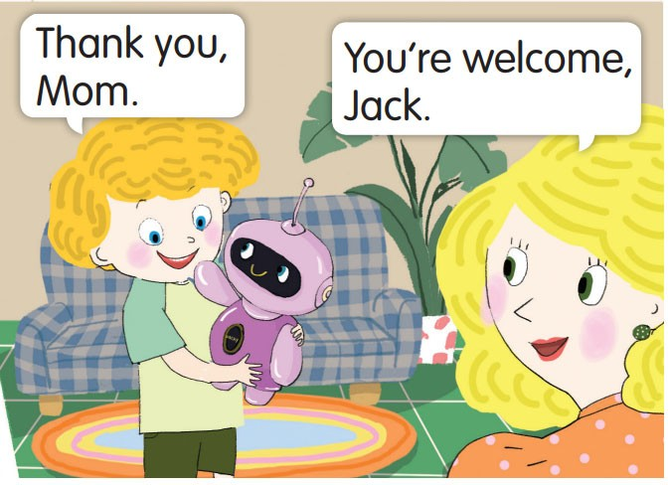

Listen and sa y.– Listen and rep ea t.

Slide 7
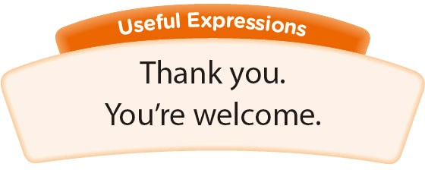
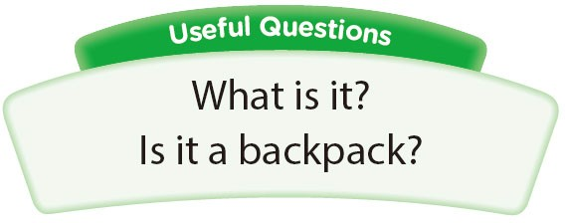
Listen and sa y.- Act it ou t.

Slide 8
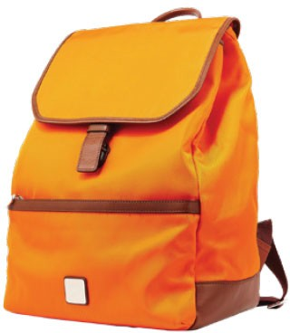

VOCABULARY -Flashcards
a backpack

Slide 9
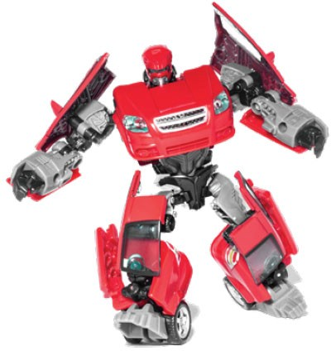

VOCABULARY -Flashcards
a robot

Slide 10


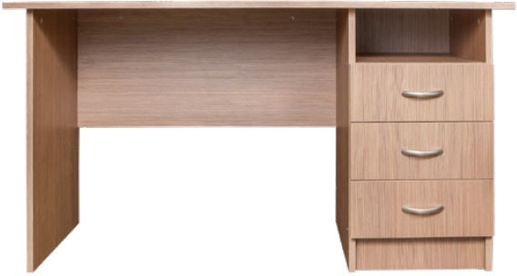
VOCABULARY -Flashcards
a desk

Slide 11


VOCABULARY -Flashcards
a book

Slide 12
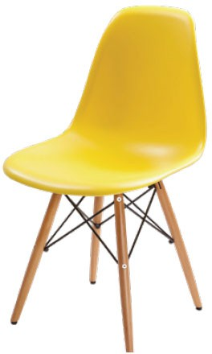

VOCABULARY -Flashcards
a chair

Slide 13
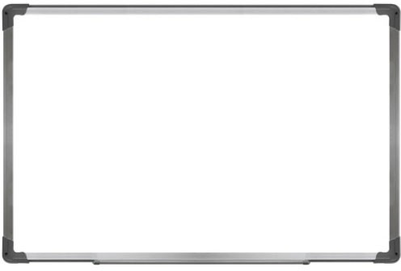

VOCABULARY -Flashcards
a board

Slide 14
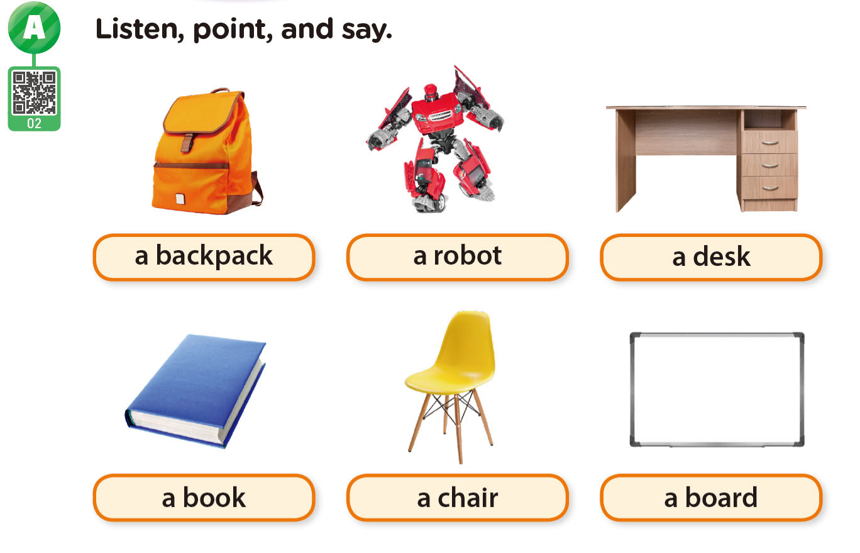

VOCABULARY

Slide 15
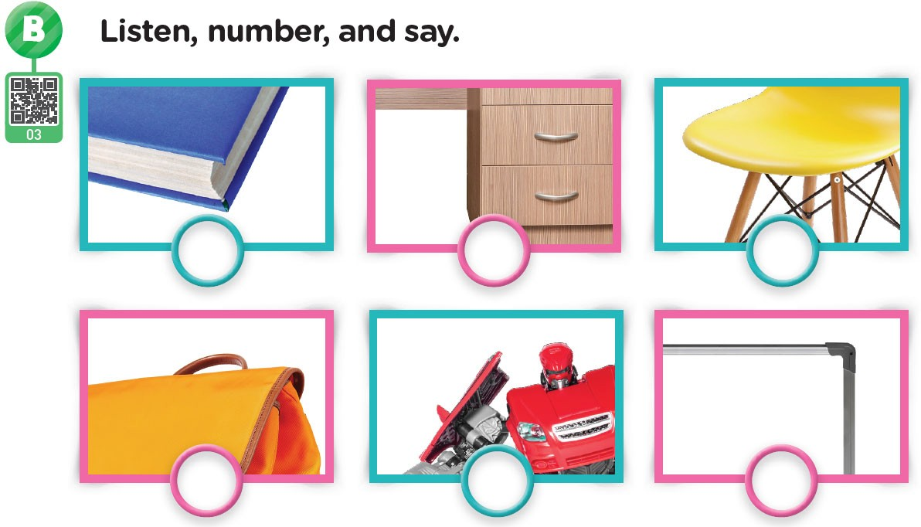

VOCABULARY
3
1
6
2
5
4

