Slide 1
Electric Circuits
Unit 13

Slide 2
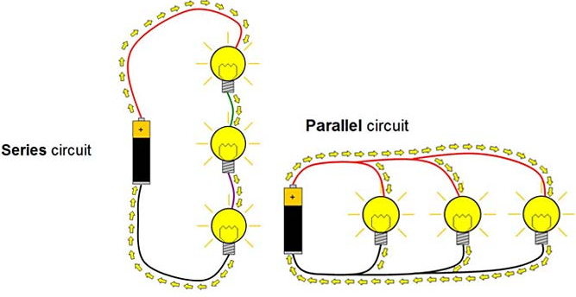
Series and Parallel Circuits
  Leaning Objectives
  Explain what series and parallel circuits are
  Calculate the value of I, V and total resistance in series and parallel circuits

Slide 3
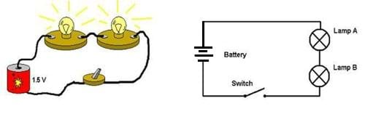
Series circuit
Series Circuit

Slide 4
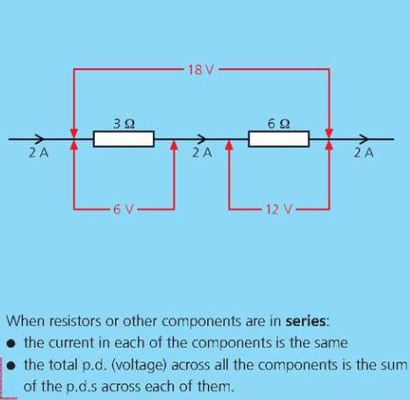
Series Circuits
Current in each component is the same
Potential difference (EMF) across the ‘power-supply’ in a series circuit is sum of p.d across each of the components
Total resistance is equal to the sum of all the resistances (R=R1+R2+..)
V
V
V
EMF=18V

Slide 5
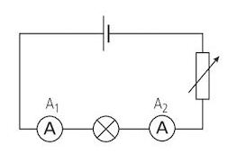
Question1
Q1. The lamp and the variable resistor are in parallel or series?
  Answer: Series
The current in the circuit is 2 A.
Q2. What is the value of A1?
Answer: 2 A
Q3. What is the value of A2?
Answer: 2 A

Slide 6
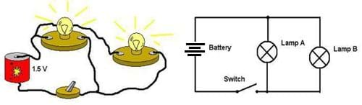
Parallel Circuit
Series Circuit
Parallel Circuit
Video

Slide 7
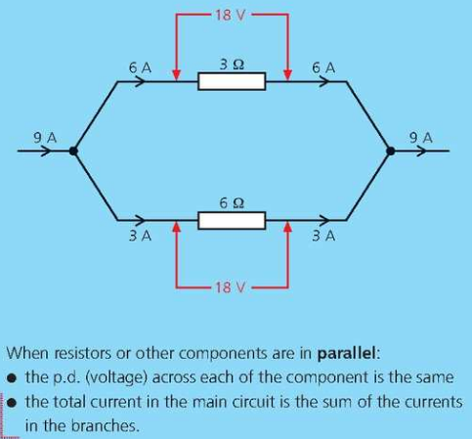

Parallel Circuits
Total current in the main circuit is the sum of the currents in the branches
Potential difference across each of the component is the same
Total resistance ‘R’:
Note: Current in lower value resistor is more then the current in the higher value resistor
V
V
EMF=18V

Slide 8
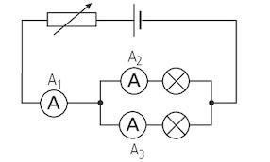
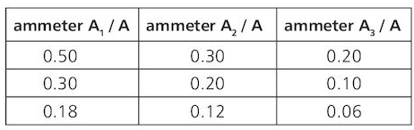
Question 2
Q1. The two lamps L1 and L2 are in series or parallel?
  Parallel
Q2. If A2 is 1 A & A3 is 2A, what is A1?
  3 A
Q3. Complete the missing items

Slide 9

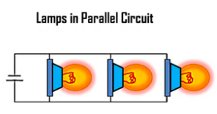
Summary: Series and Parallel
 | Current | PD | Resistance | ???
Series | Same | Distributed | R=R1+R2+R3…
Parallel | Distributed | Same | 1/Rt = 1/R1 + 1/R2 + 1/R3 +... | Total resistance is always smaller than the smallest resistance

Slide 10
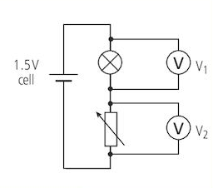
Question 3
Q1. The lamp and the variable resistor are in parallel or series?
  Answer: Series
The current in the circuit is 5 A.
Q2. What is the value of current in lamp?
Answer: 5 A
Q3. What is the value of current in variable resistor
Answer: 5 A
Q4. V1= 1 Volt, calculate V2
Answer: 0.5 Volt
Q5. Lamp has a resistance of 2 Ω and Variable resistor has a resistance of 3 Ω. What is the total resistance?
Answer: R = R1+R2 = 2Ω+3Ω = 5Ω

Slide 11
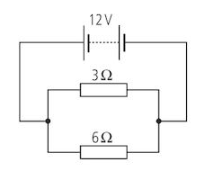
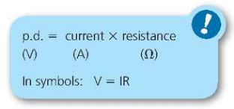
Question 4
Parallel or Series?
What is the total resistance?
What is the potential difference across 3 Ω?
What is the potential difference across 6 Ω?
What is the current in 3 Ω?
What is the current in 6 Ω?
What is the total current in the circuit?

Slide 12
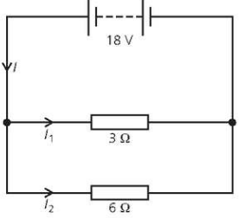
Question 5

Slide 13

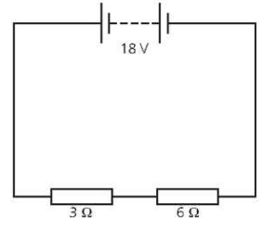
Question 6

Slide 14
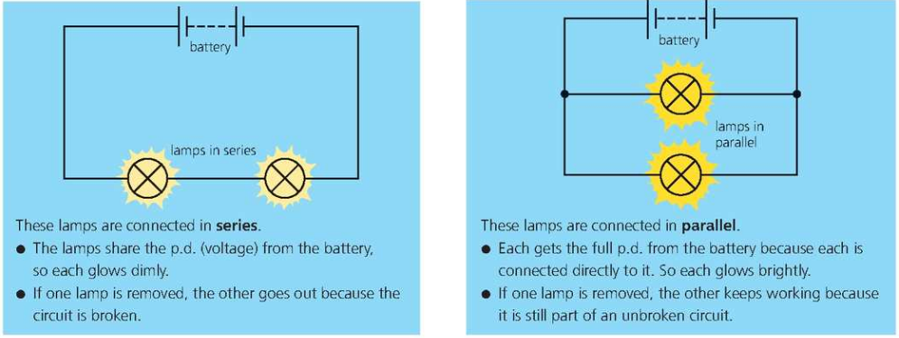
Series vs Parallel

Slide 15
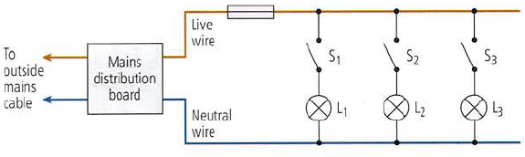
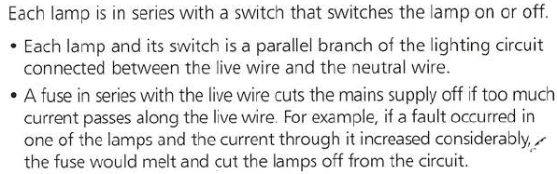
A household lighting circuit

Slide 16
Summary: Series and Parallel
 | Current | PD | Resistance | ???
Series | Same | Distributed | R=R1+R2+R3…
Parallel | Distributed | Same | 1/Rt = 1/R1 + 1/R2 + 1/R3 +... | Total resistance is always smaller than the smallest resistance

