Slide 1
Coordination Chemistry
Part 2

Slide 2
Constitutional Isomerism
Differences in atom-atom binding
Linkage isomerism – when ligands are ambidentate, e.g. –NO₂ or –ONO
Coordinate isomerism – when salts are made of both complex cations and anions, the ligands could be distributed differently between the two metals centers: [Cu(NH₃)₄][PtCl₄] and [Pt(NH₃)₄][CuCl₄]

Slide 3
Constitutional isomerism
Ionization isomerism – when ligated anion in a cationic complex exchanges with the counter ion e.g. [Co(NH₃)₅Br]SO₄ and [Co(NH₃)₅(SO₄)]Br
Solvate isomerism – when a neutral ligand exchanges for an anionic ligand (solvent)
[Cr(OH₂)₆]Cl₃, [Cr(OH₂)₅Cl]Cl₂

Slide 4
Constitutional Isomerism
Ligand isomerism – due to isomerism in the ligand itself e.g. n-propyl vs isopropyl substituent groups
Polymerization isomerism – complexes in with [ML_{m}]_{n} where n varies e.g. [Re₂Cl₈]²⁻ and [Re₃Cl₁₂]³⁻ are [ReCl₄]_{n}⁻ where n = 2 or 3

Slide 5
Stereoisomerism
Geometric isomerism: Cis and trans square planar complexes
Cis and trans octahedral complexes

Slide 6
Stereoisomerism
MA₃B₃ complexes can have the two of the ligands mutually trans (mer, meridional) or all three mutually cis (fac, facial)

Slide 7
Theories of Bonding
Valence Bond Theory
Crystal Field Theory
Ligand Field Theory

Slide 8
Valence Bond Theory
Metal-ligand bonds are regarded as coordinate covalent bonds in which electron pairs from the donating ligand enter vacant electron orbitals on the central atom
Hybridization is invoked since the coordinate bonds that are formed are indistiguishable from each other

Slide 9
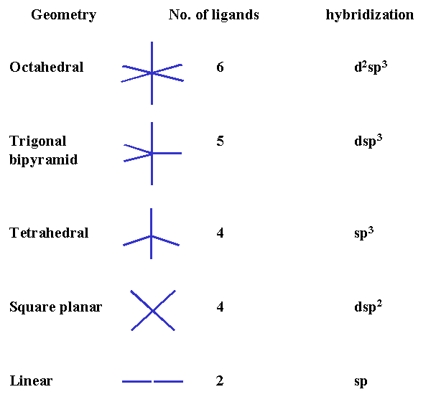
Hybridization schemes

Slide 10
Strong and weak ligands
A strong field ligand is capable of forcing the electrons of the metal atom/ion to pair up
A weak field ligand is incapable of making the electrons of the metal atom/ ion to pair up.
Strong field ligands: CN–, CO, en, NH₃, H₂O, NO–, Py.
Weak field ligands: I–, Br–, Cl–, F–, NO₃–, OH–, C₂O₄^{2–}, NH₃, H₂O.

Slide 11
Paramagnetism
μ_{s} = √n(n+2), where μ magnetic moment and n is the number of unpaired electrons
On the basis of value of magnetic moment, the number of unpaired electrons in the complex is predicted from which it is possible to predict the geometry of the complex species.

Slide 12
Limitations
The origin of their absorption spectra could not be explained.
(ii) Why do different complexes of the same metal show different colors?
(iii) Relative stabilities of different complexes could not be explained.
(iv) Why should certain ligands form high spin, while others low spin complexes?

Slide 13
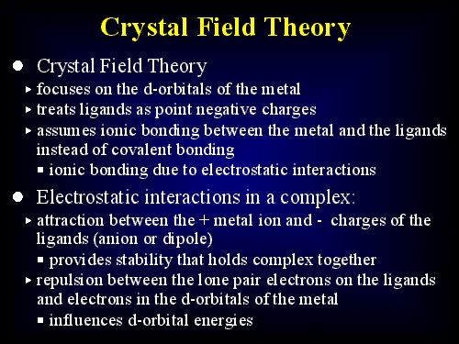

Slide 14
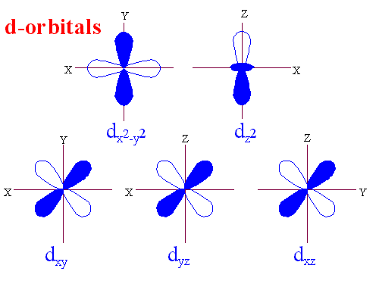

Slide 15
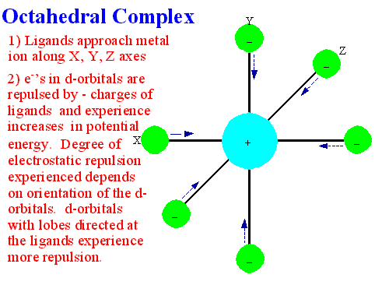

Slide 16
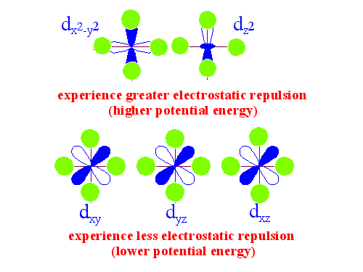

Slide 17
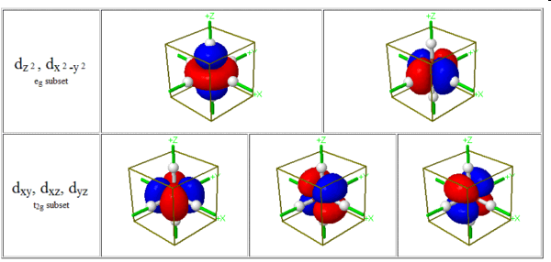
d-orbital splitting

Slide 18
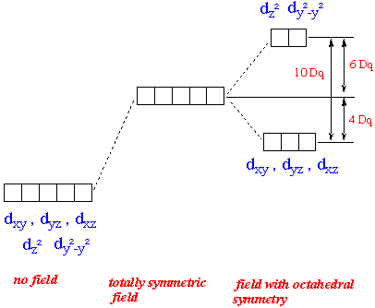
Octahedral d-splitting

Slide 19
O_{h} character table
O_{h} | E | 8C₃ | 6C₂ | 6C₄ | 3C₂ | i | 6S₄ | 8S₆ | 3 _{h} | 6 _{d} | linear functions, rotations | quadratic functions
A_{1g} | +1 | +1 | +1 | +1 | +1 | +1 | +1 | +1 | +1 | +1 | - | x²+y²+z²
A_{2g} | +1 | +1 | -1 | -1 | +1 | +1 | -1 | +1 | +1 | -1 | - | -
E_{g} | +2 | -1 | 0 | 0 | +2 | +2 | 0 | -1 | +2 | 0 | - | (2z²-x²-y², x²-y²)
T_{1g} | +3 | 0 | -1 | +1 | -1 | +3 | +1 | 0 | -1 | -1 | (R_{x}, R_{y}, R_{z}) | -
T_{2g} | +3 | 0 | +1 | -1 | -1 | +3 | -1 | 0 | -1 | +1 | - | (xz, yz, xy)
A_{1u} | +1 | +1 | +1 | +1 | +1 | -1 | -1 | -1 | -1 | -1 | - | -
A_{2u} | +1 | +1 | -1 | -1 | +1 | -1 | +1 | -1 | -1 | +1 | - | -
E_{u} | +2 | -1 | 0 | 0 | +2 | -2 | 0 | +1 | -2 | 0 | - | -
T_{1u} | +3 | 0 | -1 | +1 | -1 | -3 | -1 | 0 | +1 | +1 | (x, y, z) | -
T_{2u} | +3 | 0 | +1 | -1 | -1 | -3 | +1 | 0 | +1 | -1 | - | -

Slide 20
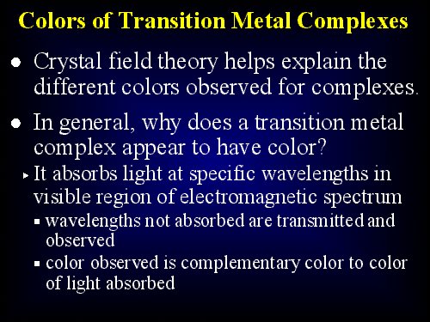

Slide 21
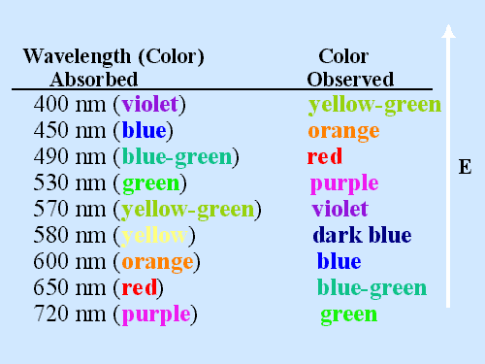

Slide 22
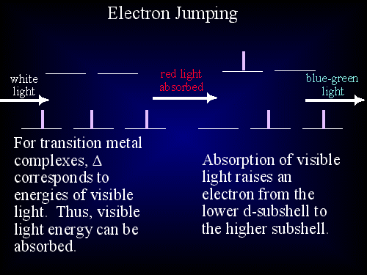

Slide 23
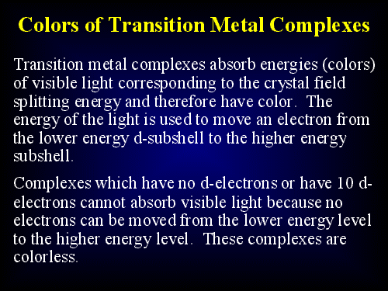

Slide 24
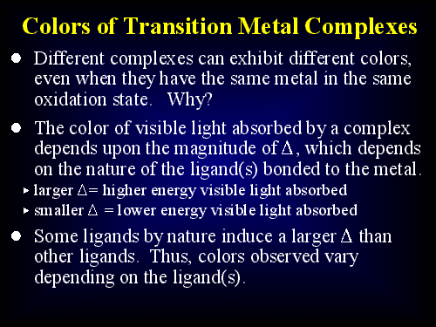

Slide 25
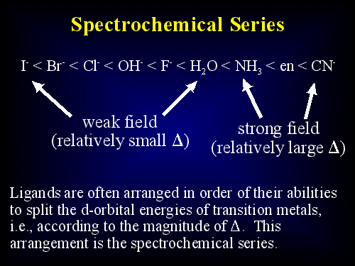

Slide 26
Orbital Splitting and Electron Spin
The split between t_{2g} and e_{g} is called Δ_{o}
Strong field ligands interact strongly with the metal orbitals resulting in large Δ_{o}
Weak-field ligands have smaller interactions and give small Δ_{o}

Slide 27
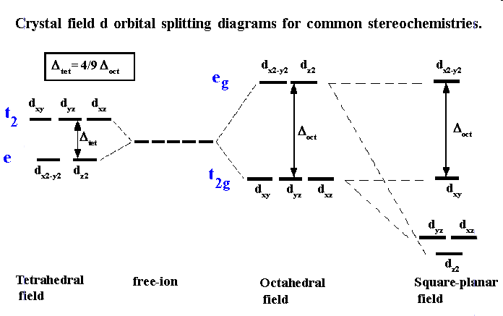
d-splitting in other fields

Slide 28
T_{d} Character Table
T_{d} | E | 8C₃ | 3C₂ | 6S₄ | 6 _{d} | linear functions, rotations | quadratic functions
A₁ | +1 | +1 | +1 | +1 | +1 | - | x²+y²+z²
A₂ | +1 | +1 | +1 | -1 | -1 | - | -
E | +2 | -1 | +2 | 0 | 0 | - | (2z²-x²-y², x²-y²)
T₁ | +3 | 0 | -1 | +1 | -1 | (R_{x}, R_{y}, R_{z}) | -
T₂ | +3 | 0 | -1 | -1 | +1 | (x, y, z) | (xy, xz, yz)

Slide 29
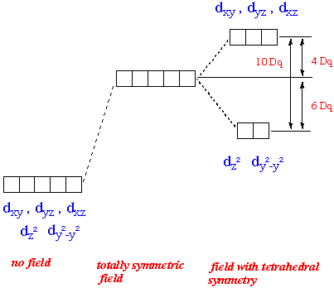
Tetrahedral d-splitting

Slide 30
D_{4h} character table
D_{4h} | E | 2C₄ (z) | C₂ | 2C'₂ | 2C''₂ | i | 2S₄ | _{h} | 2 _{v} | 2 _{d} | linear functions, rotations | quadratic functions
A_{1g} | +1 | +1 | +1 | +1 | +1 | +1 | +1 | +1 | +1 | +1 | - | x²+y², z²
A_{2g} | +1 | +1 | +1 | -1 | -1 | +1 | +1 | +1 | -1 | -1 | R_{z} | -
B_{1g} | +1 | -1 | +1 | +1 | -1 | +1 | -1 | +1 | +1 | -1 | - | x²-y²
B_{2g} | +1 | -1 | +1 | -1 | +1 | +1 | -1 | +1 | -1 | +1 | - | xy
E_{g} | +2 | 0 | -2 | 0 | 0 | +2 | 0 | -2 | 0 | 0 | (R_{x}, R_{y}) | (xz, yz)
A_{1u} | +1 | +1 | +1 | +1 | +1 | -1 | -1 | -1 | -1 | -1 | - | -
A_{2u} | +1 | +1 | +1 | -1 | -1 | -1 | -1 | -1 | +1 | +1 | z | -
B_{1u} | +1 | -1 | +1 | +1 | -1 | -1 | +1 | -1 | -1 | +1 | - | -
B_{2u} | +1 | -1 | +1 | -1 | +1 | -1 | +1 | -1 | +1 | -1 | - | -
E_{u} | +2 | 0 | -2 | 0 | 0 | -2 | 0 | +2 | 0 | 0 | (x, y) | -

Slide 31
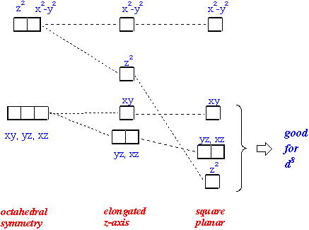
Square planar d-splitting

Slide 32
Orbital Splitting and Electron Spin
spectrochemical series:
CO, CN– > phen > NO₂–, en > NH₃ > NCS– > H₂O > F– > RCO₂– > OH– > Cl– > Br– > I–
d⁴ to d⁷ ions exhibit high spin or low-spin states depending on the ligand
Strong ligand field = large Δ_{o} = low spin
Weak ligand field = small Δ_{o} = high spin
together with pairing energy, π_{e} ( >0)and exchange energy, π_{e} ( <0) the configuration with the total lower energy will be the ground state

Slide 33
Ligand Field Theory
Combined crystal field and molecular orbital theory
MOs result from combination of central metal atom accepting a pair of electrons from donor ligands which form a reducible representation in the symmetry point group of the complex

Slide 34
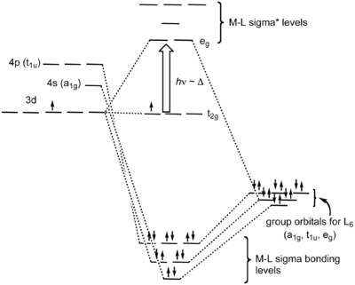
Octahedral MOs

Slide 35
Octahedral MOs and CFT

Slide 36
Jahn-Teller Effect
All molecules that have a degenerate set of molecular orbitals will undergo a geometric distortion that lifts this degeneracy.
  There cannot be unequal occupation of orbitals with identical energies
  To avoid such unequal occupation, the molecule distorts so that these orbitals are no longer degenerate.

Slide 37
For octahedral complexes, this is easily achieved by compression (rare) or elongation (common) along one axis of the octahedron
Jahn-Teller distortion is deduced from UV-VIS spectra (higher number of bands than would be expected for the undistorted case)

Slide 38
d⁹ configuration is t_{2g}⁶e_{g}³
Jahn-Teller requires that the shape of the complex change slightly resulting in a change of energies of the orbitals

Slide 39
Square Planar
Square planar transition metal complexes have one orbital that is very high in energy (x²-y²) and four orbitals that are low in energy (z², xy, xz, yz).
This favors the electron configuration d⁸ because all low energy orbitals are filled and the high energy orbital x²-y² remains empty

Slide 40
The effect is strong only if the e_{g}-level becomes populated.
e_{g}-levels split much stronger than the essentially nonbonding t_{2g} levels.
Strong Jahn Teller distortion occurs for configurations with 1 or 3 electrons in the e_{g}-level. This the case for d⁴ high spin, d⁷ low spin and d⁹.

Slide 41
Expected Jahn-Teller effects
Number of electrons | High-spin Jahn-Teller | Low-spin Jahn-Teller
1 | W | W
2 | W | W
3
4 | S | W
5 |  | W
6 | W
7 | W | S
8
9 | S | S
10
W = weak Jahn Teller effect (t_{2g} orbitals unevenly occupied)
S = strong effect (e_{g} orbitals unevenly occupied)
No entry = no Jahn-Teller effect expected

Slide 42
weak Jahn Teller distortion may result from a splitting of the t_{2g} level.
These distortions are usually so small that they cannot be observed structurally.
Predicted to occur for d¹, d², d⁴, d⁵ low spin, d⁶ and d⁷ high spin.

Slide 43
Spectroscopy
One would assume that for octahedral or tetrahedral complexes the d-d transition corresponds exactly to Δ_{o} or Δ_{t}
This is not the case. To predict the correct number of possible transitions, all possible Optical Terms have to be identified.
For the octahedrally coordinated complexes the following optical terms are observed

Slide 44
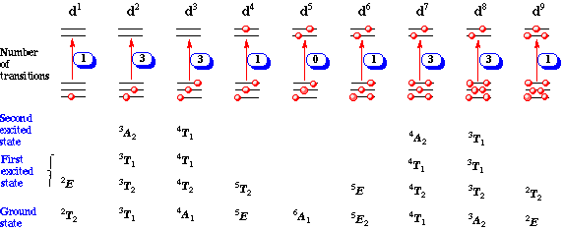
O_{h} Transitions

Slide 45
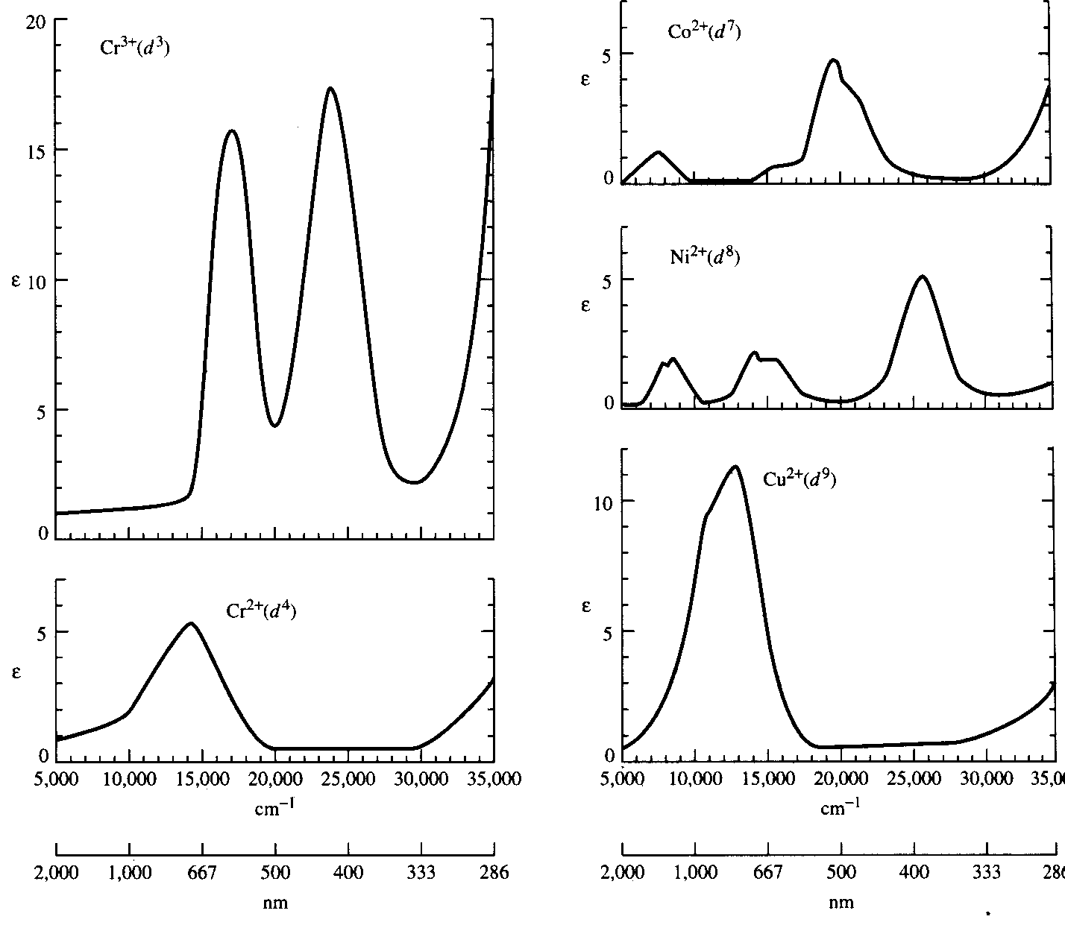

Slide 46
Carbon: 1s²2s²2p²
p electrons are expected to have the same energy
however there are three major energy levels for the p² electrons
the lowest major energy level is split into three slightly different states
five different energy levels
combination of the m_{l} and m_{s} values of the electrons

Slide 47
Russell-Saunders or LS coupling
Combination of the orbital angular momenta (m_{l}) and spin angular momenta (m_{s})
Interactions produce atomic states called microstates described by new quantum numbers
M_{L} = Σ m_{l} total orbital angular momentum
M_{S} = Σ m_{s} total spin angular momentum

Slide 48
Quantum numbers of multielectron atoms
L = total orbital angular momentum quantum no.
S = total spin angular momentum quantum no.
J = total angular momentum quantum number
L and S describe collections of microstates and are the largest possible values of M_{L} and M_{S}

Slide 49
M_{L} and M_{S} describe microstates themselves
M_{L} = 0, ±1, ±2, … , ±L ml = 0, ±1, ±2, … , ±l
M_{S} = S, S–1, S–2, …,–S ms = +½ , –½
L = 0, 1, 2, 3, …
S, P, D, F, …
S is used to calculate the spin multiplicity, 2S + 1

Slide 50
Free-ion terms
Atomic states characterized by S and L
Term symbols
Labels for the free-ion terms

Slide 51
Energies of terms
The ground term (lowest energy) has the highest spin multiplicity (Hund’s rule)
If two or more terms share the same maximum multiplicity, the ground term is the one having the highest value of L
between ⁴P and ⁴F, ⁴F has the lower energy
For subshells less than half-filled, the state with lowest J has lowest energy. For subshells more than half-filled, the state with highest J has lowest energy. Half-filled states have only one J value.
J = L+S, L+S–1, L+S–2, … , L–S

Slide 52
Lowest Energy Term
Sketch energy levels showing electrons
Spin multiplicity of ground term = number of electrons +1
Determine maximum possible M_{L} (to give the term)
Combine steps 2 and 3

Slide 53
d²
↑ ↑ __ __ __
Spin multiplicity = 2+1 = 3
Highest M_{L} = 2+1= 3 (F)
Ground state is ³F

Slide 54
Selection Rules
Laporte Selection Rule
  Transition between states of same parity (symmetry with respect to inversion) are forbidden
  d → d transitions are forbidden (both gerade)
  d → p transitions are allowed
  (gerade to ungerade)

Slide 55
Selection Rules
Spin Selection Rule
  Transitions between states of different multiplicities are forbidden
  ⁴A₂ → ⁴T₁ spin allowed
  ⁴A₂ → ²A₂ spin forbidden

Slide 56
d² Term Symbols
¹S
³P
¹D
³F – ground term
¹G

