Slide 1

Restaurants and Eating Out

Slide 2
Vocabulary
Booking (n) arrangement made with the restaurant in advance to reserve a table.
Café (n) Small restaurant selling light food.
Course (n) Part of a meal…1,2, 3 course
Cutlery (n) utensils used to eat a meal
Doggie-bag(n) unfinished food that is packed for customer
Fine-dining(Adj) a style of eating usually takes place at expensive restaurants

Slide 3
Vocabulary
Cocktail(n) alcoholic drink made with juice
Line-up(n) number of people waiting for something
Medium-rare(adj) meat cooked and is slightly red in the middle
Pizzeria(n) restaurant where pizzsa and other Italian dishes are made And served
Menu(n) list of food you can order
Take-out(n) Food packed up to be eaten at home

Slide 4
Warm-up
Do you like to eat out at restaurants?
1. How often do you go out?
2. What is your Favourite meal?
3. Do you like trying new foods? Why?
4. Do you enjoy international food? Which ones are your favourite?
5. Which food do you dislike the most?

Slide 5
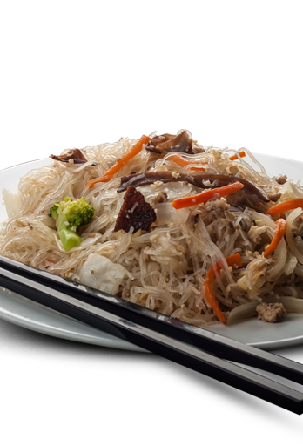
Chen Chow Mein
Chen Chow Mein
We serve lunch and dinner. Enjoy traditional Cantonese Style food. Dim sum, Chow mein, and seafood specials.
Open Daily from11:30am until 11:00pm. Closed on Mondays.

Slide 6
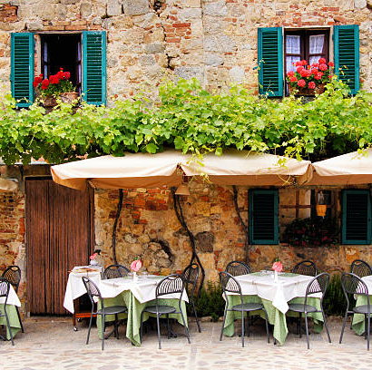
Lino’s Pizzeria
Lino’s Pizzeria
We boast the best pizzas in town. Try our spaghetti with mama’special sauce. Live bands on Saturday nights.
Open 7 days a week from 2pm until 2am
65 State Street
877 5432

Slide 7
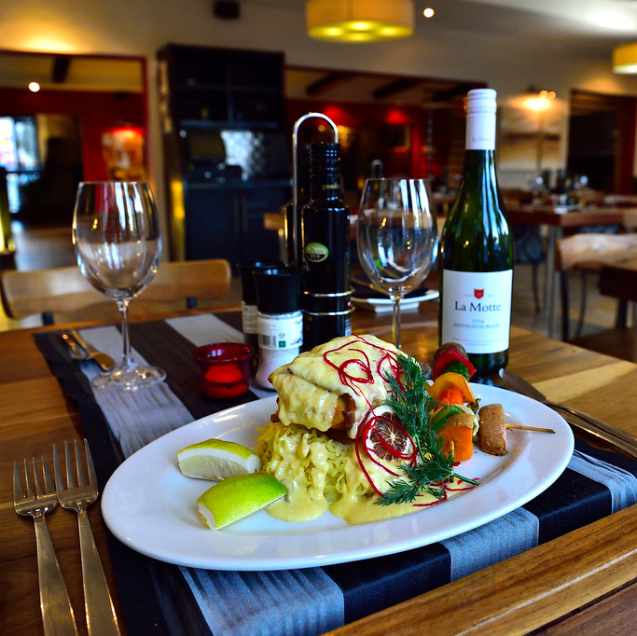
The Irish Rose
Fine Dining at its Best. Steaks and seafood. Let us prepare your perfect dining experiences you sip on our finest wines. Irish Draught beers and Irish Whiskey on the shelf
Open Tuesday – Saturday . 5pm until 2am. Reservations only.
962 Market Street
987 1789
This Photo by Unknown Author is licensed under CC BY

Slide 8
Comprehension Questions
What’s the name of the Italian restaurant?
Are any of these places open 24 hours?
Which restaurant requires a reservation?
Which restaurant serves pasta?
What does Lino’s boast?
What day is Chen’s closed?
What kind of alcoholic beverages does the Irish Rose have?

Slide 9
Discussion
Which of the 3 restaurants would you prefer to try? Why?
Which one would you least like to try? Why?
If you travelled to Europe what kind of utensils do the people in Europe use
What food would you like to try?
If you travelled to China what kind of food would you like to try?
What type of utensils do people from China use?
If you moved overseas, would you cook at home or eat out?

Slide 10

Wrap up
1. Did you enjoy today’s lesson?
2. What did you enjoy about it?
3. Did you learn anything new?
4. Where you comfortable during the lesson?
5. Would you book a lesson with me as your tutor again.
6. Would it be ok to ask you to kindly rate my lesson on a scale of 1-5. 1 being the least and 5 being the most.
7. Thank you. I really hope to see you soon.

