Slide 1
Module 2
Linking Molecular Structure, Molecular Properties And Bulk Properties of Lipids
Jonathan M. Barcelo
2021

Slide 2
OVERVIEW
Main concepts in understanding lipid properties
Molecular basis of boiling point and melting point of lipid
Molecular basis of solubility of lipid
Explaining melting point and boiling point of oils (mixtures)

Slide 3
MAIN CONCEPTS IN UNDERSTANDING
LIPID PROPERTIES
Molecular properties are NOT the same as bulk properties.
Molecular structure influences molecular properties of lipid molecules. Molecular properties influence bulk properties of substances.
Interaction of molecular components in a substance influences the bulk property of mixtures and actual macroscopic samples.

Slide 4
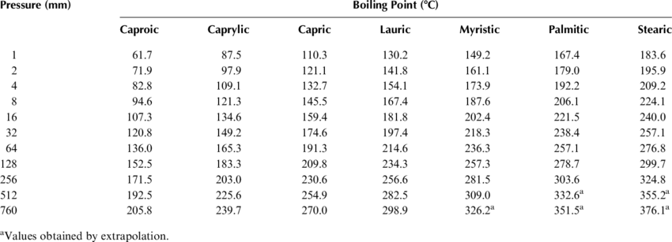
BOILING POINT OF SATURATED FATTY ACIDS
Marinos-Kouris et al, 2006

Slide 5
MELTING POINT OF SATURATED FATTY ACIDS
Knothe & Dunn, 2009

Slide 6

MELTING POINT OF TRIACYLGLYCEROL SAMPLES
https://www2.chemistry.msu.edu/faculty/reusch/VirtTxtJml/lipids.htm

Slide 7
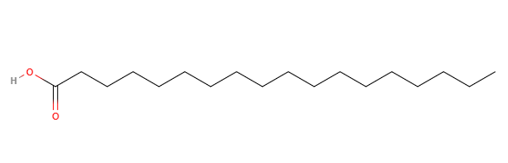
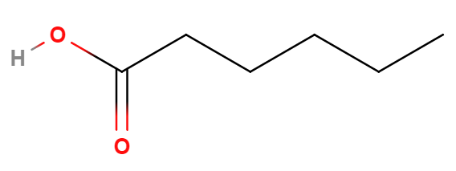
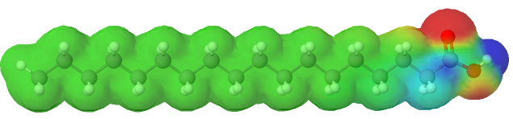
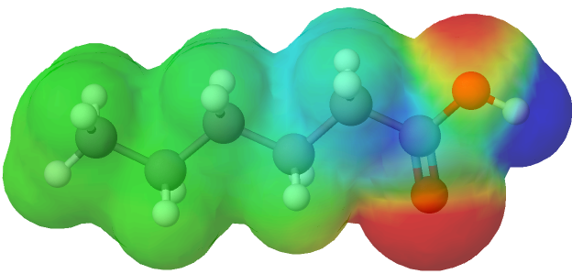
MOLECULAR BASIS OF BOILING POINT and
MELTING POINT OF SATURATED FATTY ACIDS
Caproic acid
Stearic acid
Higher chain length → Higher surface area → Higher VDW → Higher BP

Slide 8
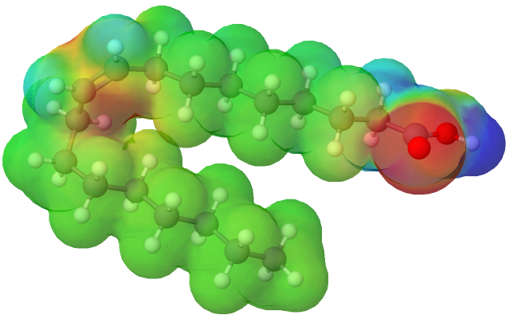
MOLECULAR BASIS OF BOILING POINT and MELTING POINT OF SATURATED and UNSATURATED FATTY ACID
Stearic acid
BP = 361ºC
MP = 69.6ºC
Oleic Acid
BP = 360ºC
MP = 13.4ºC

Slide 9
MELTING POINT of oils – DUE to Molecular interactions?
MP = 24ºC
MP = -18ºC to -16ºC
Devi & Katkhar, 2016

Slide 10
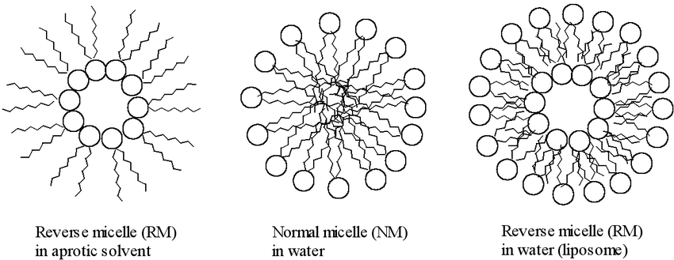
SOLUBILITY OF LIPIDS
Principle: If lipid molecules CANNOT intermingle with solvent molecules, solubility (or miscibility) will be low.
If lipid molecules are amphipathic, they form micelles or reverse micelles.
Gadomski et al, 2008

Slide 11
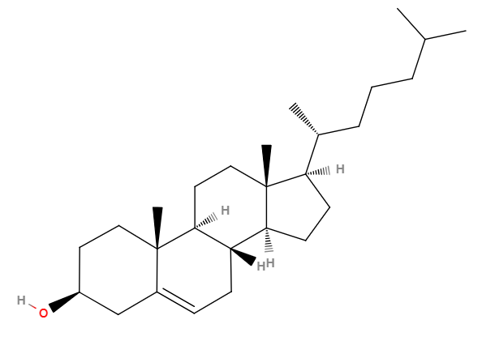
IT IS NOW YOUR TURN!
Look at the structure of a steroid molecule, cholesterol. Based on this, how do you characterize the molecule? What could be the properties of a pure sample of cholesterol?

Slide 12
References
Devi, A., & Khatkar, B. S. (2016). Physicochemical, rheological and functional properties of fats and oils in relation to cookie quality: a review. Journal of Food Science and Technology, 53(10), 3633–3641. doi:10.1007/s13197-016-2355-0
Gadomski, A, Kruszewska, N, Santamaria-Holek, I, Uher, J, Pawlak, Zenon, Oloyede, Adekunle, Pechkova, E, & Nicolini, C (2008) Can modern statistical mechanics unravel some practical problems encountered in model biomatter aggregations emerging in internal- and external-friction conditions? In Kim, B (Ed.) Statistical Mechanics Research. Nova Science Publishers, United States, pp. 1-47.
Knothe, G., & Dunn, R. O. (2009). A Comprehensive Evaluation of the Melting Points of Fatty Acids and Esters Determined by Differential Scanning Calorimetry. Journal of the American Oil Chemists’ Society, 86(9), 843–856. doi:10.1007/s11746-009-1423-2
Marinos-Kouris, D., Krokida, M., & Oreopoulou, V. (2006). Frying of Foods. Handbook of Industrial Drying, Third Edition. doi:10.1201/9781420017618.ch52

